Slide 1

County Permits
Abraham Lewis
Data 205 Capstone Project

Slide 2
Overview of Data:
I am using 2 data sets from DataMontgomery for this project, commercial permits and residential permits.
The data sets deal with permits in the county from 2000 to 2019
Commercial permits contains 28K of rows and 18 columns
Residential permits contains 180K of rows and 18 columns
The columns break in to 3 categories:
1. Location data (street, zip, city etc.)
2. Status: If a permit was completed or not
3.Description (size, value, txt info, type of permit, structure)

Slide 3
Basic things for cleaning and wrangling
1. Dealt with Na’s under 2000 and dropped irrelevant columns
2. Changed the city to match the Zip of a permits area. This mostly affected permits in Rockville to Deerwood.
3. Made the data frame’s y/m/d data date time
4. Made bins for variables such as value and area
5. Made new columns for variables like value and area and the geolocation data

Slide 4
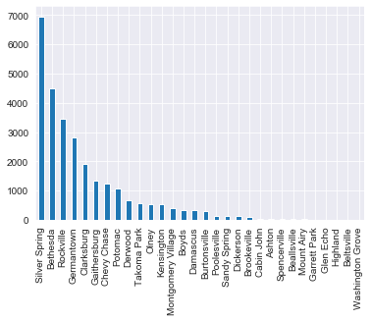
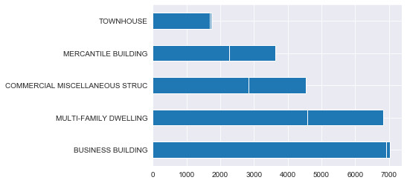
County Permits by numbers.
Top 5 cities have over 70% of permits, with Silver Spring containing 25%.
Alterations and Construction account for about 81% of the data set.
The top 5 “Use Code”s have 66% of the data
14 percent are revisions

Slide 5
Most heavily permitted addresses.
4193 addresses have at least 2 permits attached to an address that has the same value
7101 DEMOCRACY BLVD BETHESDA, MD 20817 = Westfield Montgomery (Mall)
11160 VEIRS MILL RD SILVER SPRING, MD 20902 = Westfield Wheaton (Mall)
8500 RIVER RD BETHESDA, MD 20817 = Congressional Country Club
22705 CLARKSBURG RD BOYDS, MD 20841 = Clarksburg Premium Outlets
1500 FOREST GLEN RD SILVER SPRING, MD 20910 = Holy Cross Hospital
8600 OLD GEORGETOWN RD BETHESDA, MD 20817 = John Hopkins Suburban Hospital
9901 MEDICAL CENTER DR ROCKVILLE, MD 20850 = Adventist Healthcare Center
7315 WISCONSIN AVE CHEVY CHASE, MD 20815 = Johns Hopkins Bethesda
5454 Wisconsin Ave, Chevy Chase, MD 20815 = Barlow Building; MedStar Health
8661 COLESVILLE RD SILVER SPRING, MD 20910 = Ellsworth Place (Mall)
9800 MEDICAL CENTER DR ROCKVILLE, MD 20850 = Adventist Medical Center

Slide 6
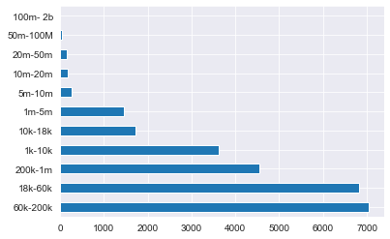
Permits By Value
The total value of permits issued.
Most permits are in the range of 18k – 200K
https://public.tableau.com/profile/abraham.lewis#!/vizhome/Book1_15754944071890/Sheet3?publish=yes

Slide 7
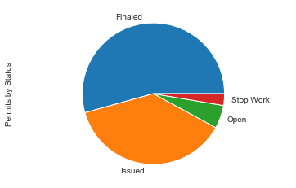
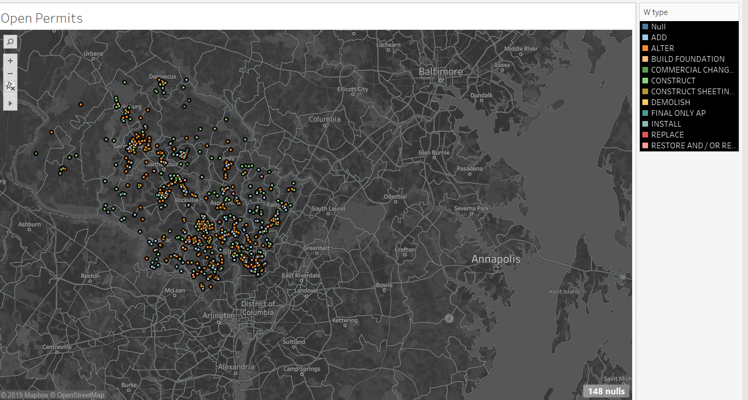
Permits by Status
54% were “Finaled”
38% were “Issued”
5% were “Open”
2% were Stop Work”
A permit can be “Open”
There are several reasons why a permit may
not be closed.
An owner may obtain a permit, but not start or
complete the work.
Perhaps the work is completed, but the owner never asked
the building department to perform an inspection.
Most Open Permits are from the 2019 and 2017

Slide 8
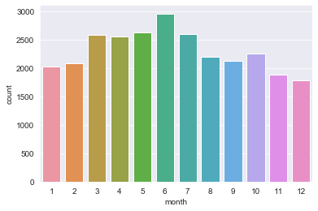
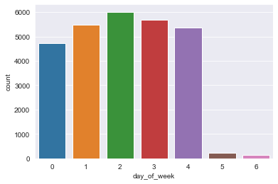
When permits are issued.
The most is between May –July
On Sunday – Thursday
Government offices are closed on weekends, so few permits are issued then.

Slide 9
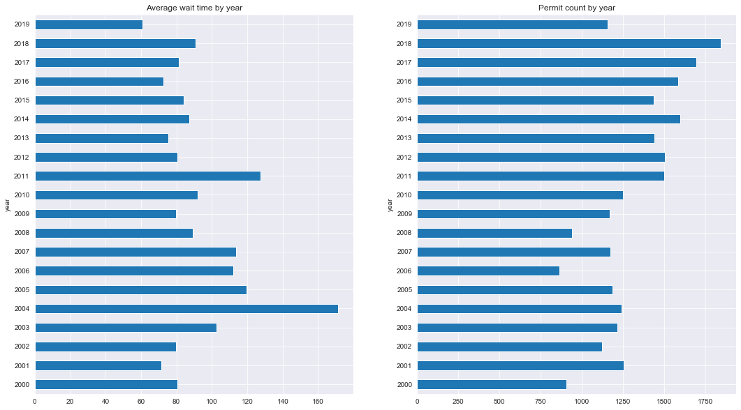
Wait Time
The department of Permitting Issue 79.4 days as the Average: https://stat.montgomerycountymd.gov/stories/s/Department-of-Permitting-Services-DPS-/qaet-mgd9

Slide 10
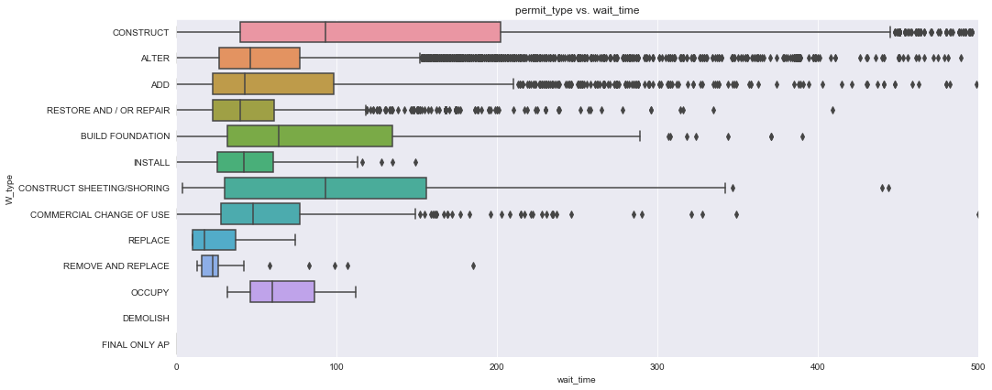
Wait time by Work type
The permits with the greatest wait time were construction and alteration permits.

Slide 11
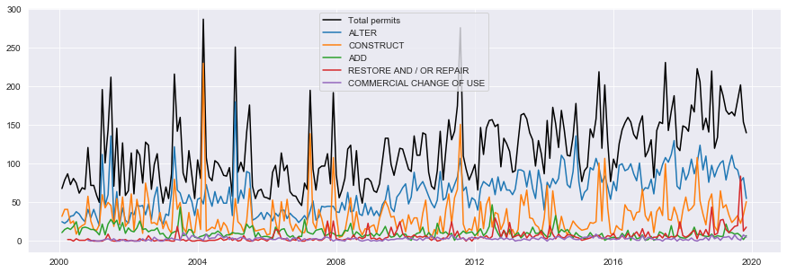
Permits’ work type
This potentially answers why there was such a dramatic spike 2004 and 2011’s wait time.

Slide 12
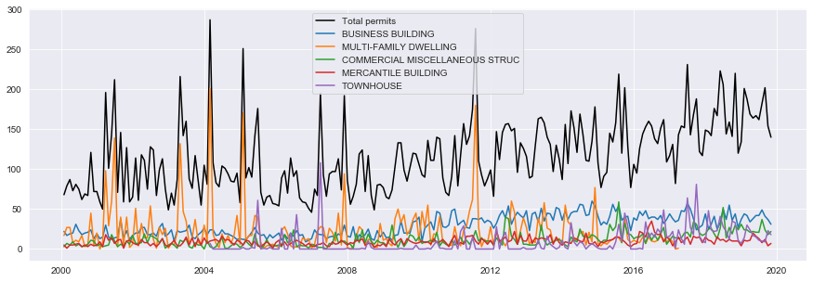
Looking at spike in the data in 2004 and 2011.
. There is a spike in Multi-Family Dwellings
https://public.tableau.com/profile/abraham.lewis#!/vizhome/Book1_15754944071890/Sheet4?publish=yes
https://public.tableau.com/profile/abraham.lewis#!/vizhome/Book1_15754944071890/Sheet6?publish=yes

Slide 13
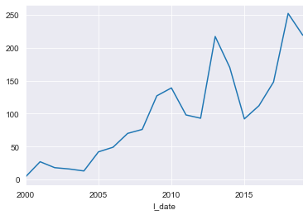
Housing data
The number of housing units in Montgomery County increased by 32 percent from 295,723 to 390,563 units between 1990 and 2016.(source:MP_TrendsReport)
Nearly one third of the growth in new units was in multifamily developments with 50-plus units. The total number of units in these types of buildings increased from 30,537 units to 60,458 units countywide between 1990 and 2016 .(source:MP_TrendsReport)
There is growth despite housing bubble
https://public.tableau.com/profile/abraham.lewis#!/vizhome/Book1_15754944071890/Sheet5?publish=yes

Slide 14
Solar Panels
The majority are in Silver Spring followed by Gaithersburg, and Rockville
SEIA says a possible reason for the contraction is the tariff war with China
Most only start after 2015

Slide 15
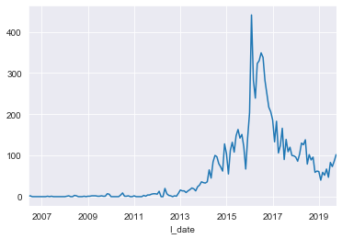
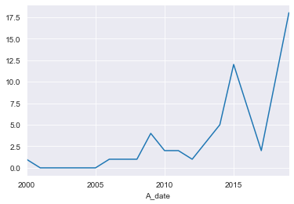
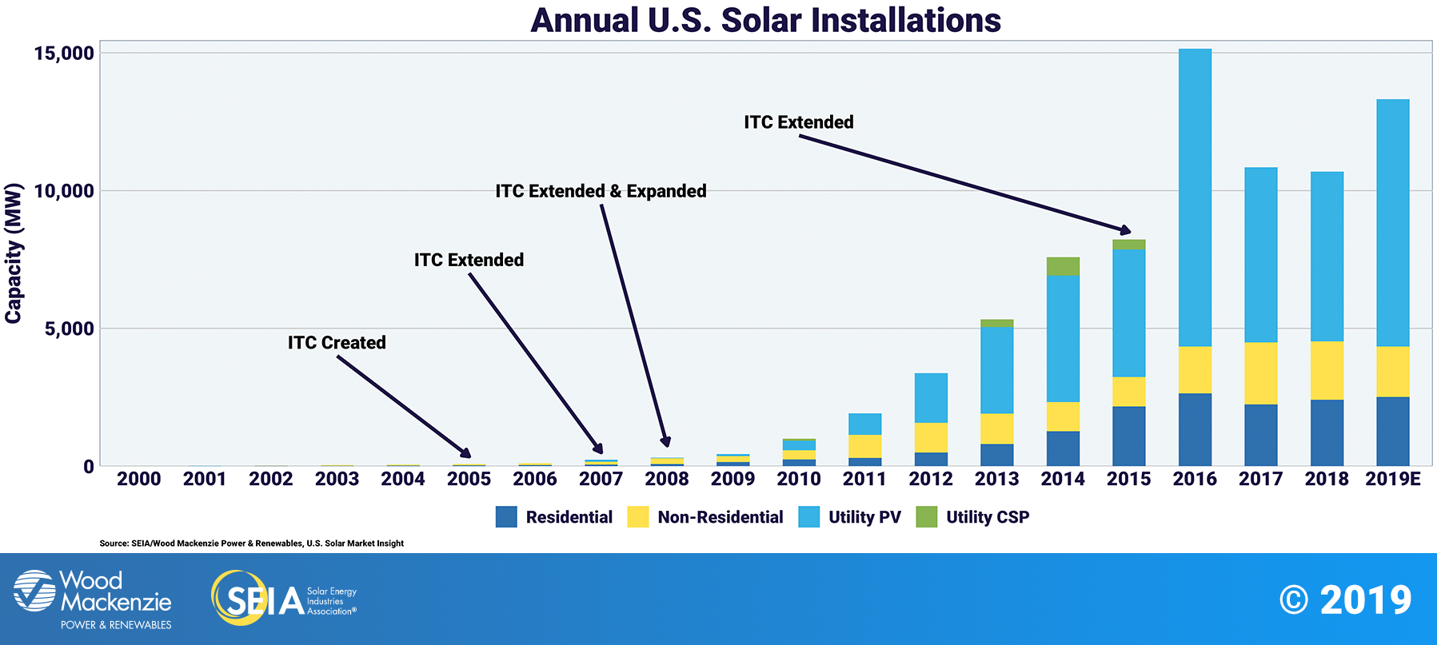
Solar Panel Instillation
Residential
Commercial

Slide 16
Conclusions:
The county seems to be growing.
Did chi squared test to see if size value and work type were correlated, they were .
One interesting thing of note is that there is a trend that Single family homes are being issued demolition permits but multi-family structures are almost always replaced.
I wish the description would be more workable.

Slide 17
Sources: Datamontgomery CountyStat Montgomery planning

Slide 18
Acknowledgments
Thank you, Professor Linehan.
To all my teachers at Montgomery college
To the people at data Montgomery who answered my questions
To Dennis for his suggestions.

