Slide 1

Org-Mode: Let a text editor save You
While any text editor can save your files,
only Emacs can save your soul.
RMS <3

Slide 2
Le Moi
Abraham Raji
He drinks.
He eats.
He codes.
He use Arch btw.
Writes exams to be a certified Instrumentation Engineer.
Actually likes being an engineer.
*Random Achievement + 5 minutes of humble bragging*
Freedom > Convenience

Slide 3
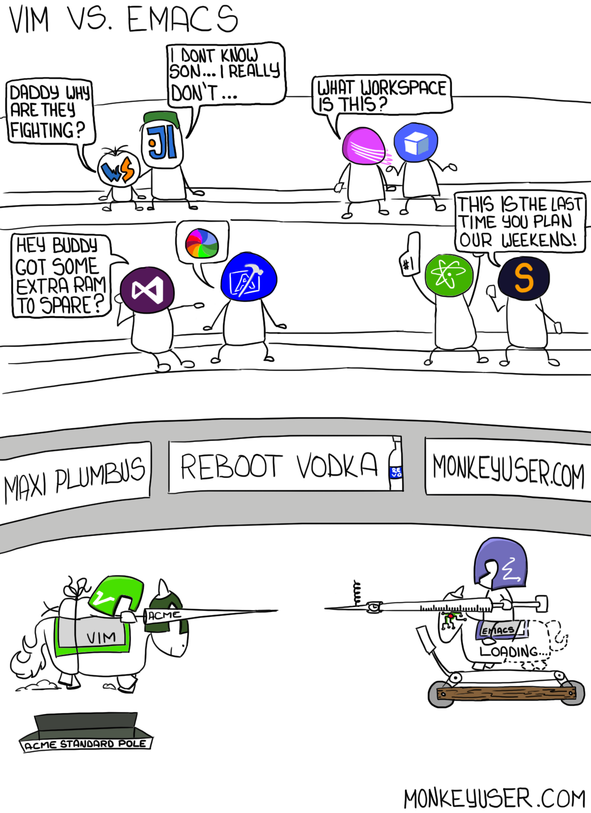
Let’s get something clear….

Slide 4
That being said...
As you all may or may not know VI VI VI is the text editor of the beast. In the name of St.Ignucious I Welcome you all to the Church Of Emacs!!!

Slide 5
Show Time.
Free as in free speech

Slide 6

Thank You
Capitalism is evil

