Slide 1
[matrix]
An open network for secure, decentralized communication.

Slide 2
The Problem
Centralization
Privacy
Technical hassle
All data in one place.
One point of failure.
One point to breach.
Lack of control for users.
Corporate controlled data
Multiple apps that cannot talk to each other.
Wastage of server spaces and other resources

Slide 3
Solution
[matrix]
a set of openly standardized HTTP APIs for the real-time synchronization and persistence of arbitrary JSON over a federation of servers.

Slide 4
What does matrix bring to the table?
Decentralization
User controlled Data
One Standard
Decentralized cryptographically signed conversation history.
Uses federated servers so that no one is in control of the data
One standard on which multiple messaging clients can be developed on.

Slide 5
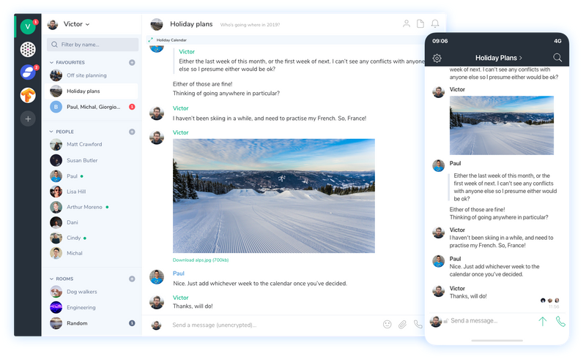

Try matrix today
Riot.im

Slide 6
How will matrix change the world?
Industrial Iot

Slide 7
Thank You.
Abraham Raji

