Slide 1

Software
Freedom Day
2018
THE
NEXUS
SJCET

Slide 2

Hello!
Ask me Stuff.
They call it seeking knowledge for a reason.

Slide 3
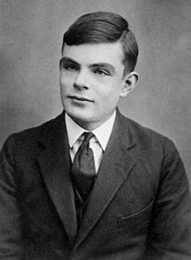
Alan Turing
(23 June 1912 – 7 June 1954)
1

Slide 4
Hackers
A computer hacker is any skilled computer expert that uses their technical knowledge to overcome a problem.

Slide 5
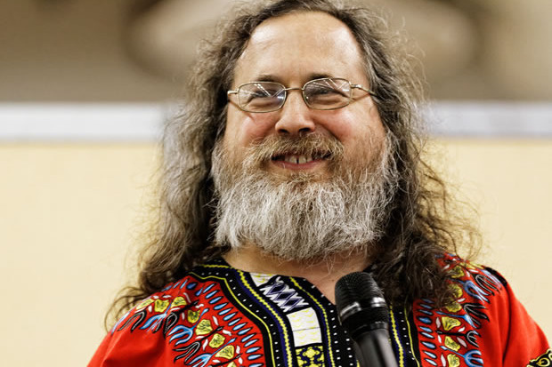
Richard Stallman
(born March 16, 1953 – )
2

Slide 6
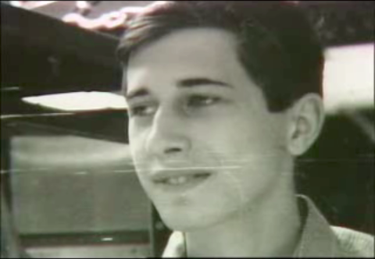
Richard Stallman
(born March 16, 1953 – )
2

Slide 7
Freedom Zero:
The freedom to run the program as you wish, for any purpose

Slide 8
Freedom One:
The freedom to study how the program works, and change it so it does your computing as you wish. Access to the source code is a precondition for this.

Slide 9
Freedom Two:
The freedom to redistribute copies so you can help others.

Slide 10
Freedom Three:
The freedom to distribute copies of your modified versions to others. By doing this you can give the whole community a chance to benefit from your changes. Access to the source code is a precondition for this.

Slide 11
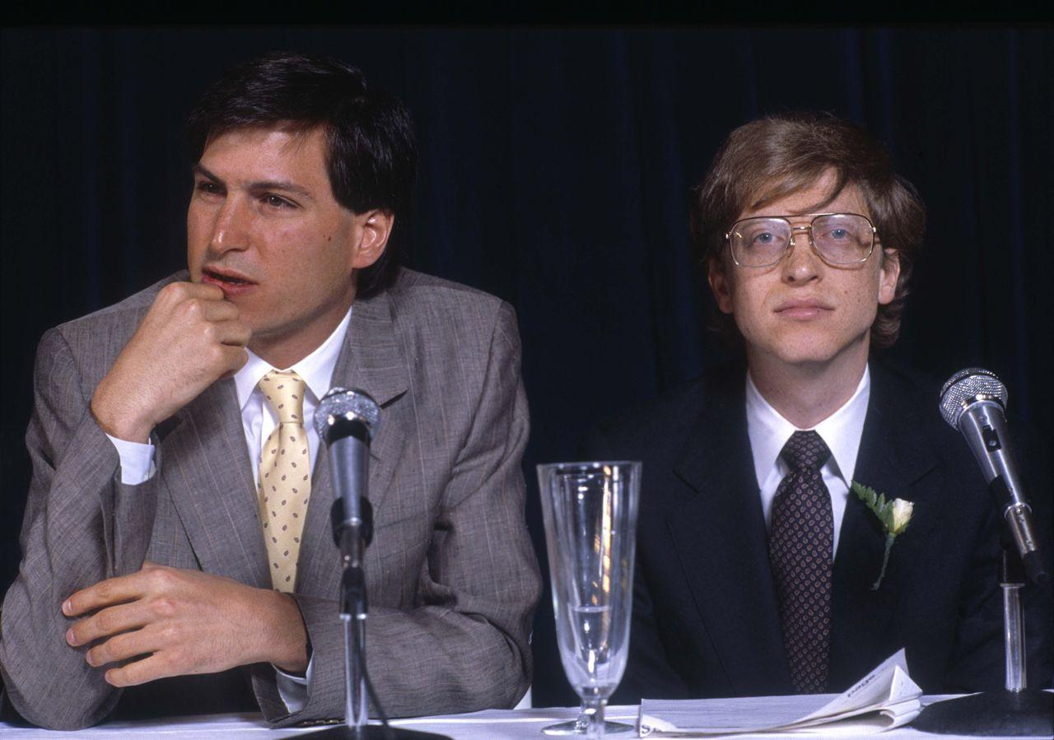
3

Slide 12
Steven Paul Jobs
( 24 February 1955 - 5 October 2011)
William Henry Gates III
(born October 28, 1955 – )
3

Slide 13
The Kernel
The kernel is one of the first programs loaded on start-up. It handles the rest of start-up as well as input/output requests from software, translating them into data-processing instructions for the central processing unit. It handles memory and peripherals like keyboards, monitors, printers, and speakers.

Slide 14
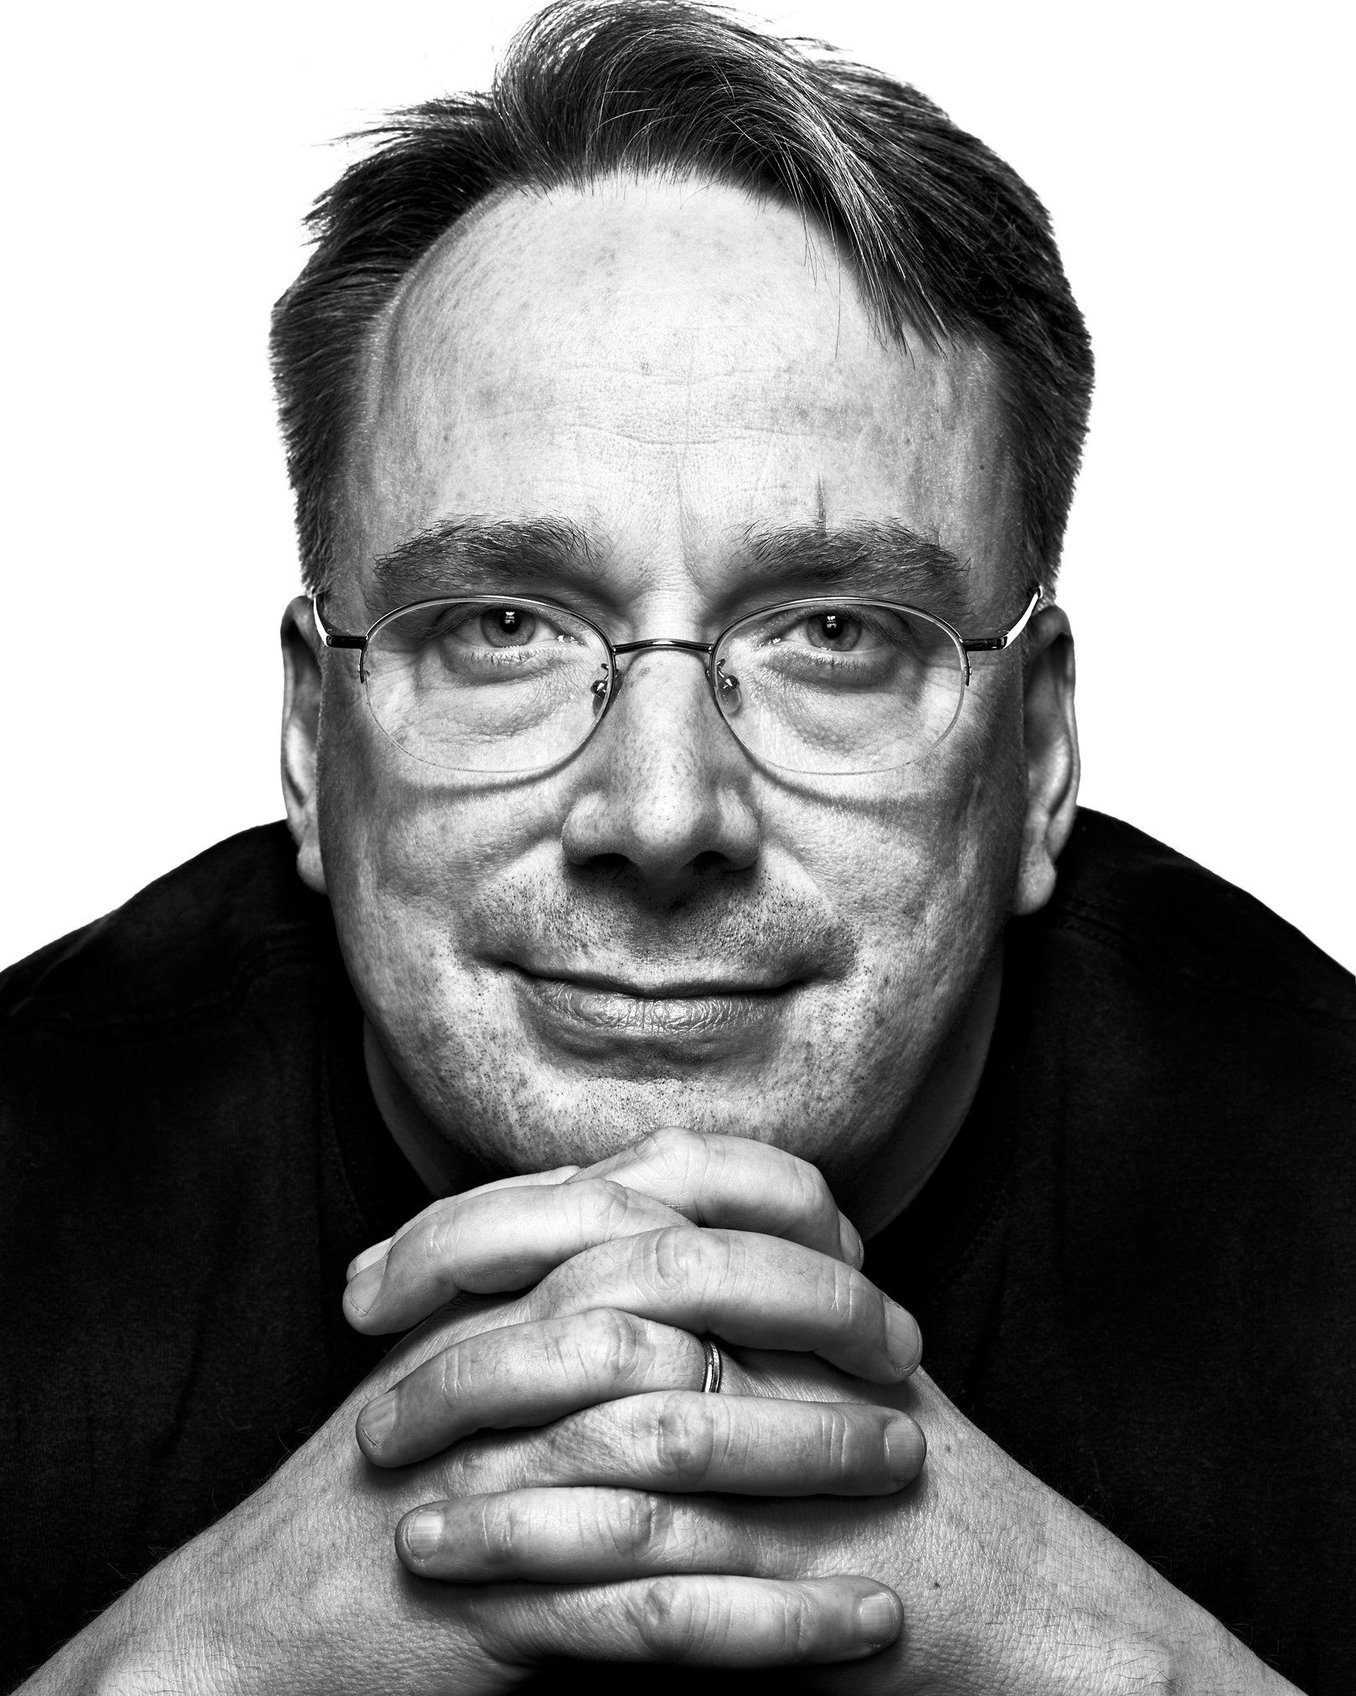
Linus Benedict Torvalds
( 28 December 1969 - )
4

Slide 15
1.8%
According to web server statistics, as of June 2016, the estimated market share of GNU/Linux on desktop computers is around 1.8%. In comparison, Microsoft Windows has a market share of around 89.7%, while macOS covers around 8.5%.

Slide 16
79.3%
Android, which is based on the GNU/Linux kernel, has become the dominant operating system for smartphones. During the second quarter of 2013, 79.3% of smartphones sold worldwide used Android. Android is also a popular operating system for tablets, being responsible for more than 60% of tablet sales as of 2013.

Slide 17
95%
According to the GNU/Linux Movies Group, more than 95% of the servers and desktops at large animation and visual effects companies use GNU/Linux. The first major film produced on GNU/Linux servers was 1997's Titanic. Since then major studios including DreamWorks Animation, Pixar, Weta Digital, and Industrial Light & Magic have migrated to GNU/Linux.

Slide 18
96.55%
W3Cook publishes stats that use the top 1,000,000 Alexa domains,[133] which as of May 2015 estimate that 96.55% of web servers run GNU/Linux, 1.73% run Windows, and 1.72% run FreeBSD.

Slide 19
GNU/Linux is Everywhere
Top 500 Supercomputers
Flight Entertainment Systems
Smart Refrigerators and Nest Thermostat
Large Hadron Collider and International Space Station
Self-Driving Cars
Traffic Control Systems
Robotic Milking System
This is just the tip of the iceberg…

Slide 20
Windows
Vs
GNU/Linux
5

Slide 21
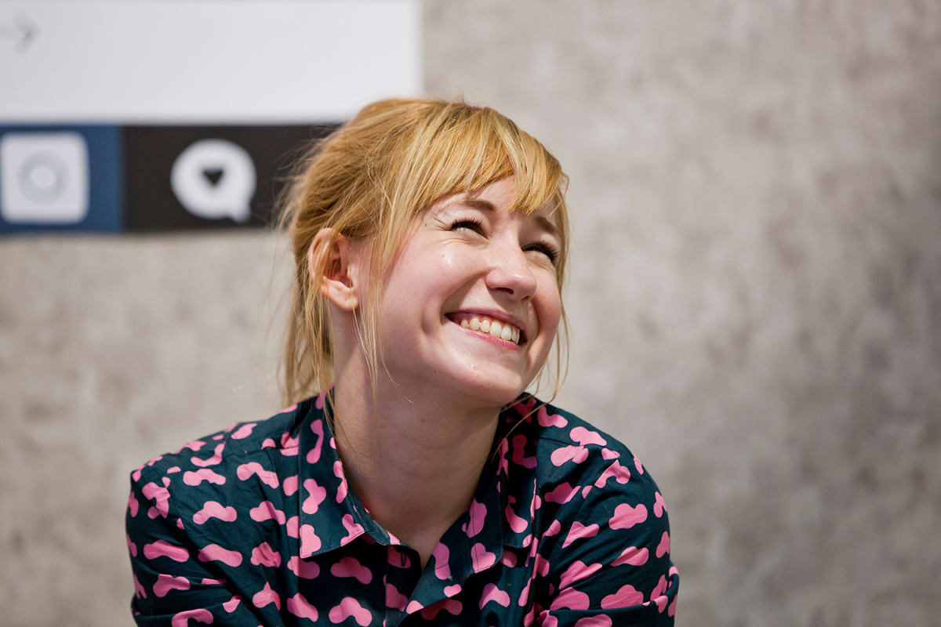
Linda Liukas
Creator of Ruby Girls
The kind of people our industry needs right now.
6

Slide 22
Thanks!
Any questions?
Like Anything.

