Slide 1
Random Forest The Sentinels
Tristen Brewer
Nicholas Fenech
Janeel Abrahams

Slide 2
What is a Random Forest?
An ensemble technique
Multiple decision trees
Bagging :Bootstrap and Aggregation
Classification and Regression

Slide 3
Advantages vs Disadvantages
Advantages
Disadvantages
It is easy to use and less sensitive to the training data compared to the decision tree.
It is more accurate than the decision tree algorithm.
It is effective in handling large datasets that have many attributes.
It can handle missing data, outliers, and noisy features.
The model can be difficult to interpret.
May require expert-level insights when selecting parameter.
It's computationally, expensive.
Possible overfitting for complex models or high number of trees

Slide 4
What are the steps involved in building a Random Forest model?
Create
model = RandomForestRegressor(n_estimators = 100, random_state =42)
Fit
Score
Optional Metrics
model = model.fit(X_train, y_train)
score = model.score(X_test, y_test)
Mean absolute Error
mean_absolute_error(y_train,y_trainPred)

Slide 5
Random Forest Jargons
Bagging
Out-Of-Bag error (OOB error)
Gini Index

Slide 6
How does it differ from other machine learning algorithms?
Ensemble Method
Feature Selection
Bootstrap Aggregating
Non-parametric Model

Slide 7
What does the Target Data Set look like?
Cars93 (Provided for the Assessment)
Housing Data Set(Used as our Toy Data Set)
100,000 UK Used Cars (Real-world Data Set)
Continuous Targets were used through all sets above:
Price
MPG
Did not use any Categorical Variables

Slide 8
How is the model evaluated?
R Squared Score
Mean Absolute Error
Mean Squared Error

Slide 9
Random Forest Hyperparameters
Boot Strapping
Feature Selection
Depth
Number of Trees
and many others!

Slide 10
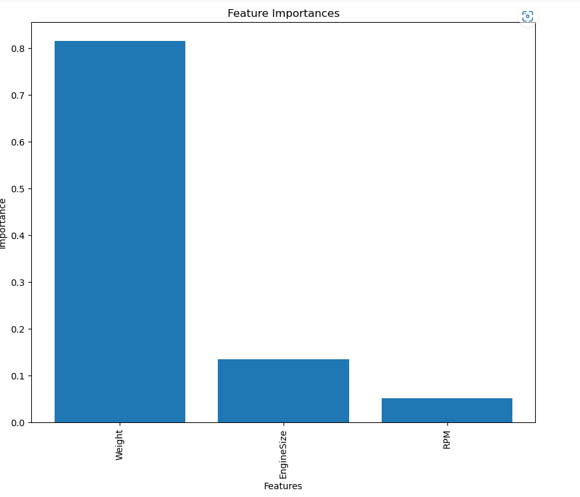
Random Forest at a Basic Level – Cars93 Feature importance

Slide 11
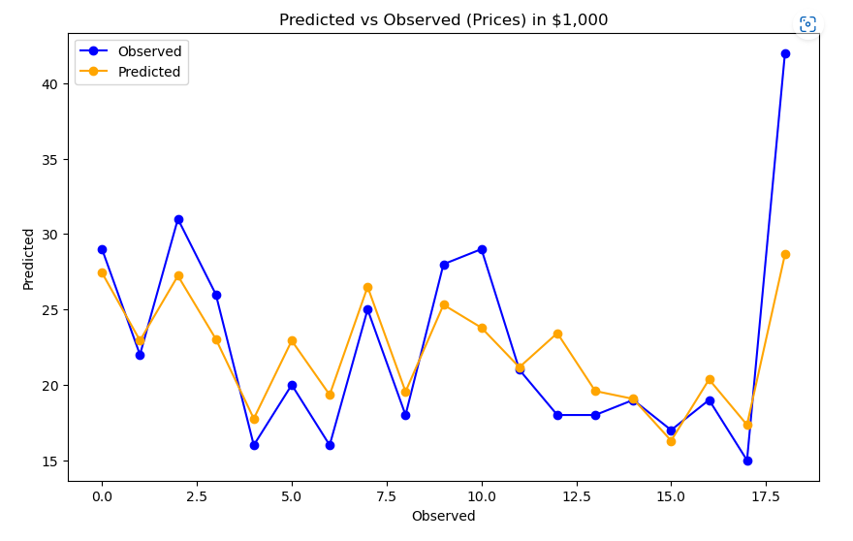
Random Forest at a Basic Level – Cars93 Line Graph
R2_score
Training- 0.97
Testing-0.64

Slide 12
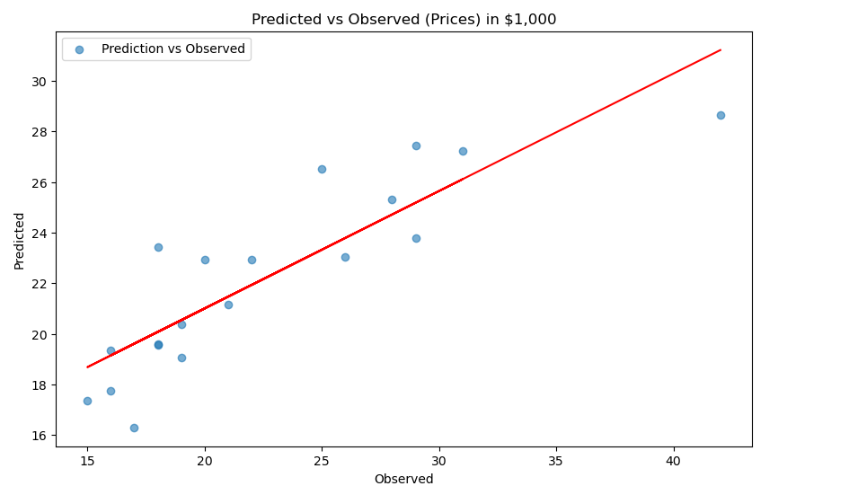
Random Forest at a Basic Level – Cars93 Scatterplot
R2_score
Training- 0.97
Testing-0.64

Slide 13
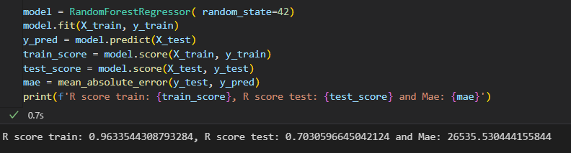
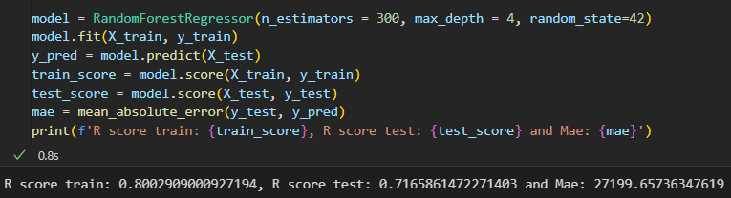
Adding Hyperparameters – Housing Data

Slide 14
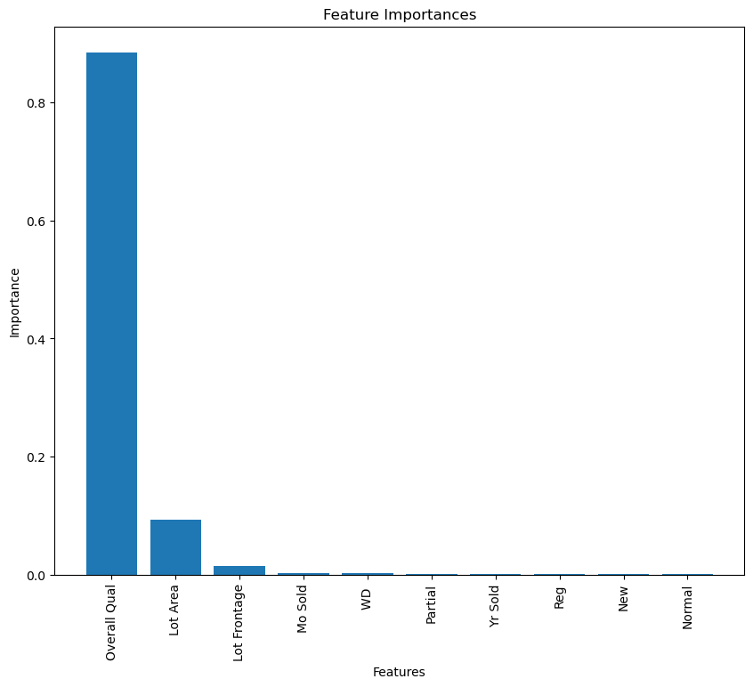
Random Forest Hyperparameters – Housing Data Feature Importance

Slide 15
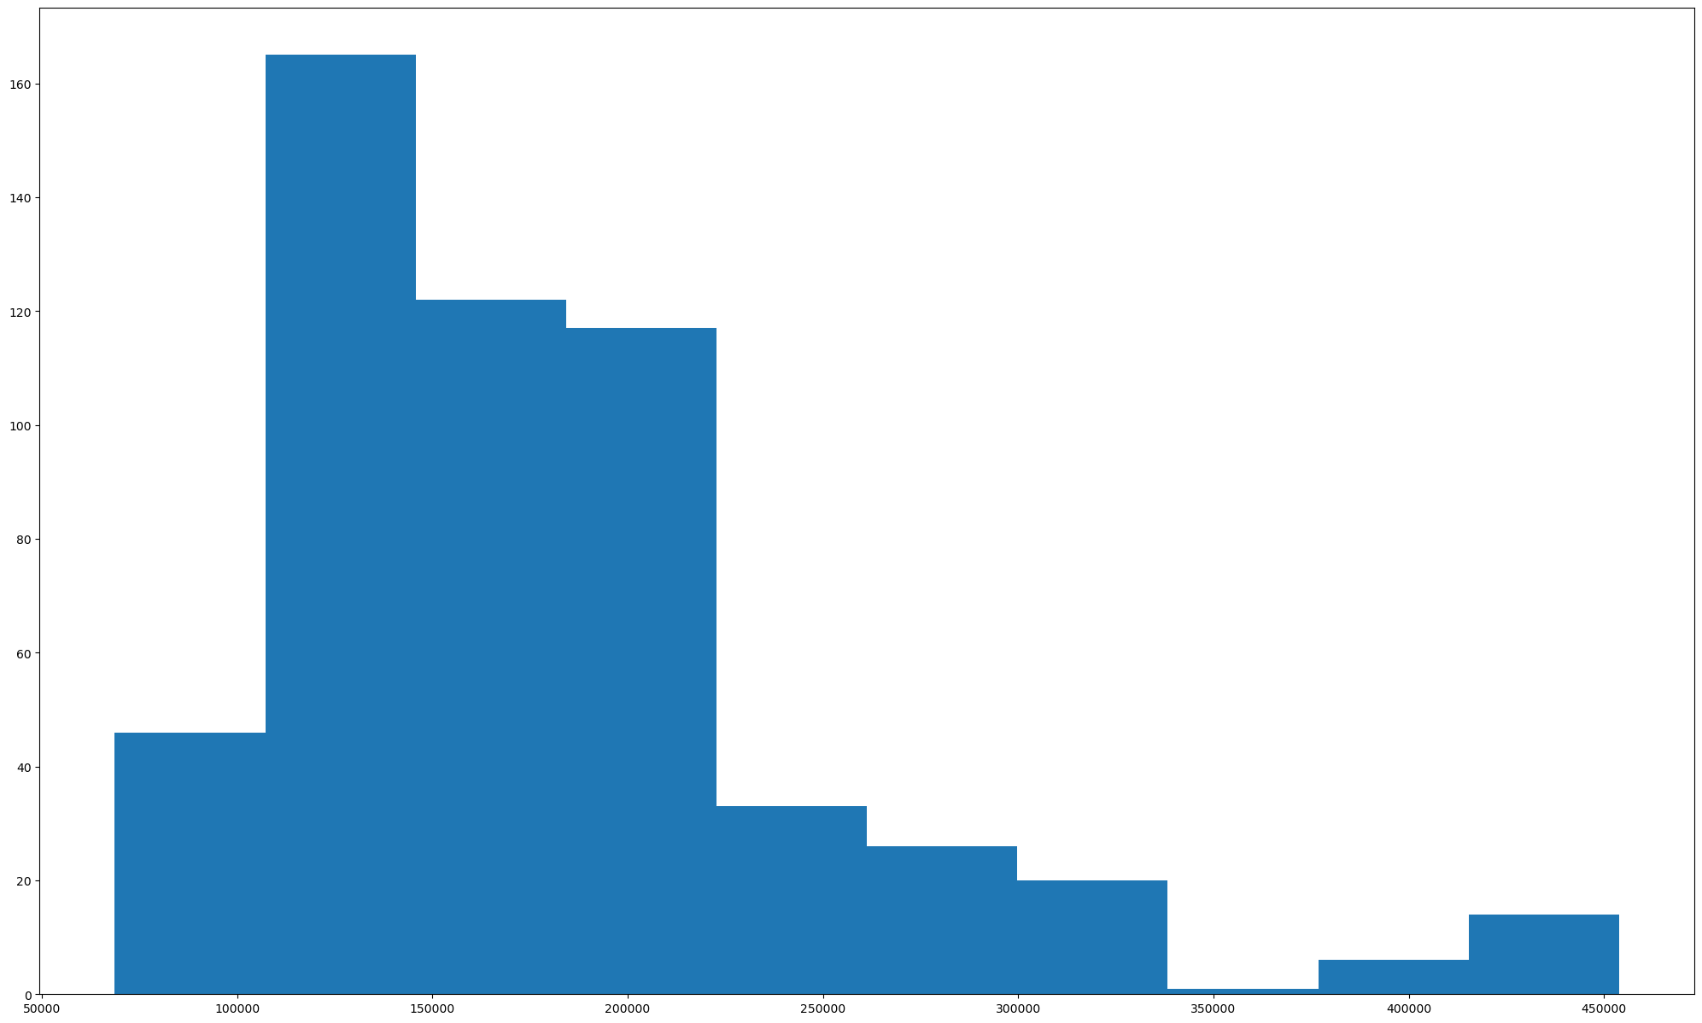
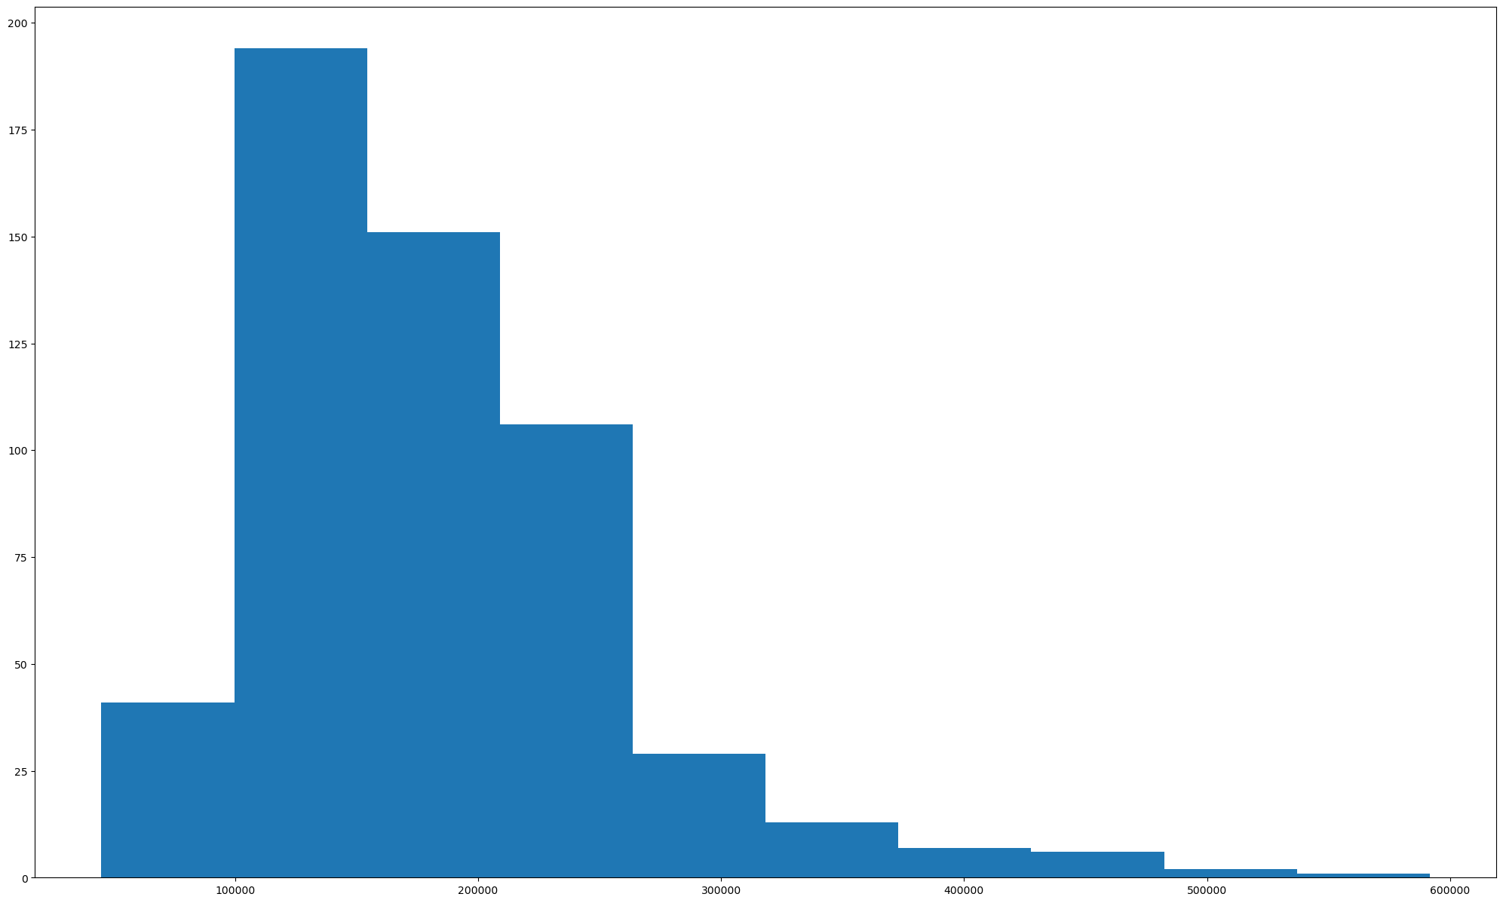
Random Forest Hyperparameters – Housing Data Histograms
Predictions
Actual

Slide 16
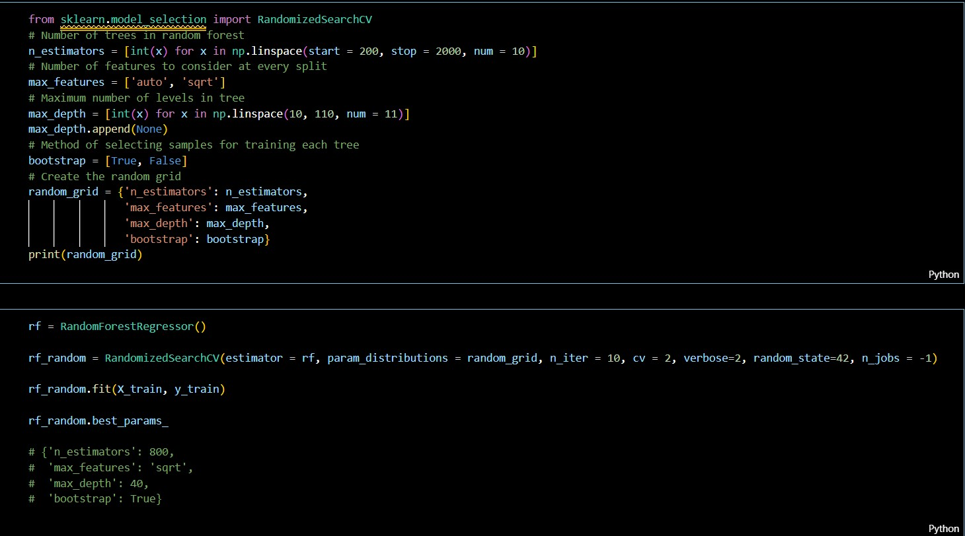
Tuning Hyperparameters for Maximum Potential – Real World Cars

Slide 17
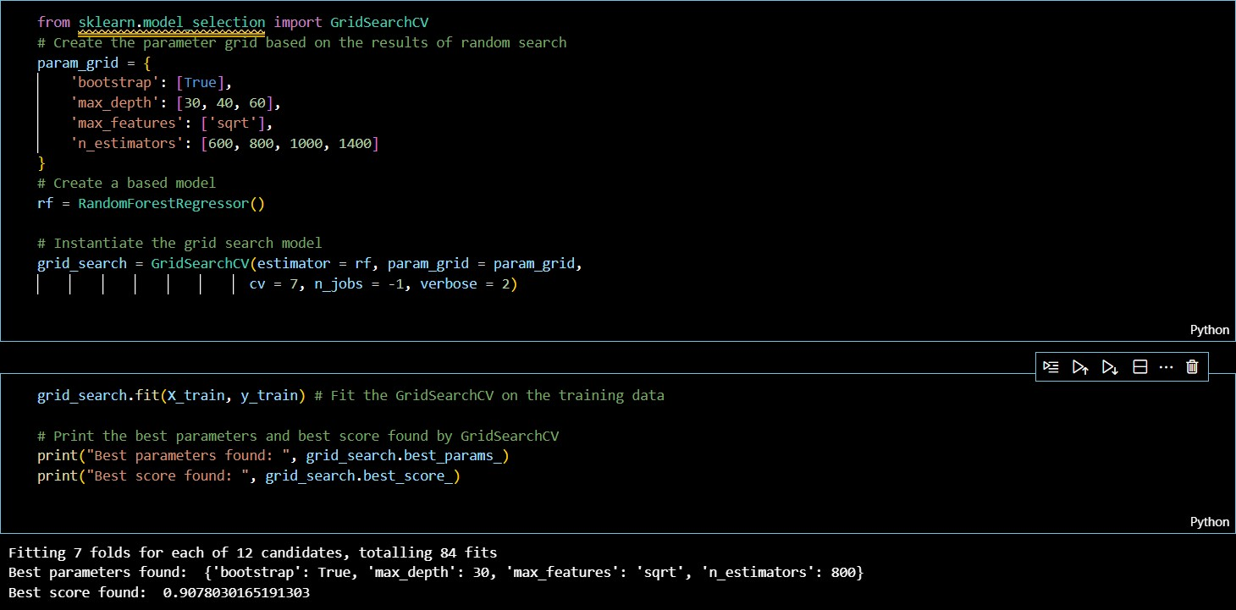
Tuning Hyperparameters for Maximum Potential – Real World Cars-Cont'd

Slide 18
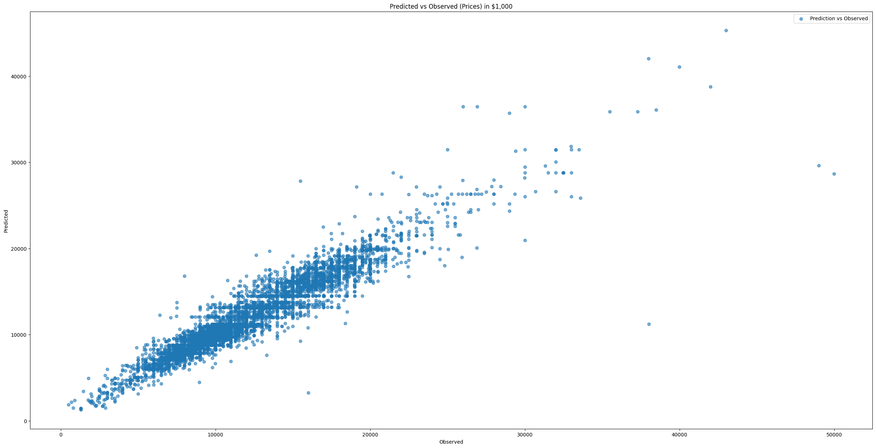
Tuning Hyperparameters for Maximum Potential – Real World Cars-Cont'd
Scatter Plot Trend
Pre-tuned R-Squared = 89%
Post-tuned R-Squared = 89%
Mean Absolute Error = $991

Slide 19
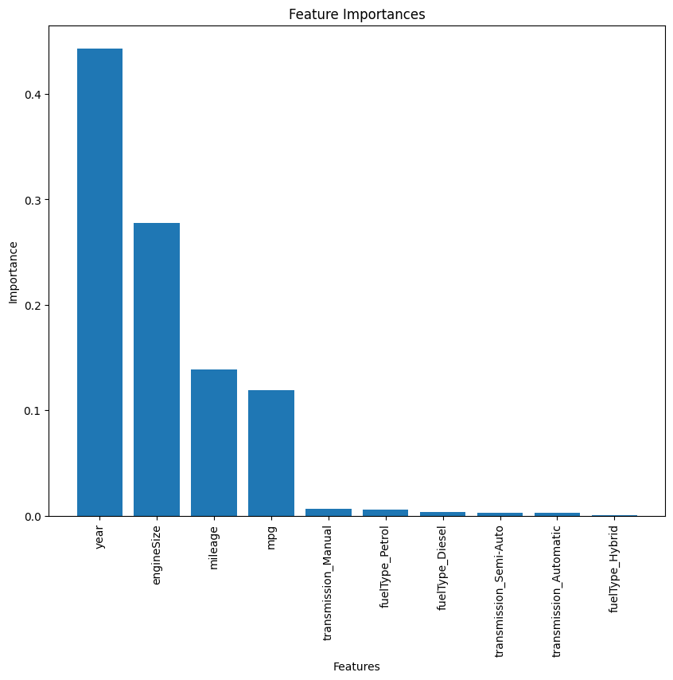
Tuning Hyperparameters for Maximum Potential – Real World Cars-Cont'd

Slide 20
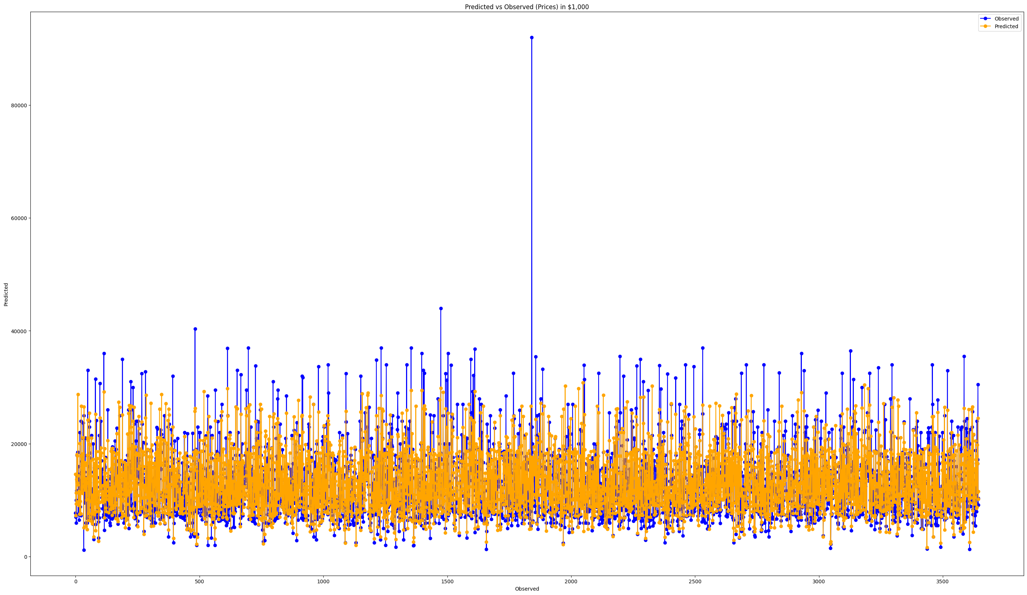
Tuning Hyperparameters for Maximum Potential – Real World Cars-Cont'd
Final Model used against an unseen dataset
R-Squared = 65%
Mean Absolute Error = 2441

Slide 21
What are some real-world applications of Random Forests?
Churn prediction
Medical diagnosis
Fraud detection
Environmental modeling
Recommender systems

Slide 22
References
Hyperparameter Tuning the Random Forest in Python: https://towardsdatascience.com/hyperparameter-tuning-the-random-forest-in-python-using-scikit-learn-28d2aa77dd74
Random Forest Regression with Python: https://www.youtube.com/watch?v=LhBOVWSu-tI
Understand Random Forest Algorithms With Examples (Updated 2023): https://www.analyticsvidhya.com/blog/2021/06/understanding-random-forest/
Random forest for imbalanced datasets: https://towardsdatascience.com/random-forest-for-imbalanced-datasets-9d0c8dcb1eb7
Preventing overfitting in random forest: https://towardsdatascience.com/preventing-overfitting-in-random-forest-8e7edffc2bbc
Real-world applications of random forest: https://www.analyticsvidhya.com/blog/2017/09/30-questions-test-knowledge-random-forest-algorithm/
Challenges of using random forest: https://towardsdatascience.com/3-challenges-of-random-forest-and-how-to-overcome-them-7dde3f50f26c
Scikit Learn : https://scikit-learn.org/stable/modules/ensemble.html#random-forestshttps://scikit-learn.org/stable/modules/ensemble.html#random-forests

Slide 23

Moving to GitHub
This Photo by Unknown author is licensed under CC BY-SA.

