Slide 1
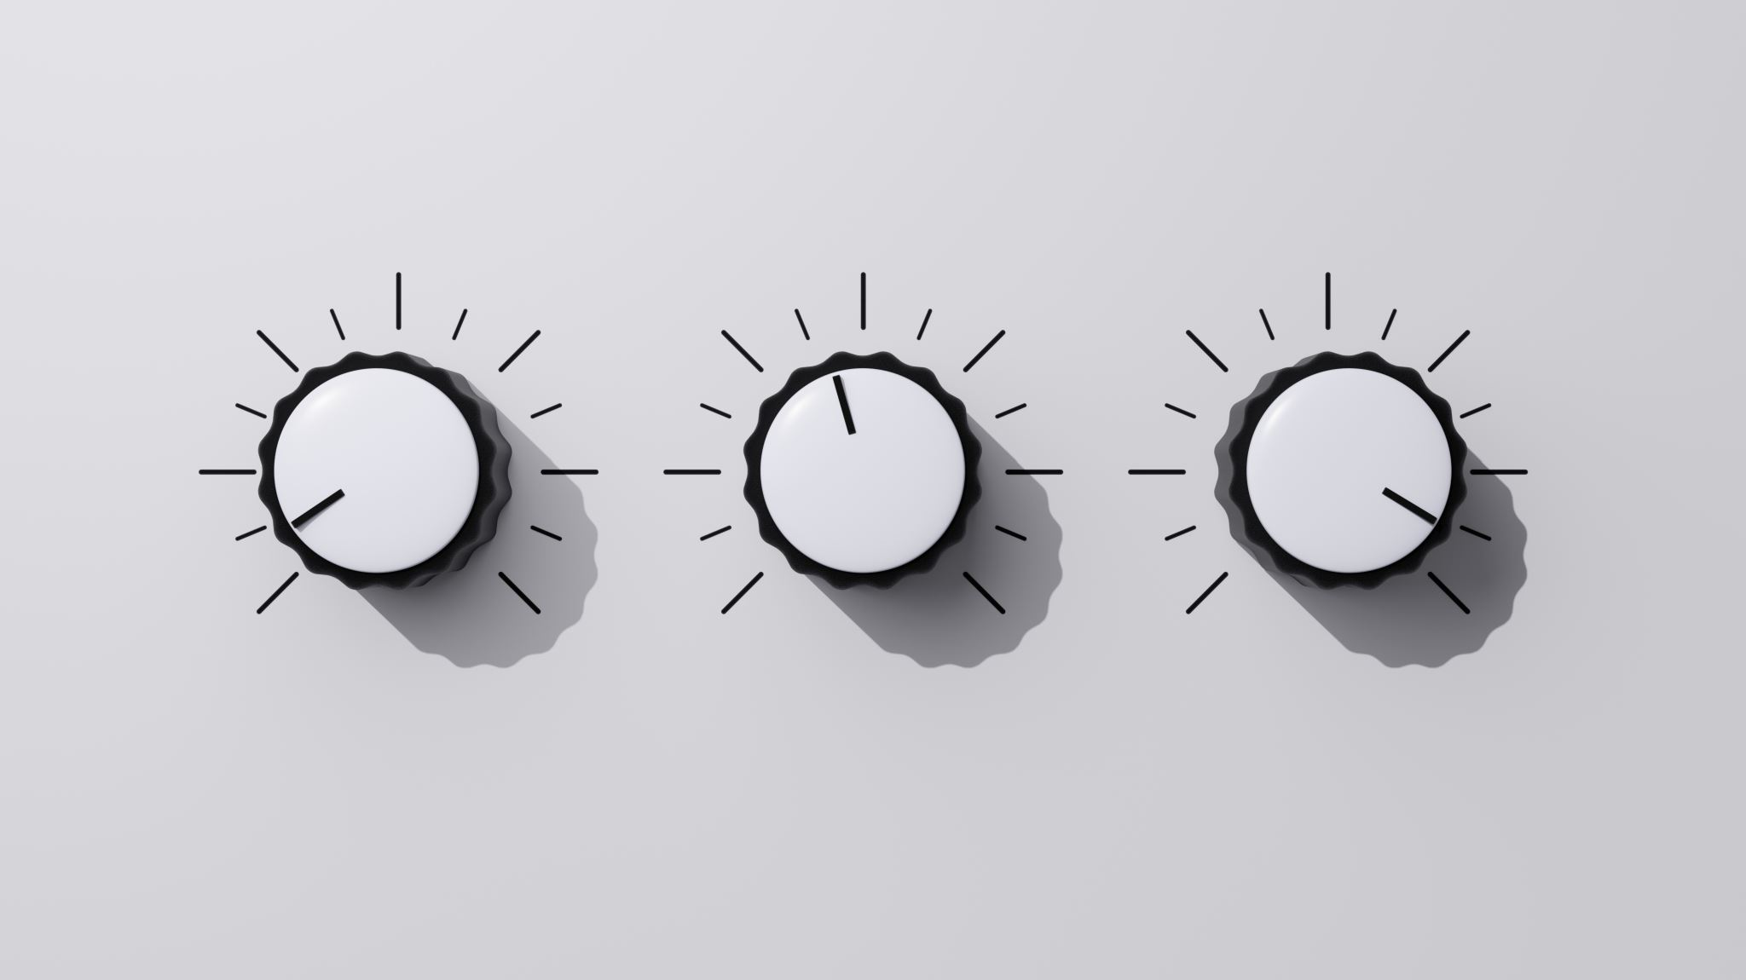
Microchip Audio Analyzer
Ziv Abraham

Slide 2
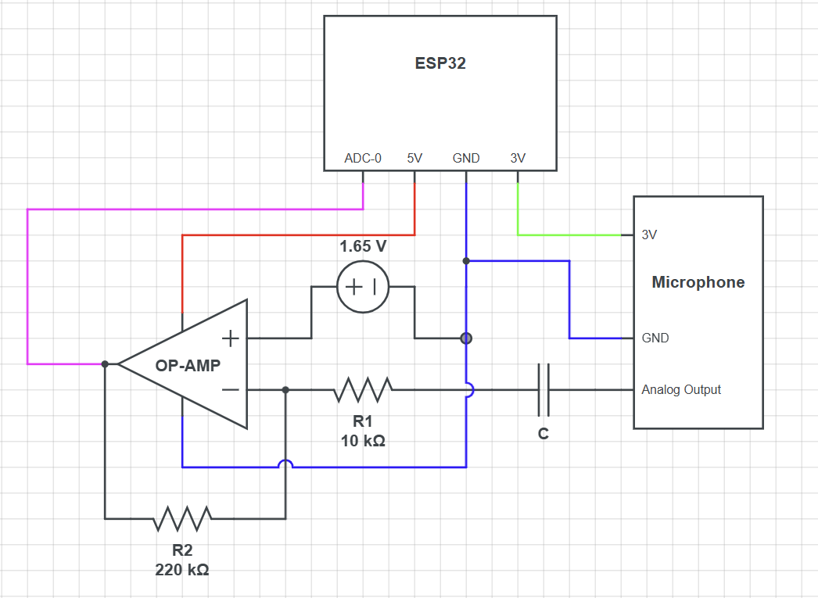
Project description
Hardware:
Microchip – ESP32
Microphone module
NE5532 OP-AMP with X22 Amplification
Software:
C++, JS
PlatformIO, arduinoFFT library
AI tools used:
Gemini for design and planning
Github Copilot for code writing

Slide 3
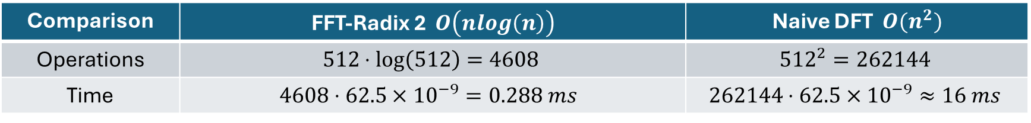
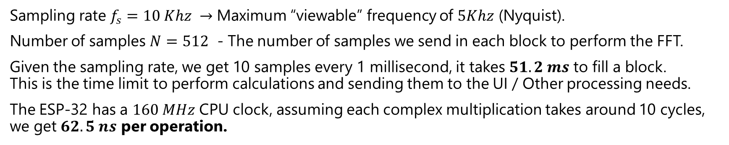
The Math
Sampling rate $f_{s}=10 Khz →$ Maximum “viewable” frequency of $5Khz$ (Nyquist).
Number of samples $N=512$ - The number of samples we send in each block to perform the FFT.
Given the sampling rate, we get 10 samples every 1 millisecond, it takes $51.2 ms$ to fill a block. This is the time limit to perform calculations and sending them to the UI / Other processing needs.
The ESP-32 has a $160 MHz$ CPU clock, assuming each complex multiplication takes around 10 cycles, we get $62.5 ns$ per operation.
Comparison | FFT-Radix 2 $O\left(nlog\left(n\right)\right)$ | Naive DFT $O(n^{2})$
Operations | $$512⋅\log\left(512\right)=4608$$ | $${512}^{2}=262144$$
Time | $$4608⋅62.5×{10}^{−9}=0.288 ms$$ | $$262144⋅62.5×{10}^{−9}≈16 ms$$
While the FFT leaves $51 ms$ for other operations, the naive DFT would leave $35.2 ms$.

Slide 4
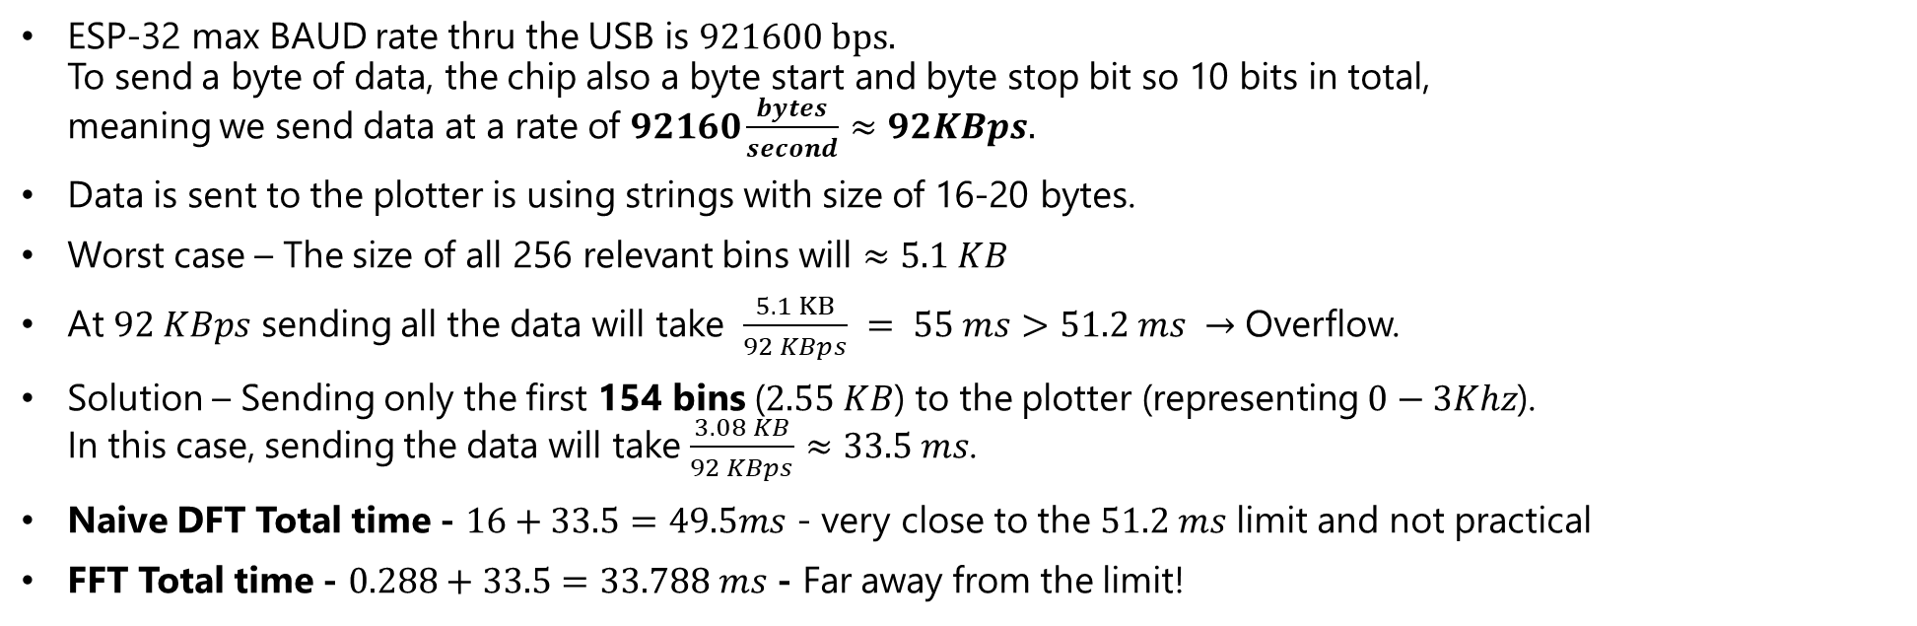
The Bottleneck
ESP-32 max BAUD rate thru the USB is $921600 bps.$ To send a byte of data, the chip also a byte start and byte stop bit so 10 bits in total, meaning we send data at a rate of $92160\frac{bytes}{second}≈92KBps.$
Data is sent to the plotter is using strings with size of 16-20 bytes.
Worst case – The size of all 256 relevant bins will $≈5.1 KB$
At $92 KBps$ sending all the data will take $\frac{5.1 KB}{92 KBps} = 55 ms>51.2 ms →$ Overflow.
Solution – Sending only the first 154 bins ($2.55 KB$) to the plotter (representing $0−3Khz$). In this case, sending the data will take $\frac{3.08 KB}{92 KBps}≈33.5 ms$.
Naive DFT Total time - $16+33.5=49.5ms$ - very close to the $51.2 ms$ limit and not practical
FFT Total time - $0.288+33.5=33.788 ms$ - Far away from the limit!

