Slide 1
Lab 2: Data handling and graphics in R An Introduction to Computational Biology
Department of Biological Sciences
University of Chicago

Slide 2
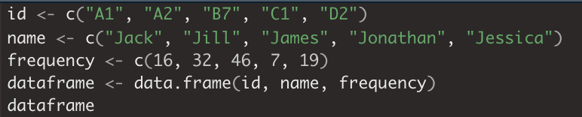
Data Frames
Definition: A data frame is a table / two-dimensional array-like structure where each column contains values of one variable and each row contains one set of values from each column.
Following are the characteristics of a data frame:
The column names should be non-empty.
The row names should be unique.
The data stored in a data frame can be of numeric, factor or character type.
Each column should contain same number of data items.
Create a data frame
Notes:
The differences between data frames and matrices is that data frames allow columns to have different variables types.
Presentation notes:
- look at the types of variables in dataframe
- look at the types of variables if dataframe is turned into a matrix using as.matrix()

Slide 3
Golub Data
Definition: Gene expression data (3051 genes and 38 tumor mRNA samples) from the leukemia microarray study of Golub et al. (1999).
Arguments:
golub: matrix of gene expression levels for the 38 tumor mRNA samples, rows correspond to genes (3051 genes) and columns to mRNA samples.
golub.cl: numeric vector indicating the tumor class, 27 acute lymphoblastic leukemia (ALL) cases (code 0) and 11 acute myeloid leukemia (AML) cases (code 1).
golub.gnames: a matrix containing the names of the 3051 genes for the expression matrix `golub`. The three columns correspond to the gene `index`, `ID`, and `Name`, respectively.
Notes:
The head() command can be used to view the first 6 rows of each piece of data. For example, head(golub) will return the first 6 rows of golub. View(golub) will open up the data in a new window in R and allow for more in-depth data exploration. It is preferable to use View() when your data is very large, such as in golub.
Presentation notes:
- Show different variables during lab

Slide 4
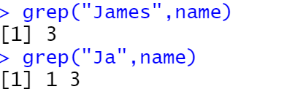
The grep() command
Question: How do we find words within a data frame?
Answer: The function grep() can be used. Grep takes 2 arguments: the string you want searched and the object you want searched. It returns the index of entries in the data that match the search.
For example, if I wanted to find the word “James” in the vector name, I would use: grep(“James”, name). Importantly, one can also search for parts of words such as with grep(“ja”, name).
Notes:
The grep() function takes in two mandatory arguments, such that the use of the function looks like: grep(“findthisword”, dataframe). Findthisword is what you would ctrl f. dataframe is the vector that you want it to search.

Slide 5
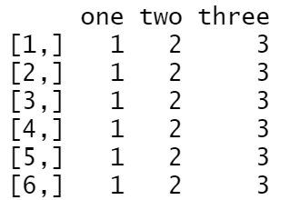
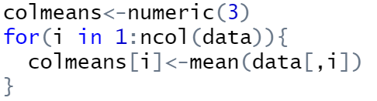

The apply() command
Question: How do run a function across many rows without loops?
Answer: The function apply() can be used. Apply requires 3 arguments: (1) the object you want it to act on (2) 0 or 1; 1 to perform the function on each row, 2 to perform the function on each column (3) the function you want performed.
Using a loop:
Using apply():
Notes:
Importantly, apply() can have the third argument be not just a default function, but a user-defined function. Has a lot of the flexibility of the for loops but has increased readability and runs faster.

Slide 6
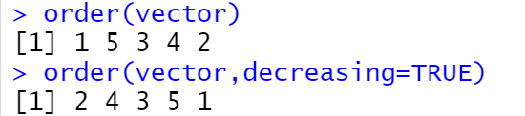

The order() command
Question: How do we order the values of a vector?
Answer: The function order() can be used. Order requires only one argument: the vector that you want ordered. It will automatically return the index of the input vector in increasing order. However, you can get them in decreasing order by typing: decreasing=TRUE.
For example, if we have a vector defined by vector<-c(1,6,3,5,2) and we want the index of the vector in order, we can use the following code:

Slide 7


The rev() command
Question: How do we reverse a vector?
Answer: The function rev() can be used. You input a vector and get the vector backwards as an output. Let’s consider an application. We have a DNA sequence and we want to find the complementary strand.
We know that the matching base pair to the sequence 5’-ATGC-3’ is 3’-TACG-5’ but DNA is antiparallel so to get the complement from 5’ to 3’ we really need to flip the sequence TACT. We can do this using rev(complement).

Slide 8
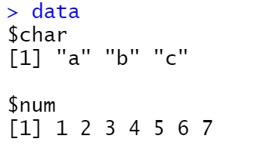
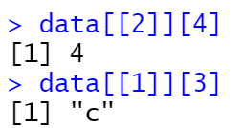
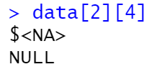
Lists
Lists can be thought of as vectors that can hold vectors of different types. For example:
We notice that unlike vectors, where each entry has a single value, lists can store entire objects under one index. To index within a list’s entry, we will have to index twice:
Please be careful and note that in order to use the second index, the first square bracket must be a double bracket. If not done correctly the output will look as below:

Slide 9

Basic Graphics in R
plot() is the main graphing function in R
What does plot() do?
Automatically produces simple plots for vectors, functions, or data frames
Many useful customization options
Types of plots
Scatterplot: plot()
Barplot: barplot()
Histogram: hist()
Boxplots: boxplot()

Slide 10
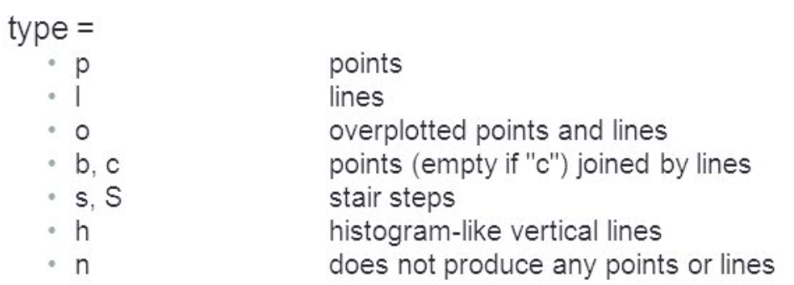
Adding Elements to graphics
Adding points or lines
plot(x,y)
points(x,y)
lines(x,y, type = “type”)
Adding titles and labels
title(main = “main”, sub = “sub”, xlab = “xlab”, ylab = “ylab”)
Adding a legend
plot(x,y)
legend(legend = c(“X1”, “X1”), lty = 1:2, col = 3:4)

