Slide 1
1
Lab 3 Overview: Databases, open reading frames, and origins of replication

Slide 2

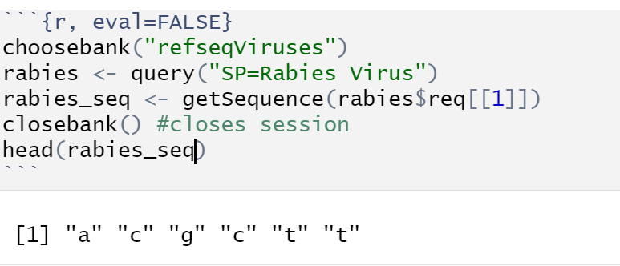
2
How do we access the NCBI database of sequences?
Choosebank() tells R to look at a specific database
The query specifies what the filters are; SP is species
getSequence takes the sequence from the database according to the query that is used

Slide 3
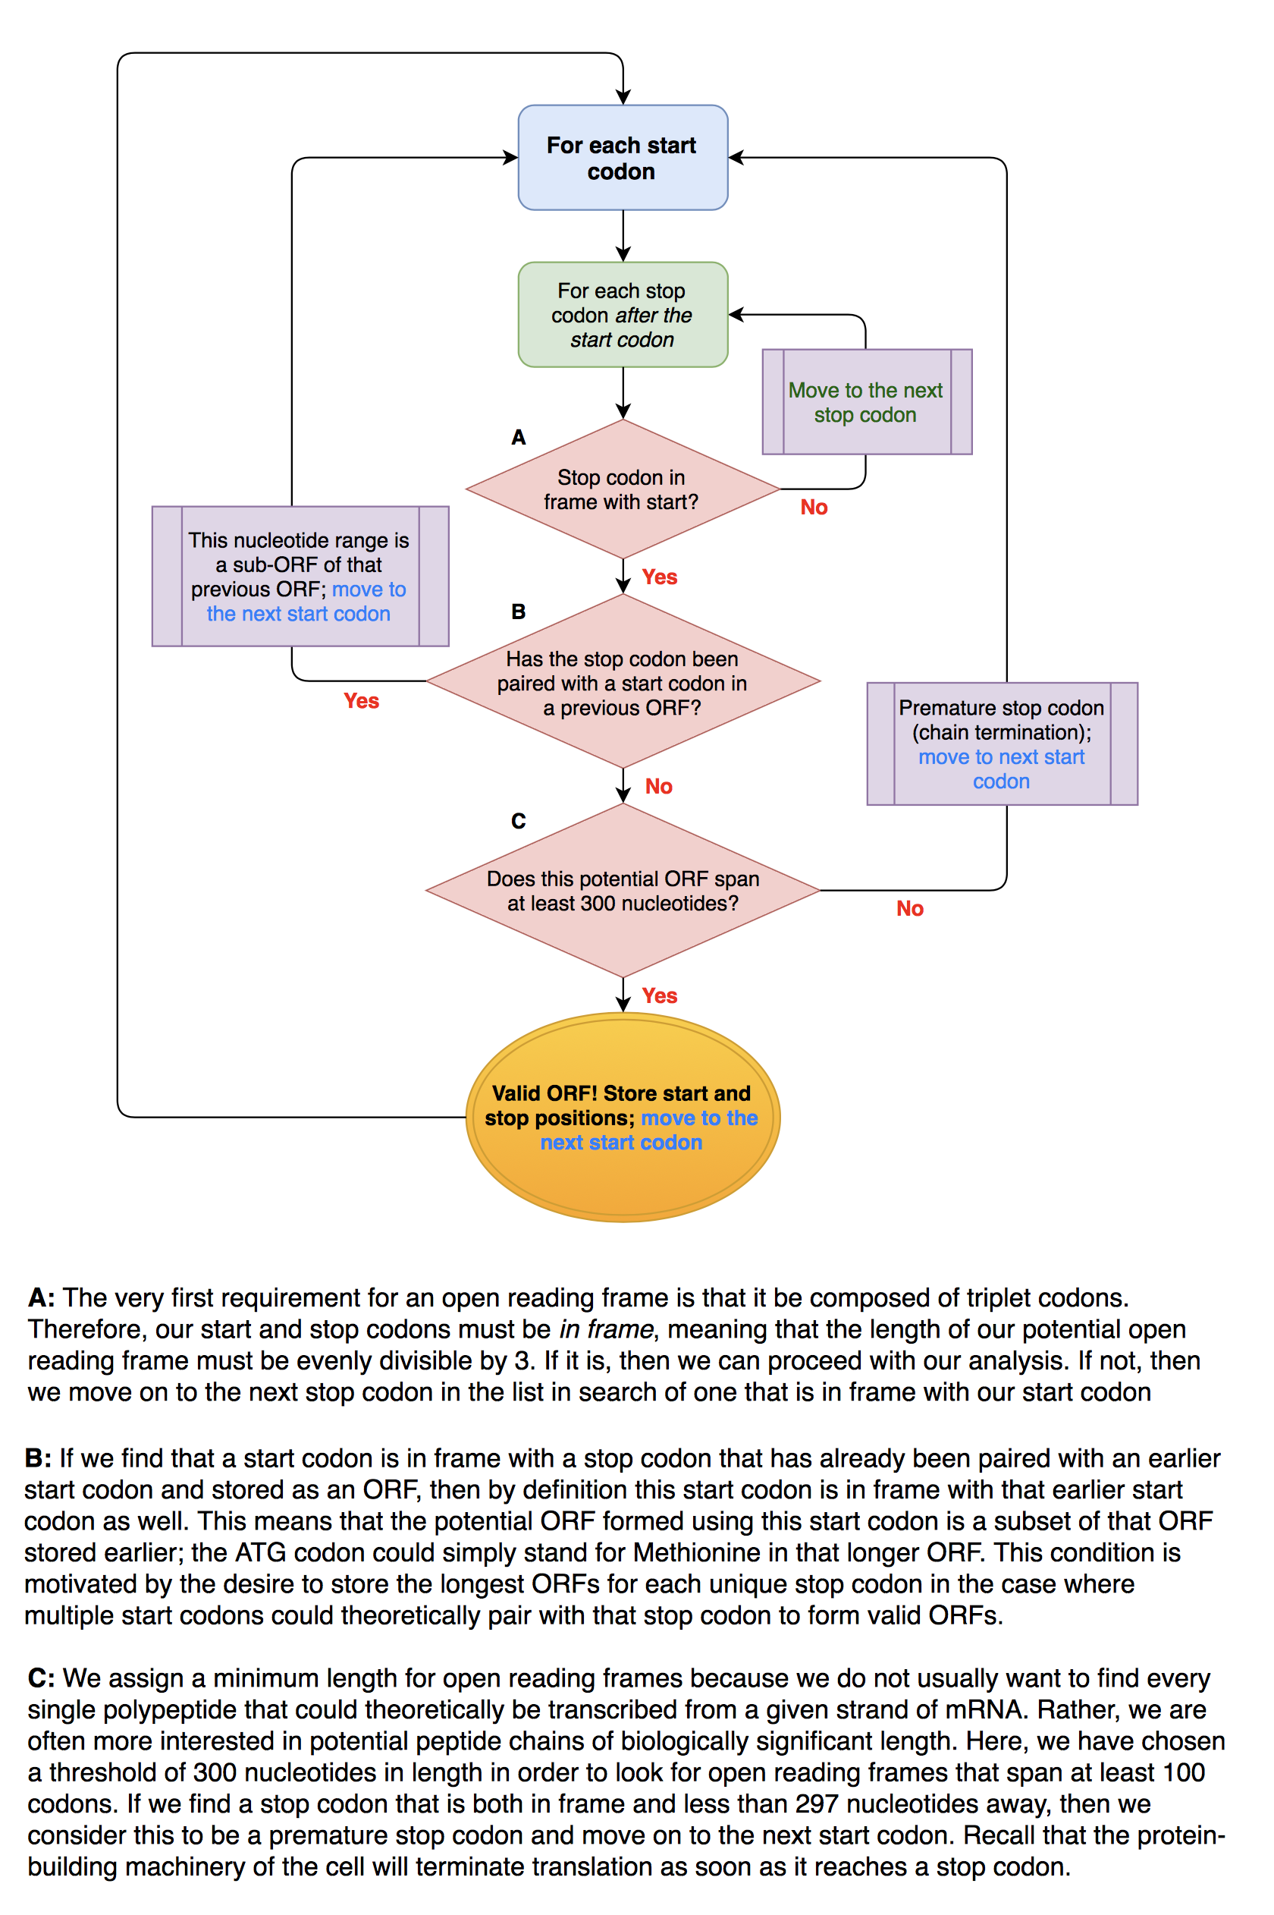
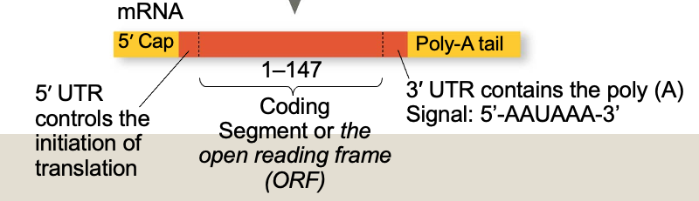
Predicting ORF’s
Notes:
Figure 17.11 RNA processing: RNA splicing
The poly(A) tail is around 200 bp lng in mamels. Thw cap athe 5’-end and the poly (A) tail at the 3’-end help in translation and also in the stability of mRNA.
The poly (A) signal is highly conserved.

Slide 4
3
How can we identify ORFs?
Open reading frames (ORFs) are stretches of base pairs in the genome that could potentially code for a protein
They must contain a start codon (ATG) and a stop codon (TAG, TGA, TAA)
The start and stop codons must be in the same reading frame (same frame of 3-codon units contains both the start and the stop codon

Slide 5
3
How can we identify ORFs?
Open reading frames (ORFs) are stretches of base pairs in the genome that could potentially code for a protein
They must contain a start codon (ATG) and a stop codon (TAG, TGA, TAA)
The start and stop codons must be in the same reading frame (same frame of 3-codon units contains both the start and the stop codon
Which of the following are valid ORFs? Why or why not?
1. ATGCGATAG 2. ATGCGACGG 3. ATGCGACTAG

Slide 6
4
How would we write our algorithm?
There are many ways. One framework is presented in your lab, here is another possible one that you could implement
We first choose a reading frame and map out where the start and stop codons are. Consider the example sequence with the reading frame starting from the first base pair:
ATGATGTAGATGCGACGGATGCGACGCTAG
1 4 7 10 19 28
Start codons begin at indices 1, 4, 10, and 19. Stop codons begin at indices 7 and 28.

Slide 7
5
ATGATGTAGATGCGACGGATGCGACGCTAG
1 4 7 10 19 28
Start codons begin at indices 1, 10, and 19. Stop codons begin at indices 7 and 28.
Now that we have mapped out where the starts and stops are, we can search for ORFs.
We start looking at our first start codon at index 1, what is the ORF we identify?

Slide 8
5
ATGATGTAGATGCGACGGATGCGACGCTAG
1 4 7 10 19 28
Start codons begin at indices 1, 10, and 19. Stop codons begin at indices 7 and 28.
Now that we have mapped out where the starts and stops are, we can search for ORFs.
We start looking at our first start codon at index 1, what is the ORF we identify?
1-7

Slide 9
6
ATGATGTAGATGCGACGGATGCGACGCTAG
1 4 7 10 19 28
We start looking at our first start codon at index 1, what is the ORF we identify?
1-7
Where is the next start codon we begin searching at?
10. We should only look at start codons that come after the stop codon we just found (7) because if we use start codons before that we will just find a smaller ORF. The start codon at index 4 is probably just a methionine.

Slide 10
7
How does our overall algorithm look?
Find the start index for all start codons and stop codons in the sequence for a given reading frame
Starting from the first start codon, find the nearest stop codon that comes after. Continue the search from start codons that come after the previous stop codon.
You should now have all of the ORFs. But you want only those that are larger than a certain threshold. Filter out your list of ORFs based on this threshold.
Repeat this process for all three reading frames. Then find the complementary sequence and repeat for all three reading frames on that sequence.

Slide 11
8
How can we identify OriC?
Reading from 5’ to 3’ we calculate G - C
G-C should be minimized at the Ori because deamination of the complementary strand reduces G content left of the Ori and the G content should be higher on the right side

Slide 12
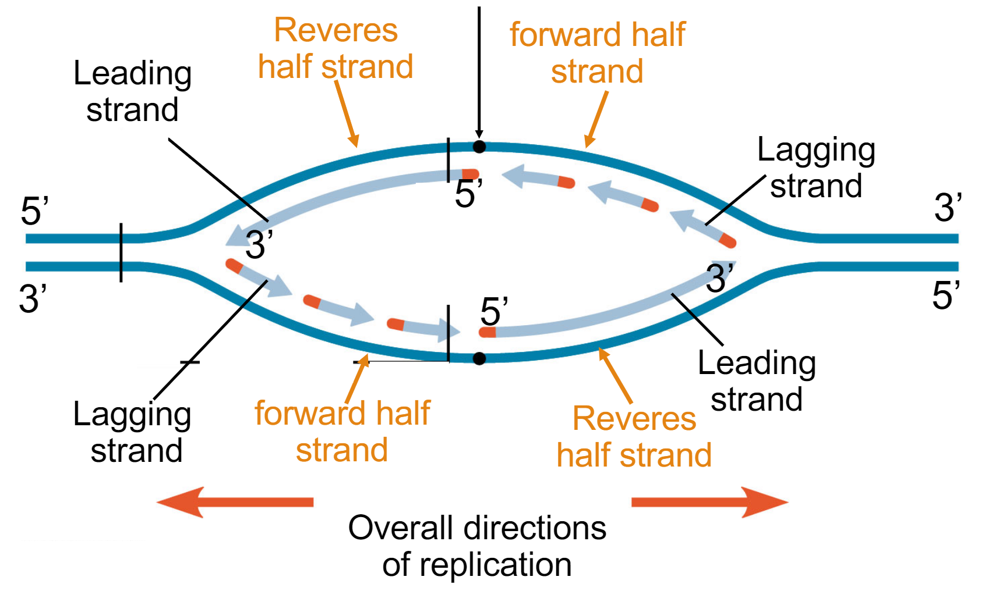
9
How can we identify OriC?
5’-TACGG-Ori-3’
3’-ATGCC-Ori-5’
5’-TACAG-Ori-3’
3’-ATGTC-Ori-5’

