Slide 1
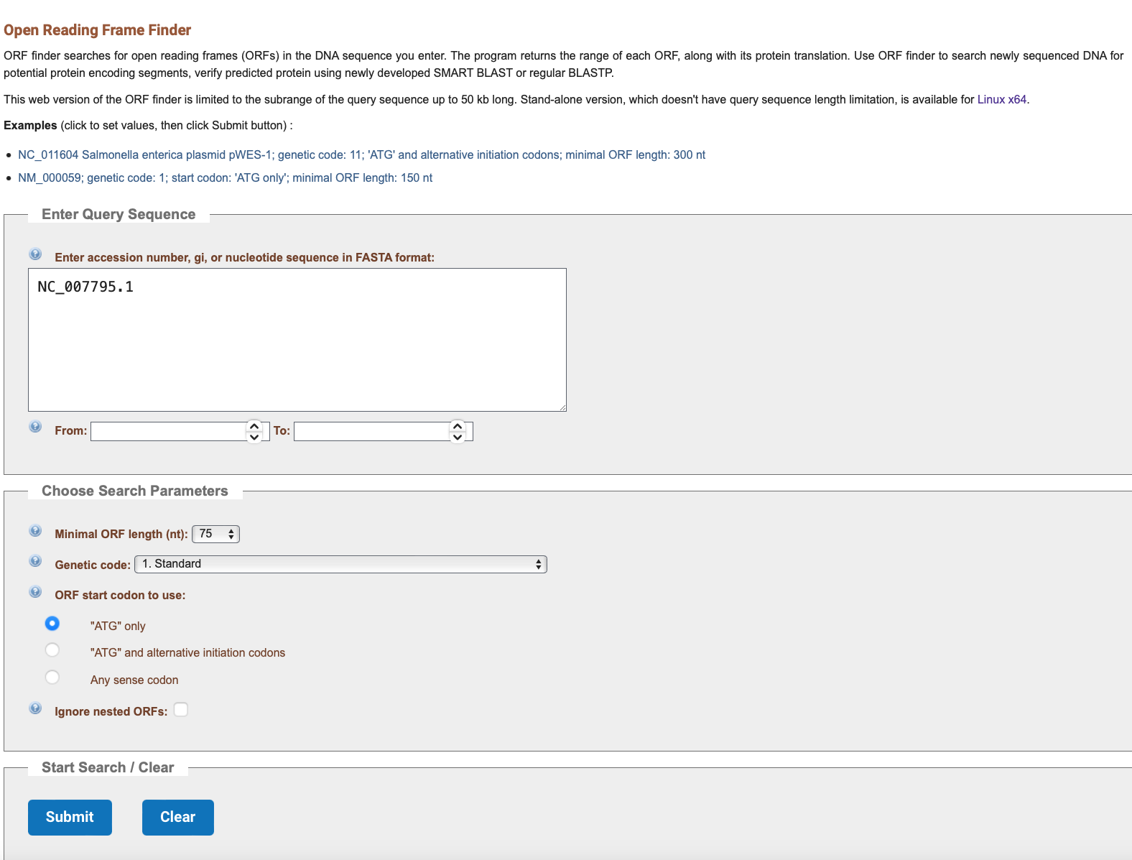
NCBI ORF Finder

Slide 2
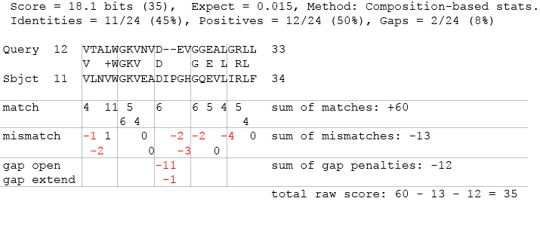
Example of pairwise alignment raw score: human beta globin and myoglobin
Total score for
mismatches
Total gap
penalty
Raw score
Total score for identities

Slide 3

Hypothesis testing: a quick introduction
We want to know something about this population. For example, are male and female squirrels the same length, on average, or do they differ?
We can’t study everyone, so we take a sample. We then determine whether males and females in our sample have different sizes, on average.
But there is a problem: our sample differs from the population because of sampling error!
Sample

Slide 4
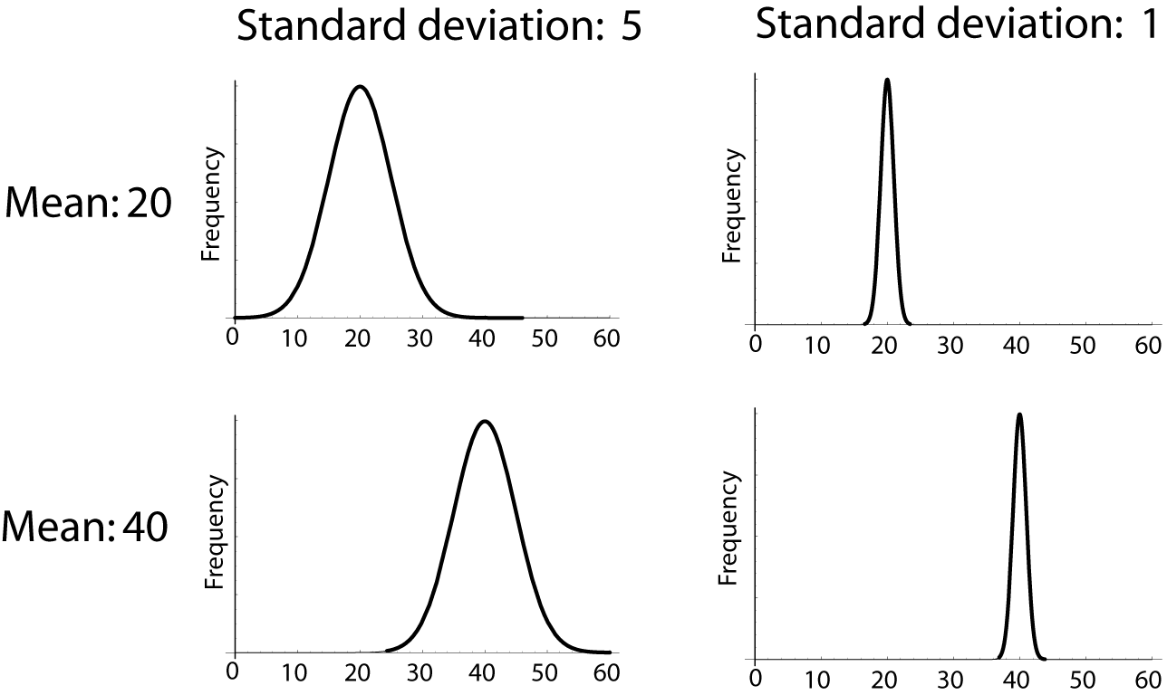
Hypothetical
Population
(H₀ true)
We imagine a population in which the null hypothesis is true (in this case, male and female squirrels are in average the same length).
We then imagine taking an infinite number of samples from this population. We calculate an estimate from each of these samples, and generate a sampling distribution of that estimate (the null distribution).
sample
sample
sample
sample
sample
Probability
sample
sample
sample
-10 -5 0 5 10
Difference in mean length between
males and females
Notes:
To decide weather the data is compatible with the null HP, we must calculate the probability of a mismatch as extreme as that observed, assuming Ho is true

Slide 5
Real population
sample
If the actual estimate from the real sample would be highly unusual under the null hypothesis, then we can conclude that the null hypothesis probably isn’t true.
Hypothetical
Population
(H₀ true)
Probability
sample
sample
sample
sample
sample
-10 -5 0 5 10
sample
sample
sample
Difference in mean length between
males and females

Slide 6
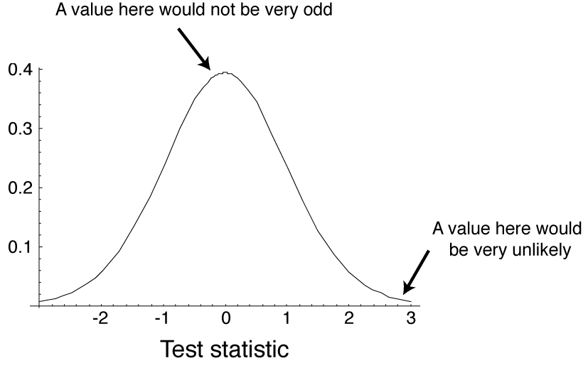
The test static is a quantity calculated from the data that is used to evaluate how compatible the data are with the result expected under the H₀
The null distribution is the sampling distribution of outcomes for a test static under the assumption that the H₀ is true.
The trick part is to figure
out what the null distribution
is for the test static.
Probability
Notes:
Define tests statistic briefly here; example: difference between men and women height
A test statistic summarizes the match between the data and the null hypothesis
A computer can do this!

Slide 7
Statistical significance
The significance level, α, is a probability used as a criterion for rejecting the null hypothesis.
If the P-value for a test is less than or equal to a, then the null hypothesis is rejected.
α is often 0.05 in biology

Slide 8
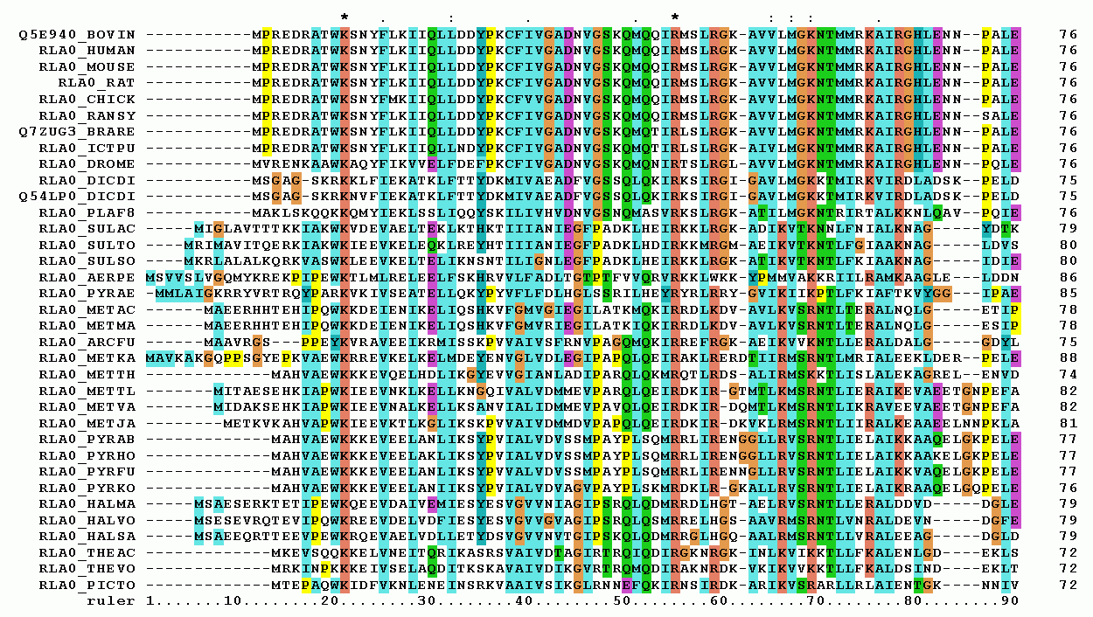
Multiple Sequence Alignment (MSA) is often used to assess sequence conservation of protein domains, tertiary and secondary structures, and even individual amino acids or nucleotides
First 90 positions of a protein multiple sequence alignment of instances of the acidic ribosomal protein P0 (L10E) from several organisms.
Notes:
A multiple sequence alignment (MSA) is a sequence alignment of three or more biological sequences, generally protein, DNA, or RNA. In many cases, the input set of query sequences are assumed to have an evolutionary relationship by which they share a lineage and are descended from a common ancestor. From the resulting MSA, sequence homology can be inferred and phylogenetic analysis can be conducted to assess the sequences' shared evolutionary origins. Visual depictions of the alignment as in the image at right illustrate mutation events such as point mutations (single amino acid or nucleotide changes) that appear as differing characters in a single alignment column, and insertion or deletion mutations (indels or gaps) that appear as hyphens in one or more of the sequences in the alignment. Multiple sequence alignment is often used to assess sequence conservation of protein domains, tertiary and secondary structures, and even individual amino acids or nucleotides.
First 90 positions of a protein multiple sequence alignment of instances of the acidic ribosomal protein P0 (L10E) from several organisms. Generated with ClustalX.

Slide 9
Pairwise Sequence Alignment is used to identify regions of similarity that may indicate functional, structural and/or evolutionary relationships between two biological sequences (protein or nucleic acid).
By contrast, Multiple Sequence Alignment (MSA) is the alignment of three or more biological sequences (of similar length). From the output of MSA one can assess sequence conservation of protein domains, tertiary, and secondary structures.
MSA would also allow to identify important protein residues in its function.
Notes:
From the output of MSA applications, homology can be inferred and the evolutionary relationship between the sequences studied.

Slide 10
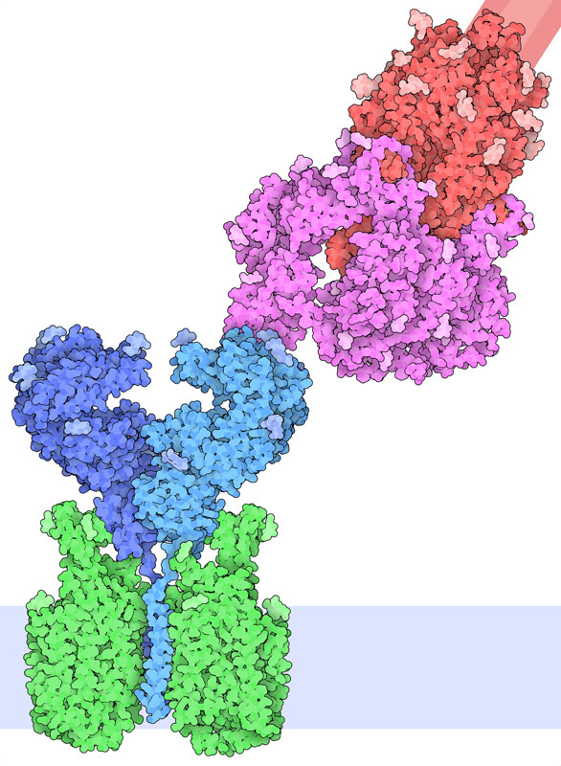
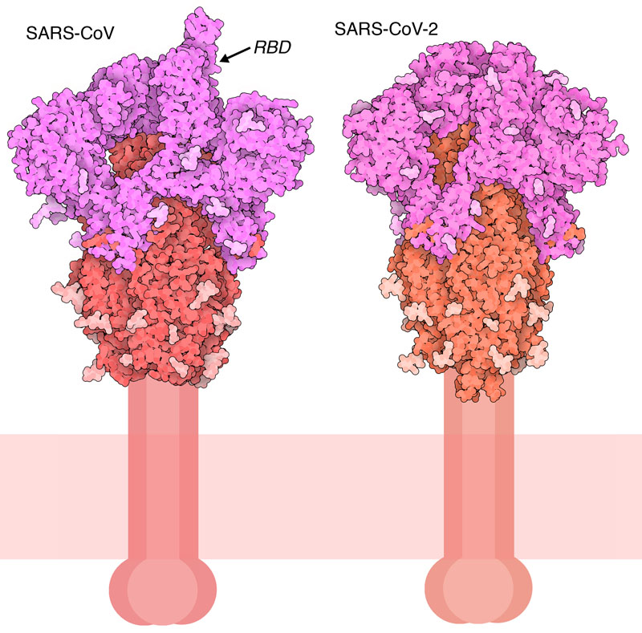
Covid-19 Spike protein
http://pdb101.rcsb.org/motm/246

Slide 11
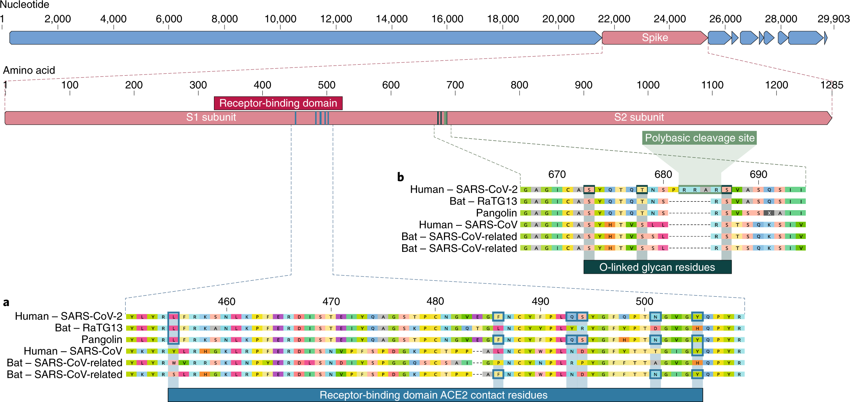
Does COVID-19 coronavirus epidemic have a natural origin?
https://www.nature.com/articles/s41591-020-0820-9
https://www.sciencedaily.com/releases/2020/03/200317175442.htm
“If someone were seeking to engineer a new coronavirus as a pathogen, they would have constructed it from the backbone of a virus known to cause illness. But the scientists found that the SARS-CoV-2 backbone differed substantially from those of already known coronaviruses and mostly resembled related viruses found in bats and pangolins.”
Notes:
More specifically, they focused on two important features of the spike protein: the receptor-binding domain (RBD), a kind of grappling hook that grips onto host cells, and the cleavage site, a molecular can opener that allows the virus to crack open and enter host cells.
This evidence for natural evolution was supported by data on SARS-CoV-2's backbone -- its overall molecular structure. If someone were seeking to engineer a new coronavirus as a pathogen, they would have constructed it from the backbone of a virus known to cause illness. But the scientists found that the SARS-CoV-2 backbone differed substantially from those of already known coronaviruses and mostly resembled related viruses found in bats and pangolins.
"These two features of the virus, the mutations in the RBD portion of the spike protein and its distinct backbone, rules out laboratory manipulation as a potential origin for SARS-CoV-2"

Slide 12
Center star algorithm
4 sequences to align are:
“MALG” “MALK” “MALLG” “MAL”
Expected Output:
Overall: Find global alignment by compiling best pair alignments
1. Find all unique pairings and score each paired alignment
2. Find which sequence has the lowest distance (or largest alignment) score across pairings equals “center” sequence
3. Combine all of the center sequences paired alignments into one global alignment
M | A | L | - | G
M | A | L | - | K
M | A | L | - | -
M | A | L | L | G

Slide 13
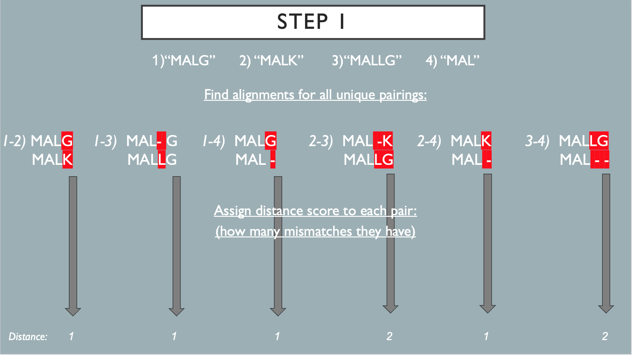

Slide 14
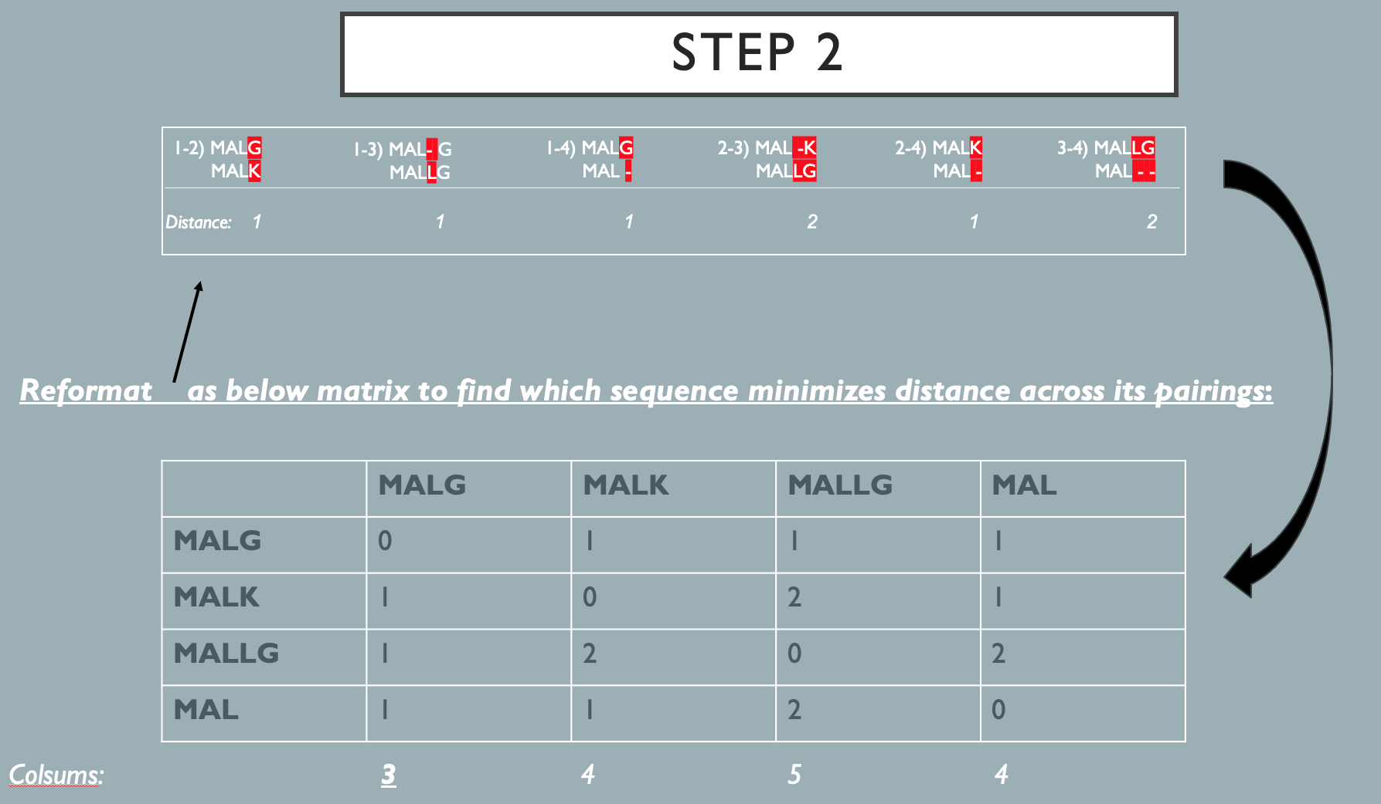

Slide 15
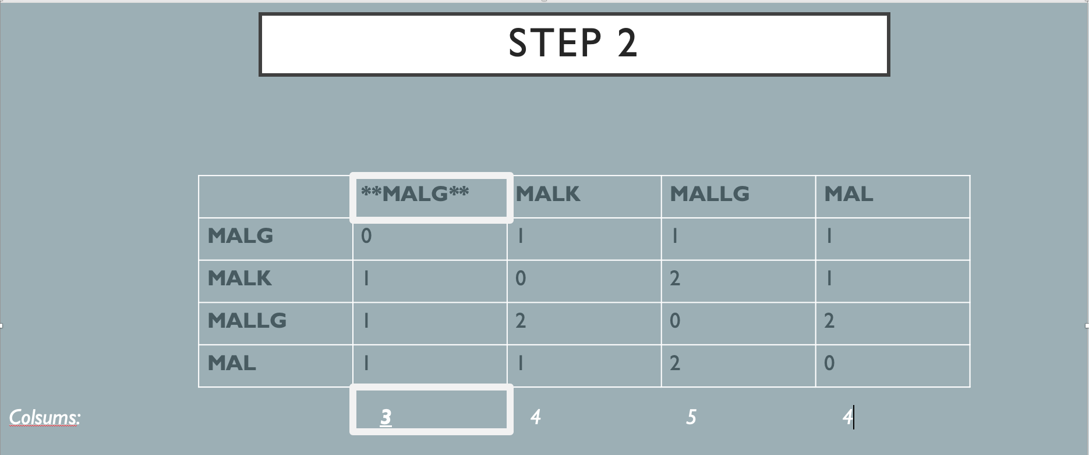

Slide 16
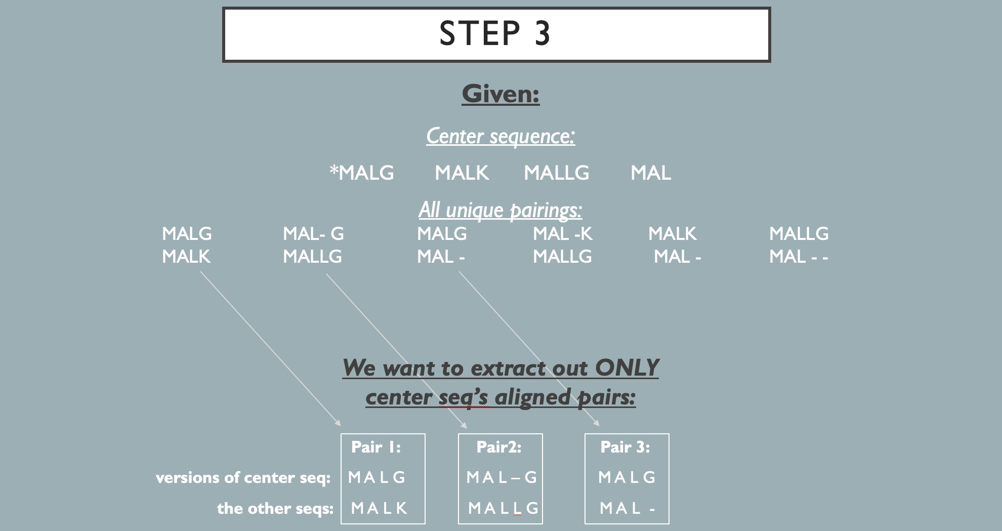

Slide 17
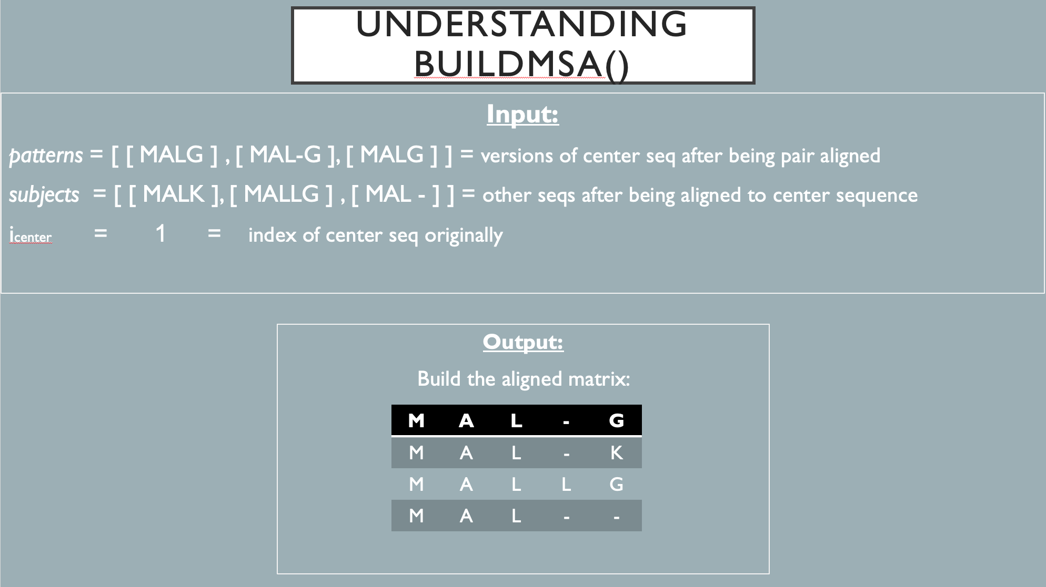

Slide 18
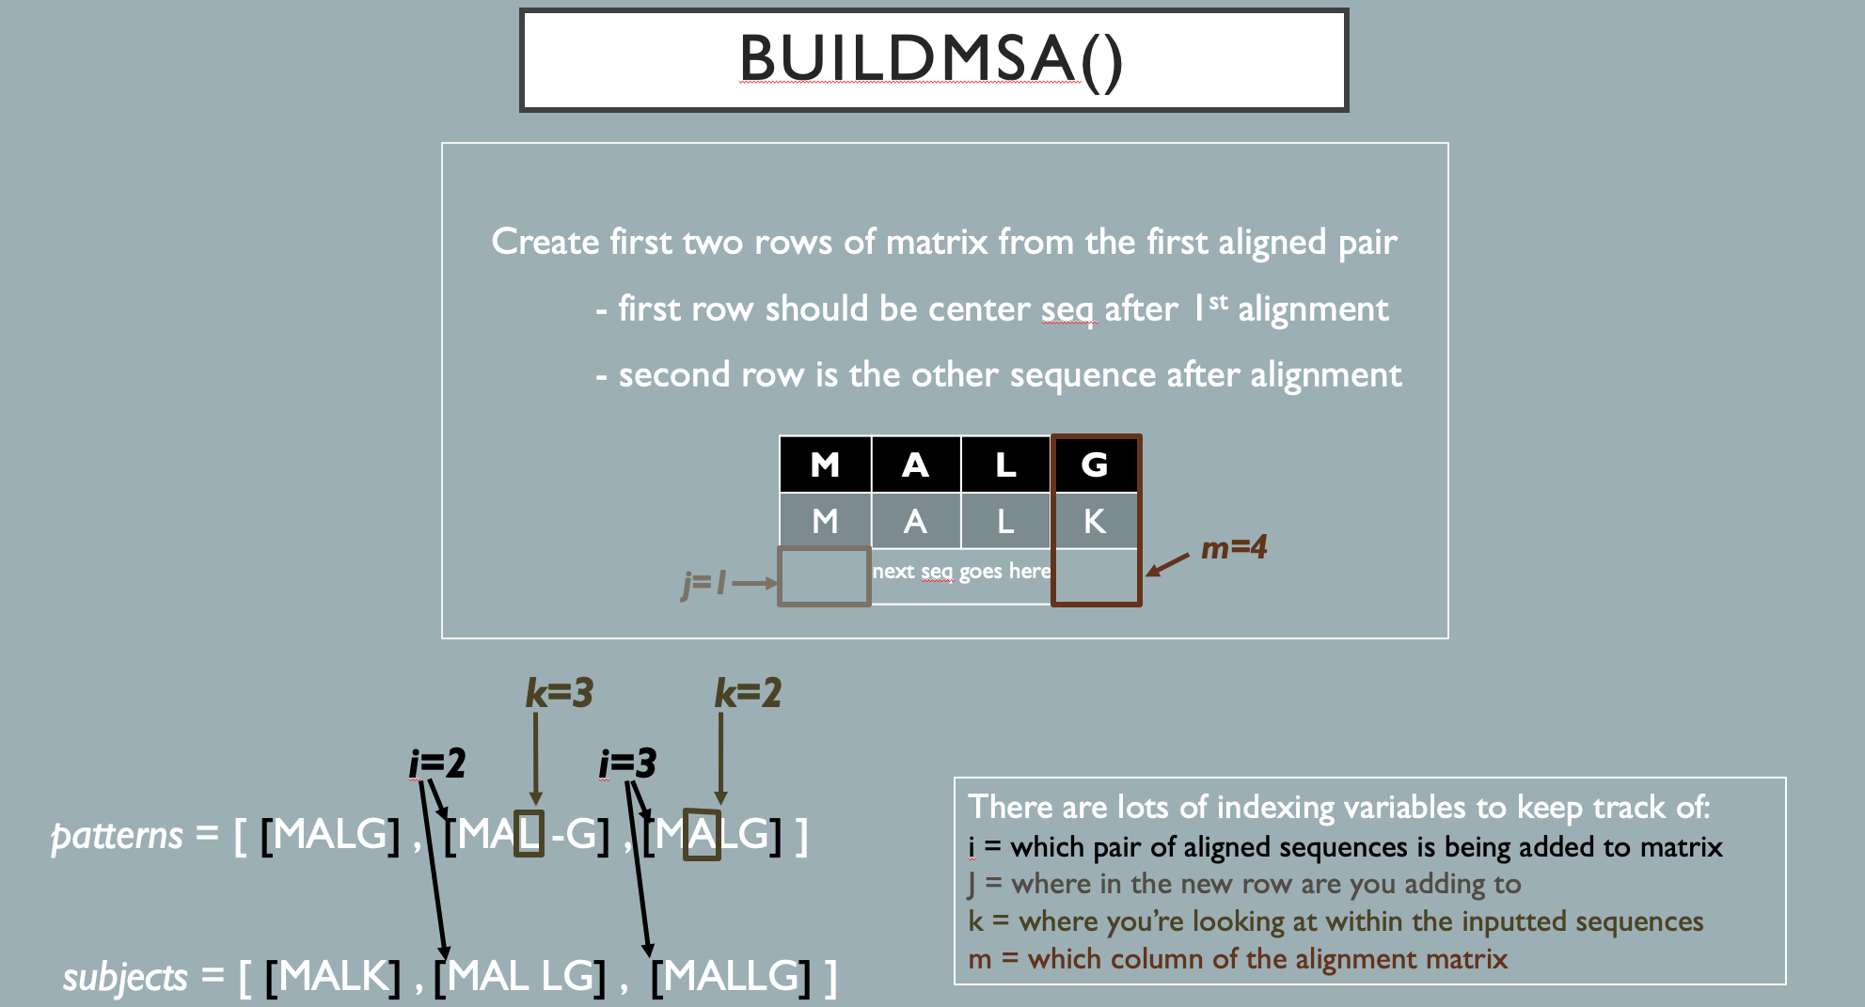

Slide 19
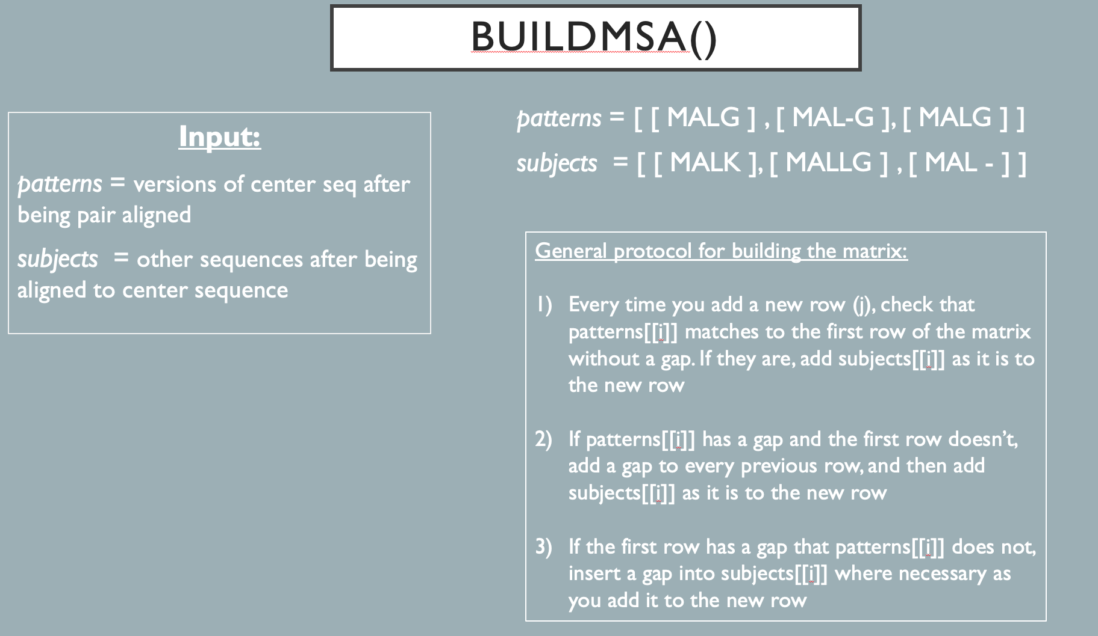

Slide 20
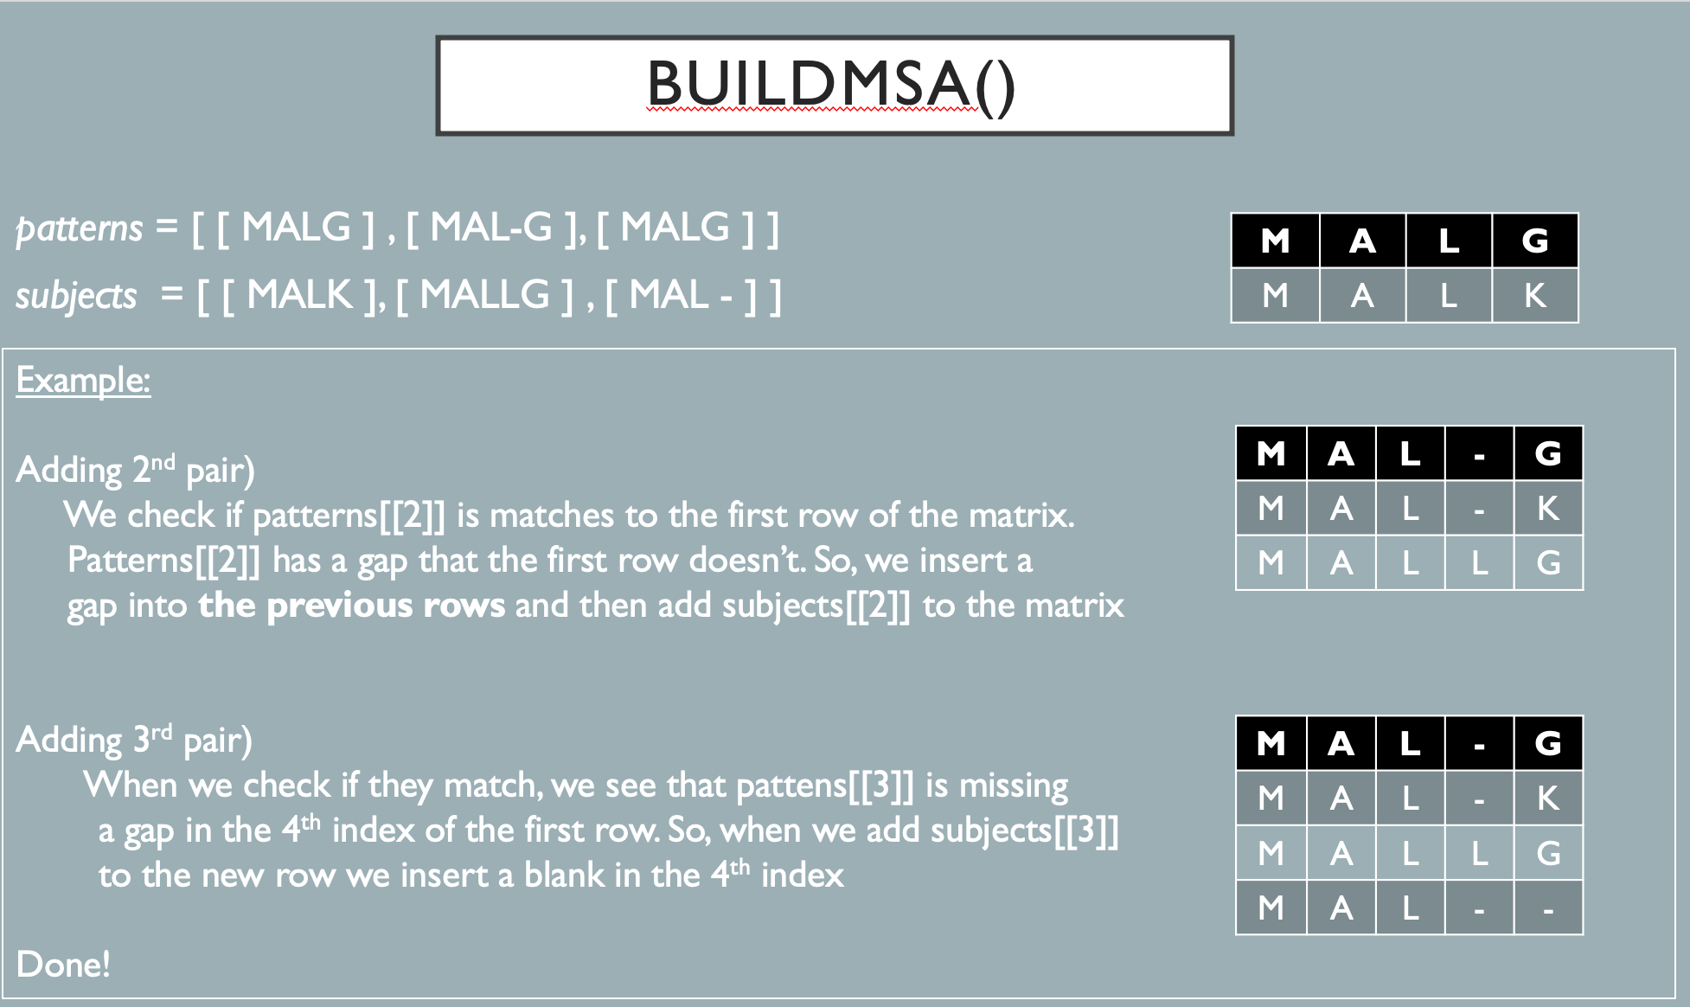

Slide 22

4
How do we tell how good our alignment is?
Suppose we align ATG with ATG. Matches are +2 and mismatches are -1.
Now we permute ATG to all combinations:
ATG, AGT, TAG, TGA, GAT, GTA
ATG, ATG, ATG, ATG, ATG, ATG
6 2 2 0 0 0
What is the probability of our alignment quality?

Slide 23
5
How does the Center Star Algorithm work?
We first align each sequence with every other sequence and record the alignment qualities
The sequence with the highest average quality will be our center that we align everything else against
We align all the other sequences against our center sequence. Each alignment will give a different version of the center sequence (patterns) and a different version of the other sequences (subjects). Put these inputs into buildMSA() and it will output the multiple sequence alignment.

