Slide 1
Addressing Mobile Users with SVG, Canvas and JS
Abram Hindle
abram.hindle@softwareprocess.es
Department of Computing Science
University of Alberta
Presented to ExchangeJS
The Edmonton Javascript Users Group
http://www.exchangejs.com/
(C) 2013 Abram Hindle licensed under CC-BY-SA 3.0

Slide 2
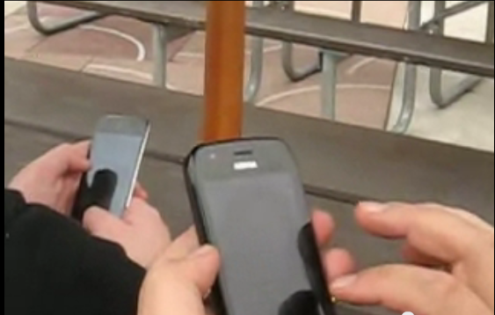
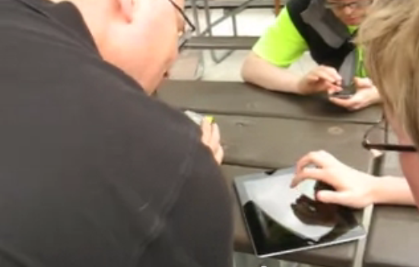
The Bane of Mobile
Multiple Kinds of Browsers
Multiple sets of supported features (SVG, Canvas, XML Http Request, Long Polling, Web Sockets etc.)
Slightly different look and feel
Multiple kinds of input
  Touch Input is handled differently than mouse input
Multiple Screen Sizes

Slide 3
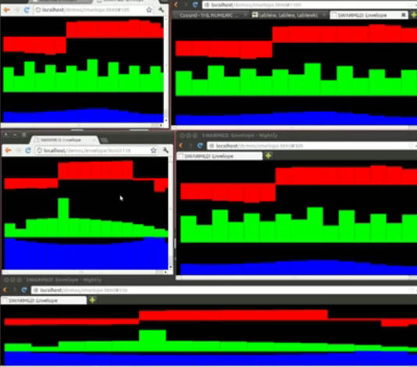
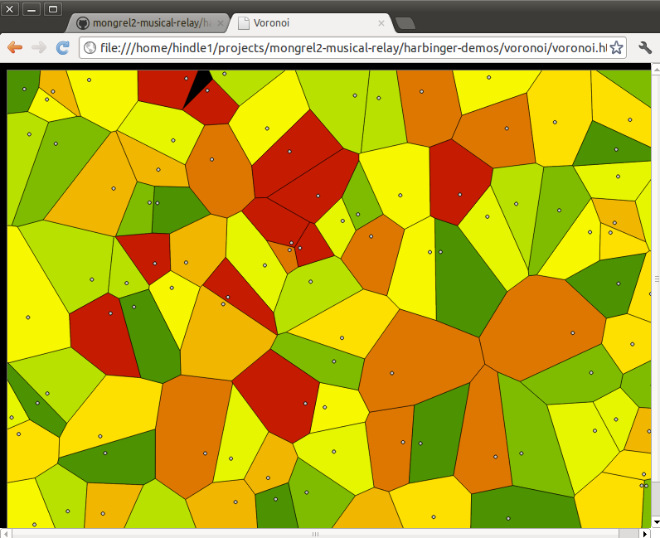
Focus of the Talk
The focus of this talk is interactive, graphics heavy UIs.
UIs of games
UIs of datavisualizers
UIs of musical instruments
Much of what is covered here will apply to plain-jane UIs as well (especially if you have drag operations).

Slide 4
Coverage
Using JS & HTML5
  Full Screening an App
  Figuring out where people are clicking in Canvas
  Adding appropriate Touch Events to Canvas and SVG that allow for touch dragging
Not covered:
  Drawing on a canvas

Slide 5
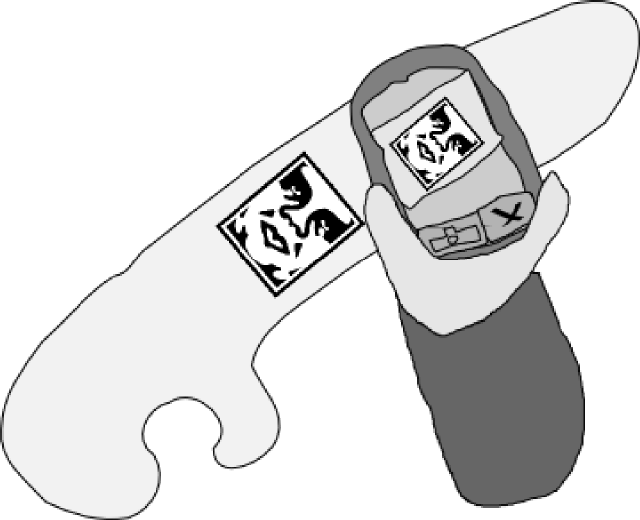
Mobile Stereotypes
IOS – can handle SVG and Canvas. Usually problem free except can act funny with captive networks
Android 1 and 2: No SVG, usually Canvas is supported. Touch often works.
Android 4: SVG, Touch, works pretty well.
BlackBerry: A little different but supports SVG and Canvas

Slide 6
Javascript on Mobile
Given the wide variety of browser and versions
  Choose a good framework you are comfortable with that ensures portability.
  JQuery Mobile seems to work ok.
Some JS frameworks do not handle touch events by default.

Slide 7
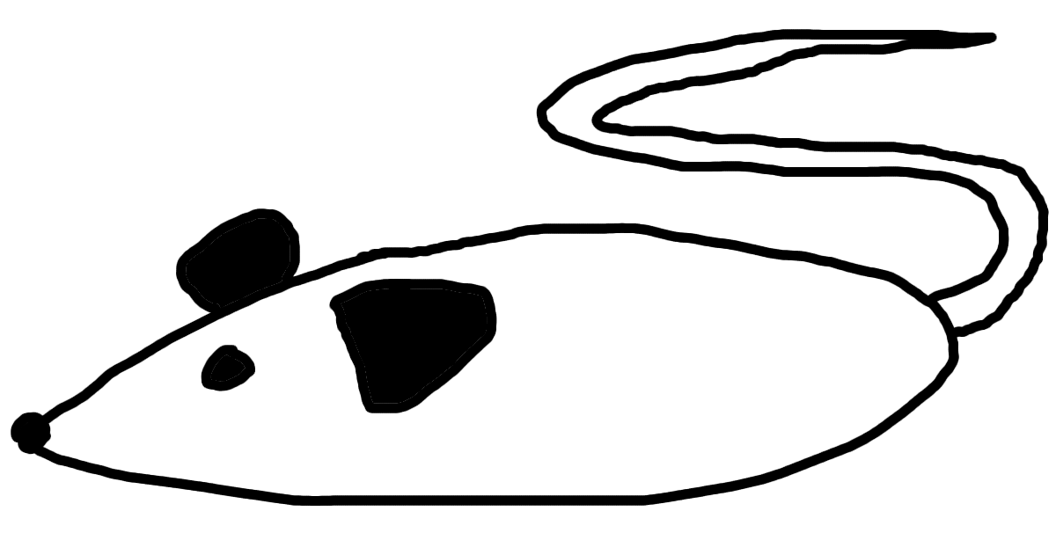
Remember the Mouse?
Your phone pretends to have mice.
Mouse Down
Mouse Up
Mouse Move
Mouse Click
All irritating handlers to deal with.
Also handlers about exiting and entering context (useful in dragging).
Unfortunately the canvas doesn't rreturn a great location for you.

Slide 8
Get The Position of the Mouse for Mobile
// This code allows you to get the x,y coords of a touch from the first touch
// Or just fall back on the supposed mouse position
// Note that touches are stored as a list so in the multi-touch context you can address this
function getPosition(e) {
if ( e.targetTouches && e.targetTouches.length > 0) {
var touch = e.targetTouches[0];
var x = touch.pageX - canvas.offsetLeft;
var y = touch.pageY - canvas.offsetTop;
return [x,y];
} else {
var rect = e.target.getBoundingClientRect();
var x = e.pageX - canvas.offsetLeft;
var y = e.pageY - canvas.offsetTop;
return [x,y];
}
}

Slide 9
Mouse Down Handler
mousedown: function(e) {
e.preventDefault(); // Browser no don't do it!
var pos = getPosition(e);
var x = pos[0];
var y = pos[1];
self.clicked = 1;
// This is a bad smell (x,y) should be
// a position object, please excuse this.
self.handleClicked(x,y);
},

Slide 10
MouseUp Handler
mouseup: function(e) {
e.preventDefault();
// we're not dragging no more
self.clicked = 0;
},

Slide 11
MouseMove Handler
mousemove: function(e) {
e.preventDefault();
var pos = getPosition(e);
var x = pos[0];
var y = pos[1];
// If we are dragging
if (self.clicked != 0) {
self.handleClicked(x,y);
}
},

Slide 12
Touch?
Touch Events have different event types and contain different information than a simple mouse move, mouse up, mouse down, mouse click event.
Touch Events and Mouse events are not compatible and do not really have compatible listeners.
Touch is awkward because there is no mouse motion.

Slide 13
Touch?
Touch Events have different event types and contain different information than a simple mouse move, mouse up, mouse down, mouse click event.
Touch Events and Mouse events are not compatible and do not really have compatible listeners.
Touch is awkward because there is no mouse motion.
There are often multiple touch positions

Slide 14
TouchStart and TouchEnd Handler
Because we used the getPosition function in our mouse handler, our handlers are now compatible, we just need to delegate to the right handler!
This handler deals with the start of a touch event. And the End of it
touchstart: function(e) {
return self.mousedown(e);
},
touchend: function(e) {
return self.mouseup(e);
},

Slide 15
touchMove
Touch Move handler deals with mouse motion but by abstracting location in getPosition we can just call our mousemove handler.
Note we can rely on touchstart to occur first
And we can rely on touchend to occur after
touchmove: function(e) {
return self.mousemove(e);
},

Slide 16
Install The Handlers
canvas.addEventListener("mousedown", self.mousedown, false);
canvas.addEventListener("mousemove", self.mousemove, false);
canvas.addEventListener("mouseup", self.mouseup, false);
canvas.addEventListener("touchstart", self.touchstart, false);
canvas.addEventListener("touchmove", self.touchmove, false);
canvas.addEventListener("touchend", self.touchend, false);
Note: these are added to the canvas.

Slide 17
Mobile Canvas Review
For canvas you need to subtract offsets to find pixel click location
For touch events your method for determining location are different than mouse events
You need to install handlers
Abstraction is your friend

Slide 18

Dragging Still Sucks
Often when you drag on a canvas it will pull the canvas out of context like you would drag an image.
We need to disable as much automatic dragging stuff in the browser as possible.

Slide 19
When I Drag It still drags funny
We want to disable default dragging behaviour by calling preventDefault on the event.
function preventDefault(e) {
e.preventDefault();
}
document.addEventListener("touchstart", preventDefault, false);
document.addEventListener("touchmove", preventDefault, false);
document.addEventListener("touchend", preventDefault, false);
document.addEventListener("click", preventDefault, false);
canvas.addEventListener("click", preventDefault, false);

Slide 20
When I drag it drags the Canvas!
For webkitish browsers add to the style of your canvas: -webkit-tap-highlight-color: transparent;
<canvas id="c" width="100%" height="100%" style="-webkit-tap-highlight-color: transparent;"></canvas>

Slide 21
Full Screen Browser UI
Add meta information about the size of the page.
  And in your JS, assuming a canvas, grab the canvas and resize it to the window size minus some fudge factor for scrollbars and decorations.
<meta content='width=device-width; height=device-height; initial-scale=1.0; maximum-scale=1.0; user-scalable=0;' name='viewport' />
<meta name="viewport" content="width=device-width" />
...
var canvas = document.getElementById("c");
var W = canvas.width = window.innerWidth-fudgeX;
var H = canvas.height = window.innerHeight-fudgeY;

Slide 22
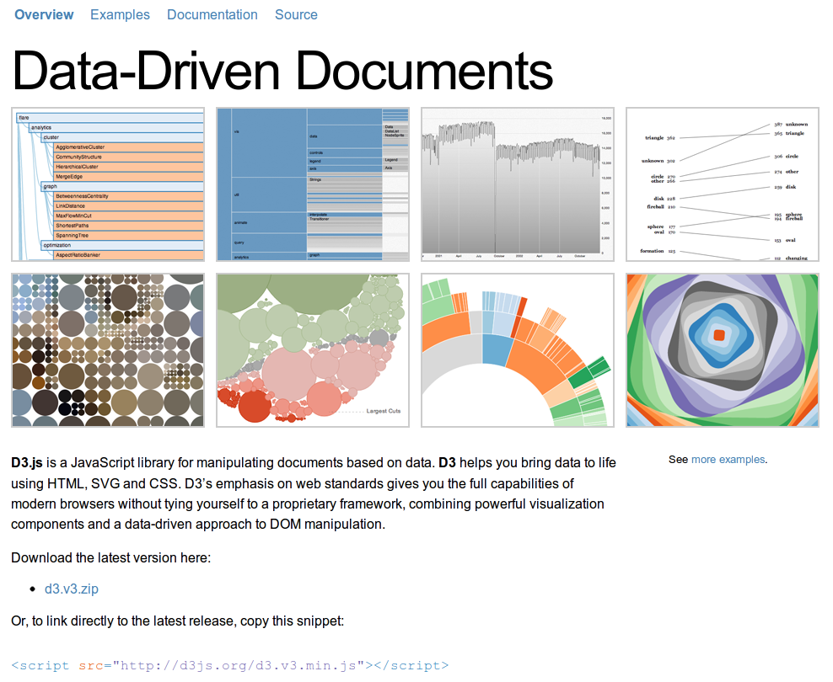

Slide 23
D3.js
Excellent Framework for Data Vizualization in SVG
Beautiful and fluid animation
Unfortunately SVG isn't too mobile-friendly compatible as Android 2 usually cannot support it.
D3.js is great if it already supports the visualization you want. It is somewhat painful otherwise.
D3.js provides touch support but it doesn't make it mouse compatible.
SVG tends to work on BB, iOS, Android 4, and Firefox browsers.

Slide 24
D3 on Mobile Needs Touch Support
// D3 is full of hairy long chains like these:
var svg = d3.select("#chart")
.append("svg")
.attr("width", width)
.attr("height", height)
.attr("class", "PiYG")
.on("mousedown", update)
.on("mousemove", update);

Slide 25
D3 on Mobile Needs Touch Support
// D3 is full of hairy long chains like these, but
// You need to explicitly insert mouse and touch handlers
var svg = d3.select("#chart")
.append("svg")
.attr("width", width)
.attr("height", height)
.attr("class", "PiYG")
.on("touchmove", touchUpdate)
.on("touchstart", touchUpdate)
.on("mousedown", update)
.on("mousemove", update);

Slide 26
More D3 Handlers
function disableDragging() {
if(d3.event.preventDefault)
d3.event.preventDefault(); // note it has its own method of dealing with this
}
function update() {
disableDragging();
vertices[0] = d3.mouse(this); //mouse
dealWithVertices();
};
function touchUpdate() {
disableDragging();
var touches = d3.touches(this); // touches
if (touches.length > 0) { // more than 0 touches
vertices[0] = touches[0];
dealWithVertices();
}
};

Slide 27
Conclusions
Touch events are not mouse events
Both canvas and svg need touch specific handlers or else touch screens become really awkward
Abstracting touch events to mouse events often simplifies your problem but you still need to handle the touch events.

Slide 28
Resources
Source code to the swarmed instrument
  https://github.com/abramhindle/mongrel2-musical-relay
  http://ur1.ca/chkz5
  Web Resources of the instrument: http://ur1.ca/chkzh
  http://skruntskrunt.ca/blog/2012/06/23/swarmed/
  http://softwareprocess.es/blog/swarmed/
D3.js http://d3js.org/
Examples from JS1k
  http://js1k.com/2010-first/

