Slide 1


Brief Intro to Statistics for use in Emprical Software Engineering
By Abram Hindle <abram.hindle@ualberta.ca>
Some content ripped from Wikipedia under public domain copyright and CC-BY-SA
This work is licensed under CC-BY-SA as it is derived from some Wikipedia sources.
Version 1.0/20120126

Slide 2
Brief Intro to Statistics
Statistics allow us to measure and reason about data
Statistics are well established and empirically validated, hence why we use them over other made up measures.
Many statistical techniques were made before the widespread use of computers, thus they tend to be overconfident with large data-sets.
Of course there are some new techniques that work well with modern computers and datasets

Slide 3
Distributions
How are values distributed over a space
Frequency distribution
  How often a value appears
Probability distribution
  The probability of a value occuring
    Discrete [1,2,3,4,..]
    Continuous [0.0, 1.0)
    http://en.wikipedia.org/wiki/Probability_distribution

Slide 4
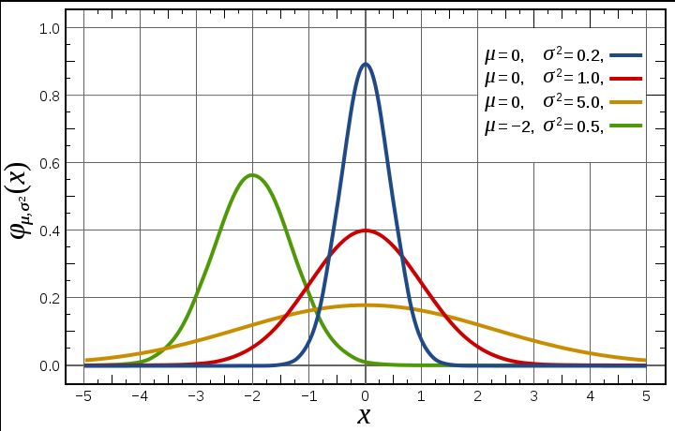
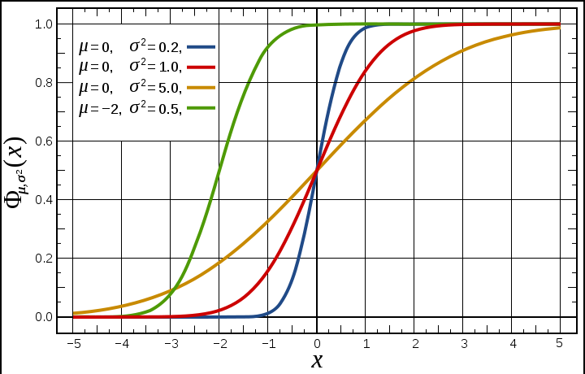
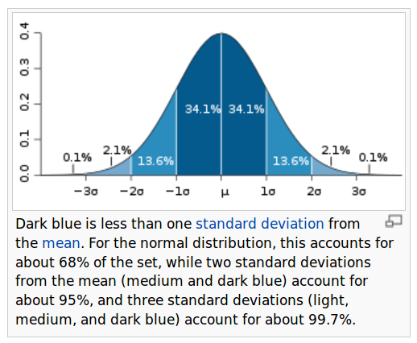

Normal Distribution
http://en.wikipedia.org/wiki/Normal_distribution
CC-BY-SA Wikipedia

Slide 5
Normal Distribution
Normal or Gaussian Distribution
  Natural distribution of errors
  Well studied
  Follow central limit theorm
    Means of a random variable tend to produce normal distributions
    E.g. We measure the average number of commits per day in a month, the mean of those monthly measurements likely converges to a normal distribution
  Has nice parameters like mean and standard deviation

Slide 6
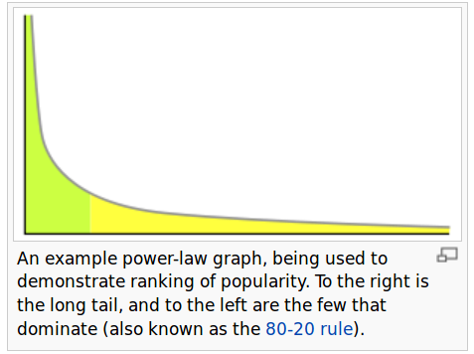

Power Law
Common kind of relationship
  In Software Engineering Data
Powerlaws are fractals!
http://softwareprocess.es/static/MultiFractal.html
Scale Free
  They look the same at different scales.
http://en.wikipedia.org/wiki/Power_law

Slide 7
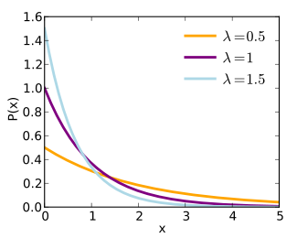
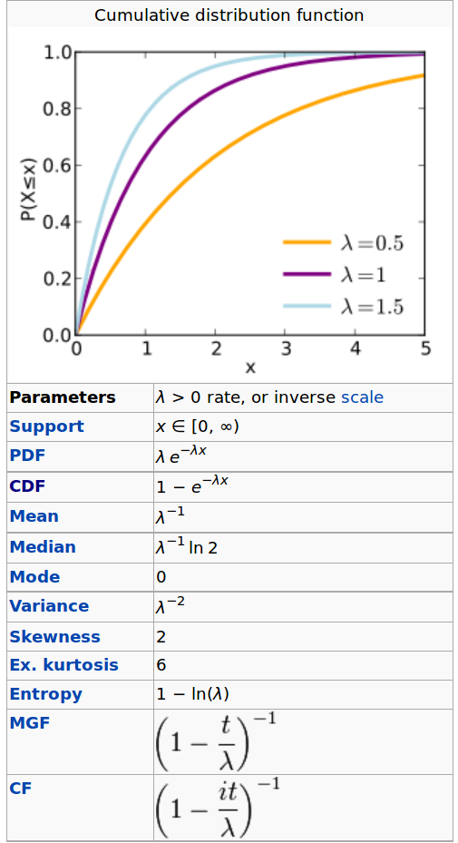
Exponential Distribution
http://en.wikipedia.org/wiki/Exponential_distribution
Common in Software engineering data
Has a long tail.
Easy to estimate and calculate
Not fun to work with
Bad for machine learners :(

Slide 8
Summary Statistics
Statistics used to describe data
  Descriptive Statistics
Location: mean, median, mode
Spread: standard deviation, variance, quartiles
  Gini coeffecient, exponents for skews (powerlaw)
Shape: skew, kurtosis
Percentiles: quartiles
Dependence: correlation

Slide 9

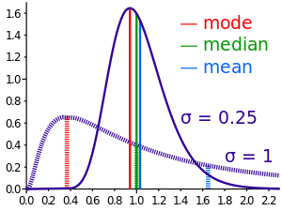
Summary Statistics
Average/Mean
  What's the value of a random element
  Works well on normal distributions
    Doesn't work well to summarize skewed distribution
  http://en.wikipedia.org/wiki/Average
Median
  The middle element
    Half the population is greater than or equal to the median
    Half the population is less than or equal to the median
  http://en.wikipedia.org/wiki/Median

Slide 10


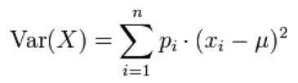

Summary Statistics
Standard Deviation and Variance
  Spread
  Continuous
  Discrete
  Describes normal distribution well
  Very wacky for exponential distributions (usually large too)

Slide 11
Quartiles and Boxplots
Quartiles partition values into 4 equal groups
  [1,2,3][4,5,6][7,8,9][10,11,12] – quartiles of natural numbers between 1 and 12
  Often seen in boxplots (median + 2 quartiles)
Boxplots show median, Quartile 2 and Quartile 3 and sometimes the other 2 quartiles or and then last 2 quartiles of 98% of the data and then some outliers (2% of the data). They generally indicate max and min, which might be represented by outliers (circles)

