Slide 1
Design Patterns in Ruby:
State Pattern
Abram Hindle
abram.hindle@ualberta.ca
Department of Computing Science
University of Alberta
http://softwareprocess.es/

Slide 2
Design Patterns
Just because you have duck-typing doesn't mean you can ignore common OO idioms!
Design patterns communicate intent, so it is best if we have a similar understanding.
OO is hard :(

Slide 3
State
State is often the current snapshot of values in a system.
State machines are a modelling methodology that try to simplify complicate control flows and protocols
State is often encoded as attributes and variables.
State Machines are often implemented imperatively.

Slide 4
State Pattern
Intent: Change an object's behaviour dynamically (runtime).
Intent: Model a state-machine following OO rules.
Avoid cluttering a class with all the different behaviours, avoid subclassing for changing behaviour.
Use the type system to ensure state transition safety.

Slide 5
State Machines?
Off
On
A
B
(A|B)B*

Slide 6
State Pattern UML (Abstract)
Context
State
state
StateOne
StateOne
StateTwo

Slide 7
State Pattern UML (Concrete)
VideoRental
Price
state
getPrice(days)
return state.getPrice(days)
getPrice(days)
NewRelease
StateOne
OldMovie
Price: 4.99
BasePrice: 1.99
getPrice(days)
getPrice(days)

Slide 8
State Pattern UML (Concrete)
BullDozer
Gear
trackGearLeft
trackGearRight
moveTrack(dozer)
move()
Forward
StateOne
Reverse
moveTrack(dozer)
moveTrack(dozer)

Slide 9
State Pattern UML (Concrete)
StompPedal
PedalState
state
Filter( audio)
filter()
On
StateOne
Off
Filter( audio)
Filter( audio)
Does nothing to the
audio

Slide 10
State Method Example
Remember Street Fighter II special moves?

Slide 11
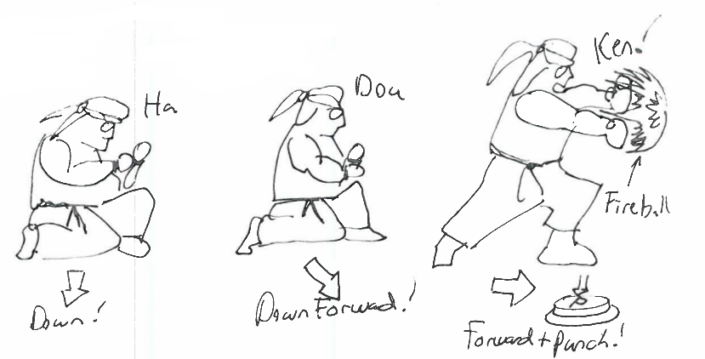
SFII: HaDouKen Fireball

Slide 12
Our Player: Ryu
class RyuPlayer
def initialize()
@moves = [WhirlwindKickMove.new(), FireballMove.new(), DragonUppercutMove.new()]
@todo = []
end
def execute( move )
@todo = [ move ]
end
def move( move, action )
@todo = []
@moves = @moves.map {|specialMove| specialMove.nextState( self, move, action ) }
executeMove()
end
def executeMove()
if (@todo.length > 0)
puts(@todo[0].say())
end
end
end
We run 3 seperate state machines for 3 special moves.
The state machines RETURN the next state, and thus we must replace the states when we execute a new move.

Slide 13
Without State Pattern

Slide 14
FireBall States
class FireballMove
def say()
return "HaDoKen!"
end
def nextState( context, move, action )
if (move.down()) then
return FireballHa.new()
end
return FireballMove.new()
end
end
class FireballDo
def nextState( context, move, action )
if (move.forward() && action.punch()) then
context.execute(FireballMove.new())
end
return FireballMove.new()
end
end
class FireballHa
def nextState( context, move, action )
if (move.downForward()) then
return FireballDo.new()
elsif (move.down()) then
return FireballHa.new()
end
return FireballMove.new()
end
end

Slide 15
Dragon Uppercut State Machine
class DragonUppercutMove
def say()
return "ShoRyuKen!"
end
def nextState( context, move, action )
if (move.forward()) then
return DragonUppercutSho.new()
end
return DragonUppercutMove.new()
end
end
class DragonUppercutSho
def nextState( context, move, action )
if (move.downBackward()) then
return DragonUppercutRyu.new()
end
return DragonUppercutMove.new()
end
end
class DragonUppercutRyu
def nextState( context, move, action )
if (move.forward() && action.punch()) then
context.execute(DragonUppercutMove.new())
end
return DragonUppercutMove.new()
end
end

Slide 16
Whirlwind Kick State Machine
class WhirlwindKickMove
def say()
return "TaTsunaki!"
end
def nextState( context, move, action )
if (move.up()) then
return WhirlwindKickTa.new()
end
return WhirlwindKickMove.new()
end
end
class WhirlwindKickTa
def nextState( context, move, action )
if (move.down()) then
return WhirlwindKickTsun.new()
end
return WhirlwindKickMove.new()
end
end
class WhirlwindKickAki
def nextState( context, move, action )
if (move.backward() && action.kick()) then
context.execute(WhirlwindKickMove.new())
end
return WhirlwindKickMove.new()
end
end
class WhirlwindKickTsun
def nextState( context, move, action )
if (move.downBackward()) then
return WhirlwindKickAki.new()
end
return WhirlwindKickMove.new()
end
end

Slide 17
Trying Some Moves Out!
player = RyuPlayer.new()
puts("# crouching")
player.move( Down.new(), Action.new() )
player.move( Down.new(), Action.new() )
player.move( Down.new(), Action.new() )
puts("# starting fireball")
player.move( Down.new(), Action.new() )
player.move( DownForward.new(), Action.new() )
player.move( Forward.new(), Punch.new() ) #fireball
puts("# converting to dragon uppercut")
player.move( DownBackward.new(), Action.new() )
player.move( Forward.new(), Punch.new() ) #DragonUppercut
puts("# charging whirlwind kick")
player.move( Up.new(), Action.new() )
player.move( Down.new(), Action.new() )
player.move( DownBackward.new(), Action.new() )
player.move( Backward.new(), Kick.new() ) #whirlwind

Slide 18
State Resources
C2 on State Pattern
Wikipedia on State Pattern

