Slide 1
COMBATMED-PRO-HEALTHCARE APP FOR MILITARY PERSONNEL
GUIDE: DR.M.S.VINMATHI,M.E.,Ph.D.,
SUPERVISOR
ASSOCIATE PROFESSOR
BY
BATCH – C2
RAMYA AB (2022PECCS259)
RADHIKA K(2022PECCS254)

Slide 2
ABSTRACT
CombatMed-Pro is a specialized mobile health application designed to provide real-time health monitoring, telemedicine, deployment-specific assessments, and trauma care protocols for military personnel. The application is tailored to enhance the physical well-being and operational readiness of soldiers in high-stress environments. By integrating advanced technologies such as IoT-based health monitoring devices, secure communication channels, and AI-driven analytics, the app ensures comprehensive health management during military operations.CombatMed-Pro aims to streamline health management and medical consultation processes in remote and challenging environments. Its robust system ensures that military personnel receive timely, accurate health information and remote medical support. Built with military-grade security standards, the app secures sensitive health data and provides actionable insights to medical professionals to improve decision-making and optimize medical intervention.

Slide 3
introduction
CombatMed Pro is a mobile health app for military personnel, offering real-time health monitoring of vital signs and secure telemedicine services. It enables soldiers to communicate with medical professionals and receive guidance during emergencies. With AI-driven analytics and trauma care protocols, the app enhances decision-making and medical response in challenging environments while ensuring data security. Additionally, it supports continuous tracking of health metrics to identify potential issues early. The app's military-grade security protects sensitive information, ensuring confidentiality. Overall, it aims to improve soldiers' well-being by providing essential health tools and remote support wherever they are deployed..

Slide 4
Existing system
Existing mobile health solutions for military personnel lack real-time integration of comprehensive health monitoring, telemedicine, and personalized assessments in a unified platform. Most focus on isolated features like fitness tracking or remote consultations but fail to address military-specific challenges such as trauma care, battlefield conditions, and deployment-specific assessments. Additionally, they often lack military-grade security, risking sensitive health data. While telemedicine systems exist, they generally don't offer the real-time monitoring or rapid response needed in combat or align with specialized military health protocols.

Slide 5
Proposed SYSTEM
The CombatMed-Pro system is designed to meet the specific healthcare needs of military personnel by integrating real-time health monitoring, telemedicine, and personalized health assessments into a single mobile application. This ensures soldiers receive immediate and accurate health information, regardless of their deployment location, which is crucial in remote and high-stress environments.
With continuous tracking of vital signs, CombatMed-Pro enables early detection of health issues and allows for instant consultations with healthcare professionals through its telemedicine feature. Additionally, the app uses AI-driven analytics for personalized assessments, enhancing decision-making for soldiers and medical personnel. Overall, CombatMed-Pro improves the speed and efficiency of medical interventions in the field, supporting the well-being and operational readiness of military personnel.

Slide 6
DEVELOPMENT ENVIRONMENT
SOFTWARE REQUIREMENT :
Programming Language : Java
Development Environment: Android Studio
Operating System
Database : Firebase
Accessibility Feature

Slide 7
HARDWARE REQUIREMENT :
Mobile Device
Internet Connectivity
Audio Output

Slide 8
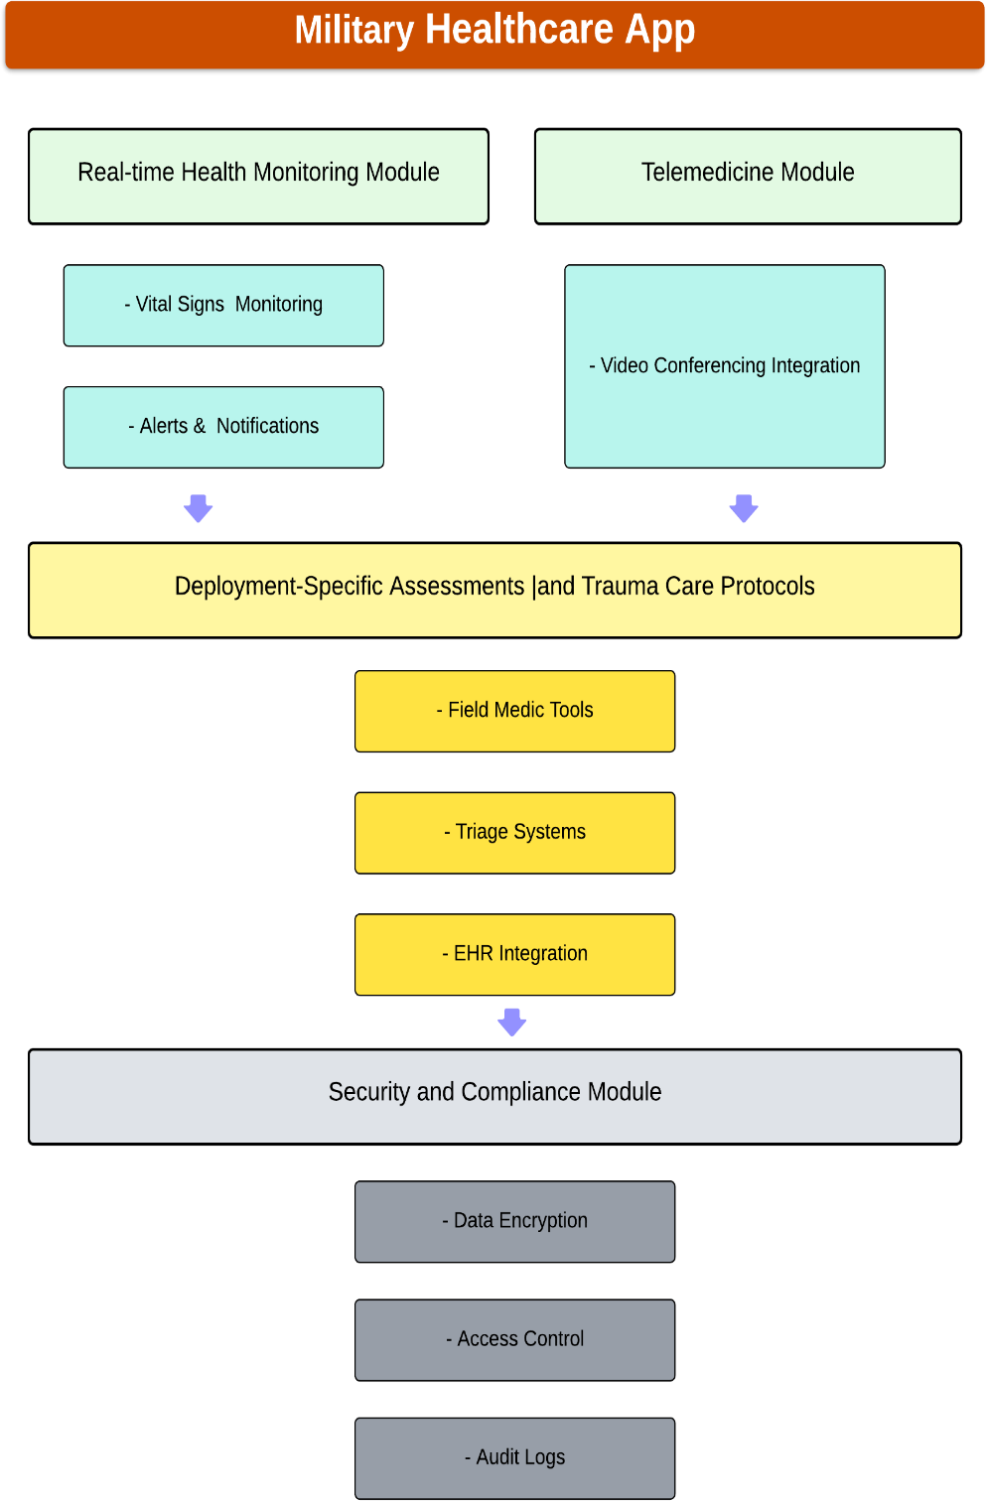
SYSTEM ARCHITECTURE DIAGRAM

Slide 9
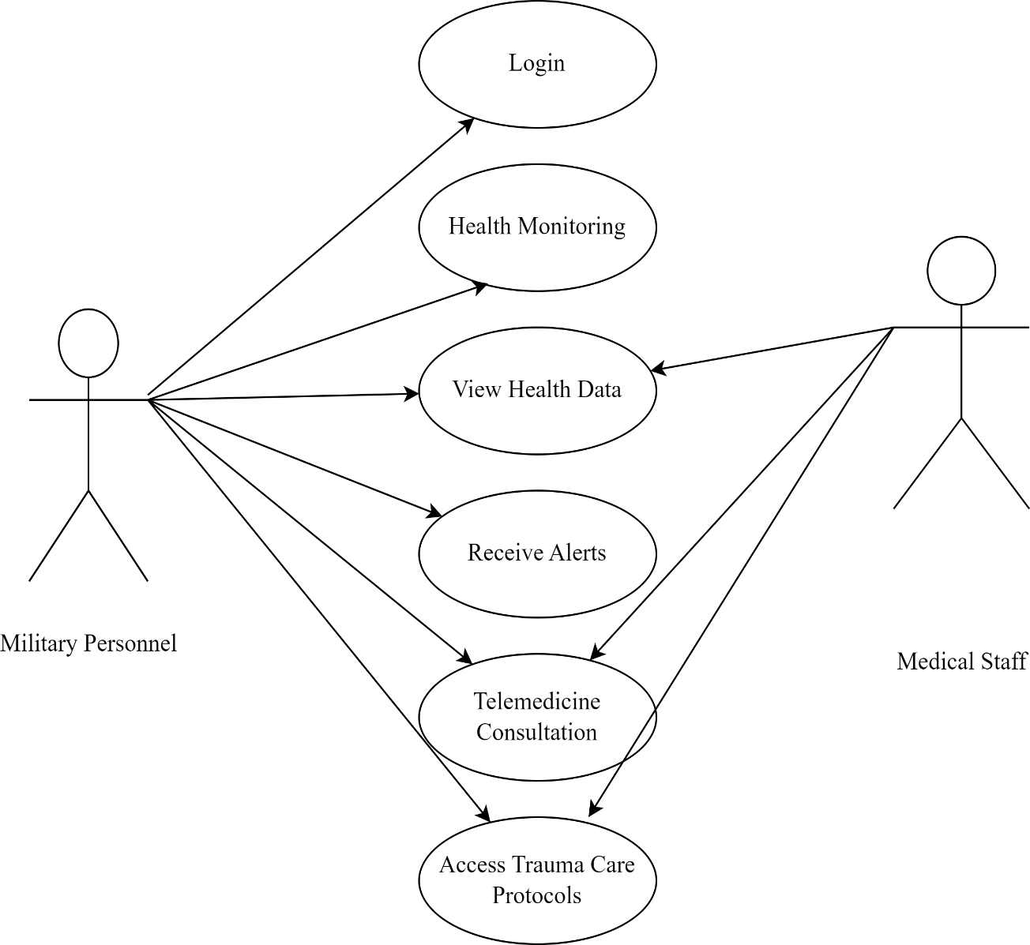
UML DIAGRAMs USE CASE DIAGRAM

Slide 10
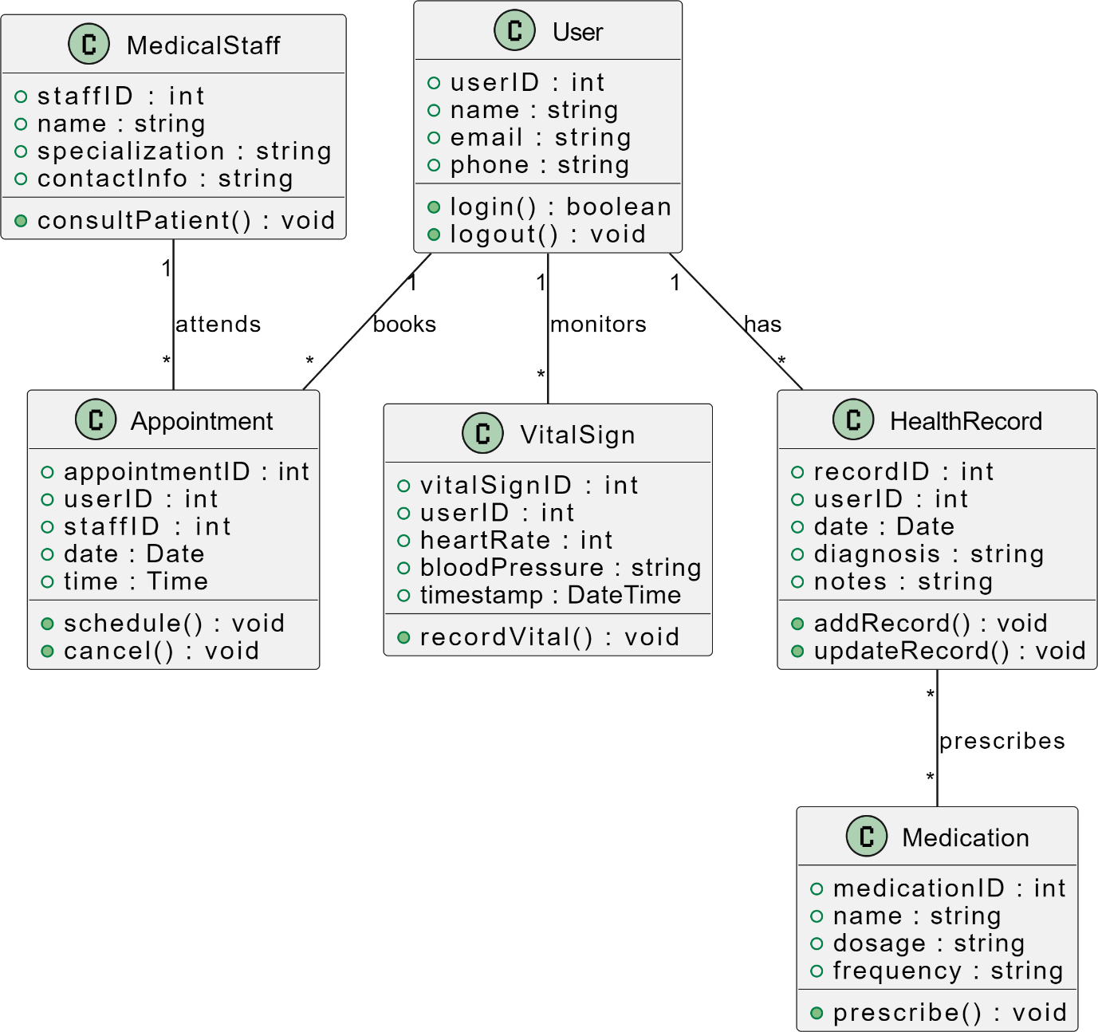
CLASS DIAGRAM

Slide 11
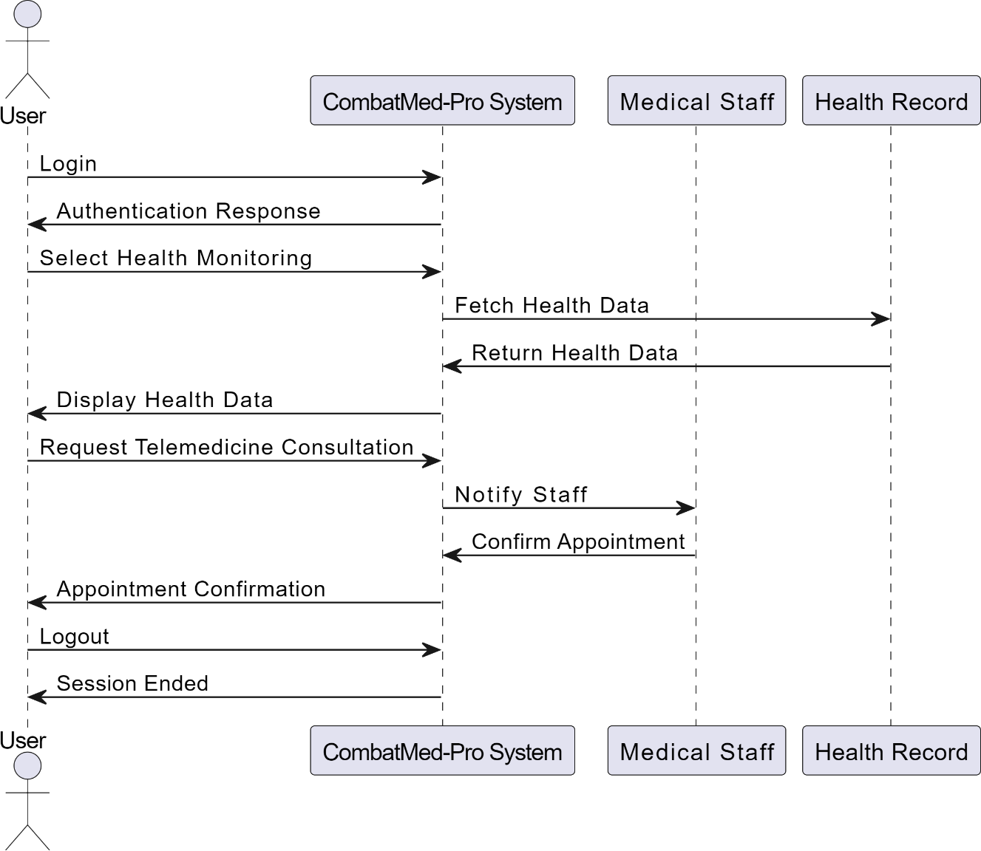
Sequence diagram

Slide 12
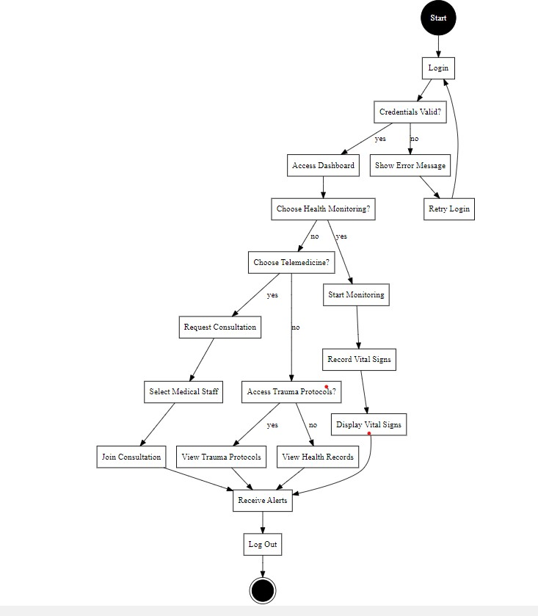
State chart diagram

Slide 13
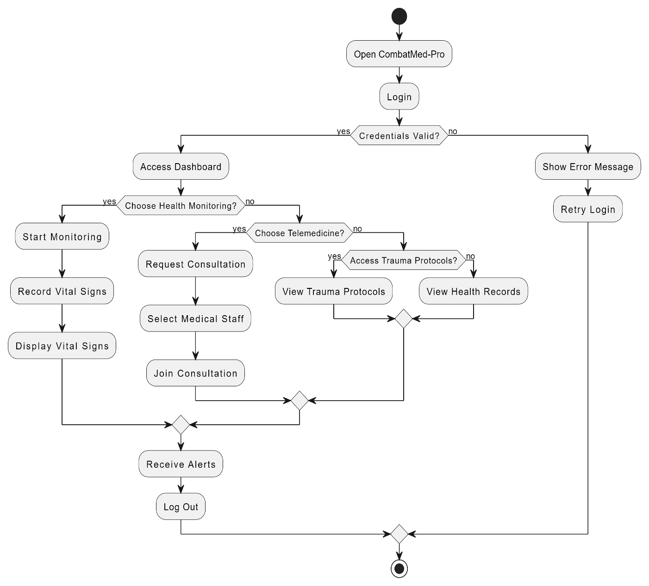
Activity diagram

Slide 14
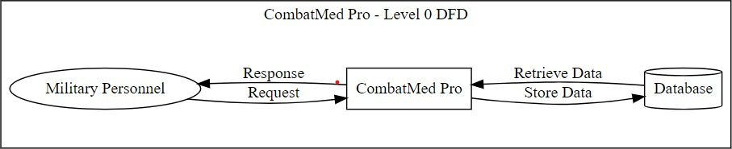
DATAFLOW DIAGRAMs
Data flow diagram level 0

Slide 15
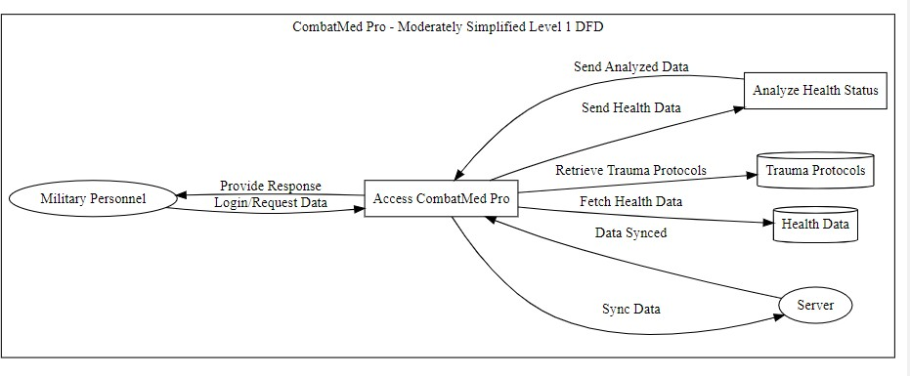
Dataflow diagram level 1

Slide 16
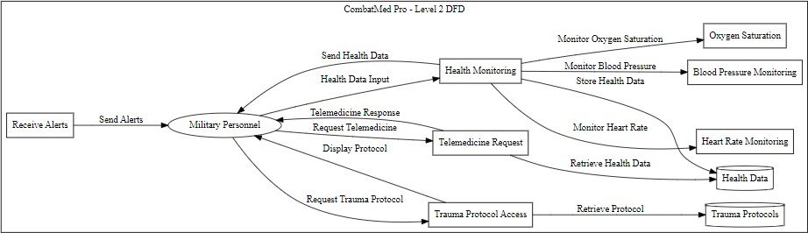
Dataflow diagram level 2

Slide 17
Module description
CombatMed-Pro consists of 4 main modules.
Login & Authentication Module
Health Monitoring Module
Telemedicine Module
Assessments Module

Slide 18
Login & Authentication Module:
The Login & Authentication Module ensures secure access for military personnel through a robust authentication system. It features a username and password input mechanism, integrated with Firebase Firestore for secure data storage and retrieval.
The module validates user credentials against stored records, enhancing security and protecting sensitive health information.

Slide 19
Health Monitoring Module:
The Health Monitoring Module is designed for real-time tracking and management of users' health metrics. This module displays critical health data such as heart rate and blood pressure tailored to each user.
It fetches information from external health devices, providing a comprehensive overview of the user's health status directly through the app, thereby facilitating prompt medical intervention when necessary.

Slide 20
Telemedicine Module:
The Telemedicine Module enables remote medical consultations, bridging the gap between military personnel and healthcare providers. Users can book virtual appointments, ensuring timely access to medical expertise.
This module supports effective communication between users and medical professionals, enhancing the quality of care received, especially in challenging field conditions

Slide 21
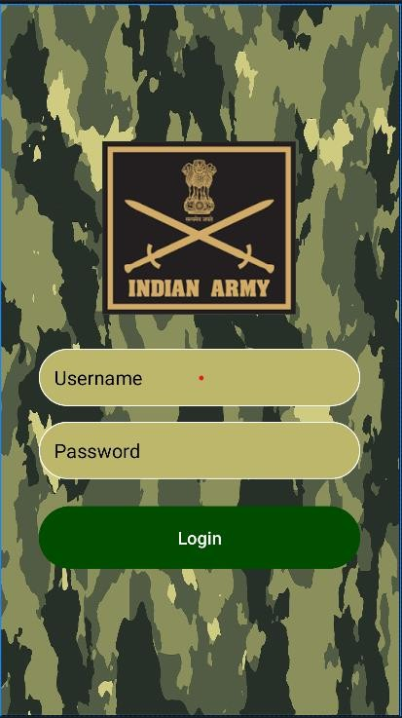
main page

Slide 22
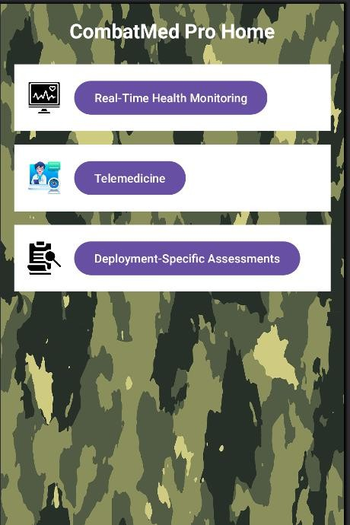
home page

Slide 23
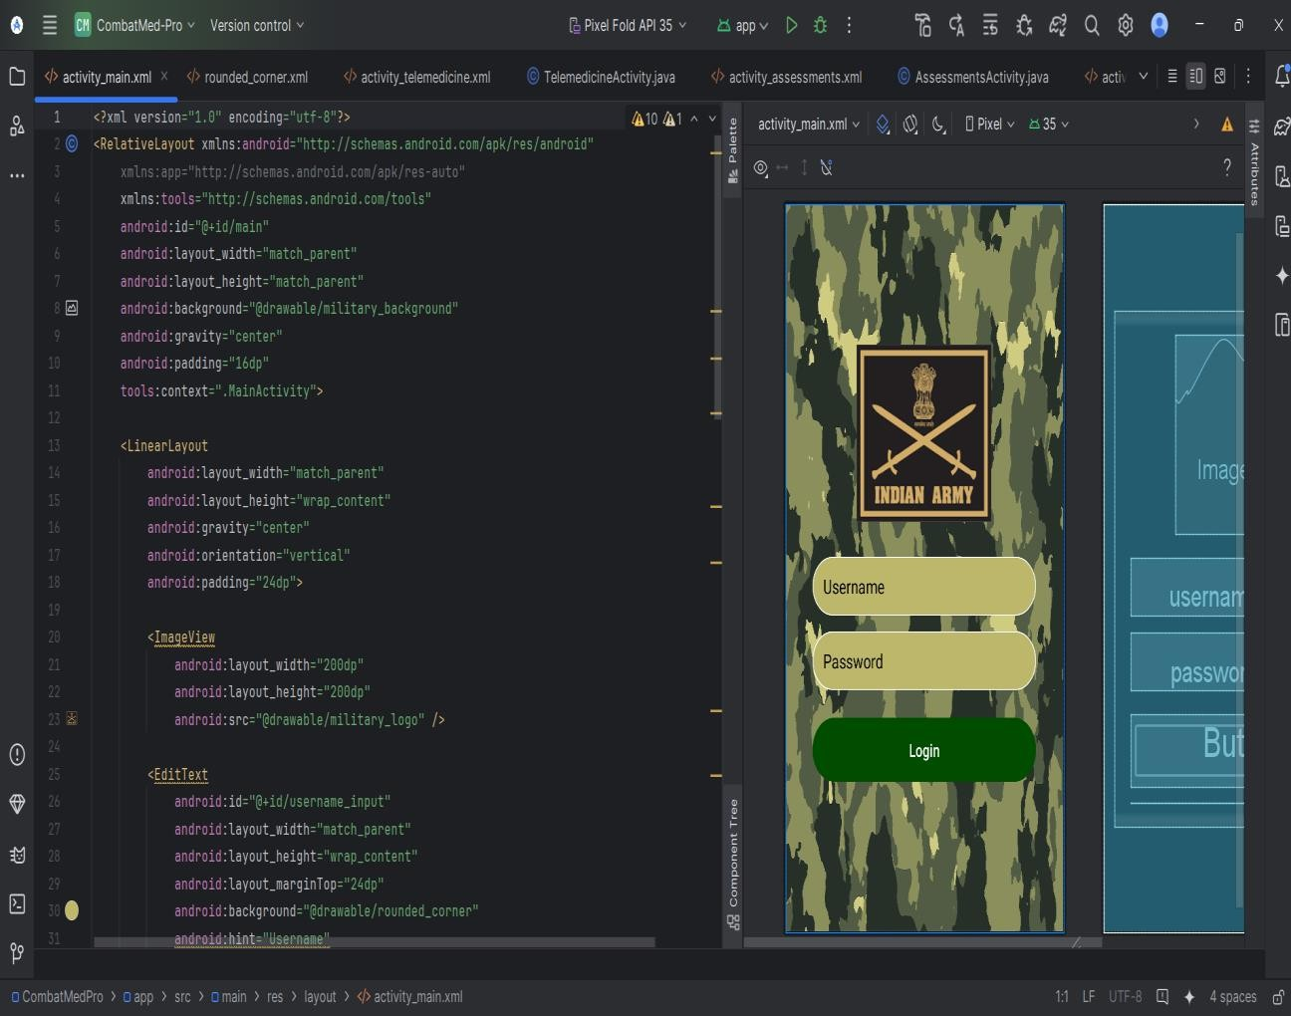
Sample outlook of project

Slide 24
CONCLUSION
CombatMed Pro represents a significant advancement in mobile health management for military personnel, combining essential features such as real-time health monitoring, telemedicine services, and deployment-specific assessments. The implementation of secure user authentication and integration with health monitoring devices enhances the reliability and effectiveness of the system, ensuring that users can access critical health data when needed. Through rigorous testing and user feedback, the application has demonstrated a high level of accuracy in health data retrieval and a user-friendly interface that facilitates easy navigation. While the project has successfully achieved its primary objectives, ongoing refinements, particularly in data visualization and user experience, will further enhance its functionality. Overall, CombatMed Pro is poised to make a valuable contribution to the well-being and operational effectiveness of military personnel .

Slide 25
Future work
Future scope could focus on several key areas: Integrating advanced artificial intelligence could enhance predictive health analytics, allowing better monitoring of military personnel's health trends. Additionally, expanding the telemedicine module to include video consultations and AI-driven chatbots would facilitate more effective communication between users and medical professionals. Implementing a user feedback mechanism would further support continuous app improvement by gathering insights from users. Lastly, enabling interoperability with other health systems would provide comprehensive data access, improving the overall utility and effectiveness of the application in real-world scenarios

Slide 26
references
[1]. Jensen, M. L., Yates, C., & Cantu, J. (2017). Telemedicine Solutions for Remote Military Healthcare. Military Medicine, 182(3), 18-23. doi:10.7205/MILMED-D-16-00405.
[2].Sharma, R. K., Singh, A., & Patel, M. (2018). Wearable Health Monitoring Systems for Combat Zones. Journal of Healthcare Engineering, 2018, Article ID 9825241. doi:10.1155/2018/9825241.
[3]. Solis, V. I., Chen, K., & Gupta, A. (2019). AI-Driven Analytics for Health Monitoring in Military Personnel. Journal of Medical Systems, 43(7),123. doi:10.1007/s10916-019-1404-8.
[4]. Lewis, D. W., Bell, R. M., & Jones, K. (2020). Field Trauma Care Protocols for Combat Medics. Journal of Trauma & Acute Care Surgery, 89(5), 1046-1052. doi:10.1097/TA.0000000000002948.
[5]. Friedman, C. P., et al. (2019). "The Role of Artificial Intelligence in Medical Decision-Making: A Review." Journal of Biomedical Informatics, 99, 103328. doi:10.1016/j.jbi.2019.103328.
[6]. Hollis, V., et al. (2021). "Telehealth in Military Healthcare: Current Applications and Future Directions." Journal of Health Care for the Poor and Underserved, 32(1), 8-21. doi:10.1353/hpu.2021.0002.

Slide 27
THANK YOU

