Slide 1
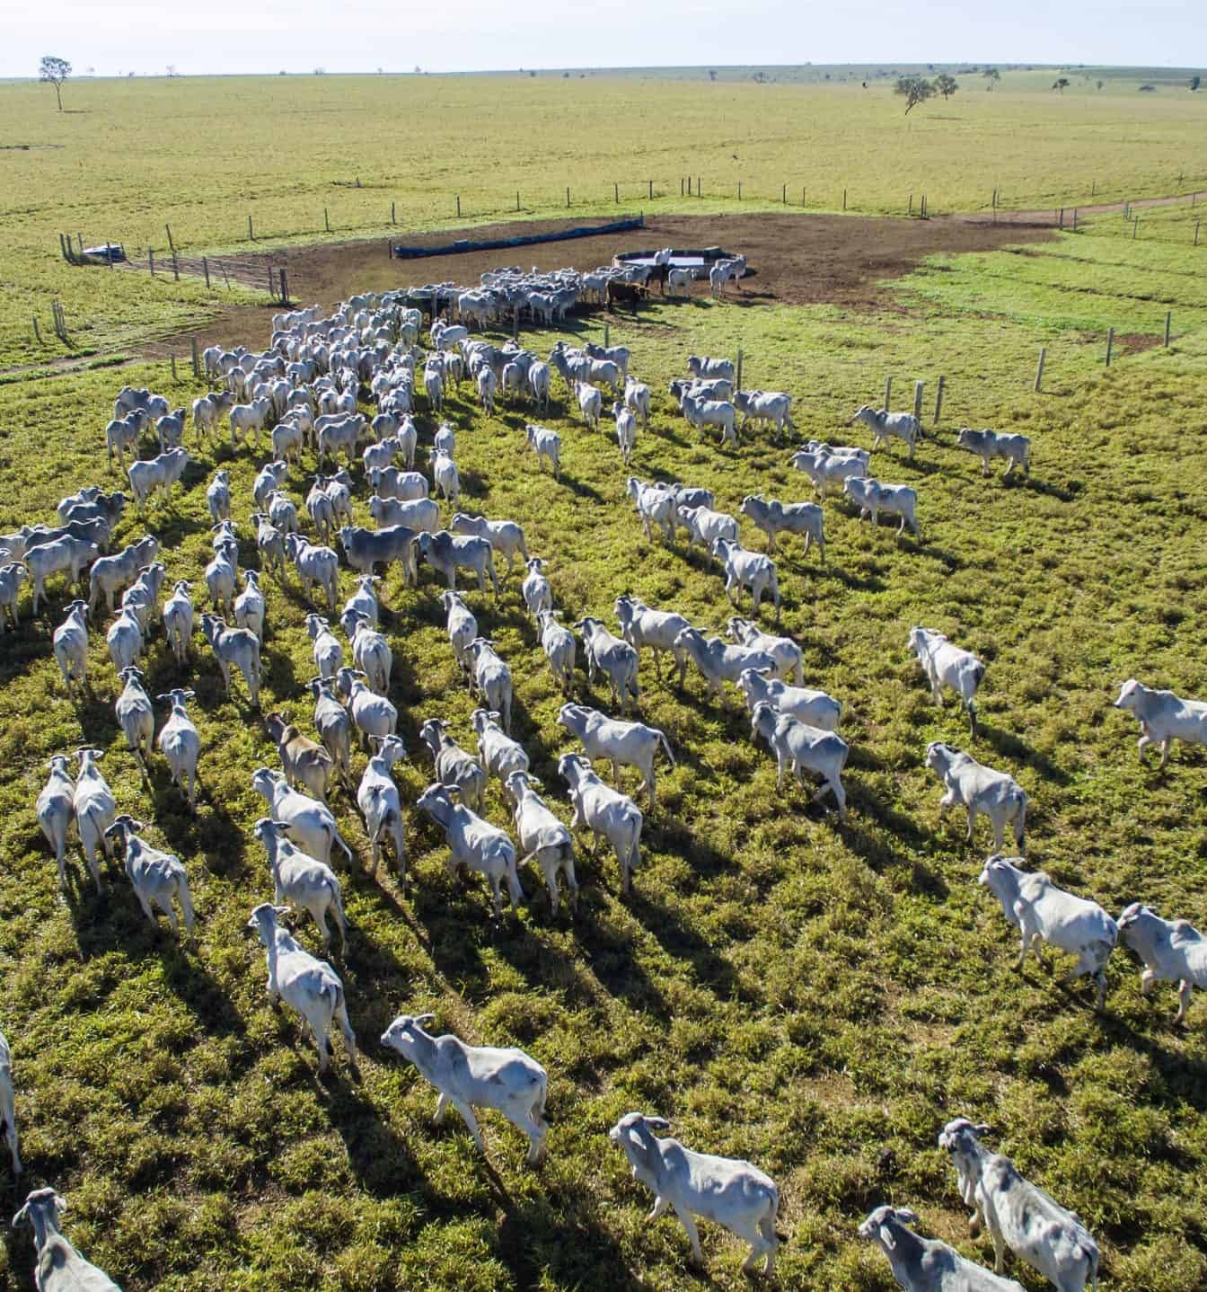
FOREST CODE · GTA-LINKED WORKED EXAMPLES
Six properties.
Three source bases.
Every vector layer visible.
Validated, Digital, and Proxy — one property above and one property up to four fiscal modules in each base, all linked to GTA and containing both forest and cerrado.
Mato Grosso · final model run · 7 October 2026
Photo: UN PAGE · Mato Grosso Goes Green

Slide 2
The six examples satisfy the same selection rules
Every row is GTA-linked, contains forest and cerrado, and represents one source × size branch.
Source base
Size
CAR record
Modules · area · cattle
SIMCAR Validated
> 4 modules
MT-5107602-4838366C339B4
9D69077F3DC87A8074C
13.36 modules · 801.37 ha · 939 cattle
SIMCAR Validated
≤ 4 modules
MT-5106257-60F736EB772F4
CF6A460A8D0BE0ADCBB
1.39 modules · 111.27 ha · 36 cattle
SIMCAR Digital
> 4 modules
MT-5107750-3D69A53C7D644
B4098DE759BD0FE2AF1
19.54 modules · 1,564.00 ha · 2,131 cattle
SIMCAR Digital
≤ 4 modules
MT-5102603-D132829CFF784
C919A4FA35C7A5F32A5
3.54 modules · 283.08 ha · 588 cattle
SIMCAR Proxy
> 4 modules
MT-5106828-23ABB407C9334
E9F864BC6C07D00148C
10.51 modules · 839.84 ha · 591 cattle
SIMCAR Proxy
≤ 4 modules
MT-5103304-CDD5B177BF434
05FA86B66729E82F424
1.87 modules · 186.59 ha · 121 cattle
Source: final GTA compliance mega table
02

Slide 3
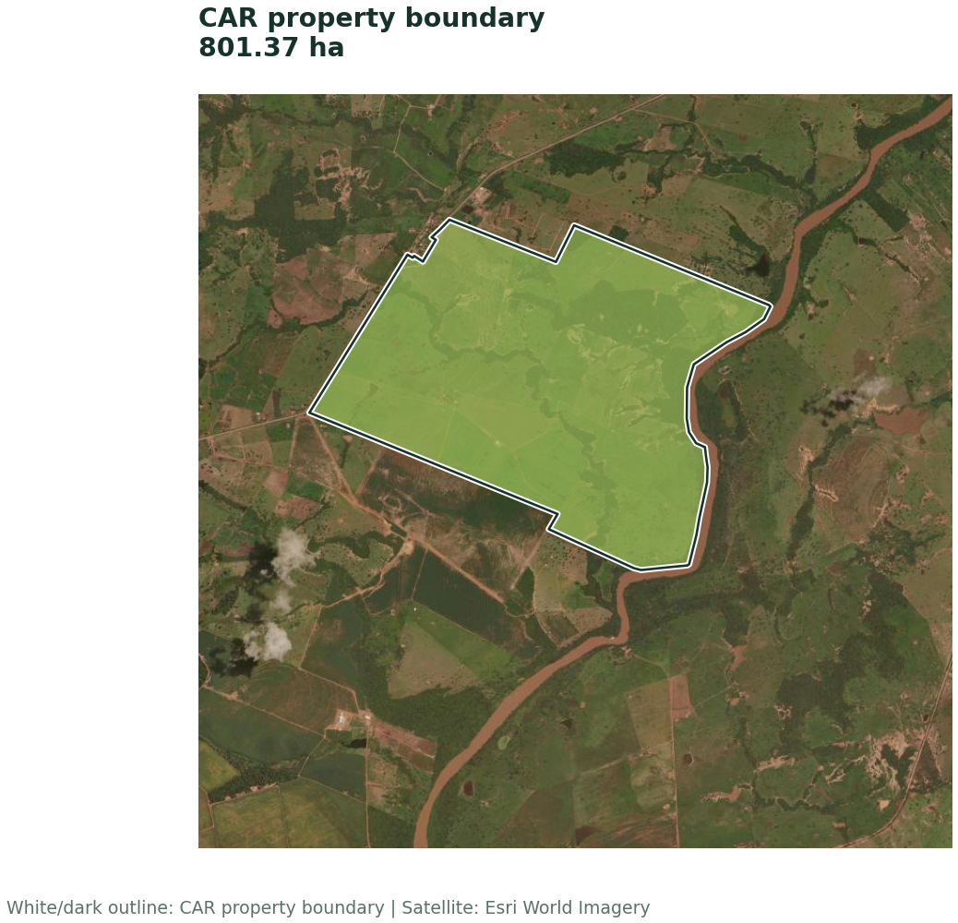
SIMCAR Validated · > 4 modules · property overview
13.36 fiscal modules · GTA direct supplier · 939 slaughter cattle
Property area
801.37 ha
Forest formation
552.09 ha
Cerrado formation
247.92 ha
Current native vegetation
133.87 ha
Baseline liability
435.06 ha
With secondary vegetation
340.83 ha
CAR: MT-5107602-4838366C339B49D69077F3DC87A8074C
Source: final GTA compliance mega table
03

Slide 4
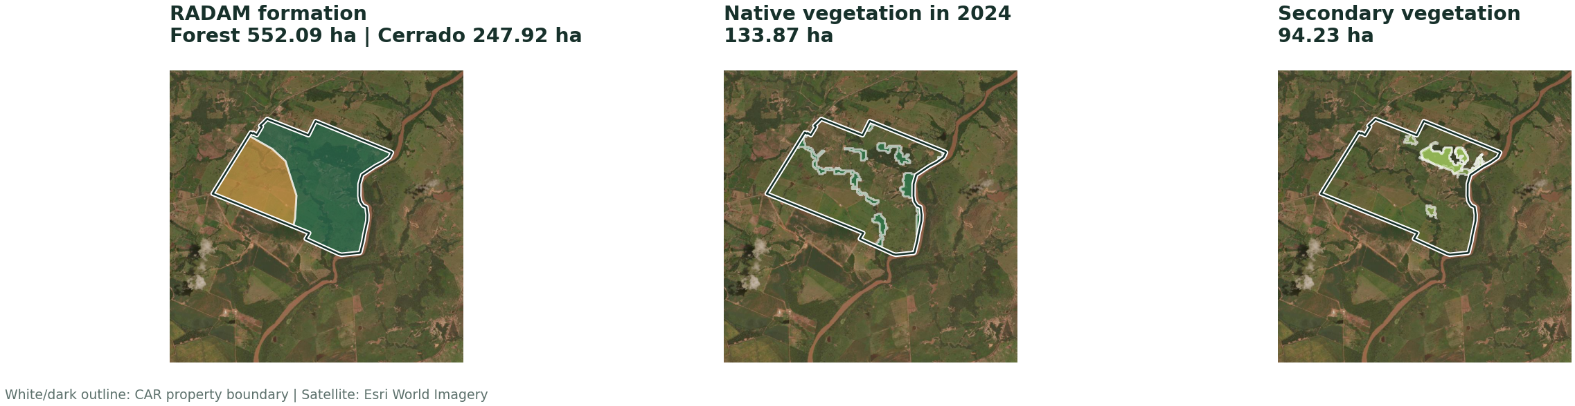
SIMCAR Validated · > 4 modules · Legal Reserve vector layers
RADAM, current native vegetation, and secondary vegetation.
Class totals close exactly to mapped APP area.
04

Slide 5
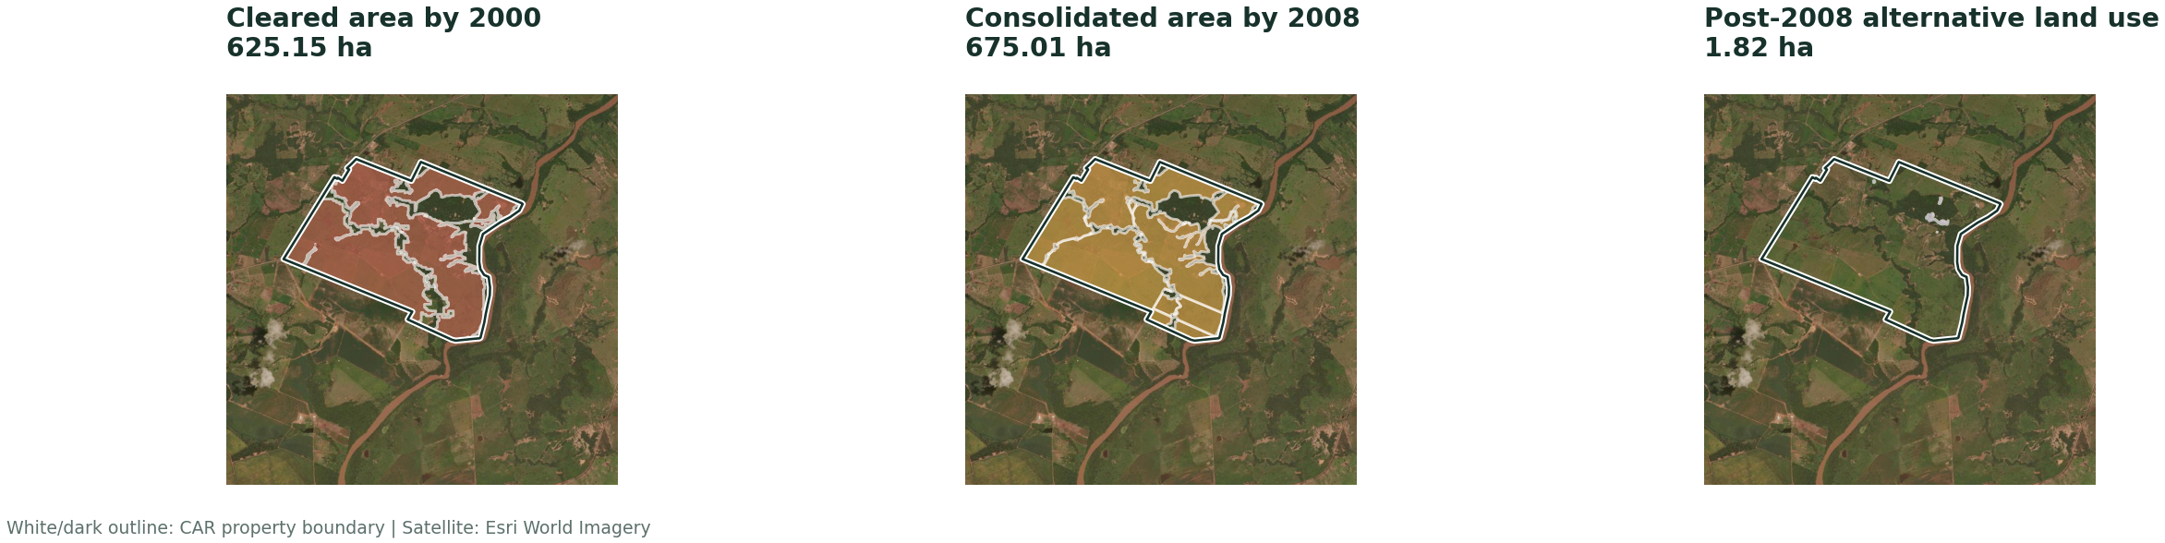
SIMCAR Validated · > 4 modules · Temporal vector layers
The 2000 and 2008 cut-offs and post-2008 alternative land use.
Class totals close exactly to mapped APP area.
05

Slide 6
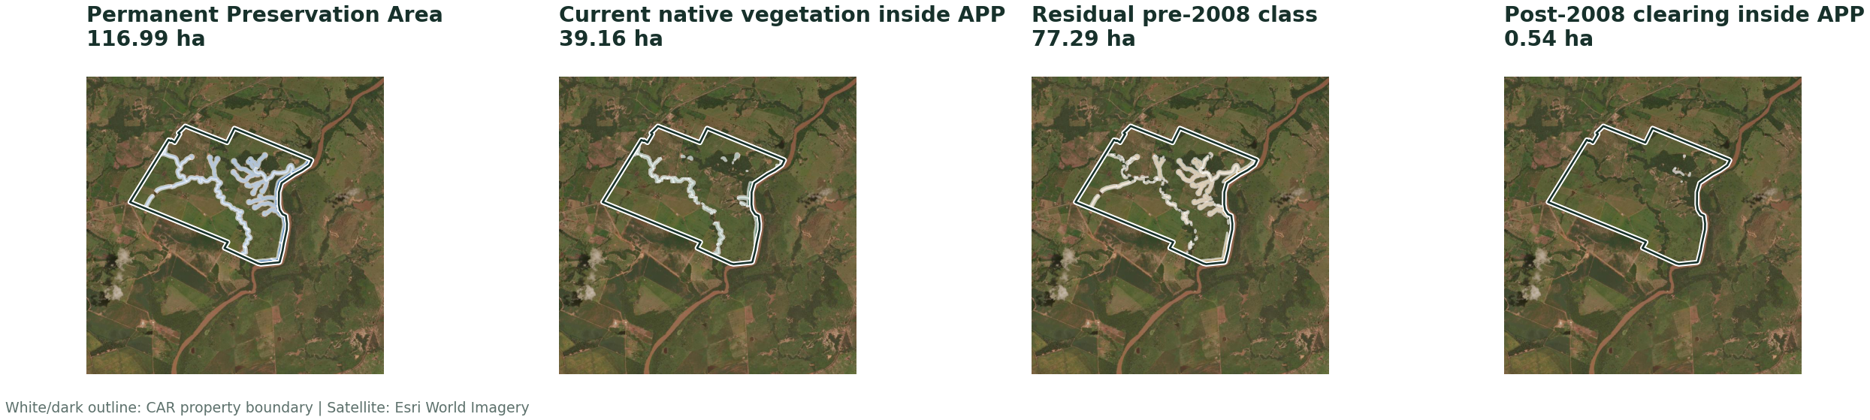
SIMCAR Validated · > 4 modules · APP vector layers
APP extent partitioned into mutually exclusive current and temporal classes.
Class totals close exactly to mapped APP area.
06

Slide 7
SIMCAR Validated · > 4 modules · calculation chain
Article 68 selects the LR requirement; APP and secondary vegetation remain separate.
Article 68 requirement
Legal Reserve deficit
IF vegetation 2000 ≥ historical floor → floor; ELSE → Article 12 ceiling
528.44 ha − 133.87 ha
= 528.44 ha
= 394.57 ha
LR pathway
APP restoration
Restore = MIN(post-2008 clearing, LR deficit)
Pre-2008 component after cap + post-2008 APP clearing
= 1.82 ha restore · 392.75 ha compensate
= 40.49 ha
BASELINE 435.06 ha
WITH SECONDARY 340.83 ha
Source: final GTA compliance mega table
07

Slide 8
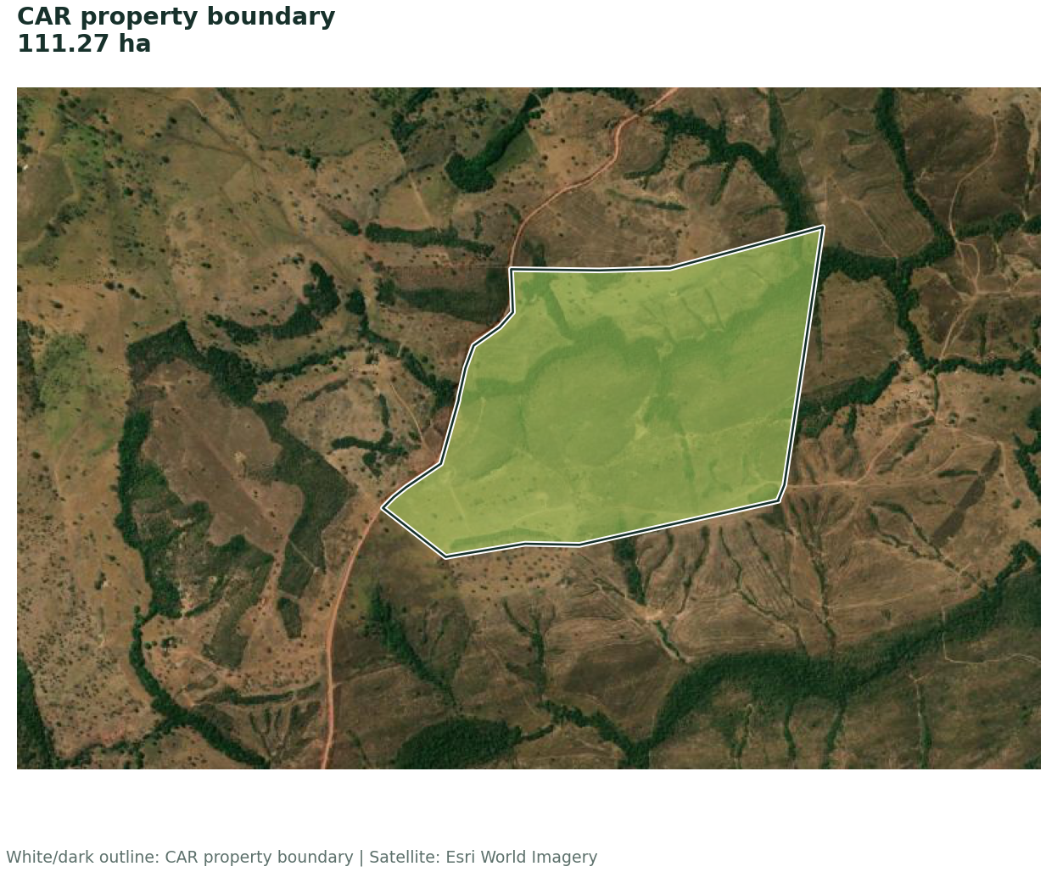
SIMCAR Validated · ≤ 4 modules · property overview
1.39 fiscal modules · GTA direct supplier · 36 slaughter cattle
Property area
111.27 ha
Forest formation
95.53 ha
Cerrado formation
15.73 ha
Current native vegetation
16.40 ha
Baseline liability
79.54 ha
With secondary vegetation
78.14 ha
CAR: MT-5106257-60F736EB772F4CF6A460A8D0BE0ADCBB
Source: final GTA compliance mega table
08

Slide 9
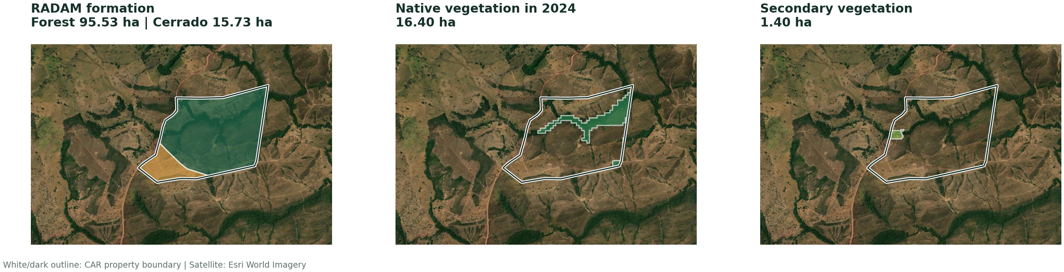
SIMCAR Validated · ≤ 4 modules · Legal Reserve vector layers
RADAM, current native vegetation, and secondary vegetation.
Class totals close exactly to mapped APP area.
09

Slide 10
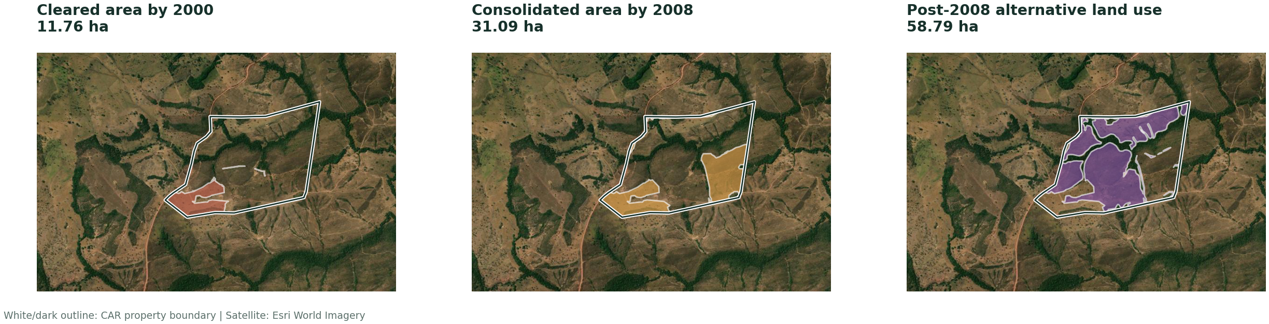
SIMCAR Validated · ≤ 4 modules · Temporal vector layers
The 2000 and 2008 cut-offs and post-2008 alternative land use.
Class totals close exactly to mapped APP area.
10

Slide 11
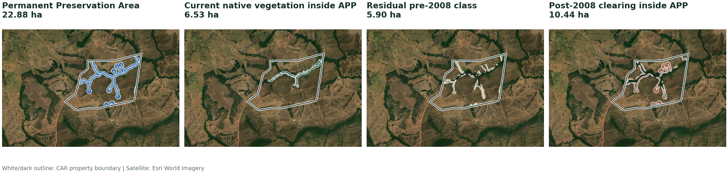
SIMCAR Validated · ≤ 4 modules · APP vector layers
APP extent partitioned into mutually exclusive current and temporal classes.
Class totals close exactly to mapped APP area.
11

Slide 12
SIMCAR Validated · ≤ 4 modules · calculation chain
Article 67 selects the LR requirement; APP and secondary vegetation remain separate.
Article 67 requirement
Legal Reserve deficit
MIN(Article 12 ceiling, vegetation in 2008)
80.18 ha − 16.40 ha
= 80.18 ha
= 63.78 ha
LR pathway
APP restoration
Restore = MIN(post-2008 clearing, LR deficit)
Pre-2008 component after cap + post-2008 APP clearing
= 58.79 ha restore · 4.98 ha compensate
= 15.76 ha
BASELINE 79.54 ha
WITH SECONDARY 78.14 ha
Source: final GTA compliance mega table
12

Slide 13
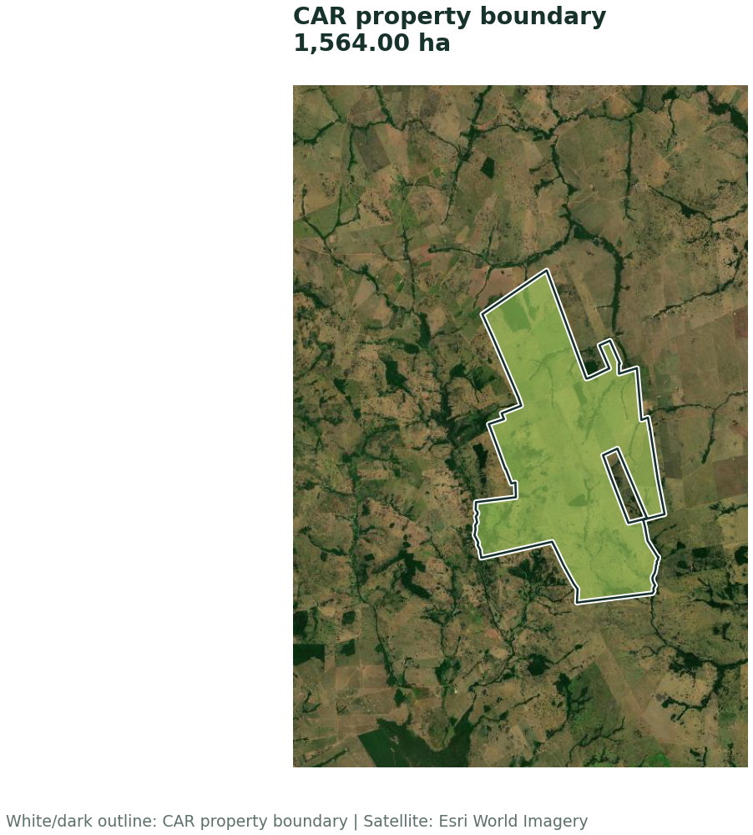
SIMCAR Digital · > 4 modules · property overview
19.54 fiscal modules · GTA direct supplier · 2,131 slaughter cattle
Property area
1,564.00 ha
Forest formation
1,502.11 ha
Cerrado formation
61.89 ha
Current native vegetation
162.98 ha
Baseline liability
1,146.59 ha
With secondary vegetation
999.45 ha
CAR: MT-5107750-3D69A53C7D644B4098DE759BD0FE2AF1
Source: final GTA compliance mega table
13

Slide 14
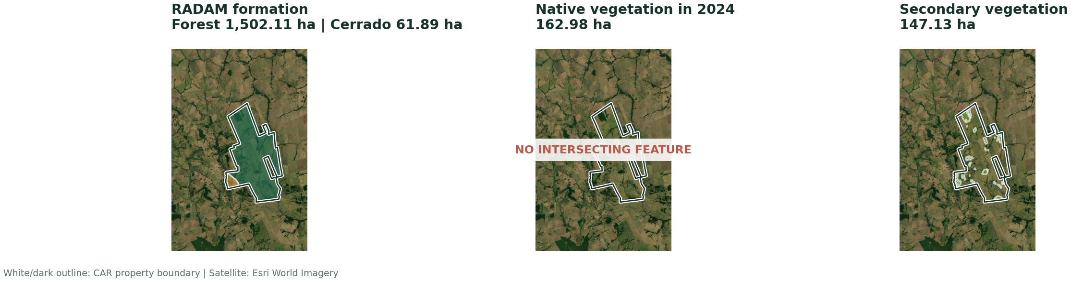
SIMCAR Digital · > 4 modules · Legal Reserve vector layers
RADAM, current native vegetation, and secondary vegetation.
Class totals close exactly to mapped APP area.
14

Slide 15
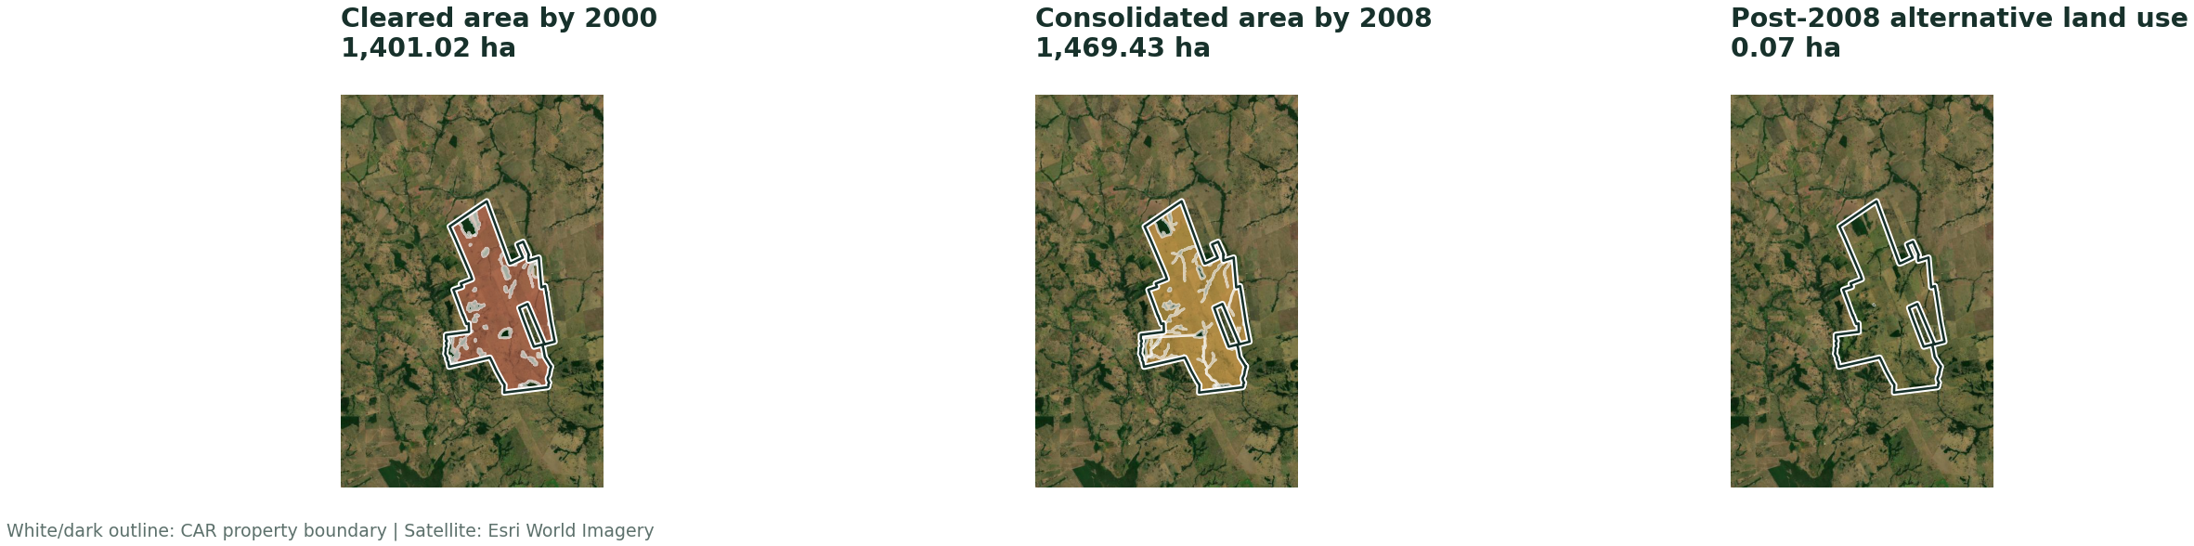
SIMCAR Digital · > 4 modules · Temporal vector layers
The 2000 and 2008 cut-offs and post-2008 alternative land use.
Class totals close exactly to mapped APP area.
15

Slide 16
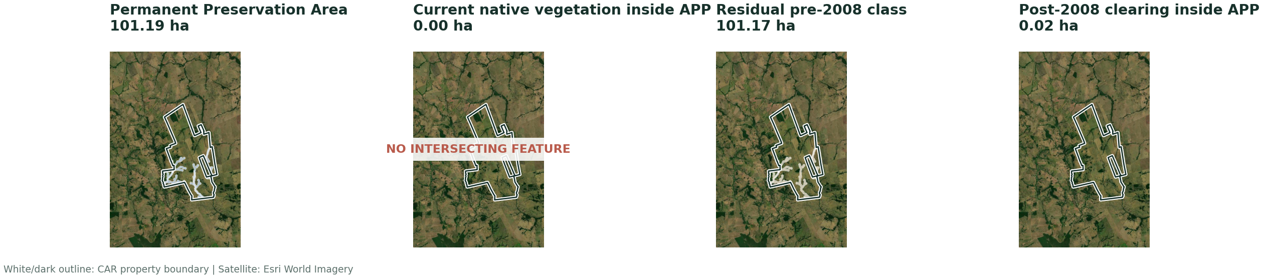
SIMCAR Digital · > 4 modules · APP vector layers
APP extent partitioned into mutually exclusive current and temporal classes.
Class totals close exactly to mapped APP area.
16

Slide 17
SIMCAR Digital · > 4 modules · calculation chain
Article 68 selects the LR requirement; APP and secondary vegetation remain separate.
Article 68 requirement
Legal Reserve deficit
IF vegetation 2000 ≥ historical floor → floor; ELSE → Article 12 ceiling
1,223.35 ha − 162.98 ha
= 1,223.35 ha
= 1,060.36 ha
LR pathway
APP restoration
Restore = MIN(post-2008 clearing, LR deficit)
Pre-2008 component after cap + post-2008 APP clearing
= 0.07 ha restore · 1,060.29 ha compensate
= 86.22 ha
BASELINE 1,146.59 ha
WITH SECONDARY 999.45 ha
Source: final GTA compliance mega table
17

Slide 18
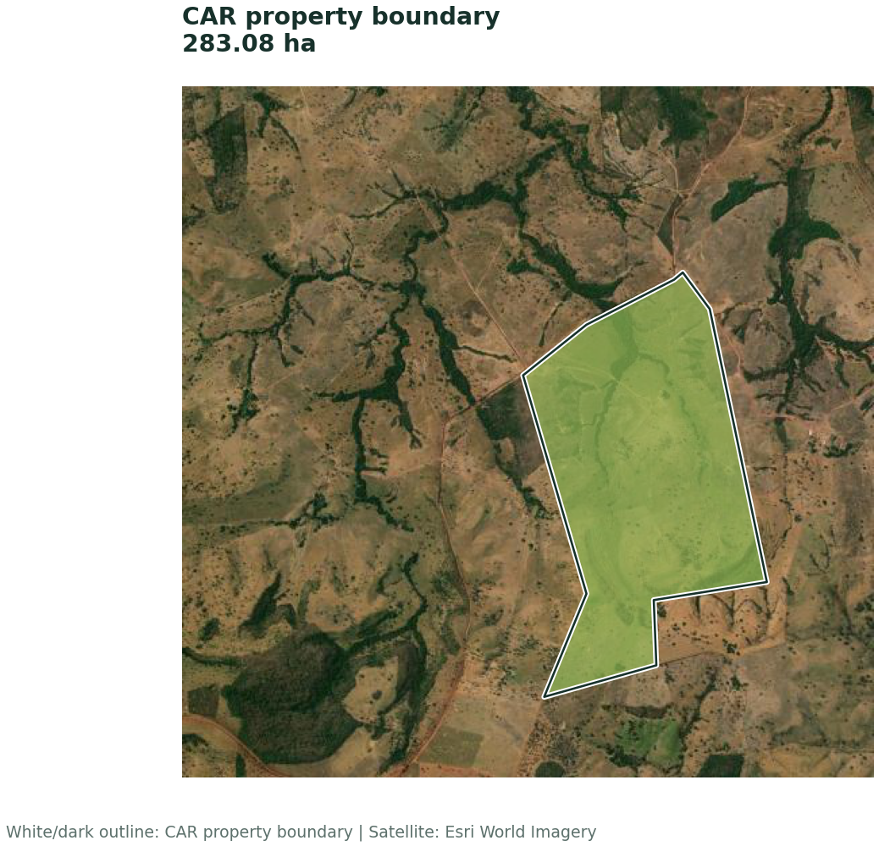
SIMCAR Digital · ≤ 4 modules · property overview
3.54 fiscal modules · GTA direct supplier · 588 slaughter cattle
Property area
283.08 ha
Forest formation
127.12 ha
Cerrado formation
155.96 ha
Current native vegetation
52.15 ha
Baseline liability
107.44 ha
With secondary vegetation
79.58 ha
CAR: MT-5102603-D132829CFF784C919A4FA35C7A5F32A5
Source: final GTA compliance mega table
18

Slide 19
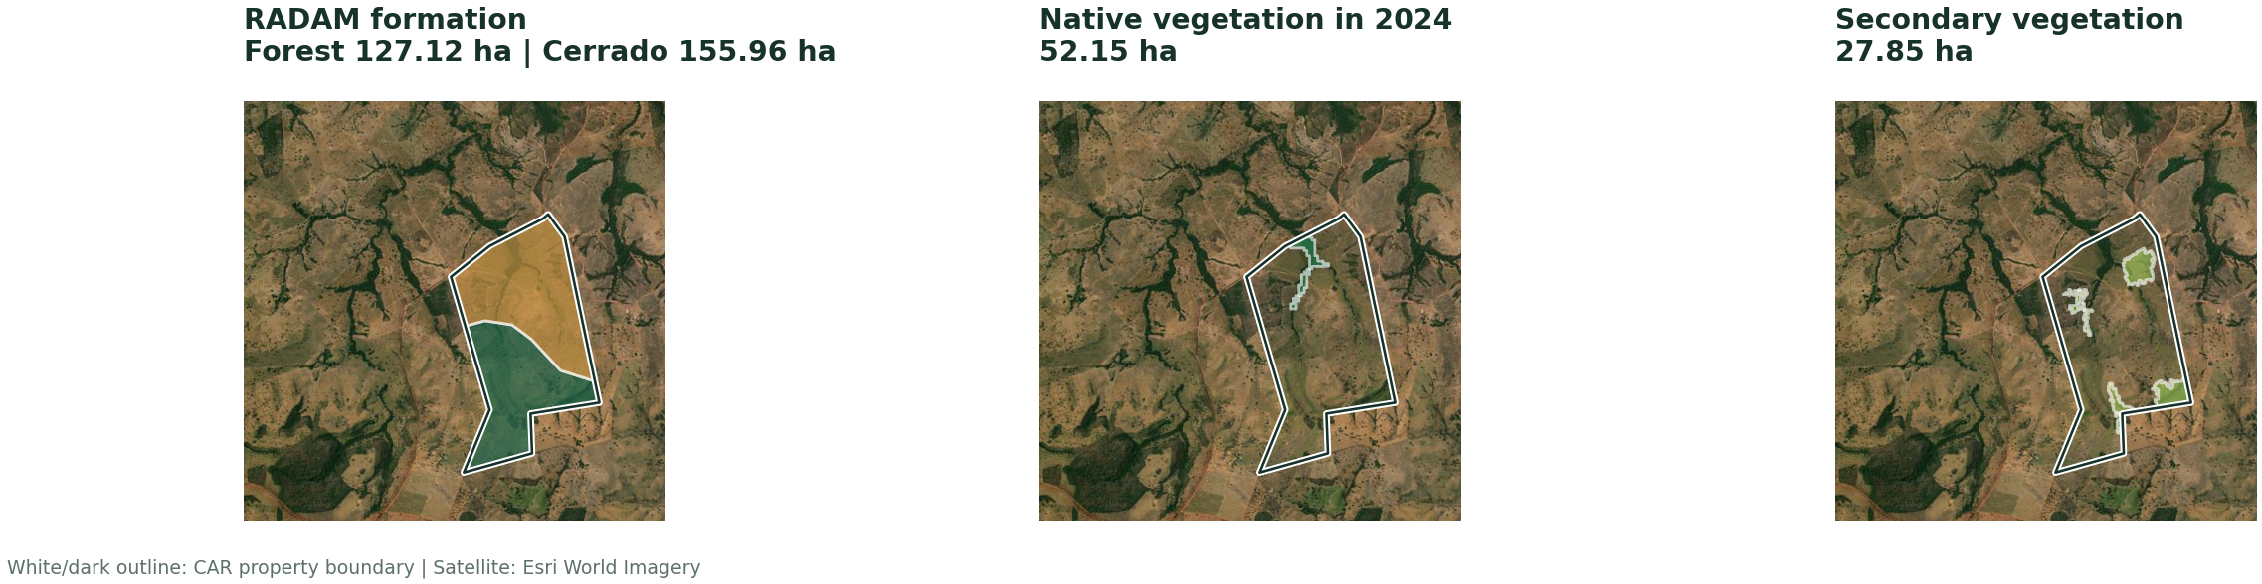
SIMCAR Digital · ≤ 4 modules · Legal Reserve vector layers
RADAM, current native vegetation, and secondary vegetation.
Class totals close exactly to mapped APP area.
19

Slide 20
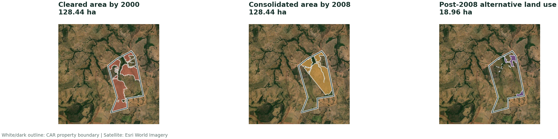
SIMCAR Digital · ≤ 4 modules · Temporal vector layers
The 2000 and 2008 cut-offs and post-2008 alternative land use.
Class totals close exactly to mapped APP area.
20

Slide 21
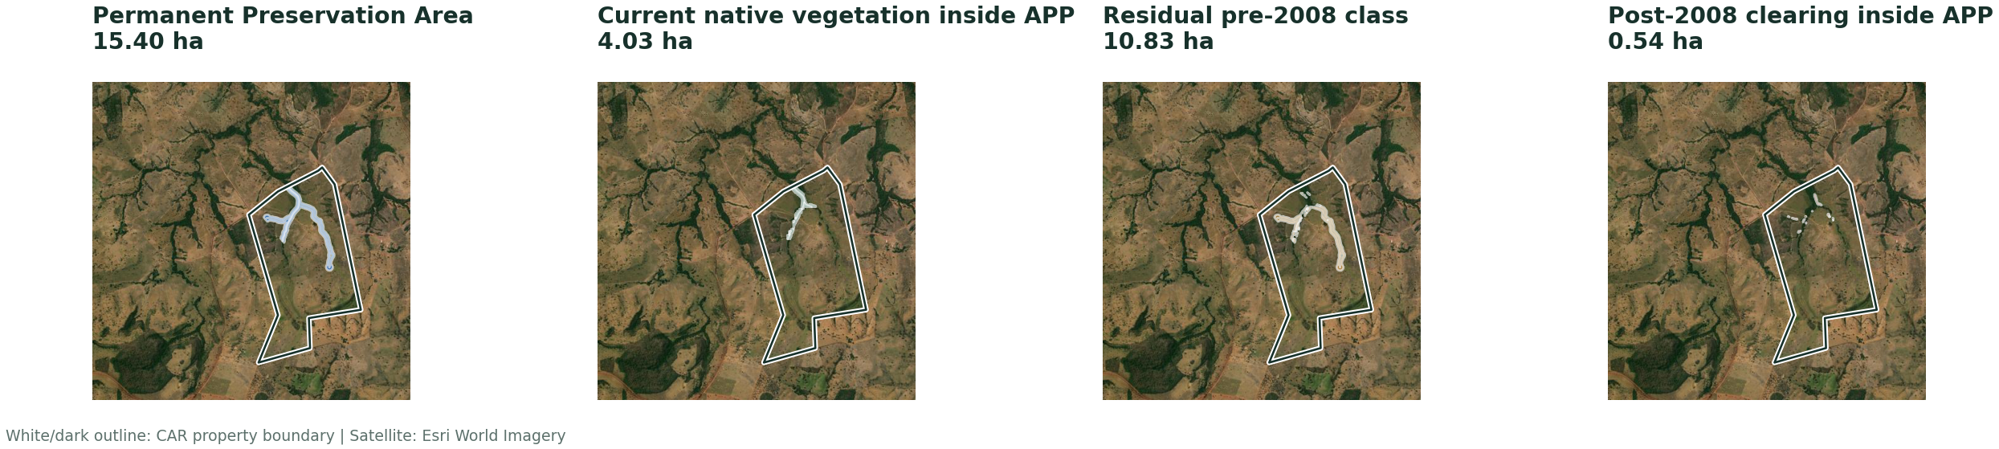
SIMCAR Digital · ≤ 4 modules · APP vector layers
APP extent partitioned into mutually exclusive current and temporal classes.
Class totals close exactly to mapped APP area.
21

Slide 22
SIMCAR Digital · ≤ 4 modules · calculation chain
Article 67 selects the LR requirement; APP and secondary vegetation remain separate.
Article 67 requirement
Legal Reserve deficit
MIN(Article 12 ceiling, vegetation in 2008)
154.64 ha − 52.15 ha
= 154.64 ha
= 102.50 ha
LR pathway
APP restoration
Restore = MIN(post-2008 clearing, LR deficit)
Pre-2008 component after cap + post-2008 APP clearing
= 18.96 ha restore · 83.54 ha compensate
= 4.94 ha
BASELINE 107.44 ha
WITH SECONDARY 79.58 ha
Source: final GTA compliance mega table
22

Slide 23
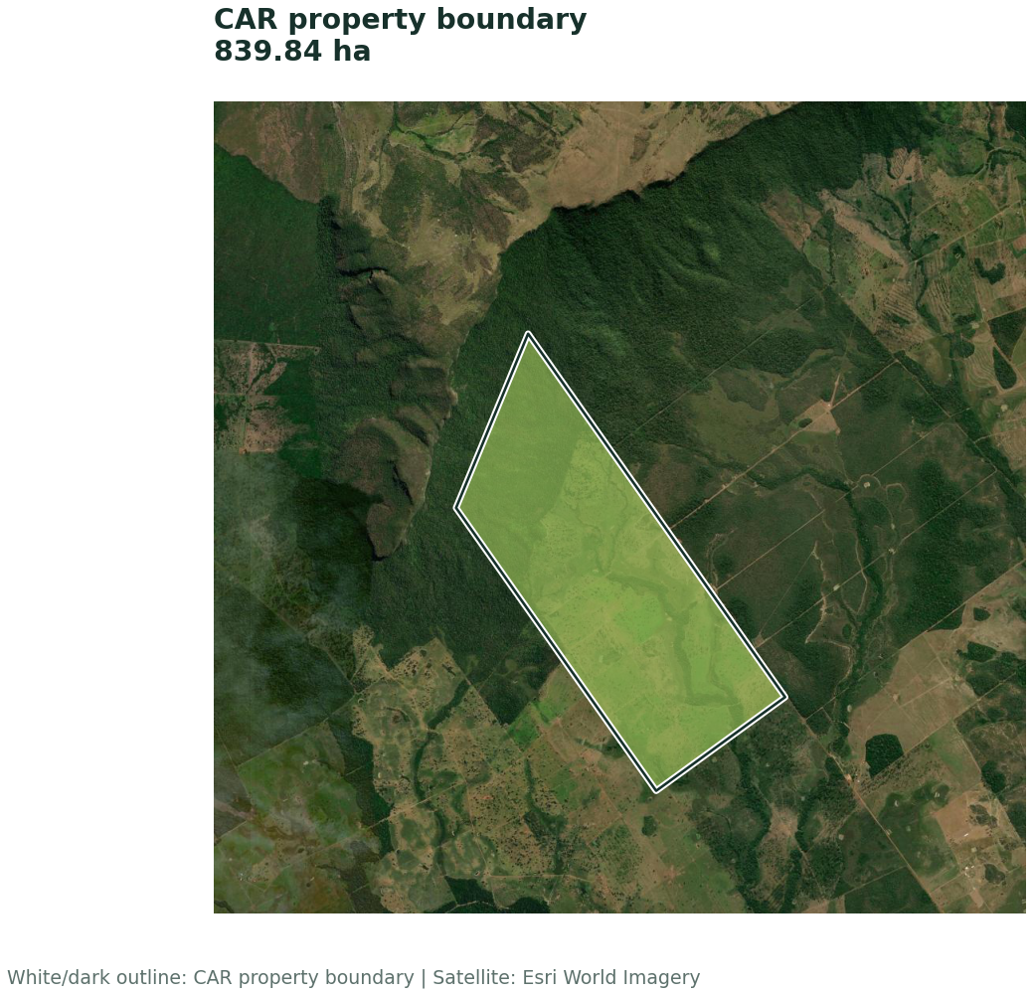
SIMCAR Proxy · > 4 modules · property overview
10.51 fiscal modules · GTA direct supplier · 591 slaughter cattle
Property area
839.84 ha
Forest formation
721.30 ha
Cerrado formation
118.54 ha
Current native vegetation
277.93 ha
Baseline liability
137.41 ha
With secondary vegetation
112.62 ha
CAR: MT-5106828-23ABB407C9334E9F864BC6C07D00148C
Source: final GTA compliance mega table
23

Slide 24
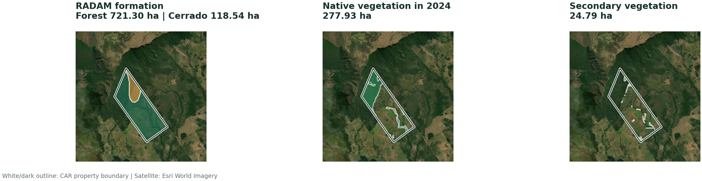
SIMCAR Proxy · > 4 modules · Legal Reserve vector layers
RADAM, current native vegetation, and secondary vegetation.
Class totals close exactly to mapped APP area.
24

Slide 25
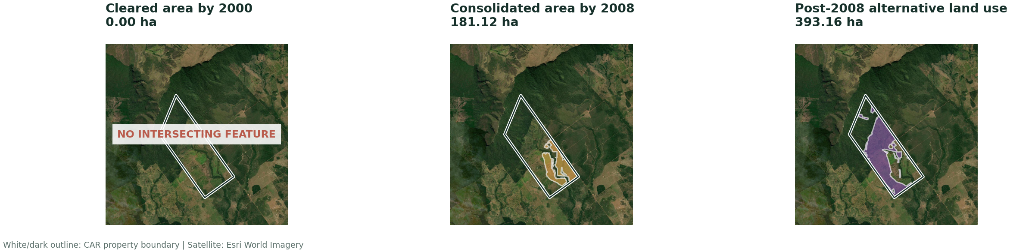
SIMCAR Proxy · > 4 modules · Temporal vector layers
The 2000 and 2008 cut-offs and post-2008 alternative land use.
Class totals close exactly to mapped APP area.
25

Slide 26
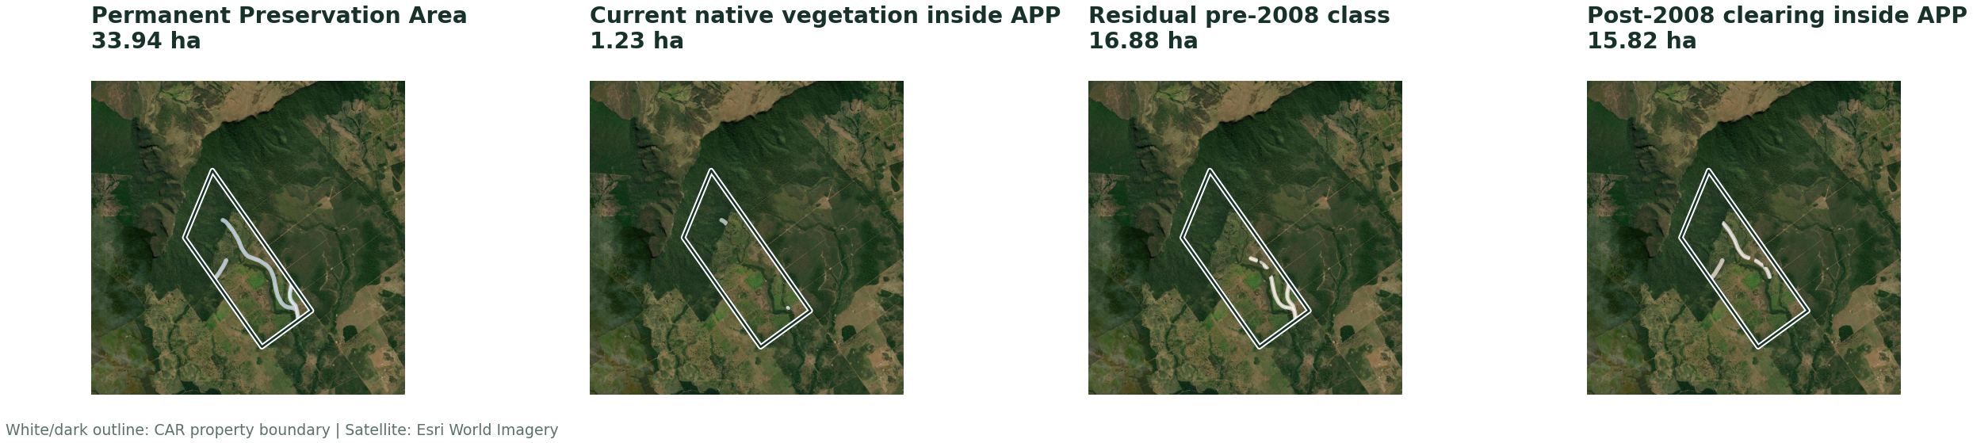
SIMCAR Proxy · > 4 modules · APP vector layers
APP extent partitioned into mutually exclusive current and temporal classes.
Class totals close exactly to mapped APP area.
26

Slide 27
SIMCAR Proxy · > 4 modules · calculation chain
Article 68 selects the LR requirement; APP and secondary vegetation remain separate.
Article 68 requirement
Legal Reserve deficit
IF vegetation 2000 ≥ historical floor → floor; ELSE → Article 12 ceiling
384.36 ha − 277.93 ha
= 384.36 ha
= 106.43 ha
LR pathway
APP restoration
Restore = MIN(post-2008 clearing, LR deficit)
Pre-2008 component after cap + post-2008 APP clearing
= 106.43 ha restore · 0.00 ha compensate
= 30.98 ha
BASELINE 137.41 ha
WITH SECONDARY 112.62 ha
Source: final GTA compliance mega table
27

Slide 28
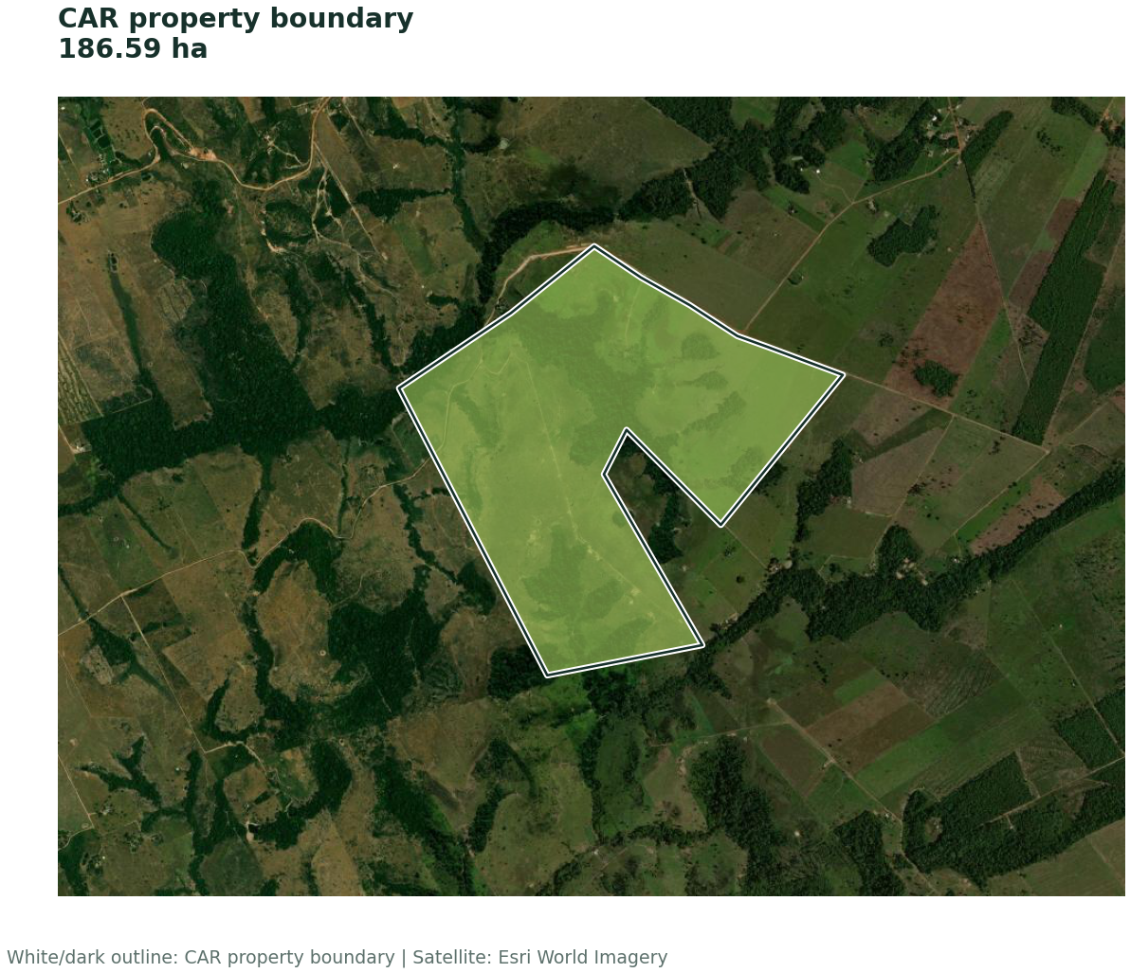
SIMCAR Proxy · ≤ 4 modules · property overview
1.87 fiscal modules · GTA direct supplier · 121 slaughter cattle
Property area
186.59 ha
Forest formation
183.31 ha
Cerrado formation
3.28 ha
Current native vegetation
43.83 ha
Baseline liability
122.69 ha
With secondary vegetation
107.60 ha
CAR: MT-5103304-CDD5B177BF43405FA86B66729E82F424
Source: final GTA compliance mega table
28

Slide 29
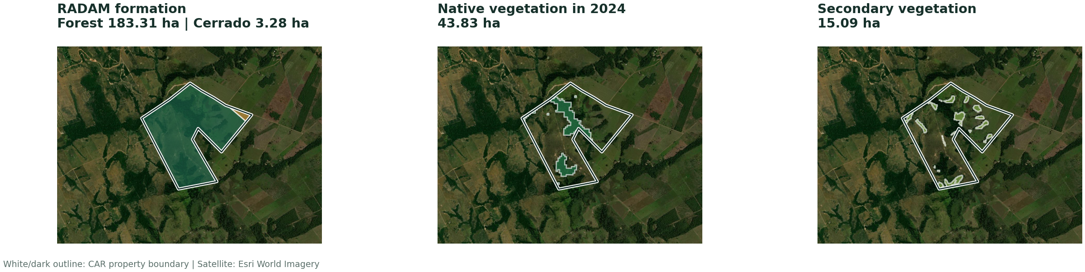
SIMCAR Proxy · ≤ 4 modules · Legal Reserve vector layers
RADAM, current native vegetation, and secondary vegetation.
Class totals close exactly to mapped APP area.
29

Slide 30
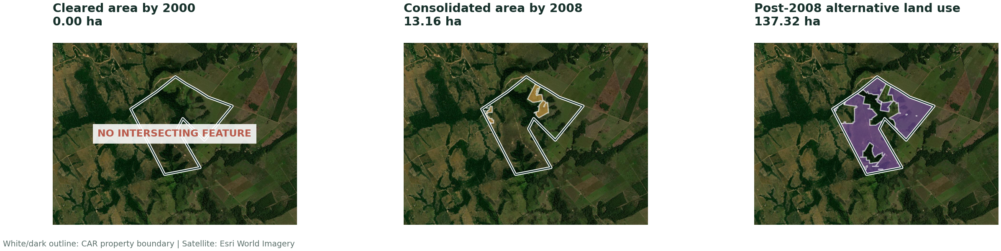
SIMCAR Proxy · ≤ 4 modules · Temporal vector layers
The 2000 and 2008 cut-offs and post-2008 alternative land use.
Class totals close exactly to mapped APP area.
30

Slide 31
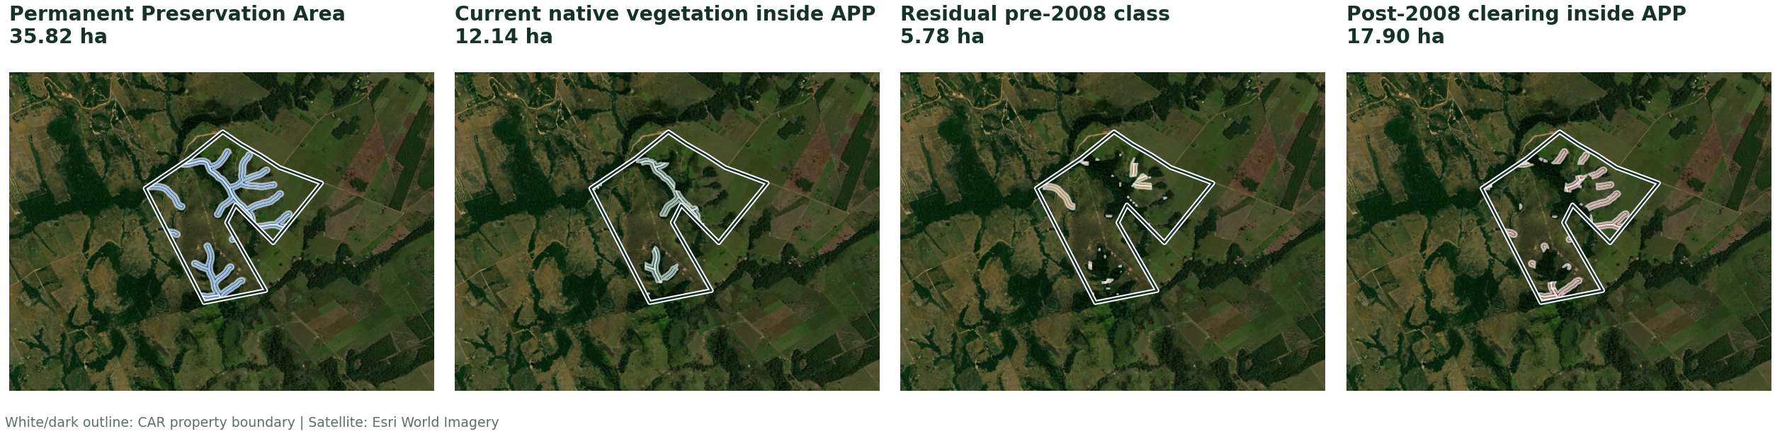
SIMCAR Proxy · ≤ 4 modules · APP vector layers
APP extent partitioned into mutually exclusive current and temporal classes.
Class totals close exactly to mapped APP area.
31

Slide 32
SIMCAR Proxy · ≤ 4 modules · calculation chain
Article 67 selects the LR requirement; APP and secondary vegetation remain separate.
Article 67 requirement
Legal Reserve deficit
MIN(Article 12 ceiling, vegetation in 2008)
147.79 ha − 43.83 ha
= 147.79 ha
= 103.96 ha
LR pathway
APP restoration
Restore = MIN(post-2008 clearing, LR deficit)
Pre-2008 component after cap + post-2008 APP clearing
= 103.96 ha restore · 0.00 ha compensate
= 18.73 ha
BASELINE 122.69 ha
WITH SECONDARY 107.60 ha
Source: final GTA compliance mega table
32

Slide 33
What the six examples make visible
The same calculation structure turns source-specific inputs into comparable results.
Source
Size
CAR record
Baseline
With secondary
SIMCAR Validated
> 4
MT-5107602-4838366C339B4
9D69077F3DC87A8074C
435.06 ha
340.83 ha
SIMCAR Validated
≤ 4
MT-5106257-60F736EB772F4
CF6A460A8D0BE0ADCBB
79.54 ha
78.14 ha
SIMCAR Digital
> 4
MT-5107750-3D69A53C7D644
B4098DE759BD0FE2AF1
1,146.59 ha
999.45 ha
SIMCAR Digital
≤ 4
MT-5102603-D132829CFF784
C919A4FA35C7A5F32A5
107.44 ha
79.58 ha
SIMCAR Proxy
> 4
MT-5106828-23ABB407C9334
E9F864BC6C07D00148C
137.41 ha
112.62 ha
SIMCAR Proxy
≤ 4
MT-5103304-CDD5B177BF434
05FA86B66729E82F424
122.69 ha
107.60 ha
Source: final GTA compliance mega table
33

Slide 34
External benchmarks differ materially
Values are not directly equivalent; population, date, overlap treatment, and legal assumptions differ.
Source
Population / area
RL deficit
APP metric
Surplus
Current project
155,547 properties · 69.55 Mha
Modeled in total
Included in 5.31 Mha
14.09 Mha
OCF 2019
116,390 records · 64.50 Mha
2.30 Mha
0.505 Mha deficit
8.90 Mha
OCF 2024
176,629 active/pending · 62.49 Mha
Included in 4.74 Mha total
Included in 4.74 Mha total
5.54 Mha
Project and OCF values use non-equivalent populations, dates, and legal denominators.
Source: final GTA compliance mega table
34

Slide 35
Benchmark interpretation is conditional
External sources validate scale and distribution; they are not an equality test.
1 Recompute APP partitions and the 2000–2008 chronology before publication.
2 Harmonize CAR status, property type, overlap policy, and reference date.
3 Compare RL deficit, APP gross deficit, required APP restoration, and surplus separately.
Sources: OCF Mato Grosso diagnostic (2019); OCF Forest Code Thermometer (2024); SFB/SICAR Rural Environmental Regularization Panel.
Status: final model run dated 07 October 2026; external benchmarks remain non-equivalent.
Source: final GTA compliance mega table
35

