Slide 1
FOREST CODE · WORKED EXAMPLES
Two properties.
One transparent calculation chain.
A field-by-field walkthrough for properties above and below four fiscal modules — both with forest and cerrado areas greater than zero.
Mato Grosso · Final compliance model
30 September 2026

Slide 2
The four-module threshold changes the legal requirement
The same harmonized inputs feed two different statutory branches.
> 4 fiscal modules
< 4 fiscal modules
Article 68 binary test
Article 67 cut-off
If vegetation in 2000 met the historical floor, the floor applies. Otherwise, the full Article 12 ceiling applies.
The requirement is the lower of the current Article 12 ceiling and native vegetation that existed in 2008.
Requirement
Requirement
IF veg_2000 ≥ historical floor → floor; ELSE → current ceiling
MIN(current ceiling, vegetation in 2008)
= rl_req_art68_ha
= rl_req_art67_ha
Worked case: 6.00 modules
Worked case: 2.41 modules
Source: MT Forest Code compliance mega table · final 2026-09-30
02

Slide 3
Large property · inputs and cut-off tests
6.00 fiscal modules · SIMCAR Digital · forest and cerrado both > 0 ha
Property area
599.92 ha
Consolidated area 2000
273.13 ha
Article 12 ceiling
286.12 ha
Fiscal modules
6.00
Vegetation in 2000
326.79 ha
Article 68 floor
170.75 ha
Forest area
169.21 ha
Consolidated area 2008
0.00 ha
Article 68 requirement
170.75 ha
Cerrado area
430.71 ha
Vegetation in 2008
599.92 ha
Current native vegetation
118.13 ha
Property key: MT-5107875-FCDC7412E5B04C10A7B5B8FA8CE4B049
Source: MT Forest Code compliance mega table · final 2026-09-30
03

Slide 4
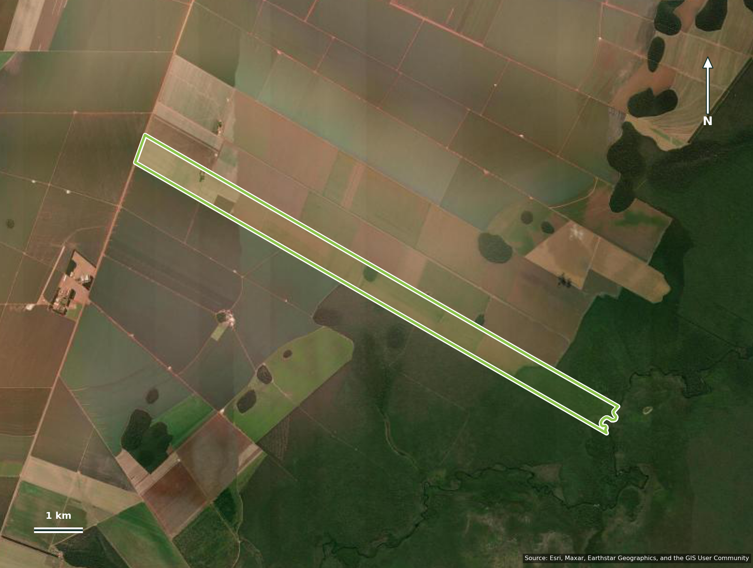
Large property · satellite context
The CAR property polygon is overlaid on Esri World Imagery.
Property area
599.92 ha
Forest area
169.21 ha
Cerrado area
430.71 ha
Fiscal modules
6.00
Baseline liability
52.61 ha
CAR boundary: MT-5107875-FCDC7412E5B04C10A7B5B8FA8CE4B049
Source: MT Forest Code compliance mega table · final 2026-09-30
04

Slide 5
Large-property calculation chain
Article 68 determines LR; APP and secondary vegetation are calculated separately.
2000 legal test
Legal Reserve deficit
326.79 ha ≥ 170.75 ha
170.75 ha − 118.13 ha
= Historical floor applies: 170.75 ha
= 52.61 ha
LR pathway
APP restoration
Restore = MIN(post-2008 clearing, LR deficit)
Pre-2008 component after cap + post-2008 APP clearing
= 0.00 ha restore · 52.61 ha compensate
= 0.00 ha
BASELINE TOTAL
SECONDARY VEGETATION SCENARIO
52.61 ha
79.11 ha added → 0.00 ha remaining
Source: MT Forest Code compliance mega table · final 2026-09-30
05

Slide 6
Small property · inputs and cut-off tests
2.41 fiscal modules · SIMCAR Validated · forest and cerrado both > 0 ha
Property area
193.20 ha
Consolidated area 2000
140.02 ha
Article 12 ceiling
115.24 ha
Fiscal modules
2.41
Vegetation in 2000
53.18 ha
Article 68 floor
70.51 ha
Forest area
108.66 ha
Consolidated area 2008
64.85 ha
Article 67 requirement
115.24 ha
Cerrado area
80.90 ha
Vegetation in 2008
128.34 ha
Current native vegetation
61.34 ha
Property key: MT-5103437-3035138E282C4E6686B61959CF506B0D
Source: MT Forest Code compliance mega table · final 2026-09-30
06

Slide 7
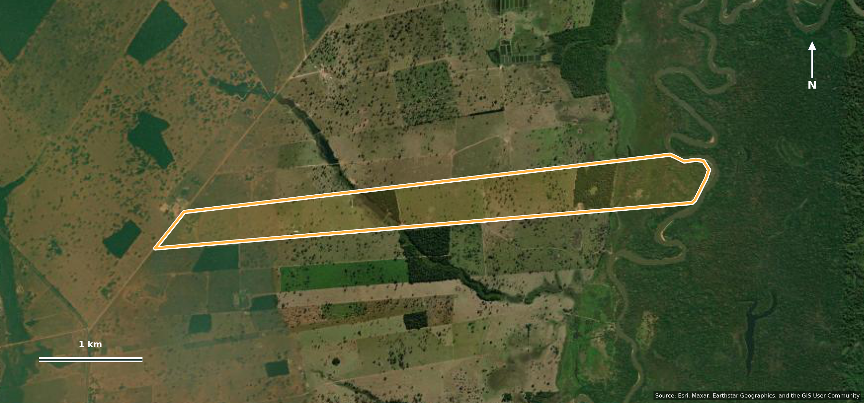
Small property · satellite context
The CAR property polygon is overlaid on Esri World Imagery.
Property area
193.20 ha
Forest area
108.66 ha
Cerrado area
80.90 ha
Fiscal modules
2.41
Baseline liability
57.07 ha
CAR boundary: MT-5103437-3035138E282C4E6686B61959CF506B0D
Source: MT Forest Code compliance mega table · final 2026-09-30
07

Slide 8
Small-property calculation chain
Article 67 determines LR; APP and secondary vegetation are calculated separately.
2008 cut-off
Legal Reserve deficit
MIN(115.24 ha, 128.34 ha)
115.24 ha − 61.34 ha
= Article 67 requirement: 115.24 ha
= 53.90 ha
LR pathway
APP restoration
Restore = MIN(post-2008 clearing, LR deficit)
Pre-2008 component after cap + post-2008 APP clearing
= 0.00 ha restore · 53.90 ha compensate
= 3.17 ha
BASELINE TOTAL
SECONDARY VEGETATION SCENARIO
57.07 ha
48.40 ha added → 8.67 ha remaining
Source: MT Forest Code compliance mega table · final 2026-09-30
08

Slide 9
What the two examples make visible
The threshold changes the requirement—not the need for transparent inputs and reconciled outputs.
Audit rules
Property
> 4 modules
Property
< 4 modules
1. Inputs retain their source-specific columns.
2. 2000 and 2008 remain separate cut-offs.
3. Restore + compensate = LR deficit.
4. Secondary vegetation cannot push vegetation above property area.
Legal branch
Article 68
Legal branch
Article 67
Requirement
170.75 ha
Requirement
115.24 ha
Baseline total
52.61 ha
Baseline total
57.07 ha
Every number shown here is traceable to the 638-column mega table.
With secondary
0.00 ha
With secondary
8.67 ha
Source: MT Forest Code compliance mega table · final 2026-09-30
09

