Slide 1
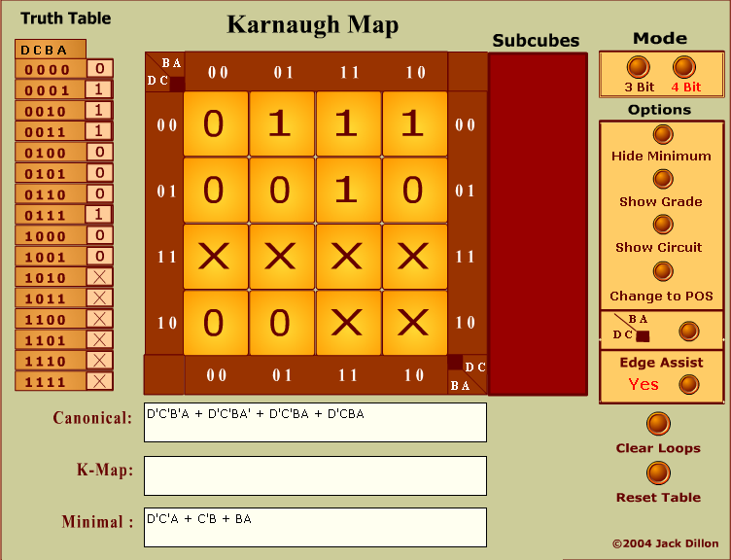
The Karnaugh Map Simulator

