Slide 1
Empowering Innovation: Robotics, IoT, and Their Role in Sustainable Development
IEEE SPAC 2024 | North South University, Bangladesh
Redwan Ferdous, CEO of JRC Board & Director of FronTech LTD

Slide 2
Introduction
Session Objectives:
Inspire innovation among students.
Discuss the role of Robotics and IoT in sustainable development.
Highlight opportunities in Bangladesh with a global perspective.
Image Placeholder

Slide 3
About Me - Redwan Ferdous
Image Placeholder
CEO of JRC Board.
Director of FronTech LTD.
Experience in leading IoT startups in Bangladesh.
Passionate about innovation and sustainability.

Slide 4
Agenda
1. The Rise of Robotics and IoT.
2. Sustainable Development Goals (SDGs).
3. Intersection of Robotics, IoT, and SDGs.
4. Case Studies in Bangladesh.
5. Global Exposure and Opportunities.
6. Q&A Session.

Slide 5
The Rise of Robotics and IoT
• Evolution over the years.
• Key global advancements.
• Impact on various industries.
Image Placeholder

Slide 6
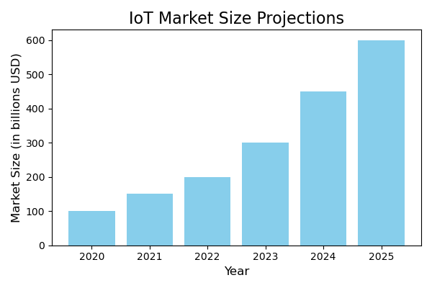
Global Impact of Robotics and IoT

Slide 7
Understanding Sustainable Development
Image Placeholder
Definition of Sustainable Development.
Introduction to the UN Sustainable Development Goals (SDGs).

Slide 8
SDGs and Technology
SDG 7
Affordable and Clean Energy
SDG 9
Industry, Innovation, and Infrastructure
SDG 11
Sustainable Cities and Communities

Slide 9
Connecting Robotics and IoT with SDGs
Image Placeholder

Slide 10
Case Study: Smart Agriculture in Bangladesh
• Use of IoT sensors for soil monitoring.
• Precision farming techniques.
• Benefits: Increased yields, reduced waste.
Image Placeholder

Slide 11
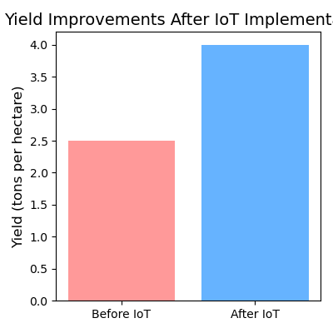
Impact on Agricultural Productivity

Slide 12
Case Study: IoT in Healthcare
• Remote patient monitoring systems.
• Telemedicine for rural communities.
• Outcomes: Improved patient care, accessibility.
Image Placeholder

Slide 13
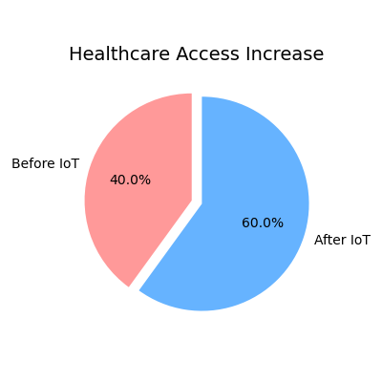
Improved Healthcare Access

Slide 14
Our Journey at JRC Board
Image Placeholder
• Key projects and innovations.
• Collaborations with local communities.

Slide 15
Innovations at FronTech LTD
Image Placeholder
• IoT solutions developed for sustainability.
• Impact stories.

Slide 16
Encouraging Innovation Among Students
Image Placeholder

Slide 17
Global Opportunities
Image Placeholder
• Collaborations with international organizations.
• Participating in global tech challenges.

Slide 18
Challenges in Implementing IoT Solutions
Challenges:
• Infrastructure limitations.
• High costs.
• Need for skilled personnel.
Solutions:
• Government support.
• Local manufacturing.
• Education and training.

Slide 19
Education and Skill Development
• Importance of STEM education.
• Training programs and workshops offered.
Image Placeholder

Slide 20
Building Collaborations
Image Placeholder
• Partnerships with universities and industry.
• Benefits of collaborative innovation.

Slide 21
The Future of Robotics and IoT in Bangladesh
• Emerging technologies (AI integration, 5G).
• Vision for the next decade.
Image Placeholder

Slide 22
How You Can Get Involved
Opportunities:
• Internships.
• Research projects.
• Innovation challenges.
Steps to participate.
Image Placeholder

Slide 23
Join the Movement
"Innovation is seeing what everybody has seen and thinking what nobody has thought." - Dr. Albert Szent-Györgyi
Image Placeholder

Slide 24
Questions & Answers
Image Placeholder

Slide 25
Thank You
Contact Information:
Email: your.email@example.com
LinkedIn: linkedin.com/in/yourprofile
Website: www.yourcompanywebsite.com
Invitation to connect and collaborate.
Image Placeholder

