Slide 1
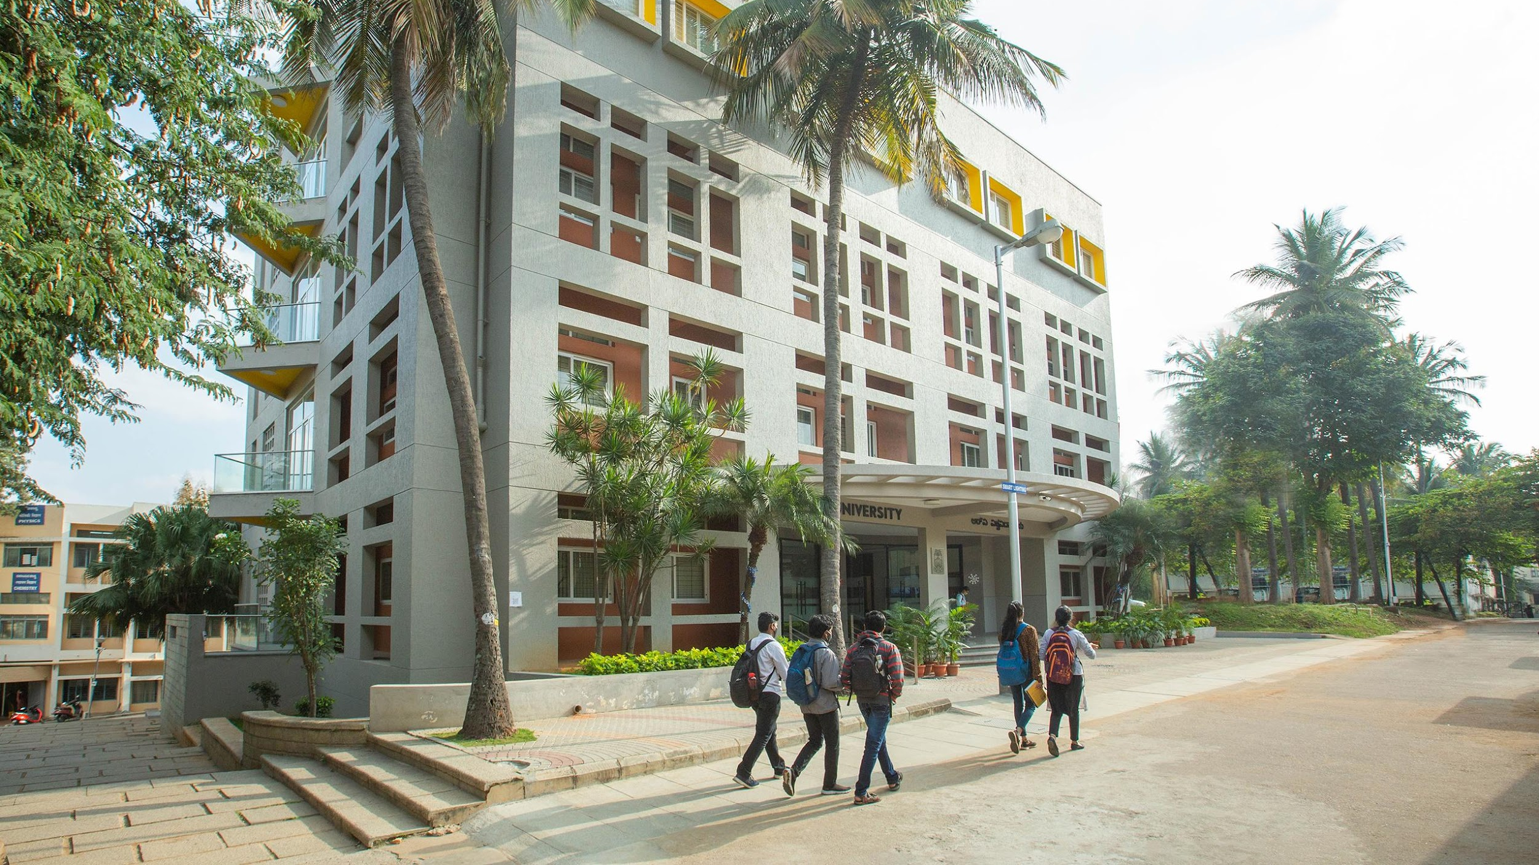

Module-1: Understand the Java fundamentals and apply the concept of classes, objects to solve a real world
problem

Slide 2
OOPs Concepts
Simula is considered the first object-oriented programming language.
The programming paradigm where everything is represented as an object is known as a truly object- oriented programming language.
Smalltalk is considered the first truly object-oriented programming language.
The popular object-oriented languages are Java, C#, PHP, Python, C++, etc.
Javascript is object based language where inheritance is not supported.

Slide 3
OOPs Concepts
Object
Any entity that has state and behavior is known as an object. For example, a chair, pen, table, keyboard, bike, etc. It can be physical or logical.
An Object can be defined as an instance of a class. An object contains an address and takes up some space in memory.
Example: A dog is an object because it has states like color, name, breed, etc. as well as behaviors like wagging the tail, barking, eating, etc.

Slide 4
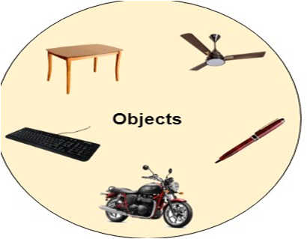
OOPs Concepts
source: https://www.javatpoint.com/java-tutorial

Slide 5
OOPs Concepts
Class
Collection of objects is called class. It is a logical entity.
A class can also be defined as a blueprint from which you can create an individual object.
Class doesn't consume any space.
Class student
{
int rollno;
String name;
Void display();
}
Struct student
{
int rollno;
String name;
}

Slide 6
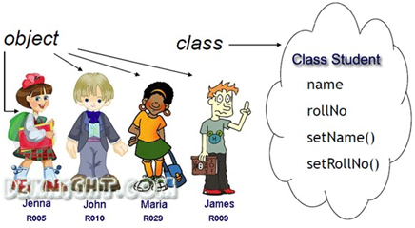
OOPs Concepts
source: https://www.javatpoint.com/java-tutorial

Slide 7
OOPs Concepts
Abstraction
Hiding internal details and showing functionality is known as abstraction.
For example phone call, we don't know the internal processing.

Slide 8

OOPs Concepts
Encapsulation
Binding (or wrapping) code and data together into a single unit are known as encapsulation.
For example, a capsule, it is wrapped with different medicines.
A java class is the example of encapsulation. Java bean is the fully encapsulated class because all the data members are private here.

Slide 9
OOPs Concepts
Inheritance
When one object acquires all the properties and behaviors of a parent object, it is known as inheritance.
It provides code reusability. It is used to achieve runtime polymorphism.

Slide 10
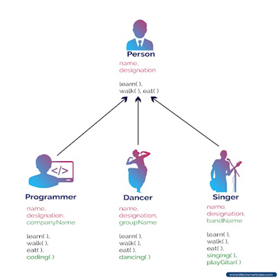
OOPs Concepts
source: https://www.javatpoint.com/java-tutorial

Slide 11
OOPs Concepts
Polymorphism
If one task is performed in different ways, it is known as polymorphism.
For example: to convince the customer differently, to draw something, for example, shape, triangle, rectangle, etc.
In Java, we use method overloading and method overriding to achieve polymorphism.
Another example can be to speak something; for example, a cat speaks meow, dog barks woof, etc.

Slide 12
Comparison of procedure oriented programming and object oriented programming
OOPs makes development and maintenance easier, whereas, in a procedure-oriented
programming language, it is not easy to manage if code grows as project size increases
OOPs provides data hiding, whereas, in a procedure-oriented programming language,
global data can be accessed from anywhere.
OOPs provides the ability to simulate real-world event much more effectively. We can provide the solution of real word problem if we are using the Object-Oriented Programming language.

Slide 13
What is Programming Language ?
A programming language is a formal computer language designed to communicate instructions to a machine, particularly a computer.
Programming languages can used to create programs to control the behaviour of machine or to express algorithms.
The most basic (called low level) computer language is the machine language that uses binary (1’s and 0’s) code which can run very fast without using translator (or) interpreter.
But it is tedious and complex.
The high - level languages (such as C, java) are much simpler to use but need to use another program to convert the high - level code into the machine code, therefore slower.

Slide 14
Example
Program to ADD 1 and 2

Slide 15
Assembly Language
Store 1 at memory location say A
Store 2 at memory location say B
ADD contents of location A and B
Store RESULT

Slide 16
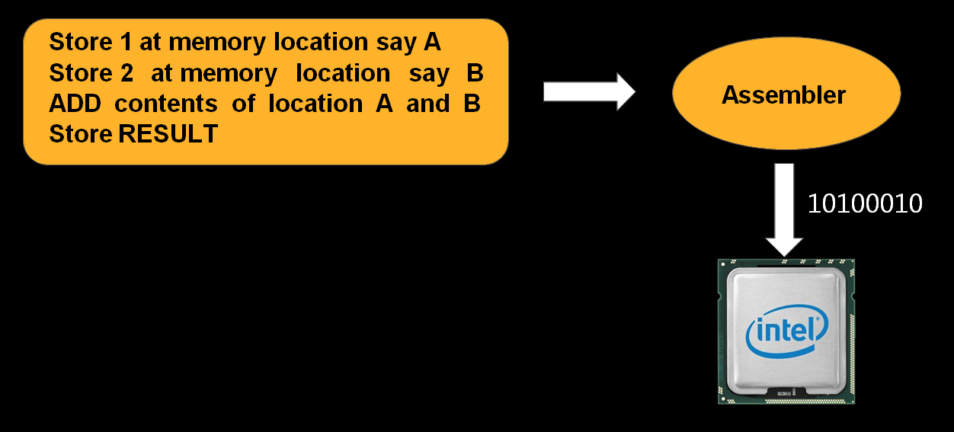
Assembly Language

Slide 17
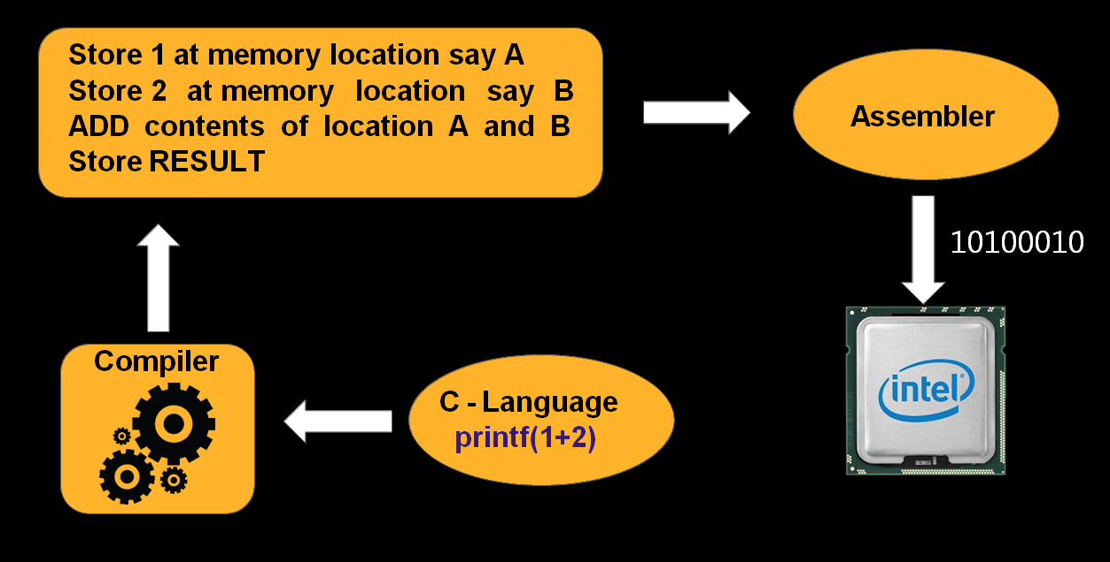
High-Level Language

Slide 18
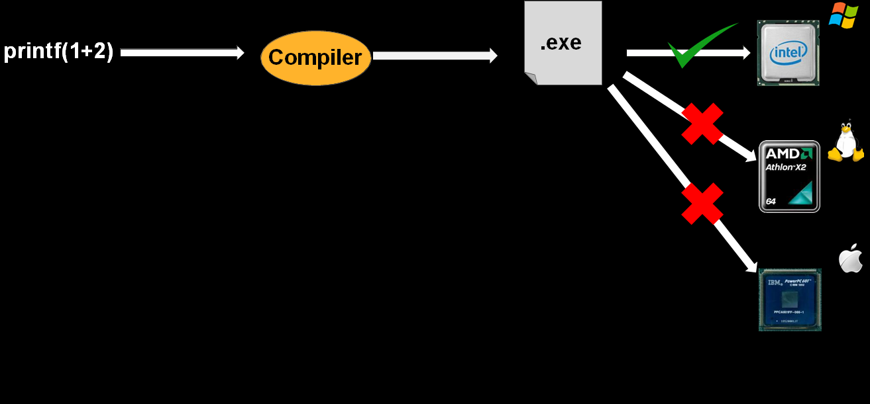
C Language

Slide 19
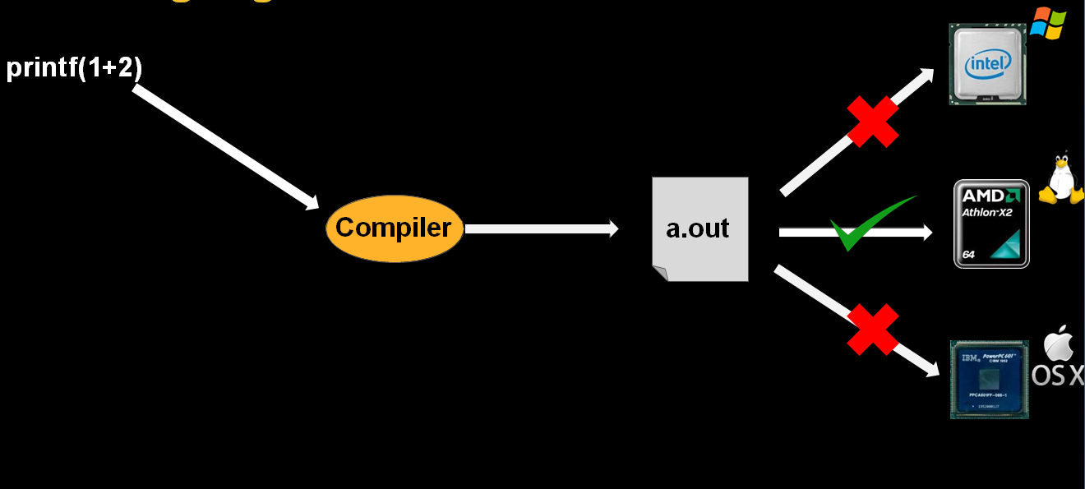
C Language

Slide 20
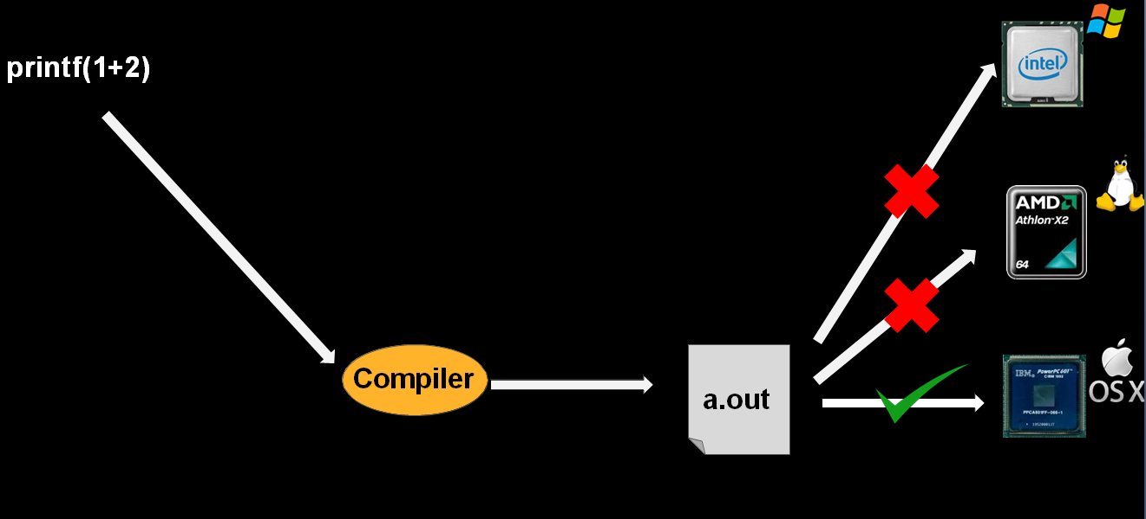
C Language

Slide 21
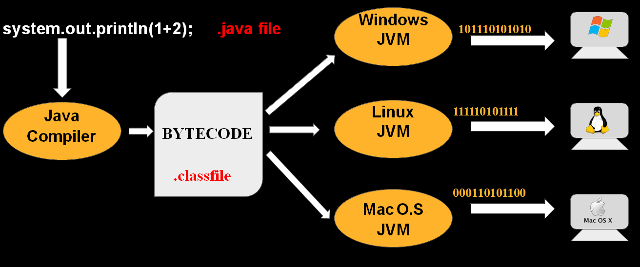
Java Language

Slide 22
History of Java
The history of java starts from Green Team. Java Team members (also known as Green Team) initiated a revolutionary task to develop a language for digital devices such as set-top boxes, televisions etc.
James Gosling, Mike Sheridan, and Patrick Naughton initiated the Java language project in June 1991. The small team of sun engineers called Green Team.

Slide 23
History of Java
Firstly, it was called “Greentalk” by james Gosling and file extension was .gt.
After that, it was called Oak and was developed as part of the Green Project
Why Oak??
Name is inspired by an Oak tree that stood outside of Gosling’s office.
Oak tree is a symbol of strength and chosen as a national tree of many countries like U.S.A, France, Germany etc.

Slide 24
History of Java
But in 1995, team had decided to change the name of language, because Oak name was already a trademark by Oak technologies.
New Name was Java
The suggested words were “dynamic”, “revolutionary”, “silk”, “joit”, “DNA” etc
According to James Gosling “Java and Silk” were two top choices.
Since java was so unique,most of the team members preferred java

Slide 25
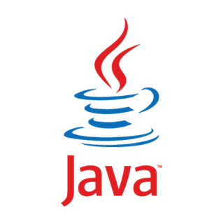
History of Java
Java is an island of Indonesia where first coffee was produced (called Java coffee)
Java coffee is consumed in large quantities by language creators.
Java is just a name not an acronym.

Slide 26
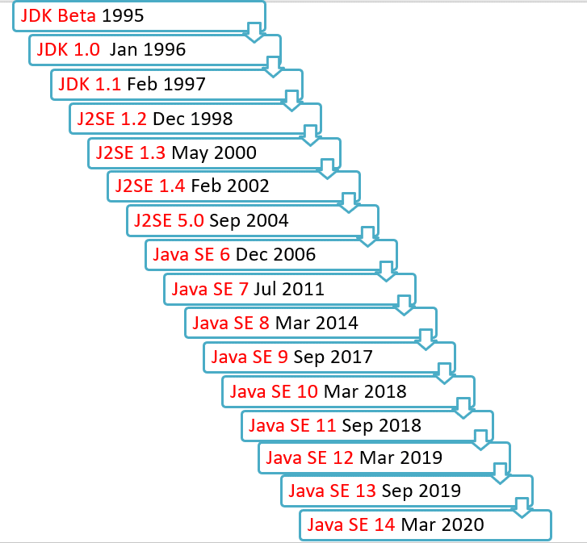
History of Java

Slide 27

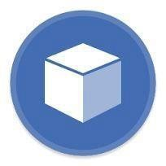

Where java is used?
According to Sun Microsystem, 3 billion devices run java. There are many devices where java is currently used. Some of them are..
Desktop Applications:

Slide 28




Where java is used?
Web Applications:
Games:

Slide 29
Types of Java Applications
Standalone application: It is also known as desktop application (or) window-based application.
➢
Standalone software is a computer software that can work offline i.e it doesn’t necessarily require network connection.

Slide 30
Types of Java Applications
Web application: An application that is stored on a remote server and delivered over the internet through a browser interface.
Enterprise application: Enterprise software is computer software used to satisfy the needs of an organization rather than individual users. Such organizations would include business, schools, clubs, charities or governments.

Slide 31
Types of Java Applications
^{Mobile Application}
most
Mobile application commonly referred to as an app, is a type of application software designed to run on a mobile device, such as smartphone or tablet computer.
Mobile applications frequently serve to provide users with similar services to those accessed on PCs.
Apps are generally small, individual software units
with limited function.

Slide 32
Features of Java
Simple
Object - Oriented
Platform independent
Secured
Robust
Architecture neutral
Portable
Dynamic
Interpreted
High Performance
Multi Threaded
Distributed

Slide 33
Features of Java
Simple- Java is very easy to learn and its syntax is simple, clean and easy to understand.
According to Sun, Java language is a simple programming language because:
Java syntax is based on C++ (so easier for programmers to learn it after C++).
Java has removed many confusing and rarely-used features e.g. explicit pointers, operator overloading etc.
There is no need to remove unreferenced objects because there is Automatic Garbage Collection in java.

Slide 34
Features of Java
Object Oriented :
Basic concepts of Object Oriented programming are
Object
Class
Inheritance
Polymorphism
Abstraction
Encapsulation

Slide 35
Features of Java
Platform independent:
A platform is the hardware or software environment in which a program runs. Java code can be run on multiple platforms e.g. Windows, Linux, Mac/OS etc.
Java code is compiled by the compiler and converted into bytecode.
This byte code is platform-independent code
because it can be run on multiple platforms i.e. Write Once and Run Anywhere(WORA).

Slide 36



Features of Java
system.out.println(1+2); .java file
Windows
JVM
101110101010
Java Compiler
Linux JVM
111110101111
BYTECODE
.classfile
000110101100
Mac O.S
JVM

Slide 37
Features of Java
Secure:
It does not use explicit pointer. So, Java does not allow access of memory area directly which makes it more secure and keeps it safe from many sources of bugs.
Java provides strong Exception Handling mechanism which makes it more secure as it does not allow to run the program until you rectify the error.
Java provides access modifier/access specifier like private, protected, public and default. It helps in controlling the access of any member.Java Programs run inside a virtual machine sandbox
Bytecode Verifier: It checks the code fragments for illegal code that can violate access rights to objects.

Slide 38
Features of Java
Robust:
Two main problems that cause program failures are memory management mistakes and mishandled runtime errors. Java handles both of them efficiently.
Memory management mistakes can be overcome by garbage collection.
Garbage collection is automatic deallocation of objects which are no longer needed. Mishandled runtime errors are resolved by Exception Handling procedures.

Slide 39
Features of Java
Portable:
When we compile the java program, the compiler
of java generates .class file that contains the
Bytecodes of your java program.
The generated Bytecodes are secure and can run
on any machine (portable) which has JVM.

Slide 40
Features of Java
^{Architecture - In} neutral:
java there is no implementation
feature e.g. size of primitive types _{is}
dependent
fixed.
In C programming, float data type occupies 4 bytes
of memory for 32-bit architecture and 8 memory for 64-bit architecture. But in
bytes of java,occupy it
occupies 4 bytes of memory for both 32 and 64 architectures.-

Slide 41
Features of Java
Multi threaded: Java supports multithreading. It enables a program to perform several tasks simultaneously.
Interpreted and High Performance:
Java interpreter
the bytecode
code. For very
into
high
converts
processor readable
performance it uses a binary just-in-time compiler.

Slide 42
Heading 1
Distributed: RMI(Remote Method Invocation) and EJB(Enterprise Javabeans) are used for creating distributed applications in java.
In simple words: The java programs can be distributed on more than one systems that are
connected to each connection. Objects on
other using one JVM (java
internet virtual Ma
Machine can execute procedures on remote JVM

Slide 43
Difference Between JDK, JVM and JRE

Slide 44
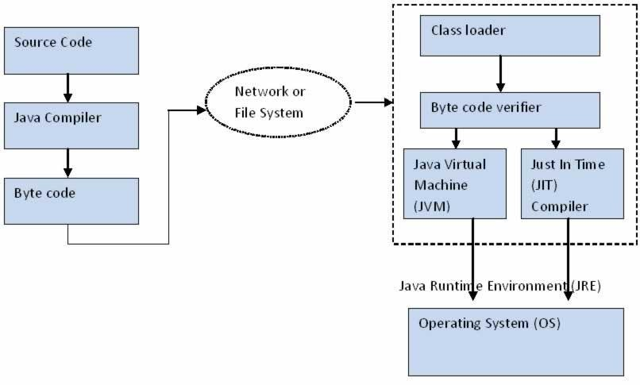

Slide 45
Java Virtual Machine (JVM)
JVM is the heart of Java programming Language.
As we all aware when we compile a java file, output is
into an “.exe” but it’s a ‘.class’ file. ‘.class’ consists of Java bytecode.
Java Virtual Machine interprets the bytecode into the
file
machine code depending upon the underlying operating system and Hardware combination.

Slide 46
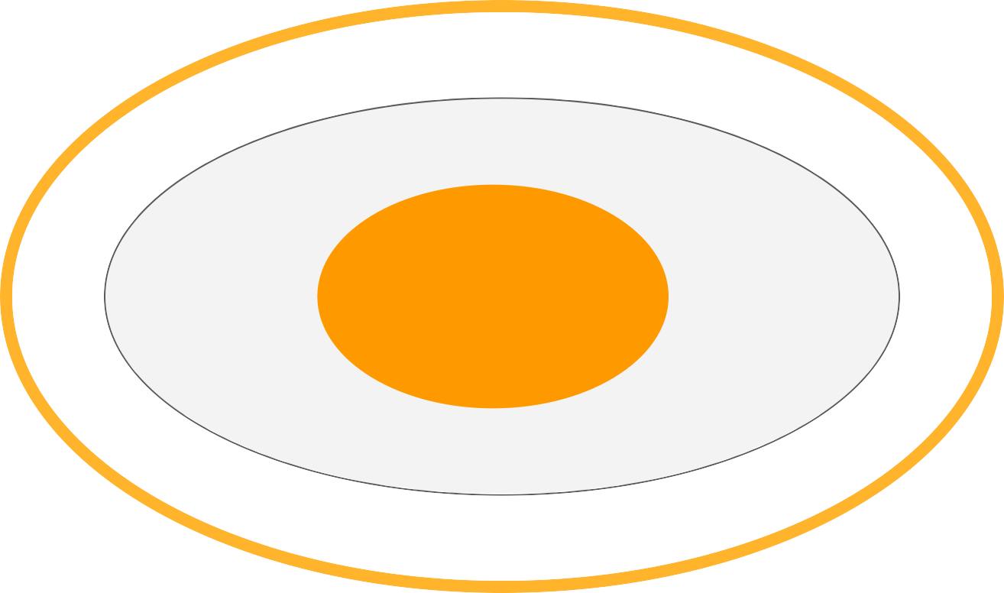
Java Virtual Machine (JVM)
Java
Application
JVM
Operating Systems

Slide 47
Lifetime of a Java Virtual Machine
When a java application starts, a runtime instance of JVM is created. When the application completes, the instance terminates.
If you start three java applications at the same time, on the same computer, you will get three java virtual machine instances running
Each java application runs inside its own java virtual
Machine.

Slide 48
Application
1
Application
2
Application
3
JVM
JVM
JVM
OS
Hardware

Slide 49
Java Runtime Environment
Java runtime environment contains JVM, class libraries and other supporting files.
It doesn’t contain any development tools such as
compiler, debugger etc.
Actually JVM runs the program, and it uses the class libraries, and other supporting files provided in Java runtime environment.

Slide 50
Java Runtime Environment
Set of libraries Eg: rt.jar,
jce.jar
JVM
Other files
JAVA RUNTIME ENVIRONMENT

Slide 51
J A V A DEVELOPMENT KIT
Java development kit provides all necessary tools
to develop any java application as well as runs it.
JDK = Tools required to develop java application
+
Java Runtime Environment

Slide 52
J A V A DEVELOPMENT KIT
The tools provided by JDK to develop java application are listed below
Java Compiler
Java Debugger
Java appletviewer etc.

Slide 53
JAVA DEVELOPMENT KIT
Compiler
libraries
J V M
Debugger
JRE
Java applet viewer
JDK

Slide 54
JUST-IN-TIME Compiler
Just-in-time compiler is a part of JVM that is used to speed up the execution time of a program.
Basic definition of compiler is “a program that translates the source code to a machine executable code”.
So, How Just-in-time compiler differs?

Slide 55
JUST-IN-TIME Compiler
When compiling a java program, the static compiler that is run using the command javac converts the source code to bytecode which are in the form of
.class files. These .class files (or) byte code needs to
be interpreted to convert it into a machine executable code

Slide 56
JUST-IN-TIME Compiler
Bytecode of a program may usually consists of methods, variables, threads and other instructions
So, if there is a repeated code, instead of interpreting it every time the code is compiled to an executable code by the JIT compiler.
JIT compiles the code when it is needed but not before runtime.

Slide 57
JUST-IN-TIME Compiler
Whenever a program is executed this compiled code is invoked instead of interpreting the entire byte code and is quite efficient, and increases the performance of the program as well.
However, the use of JIT is optional, but SUN microsystems suggest that it is quite efficient to use JIT especially if there exists a repeated code in the program.

Slide 58
Overview of How JIT compiler helps in
compilation of code
Using a compiler, java source code is converted to byte code.
JVM loads the .class files at runtime and converts them to a machine understandable code using an interpreter.
JIT compiler is a feature of JVM which when enabled makes the JVM analyze the method calls in byte code and compiles them to more efficient code.

Slide 59
Overview of How JIT compiler helps in
compilation of code
JIT optimizes the code.
The JVM then executes this optimized code instead of interpreting it. Which is likely to increase the performance of the execution.

Slide 60
Creating Java Program
class FirstProgram {
public static void main(String args[]) {
System.out.println("First Java Program");
}
}

Slide 61
Compiling a Java Program
A compiler is an application that translates programs from the Java language to a language more suitable for executing on the computer.
It takes a text file with the .java extension as input (your program) and produces a file with a .class extension (the computer-language version).

Slide 62
Compiling a Java Program
To compile FirstProgram.java type the command at the terminal.
following
javac FirstProgram.java

Slide 63
Executing a java program
Once you compile your program, you will get .class file. Now, we can execute the .class file by following command
java FirstProgram
OUTPUT:
First Java Program

Slide 64
Understanding First Java Program
class keyword is used to declare a class in java.
public keyword is an access modifier which represents visibility, it means it is visible to all.
void is the return type of the method, it means it doesn't return any value.
main represents startup of the program.

Slide 65
Understanding First Java Program
static is a keyword, if we declare any method as static, it is known as static method.
The core advantage of static method is that is no need to create object to invoke the method.
there static
The main method is executed by the JVM, so it doesn't require to create object to invoke the main method. so it saves memory.

Slide 66
Understanding First Java Program
String[ ] args is used for command line argument.
System.out.println() is used print statement.

Slide 67
JAVA VARIABLES

Slide 68
Variables
A variable is a container which holds the value while the java program is executed. A variable is assigned with a datatype.
Variable is a name of memory location. There are three types of variables in java: local, instance and static.

Slide 69
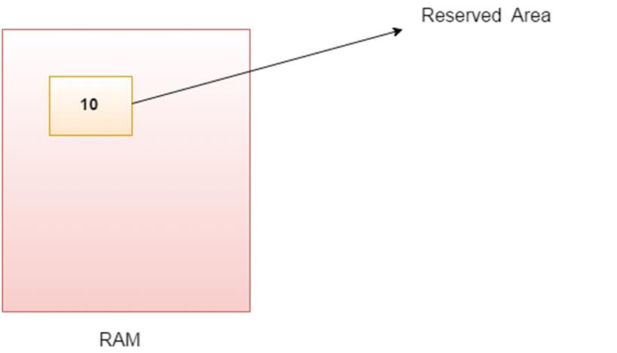
VARIABLE IS NAME OF RESERVED AREA ALLOCATED IN MEMORY.

Slide 70
TYPES OF VARIABLES
local variable - A variable declared inside the body of
the method is called local variable.
instance variable - A variable declared inside the class but outside the body of the method, is called instance variable. It is not declared as static.
static variable - A variable which is declared as static is called static variable. It cannot be local. You can create a single copy of static variable and share among all the instances of the class.

Slide 71
EXAMPLE
class A
{
int data=50; //instance variable
static int m=100; //static variable void method()
{
int n=90; //local variable
}
} //end of class Class B
{
public…………..{ A ob,ob1; ob.m=50; ob1.m=10;}}

Slide 72
JAVA VARIABLE EXAMPLE: ADD TWO NUMBERS
class Simple{
public static void main(String[] args){
int a=10; int b=10; int c=a+b;
System.out.println(c);
}}

Slide 73
Data Types
Data type is a special keyword used to allocate sufficient memory space for the data.
In general every programming language is containing three categories of data types. They are
Fundamental or primitive data types
Derived data types
User defined data types.

Slide 74
Data Types
DATA TYPE
Primitive
Derived
User Defined

Slide 75
Primitive Data Types
Primitive data types are those whose variables allows us to store only one value but they never allows us to store multiple values of same type.
Example:
int a;
a = 10; // valid
a = 10, 20, 30; // not valid

Slide 76
Primitive Data Types
There are eight built-in types supported by Java to support:
Four Integer Type
Two Float Type
One Character type
One Boolean type.

Slide 77
Integer Type
The integer types in Java are byte, short, int, and long. These four types differ only in the number of bits and, therefore, in the range of numbers each type can represent.
All integral types represent signed numbers. There
is no unsigned keyword as there is in C and C++.

Slide 78
Type | Contains | Default | Size | Range
byte | Signed integer | 0 | 1 byte(8 bits) | -128 to +127
short | Signed integer | 0 | 2 byte(16 bits) | -32768 to +32767
int | Signed integer | 0 | 4 byte(32 bits) | -2147483648 to 2147483647
long | Signed integer | 0 | 8 byte(64 bits) | -92233720368 54775808 to 922337203685 4775807

Slide 79
Boolean Type
The boolean type represents a truth value. There
are only two possible values of this type,
yes
representing the two boolean states: on or off, or no, true or false.
Java reserves the words true and false to represent
these two boolean values.
Note: boolean values can never be converted to or from other data types

Slide 80
Boolean Type
Type | Contains | Default | Size | Range
boolean | true or false | false | 1 bit | NA

Slide 81
Float Type
The float types in Java are float and double. These two types differ only in the number of bits and, therefore, in the range of numbers each type can represent.
float is a
value, and
32-bit, single-precision floating-point
double is a 64-bit, double-precision
floating-point value.

Slide 82
Float Type
Type | Contains | Default | Size | Range
float | IEEE 754 floating point | 0.0 | 32 bits | ±1.4E-45 to ±3.4028235E+3 8
double | IEEE 754 floating point | 0.0 | 64 bits | ±4.9E-324 to ±1.797693134 8623157E+308

Slide 83
Char Type
In Java, the data type used to store characters is char.
Character is 2 byte(16 bits) wide in Java.
Java uses Unicode to represent characters.
Java support lot of Unicode symbols from many more
human languages for this purpose, it requires 16 bits.
The range of a char is 0 to 65,536.
There are no negative chars.

Slide 84
Char Type
Type | Contains | Default | Size | Range
char | Unicode character | \u0000 | 16 bits | \u0000 to \uFFFF

Slide 85
WHY CHAR USES 2 BYTE IN JAVA AND WHAT IS \U0000 ?
It is because java uses Unicode system not ASCII code system. The \u0000 is the lowest range of Unicode system.
Before Unicode, there were many language standards:ASCII (American Standard Code for Information Interchange) for the United States.
ISO 8859-1 for Western European Language. KOI-8 for Russian.
GB18030 and BIG-5 for chinese, and so on.

Slide 86
WHY CHAR USES 2 BYTE IN JAVA AND WHAT IS \U0000 ?
This caused two problems:A particular code value corresponds to different letters in the various language standards.
The encodings for languages with large character sets have variable length.Some
common characters are encoded as single bytes, other require two or more byte.
Solution
To solve these problems, a new language standard was developed i.e. Unicode System.In unicode, character holds 2 byte, so java also uses 2 byte for characters.lowest value:\u0000highest value:\uFFFF
Java suitable for representing strings in any language supported byUnicode.
Unicode standard uses hexadecimal to express a character.
the char data type was originally used to represent a 16-bit Unicode code point

Slide 87
Derived Data Types
Derived data types are those whose variables allow us to store multiple values of same type. But they never allows to store multiple values of different types.
In general derived data type can be achieve using array.
Example:
int a[ ] = {10,20,30}; // valid
int b[ ] = {100, 'A', "ABC"}; // invalid

Slide 88
User Defined Data types
User defined data types are those which are developed by programmers by making use of appropriate features of the language.
User defined data types related variables allows us to store multiple values either of same type or different type or both.
This is a data type whose variable can hold more than one value of dissimilar type, in java it is achieved using class concept.

Slide 89
User Defined Data types
Note: In java both derived and user defined data
combined name as reference data type.
types
In C language, user defined data types can be developed by using struct, union, enum etc.
In java programming user defined data type can be developed by using the features of classes and interfaces.

Slide 90
Type Casting
The process of converting one data type to another is
called casting.
Casting is often necessary when a function returns a data in different form than what we need.
Under certain circumstances Type conversion can be carried out automatically, in other cases it must be "forced" manually (explicitly)

Slide 91
Type Casting
The storage size of the types while casting is very
important otherwise the data loss will occur.
For example, suppose we cast a long to an int. A long is a 64-bit value and an int is a 32-bit value. When casting a long to an int, the compiler truncates the upper 32 bits of the long value so as to fit into the 32-bit int.
If the upper 32 bits of the long contain any useful information, then data loss will occur.

Slide 92
Type Casting
In some cases, the data type of the
expression is
changed automatically to the variable's data type. For
example, suppose that i is an integer variable as follows:
int i = 10 ;
declared
Even though d is a variable of type
following assignment is valid: double d = i *10; // valid,
(i*10) is converted to type double
double, the

Slide 93
Type Casting
Java changes (i*10) from int to double, and then
assigns it to d.
This conversion does not cause any loss of information because the double data type is 64 bits wide and thus is wider than the int data type that has 32 bits. This is called a widening conversion because a narrower type is converted to a wider type, and it takes place implicitly.

Slide 94
Type Casting
some more examples of when widening conversions
occur:
short s = 10;
int num= s;
float f = 10.5f;
double d = f;

Slide 95
Type Casting
Type Casting
Following Figure summarizes the conversion rules: A conversion occurs from a given data type to any of the data types on its right.
byte | short | int | long | float | double
Conversion to the wider type on the right takes place implicitly

