Slide 1
Mind Your Money
By Team MYM

Slide 2

What is Mind Your Money?
Easy to use Android Application to maintain a periodic budget

Slide 3
Points of Interest
Starting Date of the budget period
Number of days in a budget period
The different categories of expenditure
The list of expenses

Slide 4
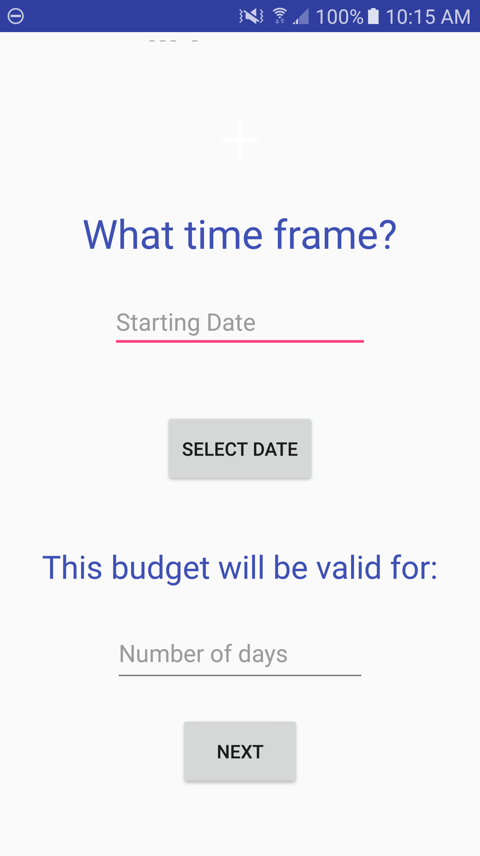
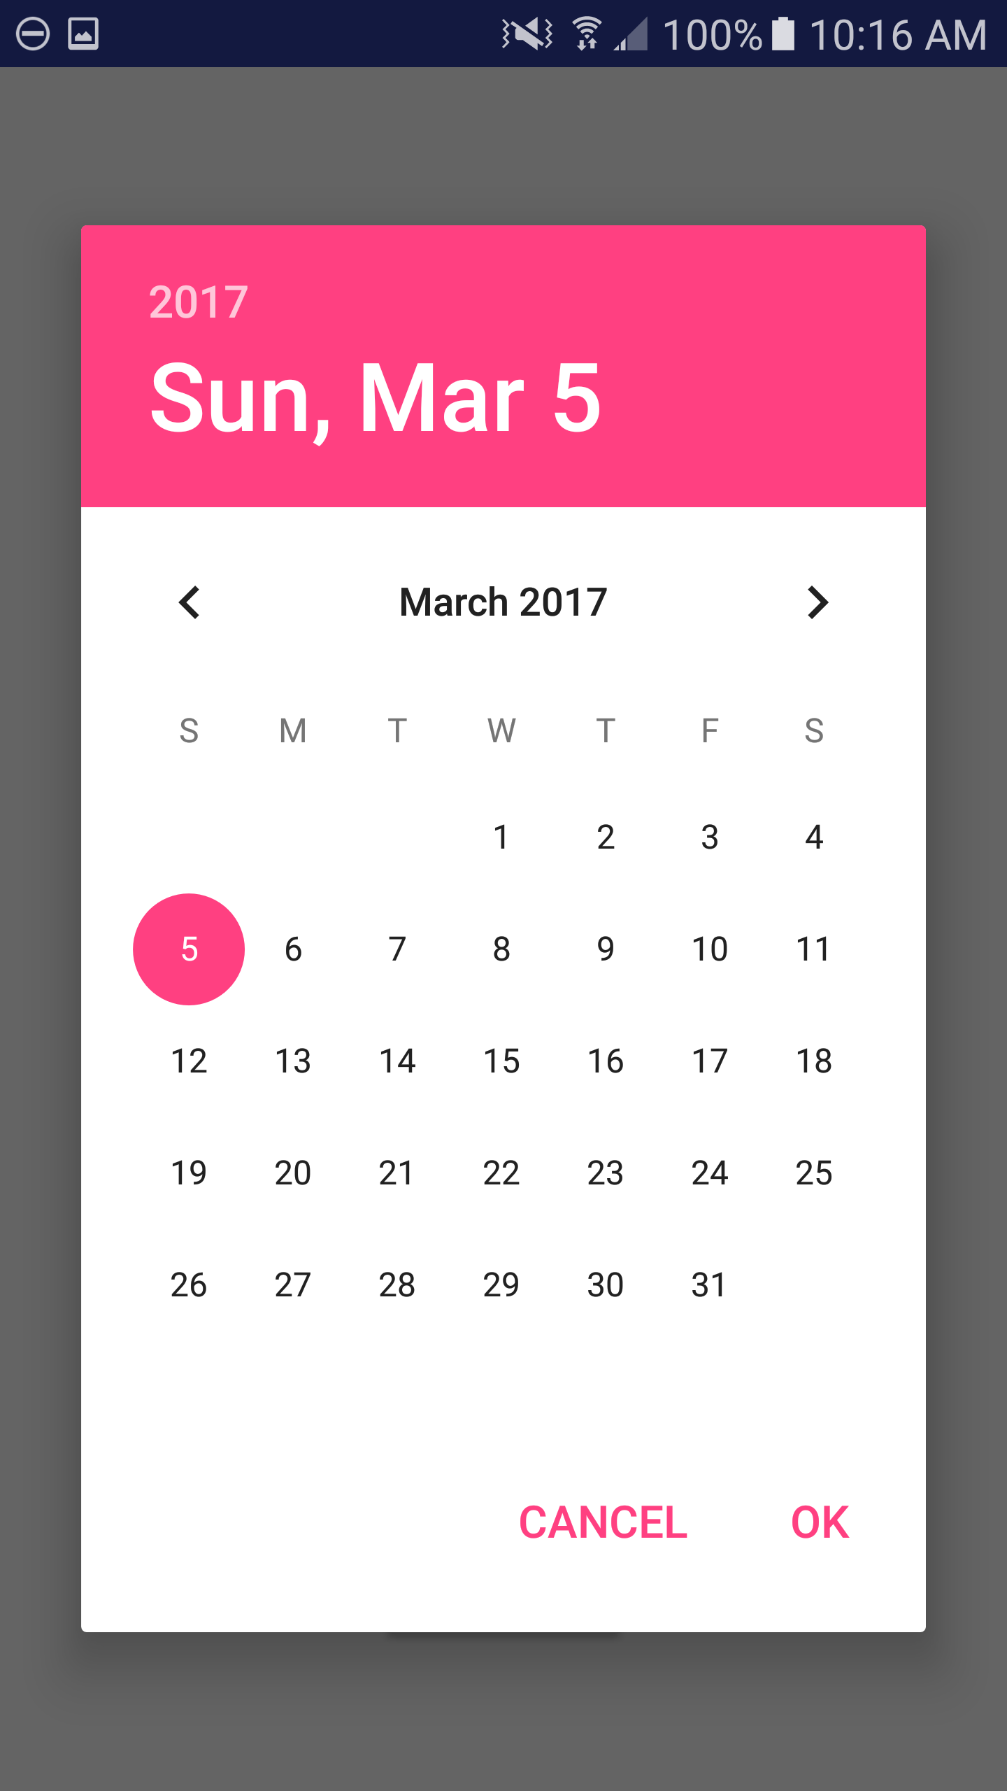
Setting the Time

Slide 5
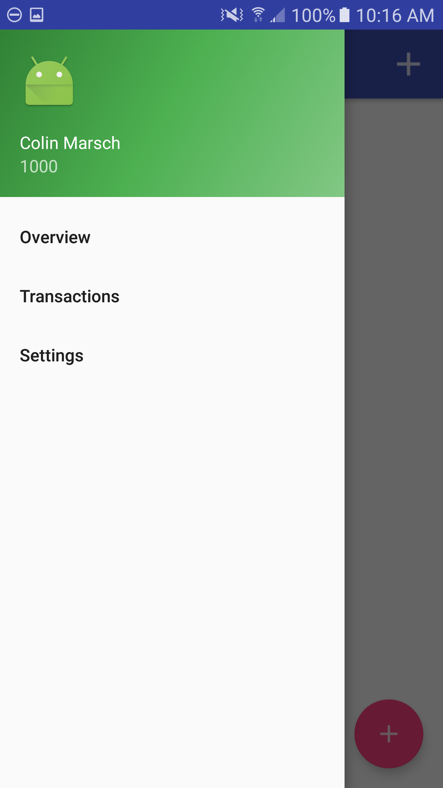
The Drawer
Name of User→
Budget→
Different Sections→

Slide 6
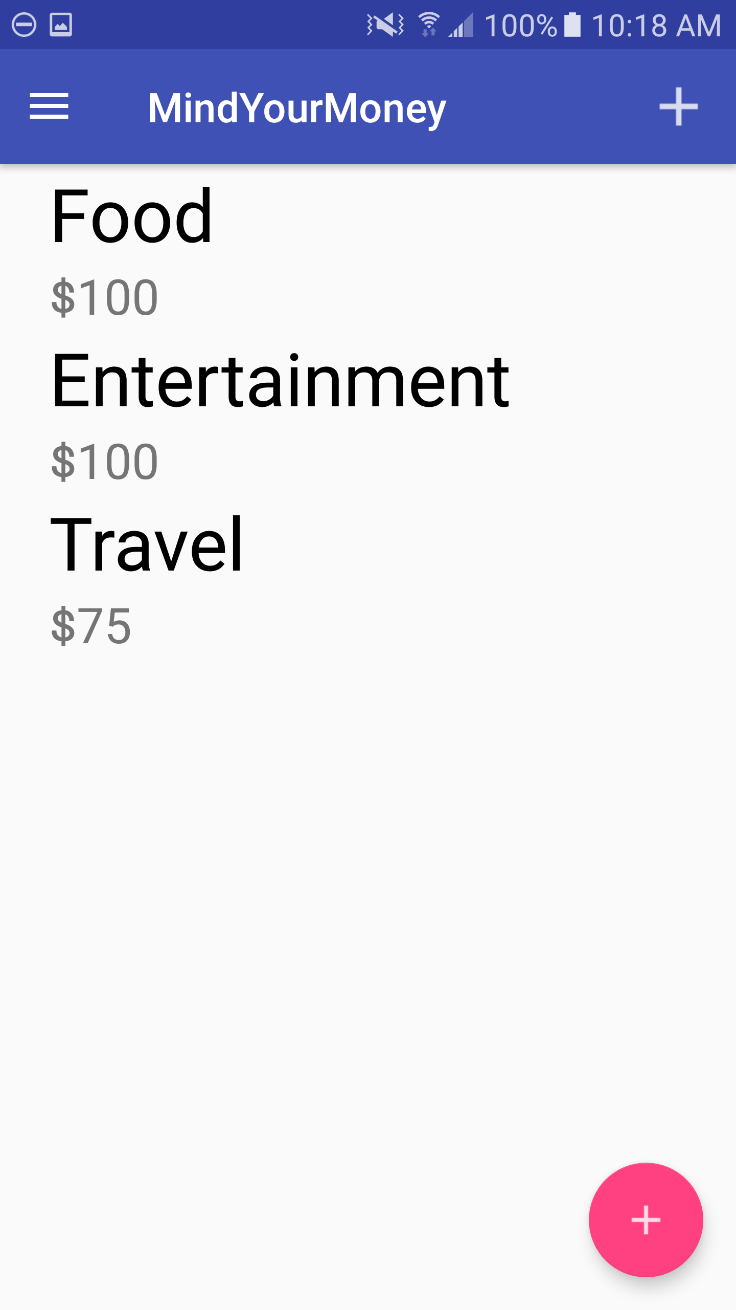
Main Overview
Drawer→
Category→
Money Assigned→
←Add Expenses

Slide 7
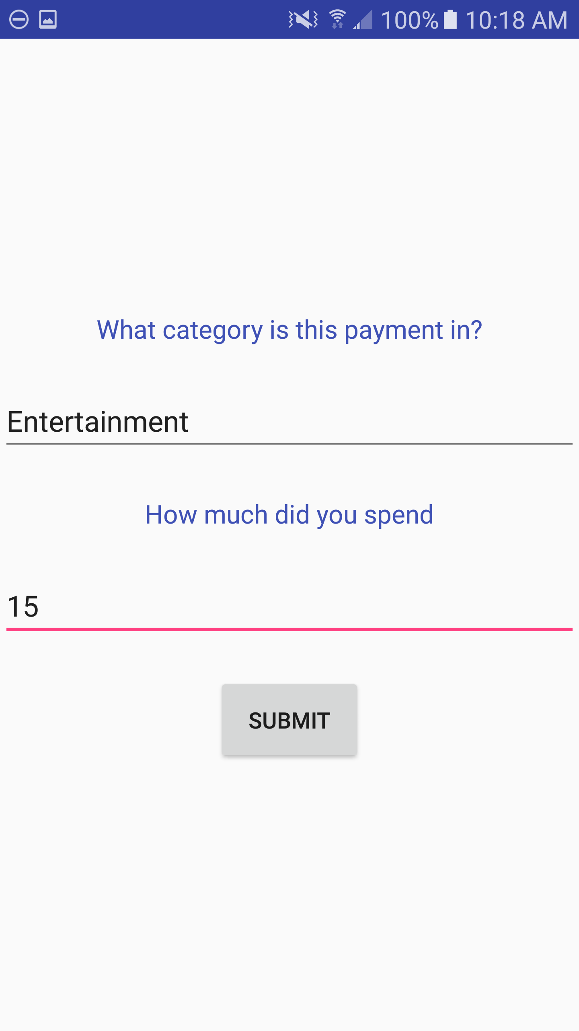
Adding Expenses
Payment Category→
Payment Amount→
Submit Button→

Slide 8
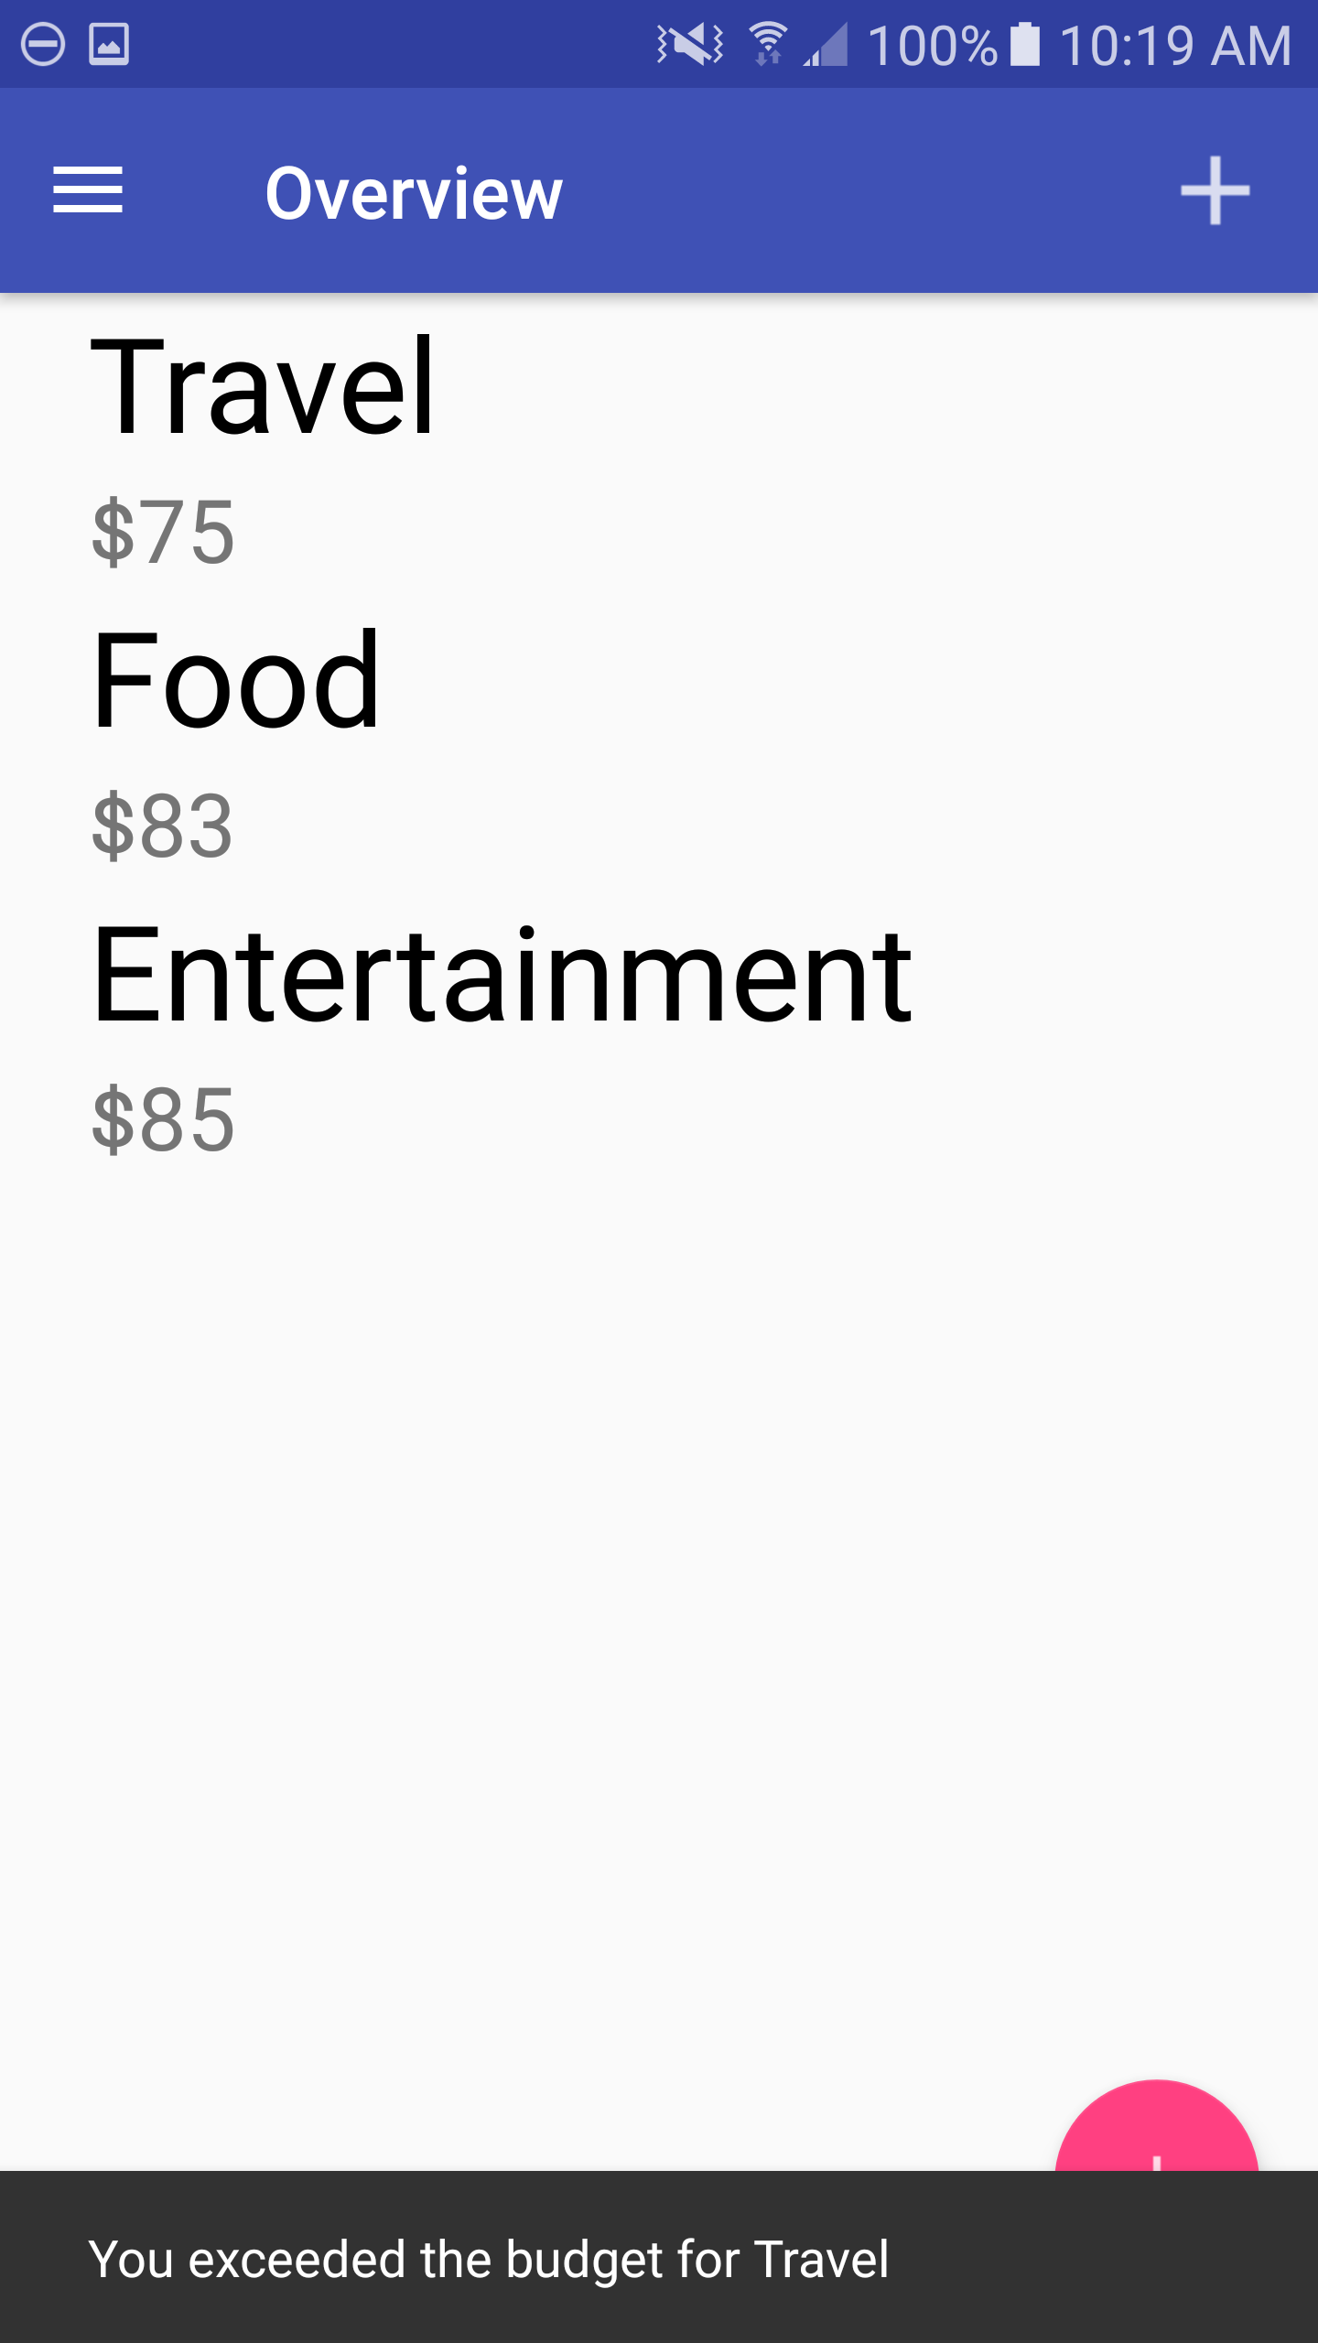
Adding Expenses
Adds An Expense

Slide 9
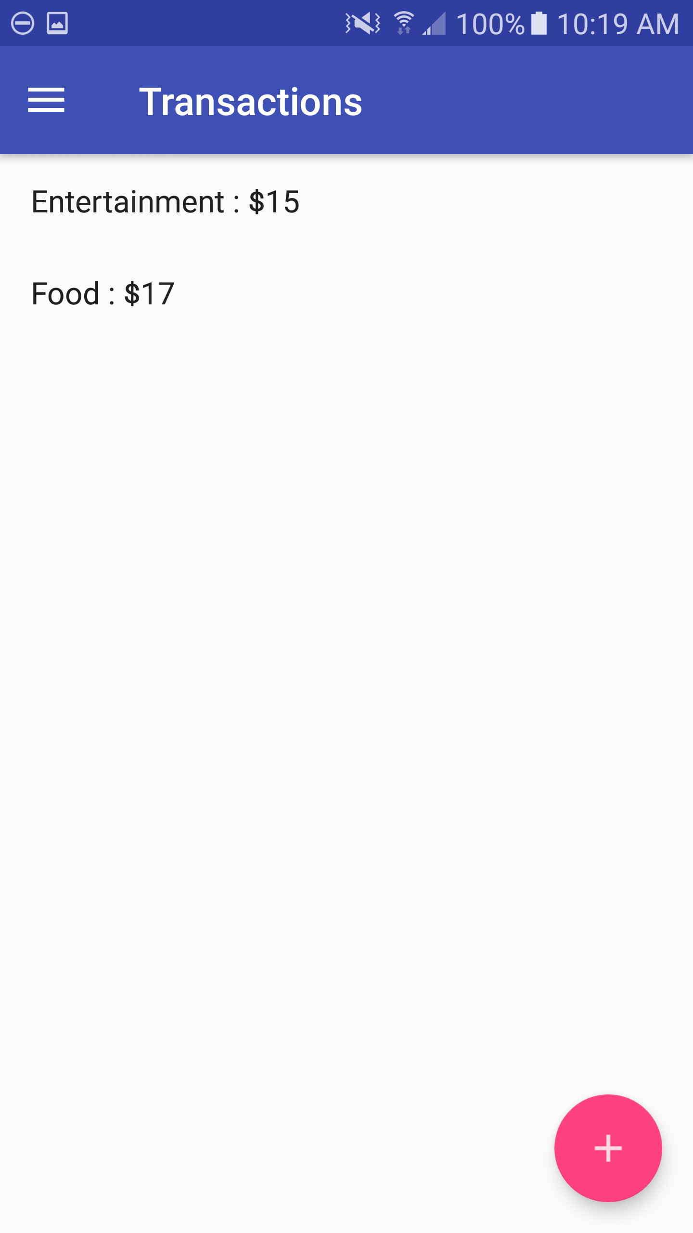
Expense List
Drawer→
Category of Expense Plus Amount→

Slide 10
Future Additions
Linking to Bank Account to prevent crossing budget
Add warning system for when remaining budget is near the last 10%
Add Aesthetics
Improve Information Saving System

Slide 11
THE END

