Slide 1
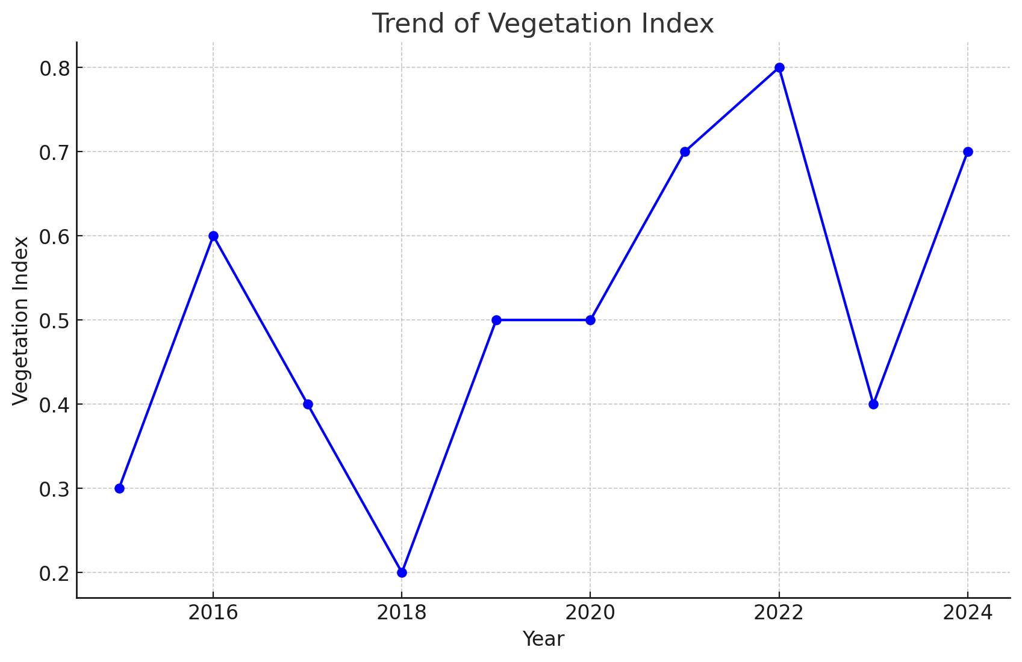
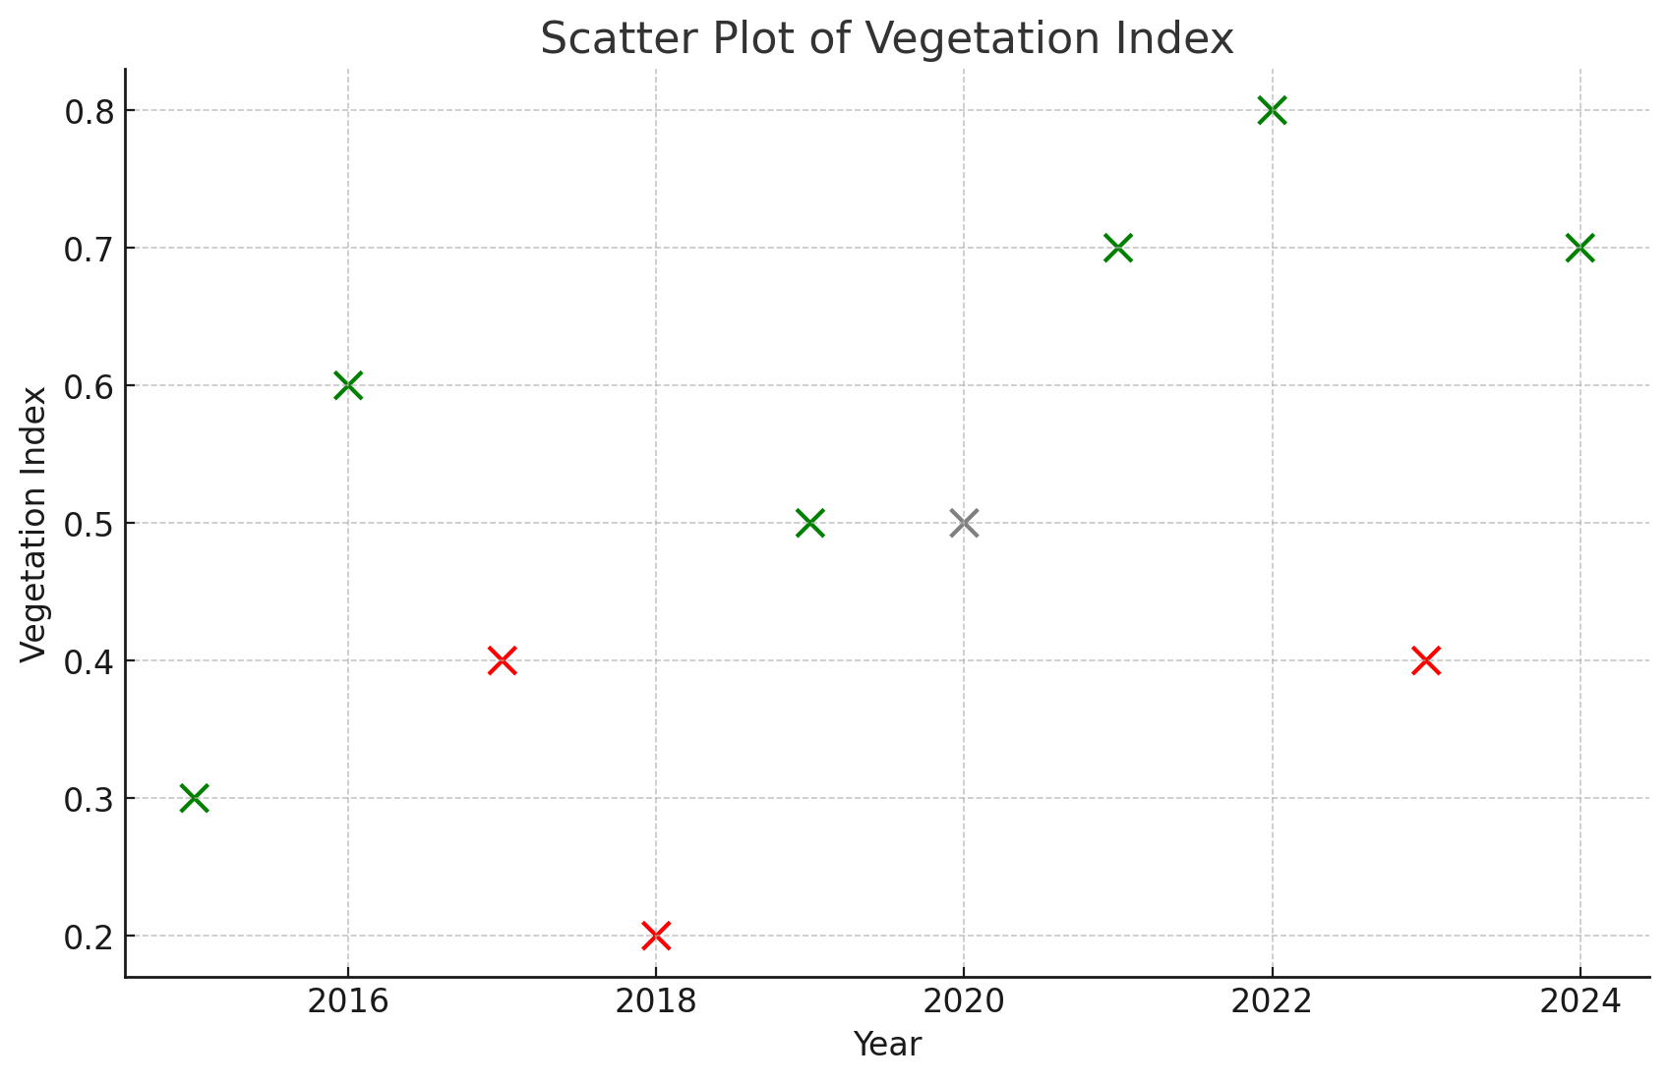
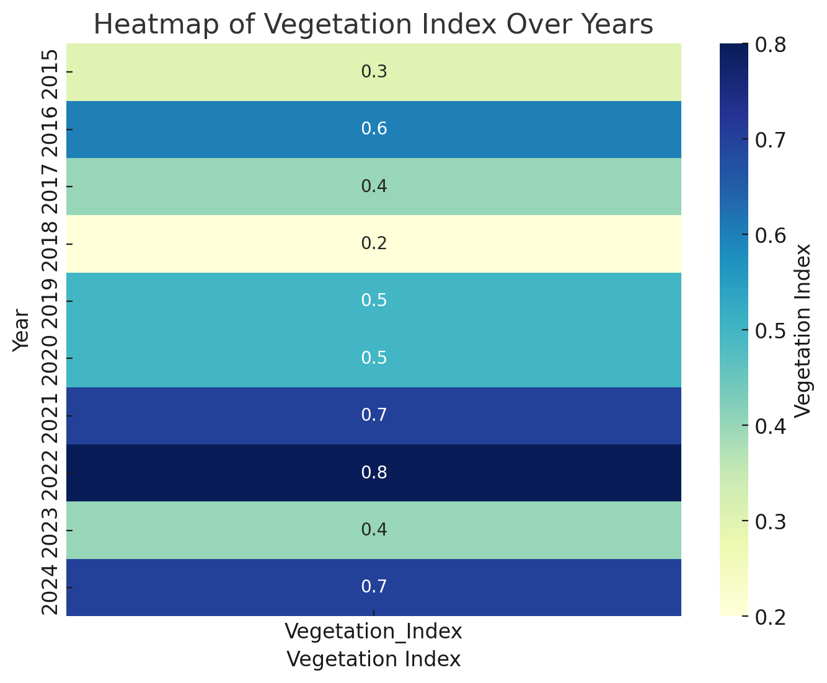
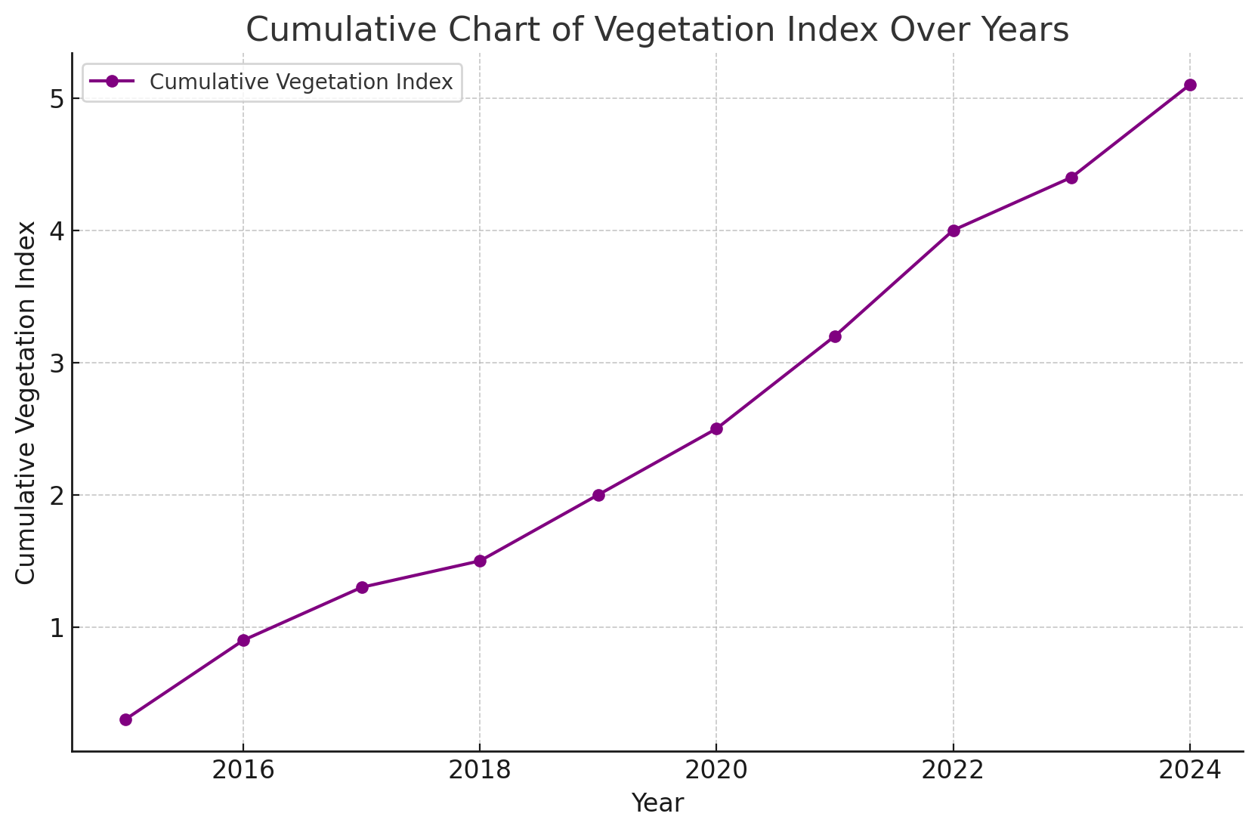
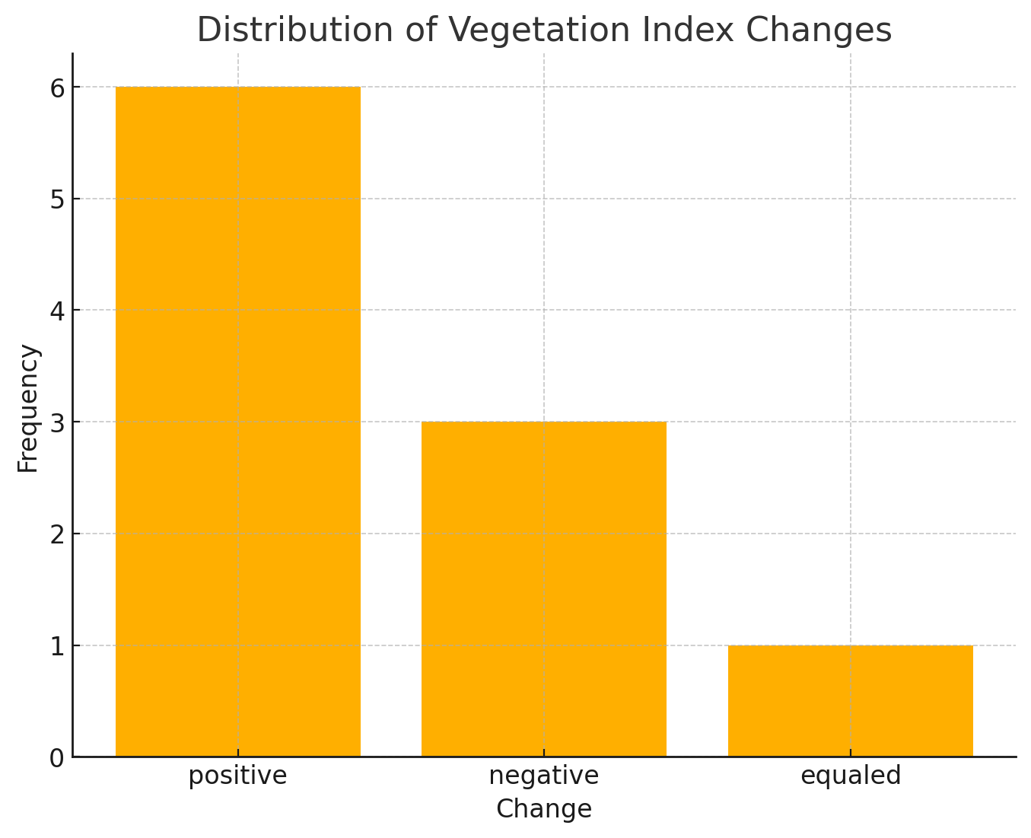
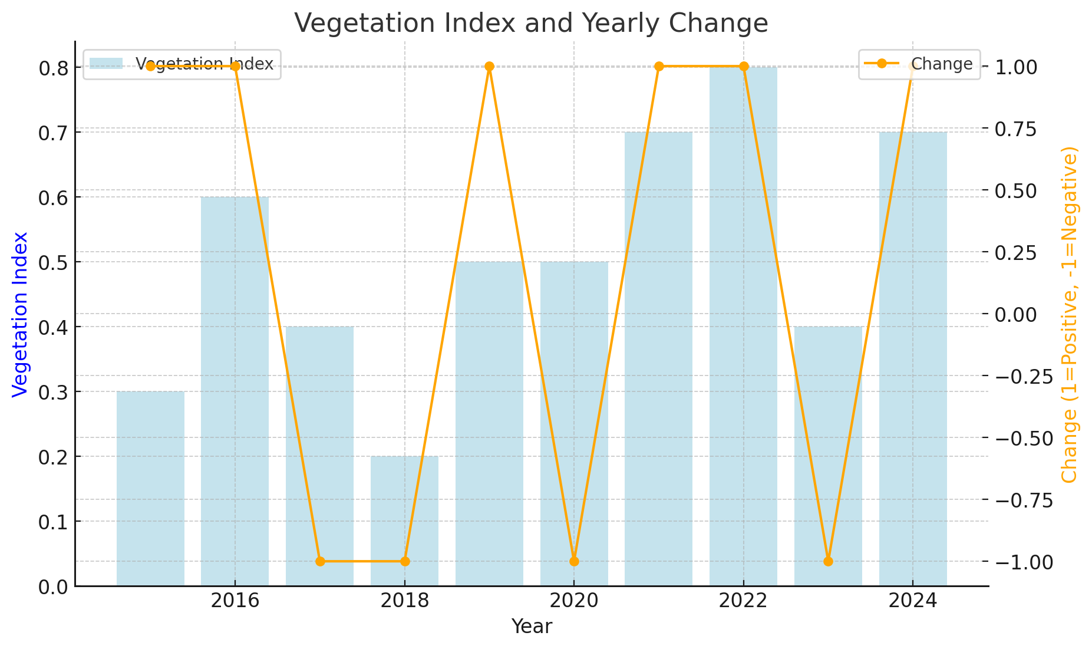
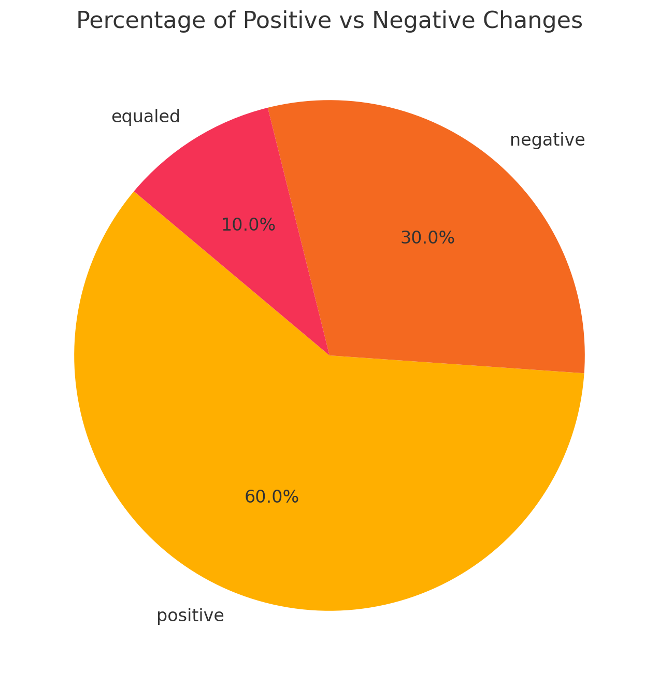
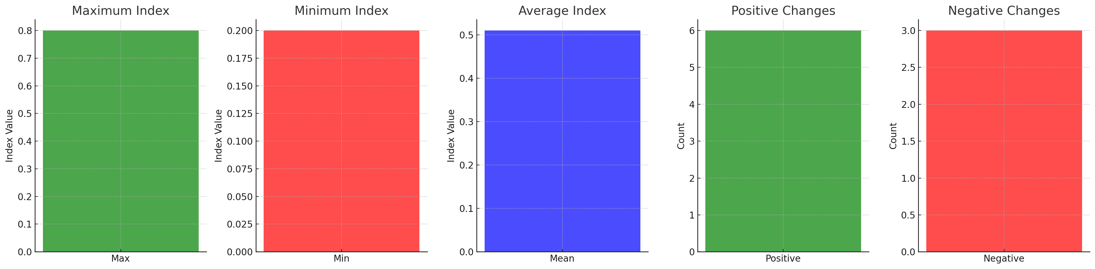
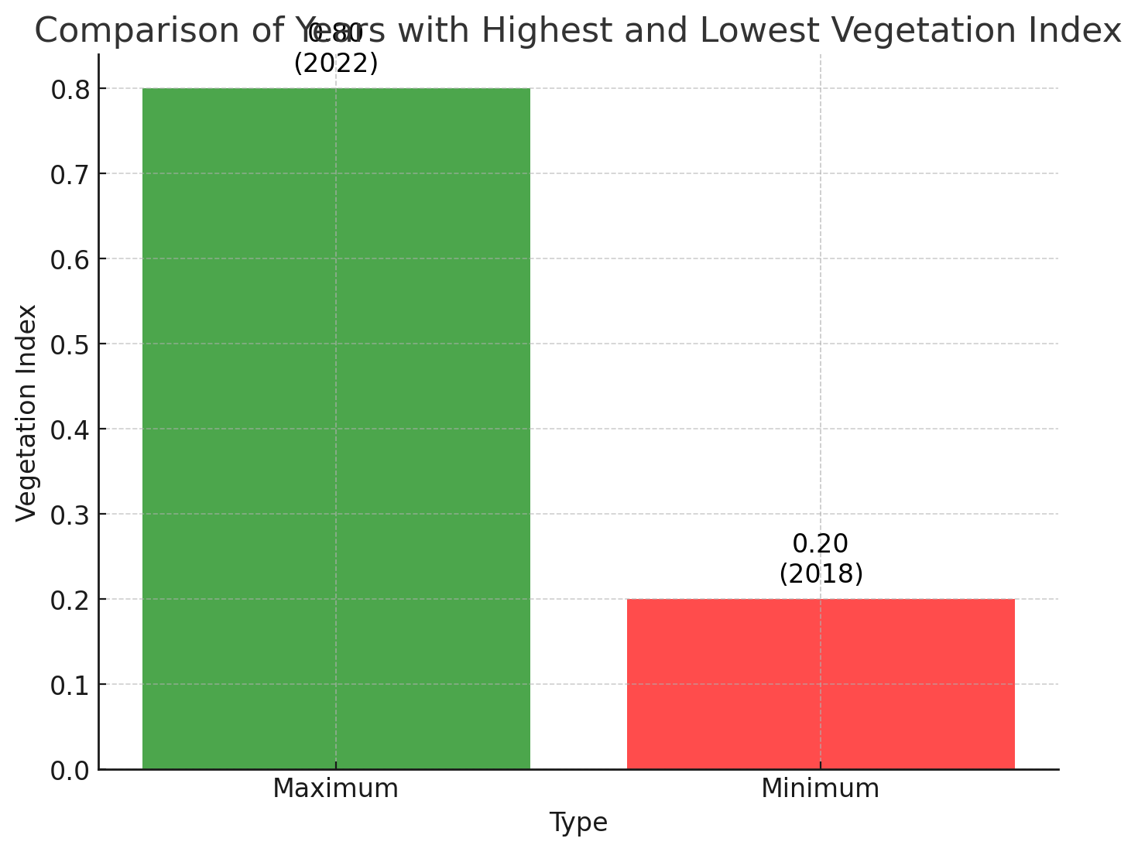
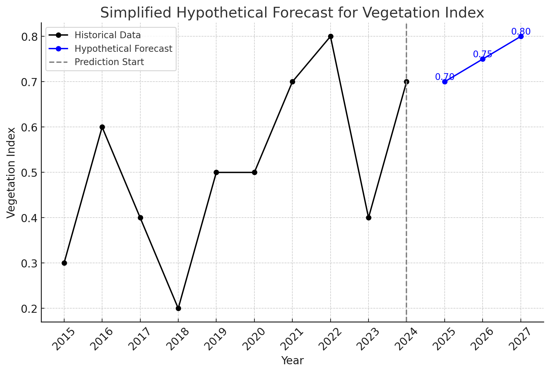

Slide 2
Line Chart: Trend of Vegetation Index
This chart shows the trend of the Vegetation Index over the years, highlighting changes in vegetation conditions. It helps identify patterns or anomalies in vegetation growth over time.

Slide 3
Scatter Plot of Vegetation Index Over Years with Changes
This scatter plot represents the Vegetation Index across different years, with color-coded markers indicating the type of change: green for positive changes, red for negative changes, and gray for unknown changes. It provides a clear visual of how the index fluctuated over time and the nature of the changes.

Slide 4
Heatmap of Vegetation Index Over Years
This heatmap visualizes the intensity of the Vegetation Index across different years using a color gradient. Darker colors represent higher values, while lighter colors indicate lower values, allowing for an intuitive comparison of vegetation trends over time.

Slide 5
Cumulative Chart of Vegetation Index Over Years
This line chart shows the cumulative Vegetation Index over the years, representing the overall growth or accumulation of vegetation conditions. The upward trend highlights consistent increases in the index, indicating improved vegetation coverage or conditions over time.

Slide 6
Distribution of Vegetation Index Changes
This bar chart illustrates the frequency of Vegetation Index changes categorized as positive, negative, and equaled. It shows that positive changes are the most frequent, followed by negative changes, with equaled changes being the least frequent.

Slide 7
Vegetation Index and Yearly Change
This chart combines a bar chart and a line graph to illustrate the Vegetation Index (in blue bars) and the yearly change (in orange line). The Vegetation Index shows the yearly values, while the line indicates whether the change was positive (1) or negative (-1). This visualization helps analyze trends and fluctuations in vegetation over time.

Slide 8
Percentage of Positive vs Negative Changes
This pie chart illustrates the percentage distribution of positive, negative, and equaled changes in the Vegetation Index. Positive changes make up the largest portion (60%), followed by negative changes (30%), while equaled changes account for the smallest share (10%). This visualization provides a clear comparison of the change types.

Slide 9
KPI Summary Charts
Maximum Index:This bar chart shows the maximum value of the Vegetation Index (0.8), represented in green.
Minimum Index:This bar chart displays the minimum value of the Vegetation Index (0.2), represented in red.
Average Index:This bar chart illustrates the average value of the Vegetation Index (approximately 0.5), shown in blue.
Positive Changes:This bar chart presents the count of positive changes in the Vegetation Index (6), represented in green.
Negative Changes:This bar chart highlights the count of negative changes in the Vegetation Index (3), represented in red.

Slide 10
Comparison of Years with Highest and Lowest Vegetation Index
This bar chart compares the years with the highest and lowest Vegetation Index values.
Maximum Index (2022): The highest index value is 0.8, represented in green.
Minimum Index (2018): The lowest index value is 0.2, represented in red.

Slide 11
Simplified Hypothetical Forecast for Vegetation Index
This chart combines historical data (black line) and hypothetical forecasts (blue line) for the Vegetation Index.
Historical Data: Displays the actual index values from 2015 to 2024.
Hypothetical Forecast: Projects future values for 2025-2027, assuming steady growth.
Prediction Start: Marked by the dashed line, indicating the boundary between historical and forecasted data.
The hypothetical forecast assumes index values of 0.70, 0.75, and 0.80 for 2025, 2026, and 2027, respectively.

Slide 12
Detailed Statistical Analysis of Vegetation Index in a Single Region Over Time
1. Maximum (0.8)
2. Sum (5.1)
3. Range (0.6)
4. Mean (0.51)
Value and Year: The maximum Vegetation Index (0.8) was recorded in 2022.
Interpretation: The year 2022 represents the peak vegetation density for this region, indicating optimal environmental conditions or effective resource management. This could be the result of favorable rainfall, government policies, or targeted afforestation projects. Businesses and policymakers should aim to replicate the conditions of this year across other periods to maximize productivity and ecosystem health.
Value: The total Vegetation Index for the analyzed period is 5.1.
Interpretation: The sum reflects the cumulative contribution of vegetation over the 10 years. This can be used as an indicator of the region’s overall ecosystem health. A low cumulative value might indicate a need for long-term restoration projects, while maintaining or increasing this value should be a key environmental target.
Value: The difference between the maximum (0.8) and minimum (0.2) vegetation values is 0.6.
Interpretation: A wide range indicates significant variability in vegetation density. This could be due to environmental instability, such as irregular rainfall or fluctuating temperatures. Businesses should consider investments in adaptive strategies like water conservation technologies or diversified planting schemes to mitigate these fluctuations.
Value: The average Vegetation Index over the analyzed period is 0.51.
Interpretation: The mean represents a moderate vegetation density. This serves as a benchmark for evaluating performance in individual years. Policymakers can use this as a baseline to track improvements or declines. For example, years below the mean (e.g., 2018 and 2023) highlight periods requiring additional interventions.
5. Standard Deviation (0.16)
6. Skewness (0.1)
7. Kurtosis (3.2)
8. Outliers (2018, 2022)
Value: Two key outliers are identified:
2018 (0.2): The lowest vegetation density recorded, possibly due to drought or environmental degradation.
2022 (0.8): The highest vegetation density recorded, likely reflecting optimal conditions or interventions.
Interpretation: Outliers are critical for understanding the dynamics of vegetation. While 2022 provides insights into best practices for vegetation enhancement, 2018 signals a period requiring immediate intervention to avoid further deterioration.
Value: The standard deviation is 0.16, reflecting the spread of the data around the mean.
Interpretation: A low standard deviation suggests that vegetation density has been relatively stable over time. This is ideal for long-term planning and reduces risks associated with extreme variations. Stability in vegetation trends can indicate effective management practices or consistent environmental conditions.
Value: Skewness is 0.1, showing a slight positive tilt in the data.
Interpretation: The slight positive skewness suggests incremental improvement in vegetation density, especially in the later years (e.g., 2021, 2022, and 2024). This reflects favorable conditions or successful interventions that gradually increased vegetation density. Policymakers should focus on sustaining this upward trend.
Value: The kurtosis value of 3.2 indicates a moderate number of outliers.
Interpretation: Moderate kurtosis reflects occasional extreme values, such as the low vegetation density in 2018 and the high in 2022. These extremes may be linked to significant climatic events or policy changes. Understanding these outliers can help develop adaptive strategies to mitigate risks or capitalize on favorable conditions.

Slide 13
Detailed Insights Based on Business Context
Recommendations for Decision-Making
Peak Years (Maximum):Leverage insights from 2022 to identify and replicate favorable conditions in other years. For example, if rainfall or policy interventions were effective, ensure their continuity or expansion.
Consistency (Mean and Std. Dev):The relatively consistent vegetation trends (low standard deviation) suggest a stable environment. Use this to build predictive models for vegetation health and long-term planning.
Addressing Variability (Range and Variance):The high range signals a need to reduce fluctuations in vegetation density. Implementing adaptive strategies like irrigation systems or reforestation can stabilize trends.
Extreme Events (Outliers and Kurtosis):Outliers in 2018 and 2022 highlight the need for resilience in environmental policies. While high kurtosis points to rare events, their significant impact requires contingency planning.
Positive Trends (Skewness):The slight positive skew reflects a gradual improvement in vegetation density over the years. Policymakers should aim to maintain this trajectory by investing in proven interventions.
Policy Focus: Develop policies that replicate the conditions of peak years like 2022 while addressing challenges seen in years like 2018.
Sustainability: Use the cumulative Vegetation Index as a measure of long-term ecosystem health and focus on increasing this value.
Stability Measures: Address variability through targeted interventions that reduce environmental risks and fluctuations.
Forecasting and Planning: Incorporate insights from statistical measures into forecasting models to support proactive decision-making.
Adaptation Strategies: Analyze outliers and kurtosis to prepare for extreme events, ensuring resilience in resource management.

