Slide 1
KeySynth
Keyboard Synthesizer with audio wave visualization and parameter changing tool
Abrar Fahim af4175
Md. Jaber Hossain mh6426

Slide 2
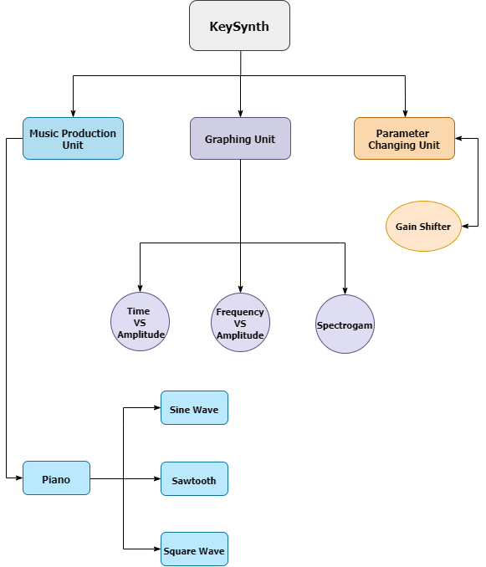
Overview

Slide 3
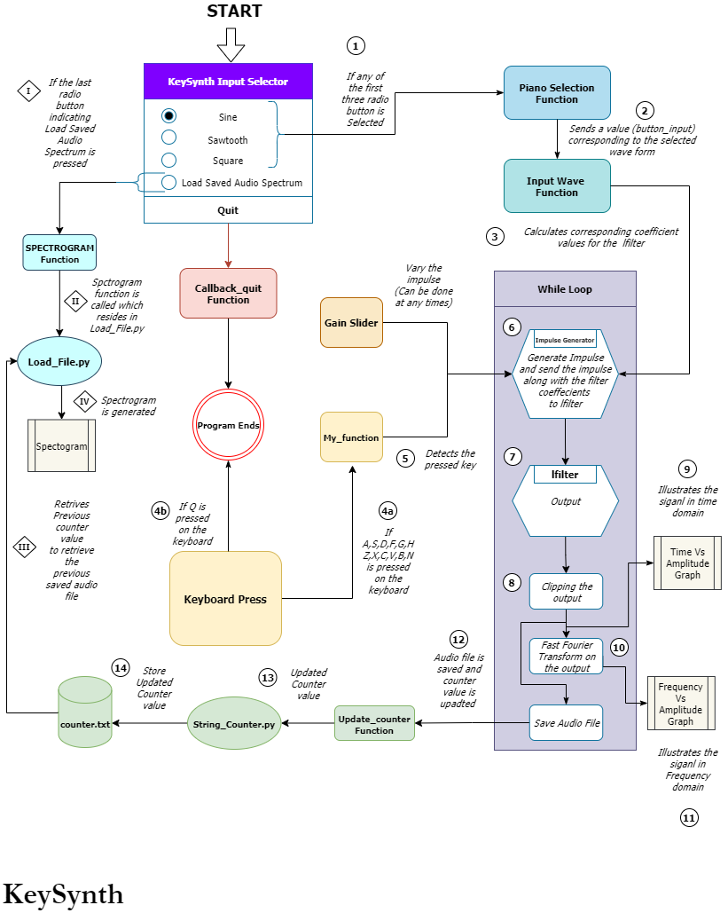
Operation Principle

