Slide 1
Introduction to Business
Course Code: BCC 101
First Semester’ 2025
BBA Program
Department of Management, CU

Slide 2
Course Organization
Course outcomes: To enhance student learning and introduce students to business in a fundamental and practical way.
Teaching Method: Lectures, in-class exercise, assignment, presentation.
Literature: Basic Text: Introduction to Business by Mohammed Ziaul Hoque

Slide 3
Objective of Introduction to Business
Its goal is to explain what is business in a thorough but concise way, why and how to do business and to whom it is important.
This course is purposely brief and covers business essentials specifically Bangladesh Perspective.

Slide 4

Chapter 01: Introduction (Chapter Outline)
Meaning
Foundation of Business
Importance of Business
Principles of Business
Functions of Business
Objectives of Business
Process of Business
Environment of Business
Business Challenges of Business

Slide 5
Business Meaning
Historically: Business is ‘activities’ and ‘interests’
Literally: Business is ‘remain busy’
Philosophically: Business is ‘State of being Busy’
History of Business: Ancient age (civilization, Barter System), Middle age (IR, SMEs) and Modern age (MNCs, Virtual)

Slide 6

Business Meaning
Generally business means the exchange of goods and services with a view to earn profit.

Slide 7

Examples of Business
Business is the money earning activities of a man and women and keep busy with investing and operating activities (economic transaction).

Slide 8
  Business Equation
Business = ΣI+ΣT+ΣAT+ΣDS; where
I= Industries
T= Trades
AT = Auxiliaries to Trade
DS = Direct Services
Σ = Summation

Slide 9

Foundation of Business
Resources (natural & capital)
Goods and services
Allocation of resources and products
Others: Business idea development
Start with small
Quality products
Strong Management and leadership
Customers Loyalty
Capital Requirements

Slide 10
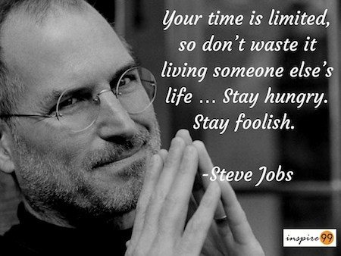
Apple Founder

Slide 11
Importance of Business
Supply of goods and services
Harnessing capital and other resources in production
Self-employment and provision of employment
Preservation of natural resources
Research, development and innovation
Income generation
Motivating general income
Contribution to social development
Contribution in the development of education, science and technology
Development of international relations

Slide 12
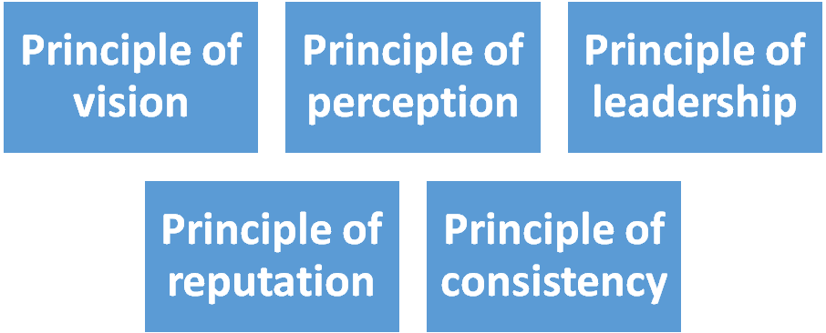
Basic Principles of Business

Slide 13
Function of Business
Business Functions
Production
Marketing
Finance
Management
Public- Relations
Personnel
Administration
Purchasing

Slide 14
Objectives of Business
Direct:
a)Economic objects – Profit earn, meet the demand, proper utilization of assets, creating customers, improve technology, etc.
b)Social motives – supply goods and services to the society, get social status, create employment, contribute to the social development, social responsibility, fair behavior to all stakeholders.

Slide 15
Objectives of Business
Indirect:
c) Human Welfare or humanitarian: good relationship between worker and management, develops worker community, good relationship with customers, increase life standard, follows the core values of company,
d) National Interest and Motives – economic development, increase revenue, remove illegal and sensitive business, public responsibility (compliance with law, ethics), optimum utilization of resources, Development of backward areas.

Slide 16
Business Process

Slide 17
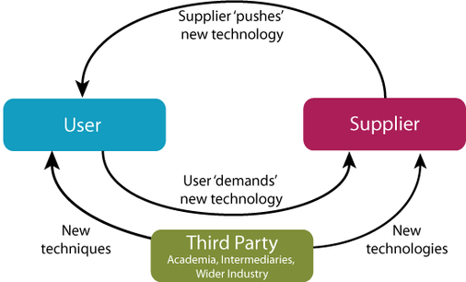
Business Environment
In the context of business, environment refers to all external forces or factors which have a bearing on the operation, and functions of a business.

Slide 18
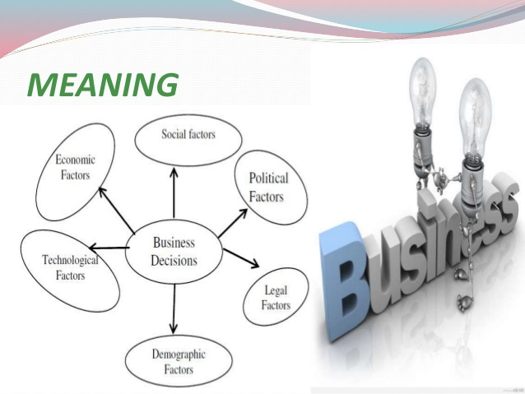
Business Environment
Internal Environment
External Environment

Slide 19
Present scenario of business in Bangladesh
Economy is expanding
New industry based on information technology is developing
Service industry is growing fast
Main contribution coming from RMG sector
Outsourcing is now more interesting for young people
Tourism industry is now becoming popular
Manpower export in another contributing sector for Bangladesh.

Slide 20
Business Challenges
Insufficient capital
High interest rate
Inappropriate government policy
Political unrest
Lack of necessary raw material
Inappropriate management
Lack of infrastructure
Unable to keep pace with the advanced technology

Slide 21
Prospects of Doing Business in Bangladesh
Prospect of IT industry in Bangladesh
Prospect of agricultural industry in Bangladesh
Prospect of pharmaceutical industry in Bangladesh
Prospect of outsourcing in Bangladesh
Prospect of garments industry in Bangladesh
Prospect of banking industry in Bangladesh

Slide 22
How a Business works?
https://www.youtube.com/watch?v=osLpjXBXBS0

Slide 23
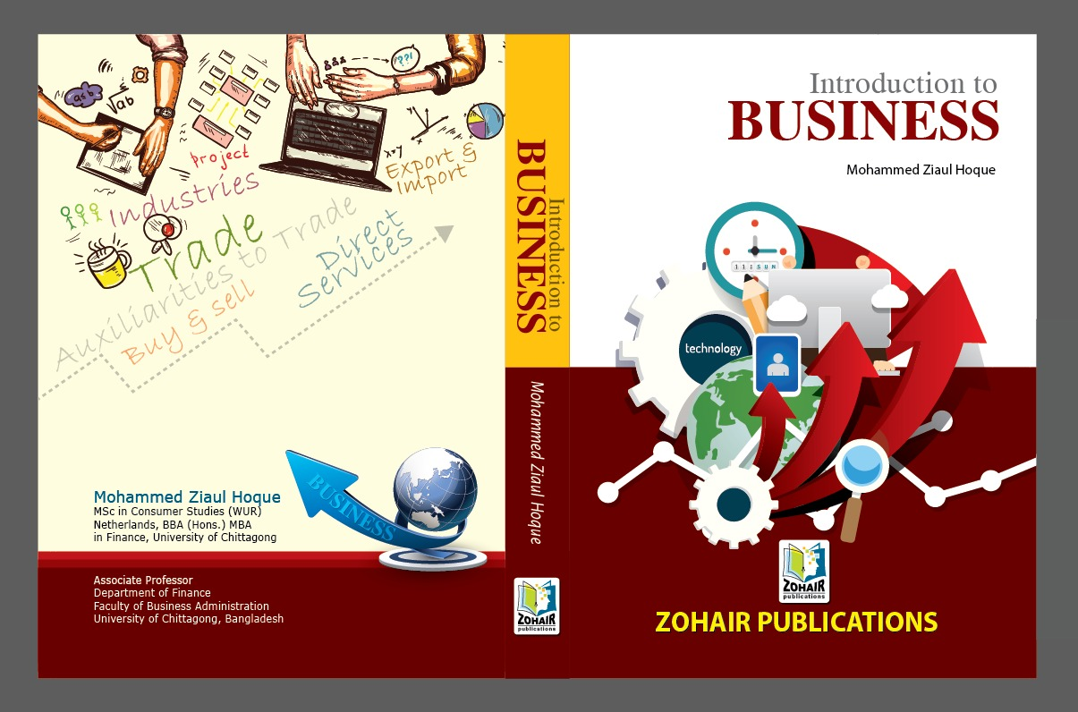
Thanks!
Question?

