Slide 1
Chapter 02
Introduction to Business
Start up a Business

Slide 2
Chapter Outline
Preliminary steps
The road map
Business plan
Deciding the form and type of business
Sources of Finance
Acts governing business in Bangladesh

Slide 3

Introduction
Bangladesh positioned 122 among 183 countries in the ranking of ‘Ease of the Doing Business’ by the World Bank.

Slide 4
Preliminary Steps to Start up Business
Part-One
EVALUATING PROPOSED BUSINESS:
1. Deciding on a business
2. The business plan
3. Home based businesses
Part-Two
BEFORE YOU START:
4. Financing the business.
5Business organization
6.Licenses and permits
7.Business insurance.
8Communication tools
9.Buying a business or franchise
Part-Three
OPERATING PITFALLS:
10. Location and leasing
11. Accounting and cash flow
12. E-Commerce
13. Opening and marketing
14. Managing employees
15. Expanding and handling problems

Slide 5
Business Road Map
A business road map is a planning tool that outlines a company's goals and its strategy for achieving them.
It has a less formalized structure than a business plan, and might take the form of a graphic, a website, a flowchart or a traditional document.

Slide 6
Road Map
Phase 1:Find and develop your business ides, build a solid foundation
1.Direction: Choose your business topic and define your audience
2.Connection:Leverage community tools for support, friendship and accountability
3. Planning: Define the problem and create a smart plan for your business
4. Set Up: Name, establish and launch your business

Slide 7
Road Map
Phase 2: Launch your business, earn through to support your self
5. Audience: Choose an audience channel and grow your audience base
6. Product: Plan and build your first small product to test your audience’s interest
7. Money: Launch your product and grow revenue to support yourself

Slide 8
Road Map
Phase 3: Optimize and grow to increased profitability and sustainability
8. Growth: A growth cycle to increase reach and revenue
9. Scale: Rapidly accelerate your business growth, make it last

Slide 9
Start up a Business
A business may be started mainly under the following ways:
Starting a business as an entrepreneurship
Small business
Home based business
Buying an existing business
Franchising

Slide 10
Entrepreneurship ( New business)
Entrepreneurs usually start with an idea, often a simple one, and then transform that idea into a sustainable business.
Advantages:
1. Innovation
2. Flexible
3. personal attention
4. independence
5. cost conscious

Slide 11
Small business
Small business is one which has less capital independently owned , managed and operated.
Following factors need to be considered to start a small business:
1. Experience 5. Customer demographics
2. Capital 6. Completion
3. Location 7. Record keeping
4. Inventory management
8. Condition of business, if purchased

Slide 12
Starting small business
Problems of small business ownership
Lack of experience
Lack of management skill
Inadequate finance
Flaws in planning

Slide 13
Home based business
It is a typical small business and found in many countries significantly as a side business by people working in offices or by people seeking self employment, taking help from family members as feasible.
It can be:
As part timer
As a full time entrepreneur

Slide 14
Home based business
Common pitfalls of home based business:
Failure to compartmentalize
Failure to limit financial risks
Disregard for zoning requirement
Physical limitations
Work at home schemes
Disagree for allowable business deductions

Slide 15
Buy a existing business
Buying an existing business is less risky than starting from scratch.
Advantages :
It has already generating cash flow and profits
It has an established customer base
It has reputation and employees who are familiar with all aspects of business.

Slide 16
Franchising
Business franchising is one of the safest and most risk free ways to start up and run a successful business. Business franchises and franchising opportunities are increasing internationally.

Slide 17
Business Plan
Business plan is a formal, written expression of the entrepreneur’s vision for converting ideas into a profitable, going business.
The business plan is the entrepreneur’s roadmap for a successful enterprise.
The primary value in learning how to write a business plan will be to create a written outline that evaluates all aspects of the economic viability of your business venture including a description and analysis of your business prospects.

Slide 18
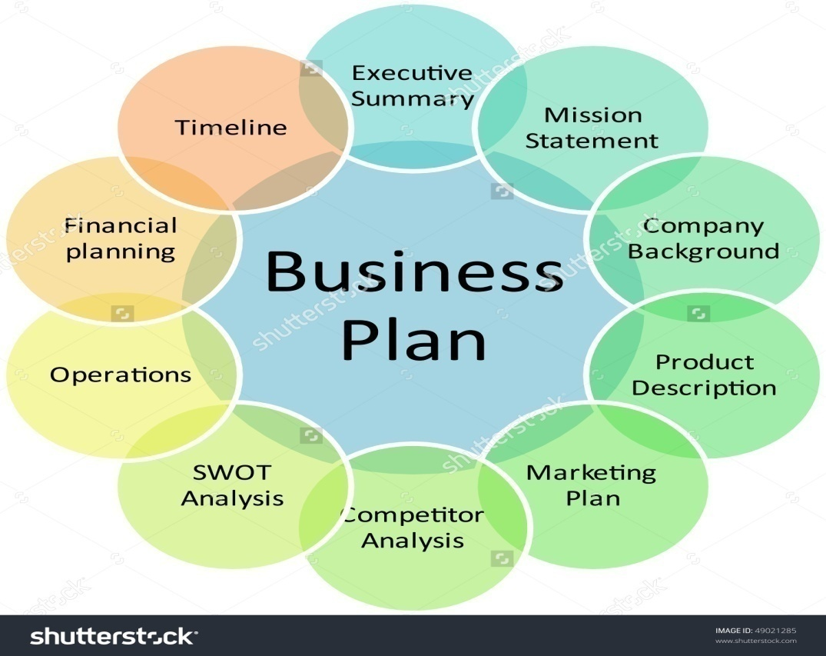
Components of a Business Plan

Slide 19
Components of a Business Plan
Executive summary:
It generally cover:
The company’s origins
The product or service and its uniqueness of competitive advantage
The goal and objectives of the organization
The market potential for the product or service
The management team and its track record
The financing required to grow the business
The exits strategy

Slide 20
Components of a Business Plan
Mission statement of business:
The mission statement spell out its overall goal, provide a path, and guide decision making.

Slide 21
Components of a Business Plan
Company background
This section cover the location, function, history, size of the business. Describe the nature of the business.

Slide 22
Components of a Business Plan
Description of product or service
This section provides a clear explanation of the product or service and its function. Photos and diagrams may be used.

Slide 23
Components of a Business Plan
Market analysis and strategy
This section covers:
Specific market and demand for the product
Who are the customers of the product?
Identify major competitors and their strengths and weaknesses and occupied market share.
Marketing strategies to reach to the customers and sell the product or service.

Slide 24
Components of a Business Plan
Competitor analysis:
This section identify the competitors and analysis their strengths and weakness and relative position of your product or service.

Slide 25
Components of a Business Plan
SWOT analysis
Strength, weakness, opportunity and threat analysis uncover the opportunities that a business can exploit with the existing resources and also identify the threats that need to manage or eliminate.

Slide 26
Components of a Business Plan
Operations
This section offers a details description of how product will be produce and service will be provided. In case of manufacturing organization it will cover how to collect raw materials, what is the manufacturing process, size of the factory, work force, work flows, and volume.

Slide 27
Components of a Business Plan
Financial planning
This section explains fund and loan needed and what business will do with this money. It provides specific amount.

Slide 28
Components of a Business Plan
Time line
A business plan, intended for circulation to investors, usually must project business operations for three years. Informal business plans can operate on shorter time frames. The core of a business plan time line is cash flow and revenue overtime.

Slide 29
General procedure to start up a company
Pre registration ( for example , name verification or reservation)
Registration (under the company act)
Post registration ( for example, social security registration, company seal)

Slide 30
Act Governing Business in Bangladesh
Legal environment of business comprise many laws, rules, and regulations framed under different laws. In fact business and business houses and concerned agencies are to work complying with such provision of relevant laws, rules and regulations.

Slide 31
Various business law regulations in Bangladesh
General laws governing business in general
Laws governing specific type of business houses
Labor law
Act relating to the consumer interest.
Some financial acts

Slide 32
General laws governing business in general
Law of contract-contract act, 1872
The negotiable instrument act 1881
Law relating to carriage.
law relating to sale of goods act 1930
Trade mark act 1940
The arbitration act 1940
The shop act 1965
Customs act. 1969
Foreign investment protection act 1980

Slide 33
Laws governing specific type of business houses
Laws governing specific type of business houses
Partnership act 1932
Company act 1994
The Bangladesh industrial enterprise order 1972
Securities and exchange order 1969
Banking company act 1991
Law of insurance 1938
The cooperative society act 1984

Slide 34
Labor law
Bangladesh labor law 2006

Slide 35
Act relating to the consumer interest
Essential commodity control act, 1956
Pure food ordinance, 1959
Essential commodity price and distribution ordinance 1970
Drug control ordinance 1982
standard of weights and measurement ordinance 1982
Breast feed substitute ordinance 1984
Tobacco marketing act 1988
Code of criminal procedure 1860

Slide 36
Some financial acts
Business profit, revenue and expenditure are being affected by some financial laws. Though these can’t be termed in strict sense as laws relevant to business operations but impact cannot ignored as they affect financial performance. Such two important acts are
Income tax ordinance 1984
Value added tax (vat)

Slide 37
Organization of small business startup costs
Start up costs are included:
Legal/paper work
Taxes
Professional development and education
Transportation
Equipment
Marketing
Miscellaneous
Required:
Listing groups of related business activities and then categorizing them. Find the areas where need to prioritize the finance.
Businessman always focus on minimize the cost.

