Slide 1

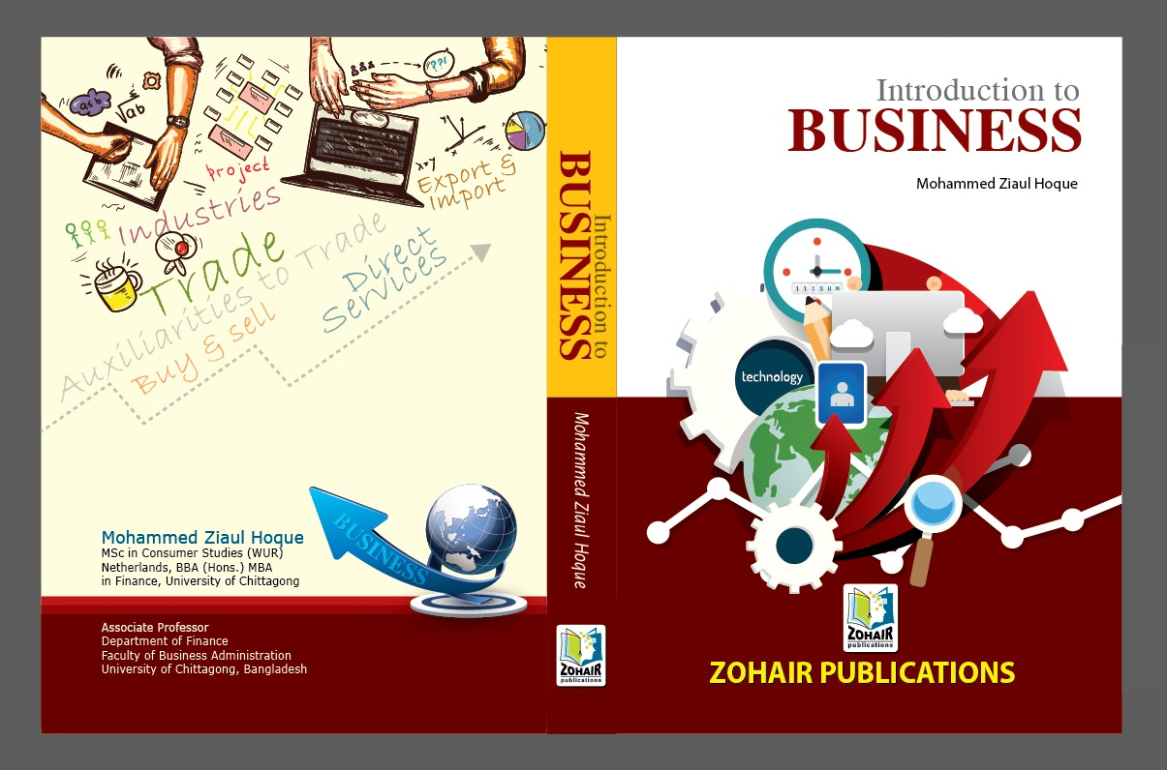

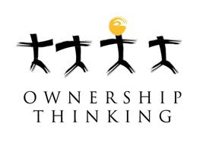
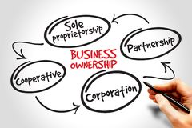
Chapter 03
Introduction to Business
Business Ownership

Slide 2
Learning Goals
After studying this lesson, students will be able to know:
Different forms of Business Ownership and identify the distinguishing characteristics of each form.
Describe the major advantages and disadvantages of each form of Business and factors to be considered in selecting specific forms.
Steps to develop business organization that must be conducted.

Slide 3
Meaning of business organization
Business organization is an act of grouping activities into effective co-operation for specific objective.
It is primarily concerned with the creation and distribution of utilities for earning profit.
There are several ways that a business can be organized to define its structure

Slide 4
Features of a business organization
Collection of different elements and allocate duties
Coordinate the factors of production
It contains organizations’ nature
Widen scope
It depends on business methods.

Slide 5
Nature of Business Organizations
Individual or Micro Business Organization: It includes all sole tradership and direct service related business because their appeal and scope of operations are very limited.
Universal or Macro Business Organization: On the other hand Partnership, Joint Stock Limited Company, State owned enterprises and Cooperative Business are universal in nature. They derive from legal aspect and collectively managed.

Slide 6
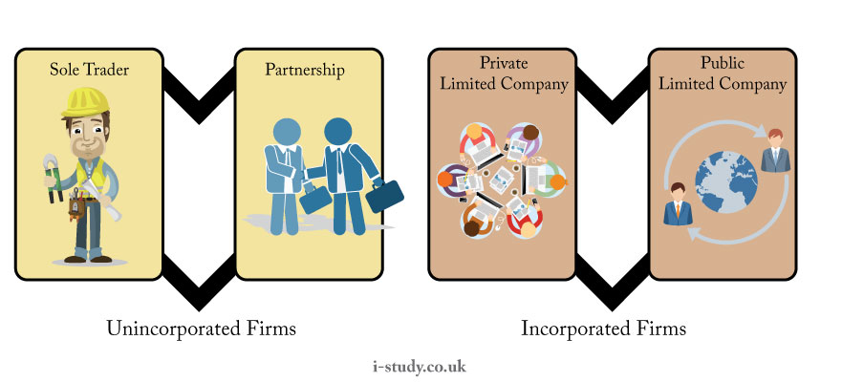
Forms and structures of Business ownership

Slide 7
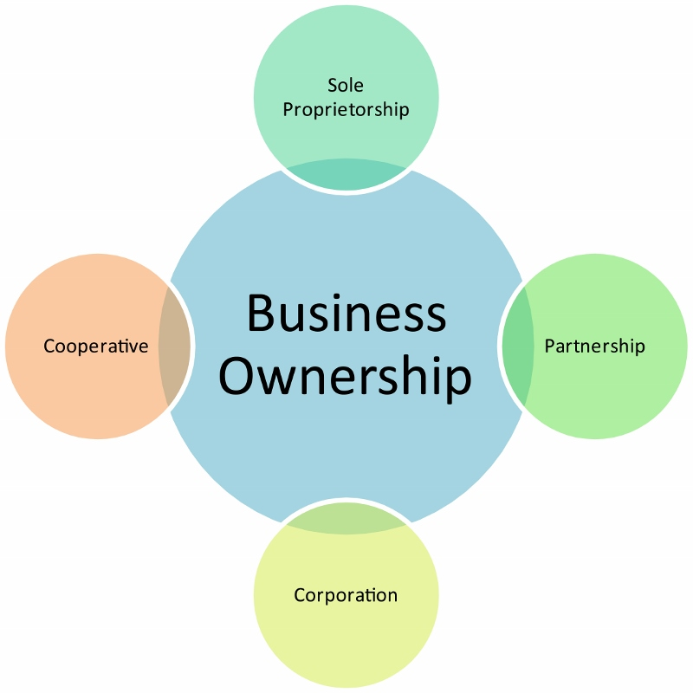

Slide 8
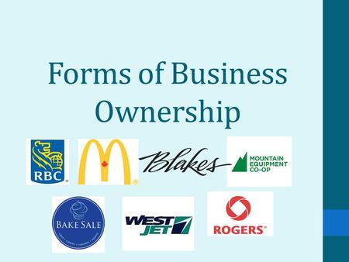
Different forms of business ownership
Sole Proprietorship
Partnership
Company
Cooperative
State Enterprise
Joint Venture
Business Combination
Global business
Franchise
Trust
Licensing

Slide 9
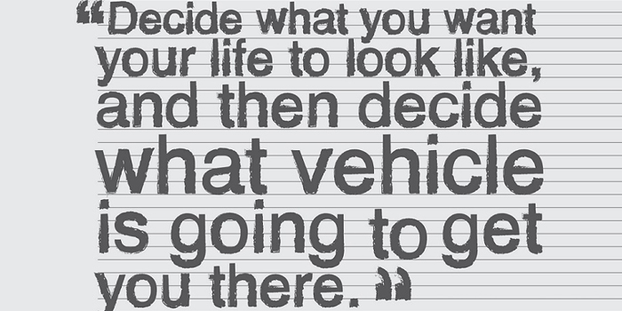

Slide 10
Different forms of business ownership
Sole Proprietorship: A sole trader ship business is profit owned and operated by an individual acting as the sole owner.
It can be formed anywhere with an optimum capital. It’s easy in those firm where prompt action, nondurable product i.e.; agriculture, secrecy can be maintained.
For small firm sole trader ship is suitable. Example: Parlor, Saloon, Grocery shop etc.

Slide 11
Different forms of business ownership
Partnership Business Organization:
A general partnership is an association of two or more persons to carry on a business for profit as co-owners and is characterized by a community of interest in a particular business and a sharing of profits.
Partnership business is suitable where larger capital, a number of employees, efficient innovative entrepreneurs required than sole trader ship.
Partnership is suitable for export import business, wholesale, super mall (retailer).

Slide 12
Different forms of business ownership
Company Organization:
Company required more capital, more risk, a number of director than partnership business.
A company formed and registered under company act or purchase an existing company to earn profit.
Company is suitable for mass production, set up an industry, factory & distribution business.

Slide 13
Private vs. Public limited company
Features | Public Limited Company | Private Limited Company
Minimum members | 7 | 2
Minimum directors | 3 | 2
Maximum members | Unlimited | 200
Minimum capital | 5,00,000 | 1,00,000
Invitation to public | Yes | No
Issue of prospectus | Yes | No
Quorum at AGM | 5 members | 2 members
Certificate for commencement of business | Yes | No
Term used at the end of name | Limited | Private limited
Managerial remuneration | No restriction | Can not exceed more than 11% of net profits
Statutory meeting (mandatory) | Yes | No

Slide 14
Different forms of business ownership
Cooperative Business:
Cooperative is an association of individual to secure a common economic goal by honest means.
Concentration of wealth in few hands, exploitation of workers by giant enterprises and their owners etc. gave augment to sense of cooperative.
“Unity is strength” that is mutual assistance among poor of weaker class- this imprison gave rise to the growth & development of cooperative society.

Slide 15
Different forms of business ownership
State Enterprise:
State enterprise is the operation of commercial or industrial undertaking by the state.
A number of factors like, some sensitive products and services, reduction ethnic & regional disparity, the desire of political party in power of control economic, reduction of rural urban imbalances, providing more basic services as water, power, communication etc. are seen as socio-economic factors that give rise to establishment, of state enterprise.
For instance, weapon, utility services, etc.

Slide 16
Different forms of business ownership
Joint venture
A joint venture is a business agreement in which parties agree to develop for a finite time, a new entity and new assets by contributing equity.
They exercise control over the enterprise and consequently share revenues, expenses, and assets.
Soudi-Bangladesh textile mills ltd
Apex corporation ltd.

Slide 17
Different forms of business ownership
Combination
Combination refers to the mergers and acquisitions of many smaller companies into much larger ones.
A consolidation of two corporations
In Bangladesh, BSRS and BSB formed new business organization named Bangladesh development bank (BDB).
Merger between Robi Axiata and Airtel Bangladesh

Slide 18
Different forms of business ownership
Global business
It refers to all those business activities which involve cross border transactions of goods, services, resources between two or more nations.

Slide 19
Different forms of business ownership
Franchise
A franchise is a right granted to an individual or group to market of company’s goods or services within a certain territory or location.
McDonald, Subway, Pizza hat.

Slide 20
Different forms of business ownership
Trust
A trust is an obligation occupied to the ownership of property, and arising out of a confidence reposed in and accepted by the owner, or declared and accepted by him , for the benefit of another , or the owner.
WBB trust (work for a better Bangladesh)
Islamic trust Bangladesh limited
Trust marine services
Asian global sourcing ltd.

Slide 21
Different forms of business ownership
Licensing
A company sells licenses to other companies to use intellectual property (IP) , brand, design, or business programs.
The licensing company may exercise control over how its IP is used but does not control the business operations of the licensee.

Slide 22
Merits and demerits of each form of ownership
SL | Business type | Key advantages | Key disadvantages | Liability
1 | Sole proprietorship | Simple to set up | Limited growth | High
2 | Partnership | Relatively simple creation | No limited liability, must have general partner | High
3 | Public limited company | Legal formality, indefinite life time, superior entity | Few owners cannot directly control management | Limited
4 | Private limited company | Well established law | Shareholders limitations | Limited
5 | State enterprise | Set rules and regulations | Blending social and profit objectives | Limited
6 | Cooperative | Secure credit at cheap rate | Conflict among members | limited

Slide 23
Factors influencing to Choice a Form of Business Organization
The nature of business:
Businesses providing direct services like tailors, restaurants and professional services like doctors, lawyers are generally organized as proprietary concerns.
While, businesses requiring pooling of skills and funds like accounting firms are better organized as partnerships.
Manufacturing organizations of large size are more commonly set up as private and public companies.

Slide 24
Continued…
Size of operations:
The volume of business (large, medium, small) and size of the market area (local, national, international) served is the key factors.
Large scale enterprises catering to national and international markets can be organized more successfully as private or public companies.
Small and medium scale firms are generally set up as partnerships and sole-proprietorship.
Similarly, where the area of operations is wide spread (national or international), company ownership is appropriate.
But if the area of operations is confined to a particular locality, partnership or proprietorship will be a more suitable choice.

Slide 25
Continued…
The level of control:
A person, who desires direct control of business, prefers proprietorship, because a company involves separation of ownership and management.

Slide 26
Continued…
Amount of capital:
It is key factor of business and required for the establishment and operation of a business.
A partnership may be converted into a company when it grows beyond the capacity and resources of a few persons.

Slide 27
Continued…
The volume of risks: Risks and liabilities as well as the mentality of the owners to bear risk, is also an important consideration.
Comparative tax liability: Comparative tax liability, assessment and returns of Business.

Slide 28
Conclusion
We have several ways that a business can be organized to define its structure. The main types of business organizations in the Bangladesh are sole proprietorship, corporations, partnerships and limited-liability companies, Cooperative, and state owned enterprises.
But someone must be ambitious to build a form of business!

Slide 29


Slide 30


Question?

