Slide 1
Functions of Business
Even in the smallest business a number of key tasks, or functions, must be done regularly.
Raw materials must be bought, bills must be paid, customers must be served and customer enquiries must be answered

Slide 2
Meaning and definition of Functional areas in Business
In a word we can say, Grouping of individuals on the basis of the function each performs in the organization, such as accounting, marketing, manufacturing, financing, administration etc.
Departments in a business organization are structured according to certain functions

Slide 3
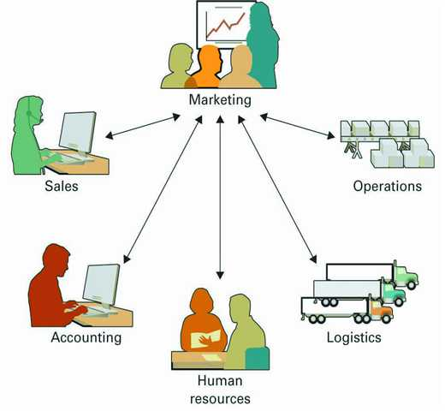

Slide 4
Functional Areas of Business
Every business organization performs some key tasks or functions.
Some functions are Managerial in nature and some functions are Administrative.

Slide 5
Functional areas in business
The activities needed to operate a business can be divided into a number of functional areas: management, operations, marketing, accounting, and finance.
In a large organization, it is usually easier to identify separate functional areas because people work together in different departments.
Each department carries out the tasks that relate to its particular area.

Slide 6
Managerial Functions of business
1. Production and operations
2. Sales and Marketing
3. Finance and Accounting
4. Human Resource
5. Customer services
6. Research and development
7. IT and support

Slide 7
The administration function
Administration is a support function required by all businesses – and this does not mean only keeping files.
Senior administrators carry out a wide range of tasks, from monitoring budgets to interviewing new staff for their departments.

Slide 8
Administrative functions
Administrative functions are supportive functions required by all businesses.
Administrative functions included:
1. Collecting, distributing, and dispatching the mail
2. Storing and retrieving paper and electronic records
3. Organizing meetings and preparing meetings documents
4. Responding promptly to enquiries
5. Preparing documents using word processing , spreadsheet and presentation packages

Slide 9
Administrative functions included:
6. Researching information
7. Sending and receiving messages by telephone, fax and email
8. Making arrangements for visitors
9. Making travel arrangements
10. Purchasing supplies of office stationery and equipment
11. Making arrangements for events , such as interviews or sales conference.

Slide 10
Production and Operations
Production and Operations Management ("POM") is about the transformation of production and operational inputs into "outputs" that, when distributed, meet the needs of customers.
The process in the above diagram is often referred to as the "Conversion Process".
There are several different methods of handling the conversion or production process - Job, Batch, Flow and Group.

Slide 11
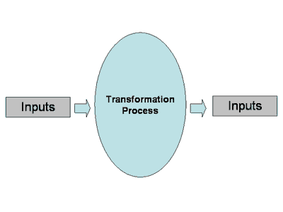

Slide 12
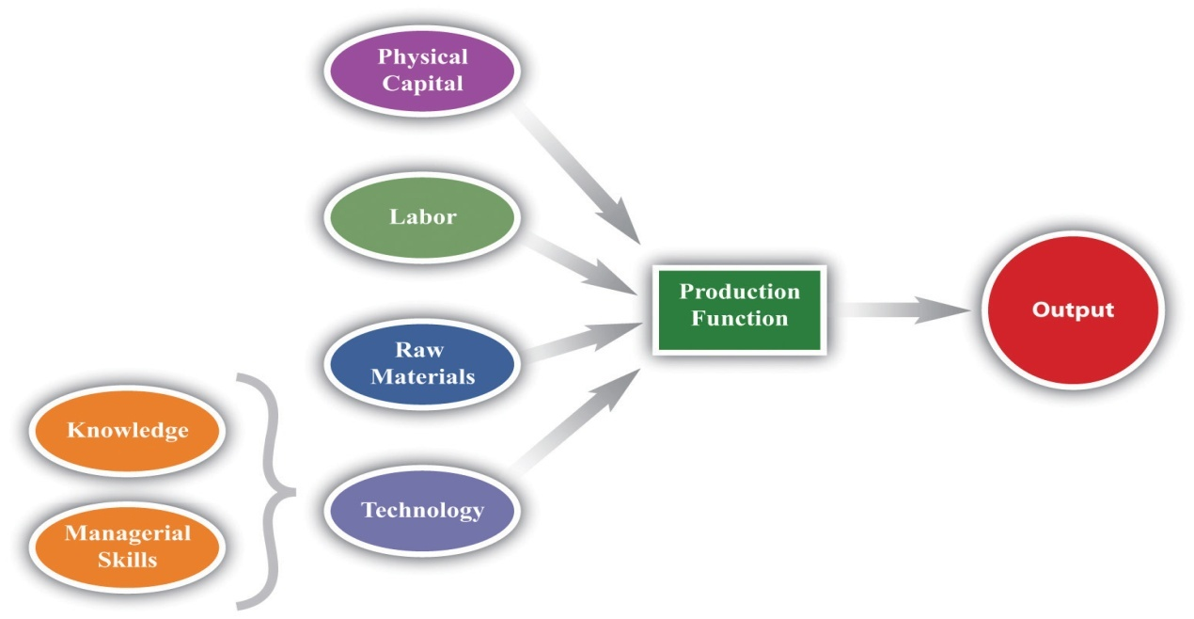

Slide 13
Sales and Marketing
This is an important question, because a carefully crafted combination of sales and marketing is vital for successful business growth.
"Selling" or making sales consists of interpersonal interaction-the one-on-one meetings, telephone calls and networking-that you engage in with prospects and customers.

Slide 14
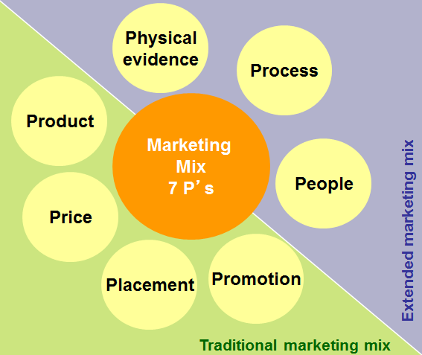

Slide 15
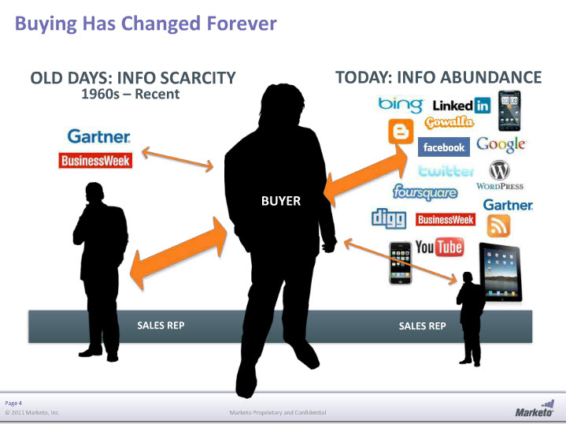

Slide 16
Finance and Accounting
Accounting and finance play an existential role in the management of any business.
In the words of John Nessel, president of the Restaurant Resource Group, "If you can't count it, you can't manage it.”
He means that companies operate on money, and if you don't control that money, you don't control your business.
By properly accounting for your company's income and expenses, you can manage the flow of money and thereby direct the course of your business

Slide 17
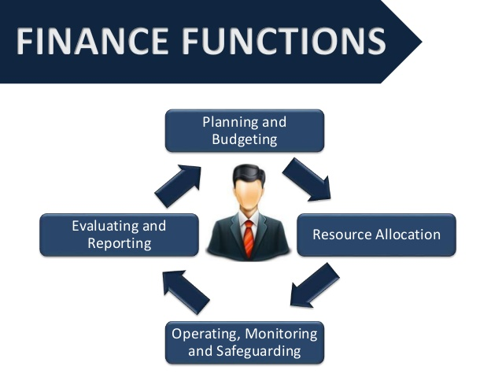

Slide 18
Human Resource
A human resources department is a critical component of employee well-being in any business, no matter how small.
HR responsibilities include payroll, benefits, hiring, firing, and keeping up to date with state and federal tax laws.

Slide 19
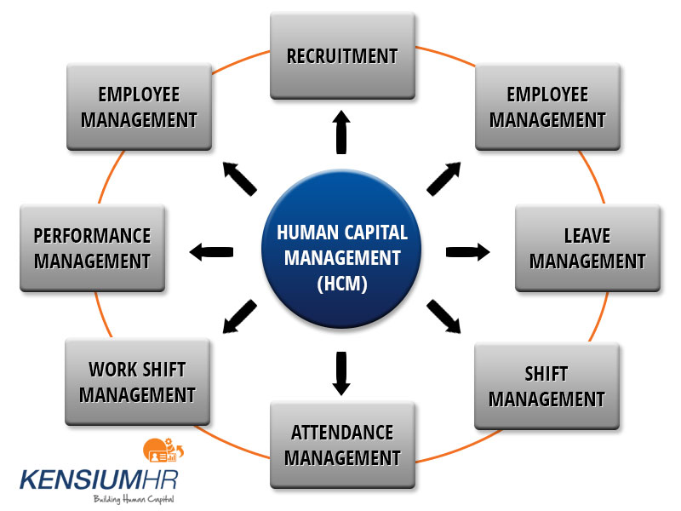

Slide 20
Research and Development (R&D)
Research and development (R&D) is a valuable tool for growing and improving your business.
R&D involves researching your market and your customer needs and developing new and improved products and services to fit these needs.

Slide 21
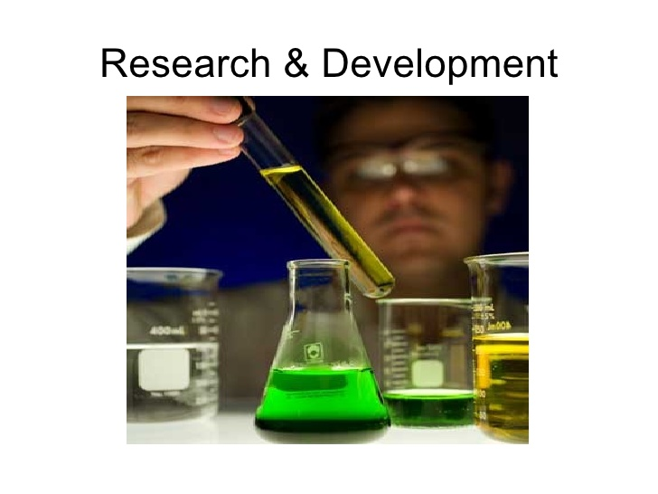

Slide 22
Customer Services in Business
Customer service is the service provided to customers before, during and after purchasing and using goods and services.
Good customer service provides an experience that meets customer expectations. It produces satisfied customers.
Bad customer service can generate complaints. It can result in lost sales, because consumers might take their business to a competitor.

Slide 23
IT and Support
Business-IT alignment is a dynamic state in which a business organization is able to use information technology (IT) effectively to achieve business objectives - typically improved financial performance or marketplace competitiveness.

Slide 24


Slide 25
Relationships between different functional areas
No functional area in a business organization can work in isolation.
Sales people know which customers still owe money and must not be sold any more goods on credit until a bill has been paid;
The manager knows which members of staff are keen and hardworking, without being told, and a customer query can quickly be solved by asking everyone in the office for advice.

Slide 26
Thank you for joining us!
Questions?

