Slide 1
Business Documents: Registration, License, Certificates

Slide 2
Learning Objectives
After studying this chapter, the students will be able to understand:
Definition and concept of different documents used in the business
The process to get them
Important requirements that have to submit to get these documents.

Slide 3
Chapter Outline
Procedure and documents required to get trade license
Factory inspection license
Bonded warehouse license
BSTI License
TIN and VAT Registration
Export registration
Patent and Trademark registration
Export registration certificate
BOI registration
Permission from Deptt. of environment
Utility, gas, electricity and T&T connection
Membership of trade organisation
Opening bank a/c

Slide 4
Introduction
It is important to file the proper documentation when starting a new business venture.
A company uses documents to communicate, transact business and analyze its productivity.

Slide 5


Slide 6
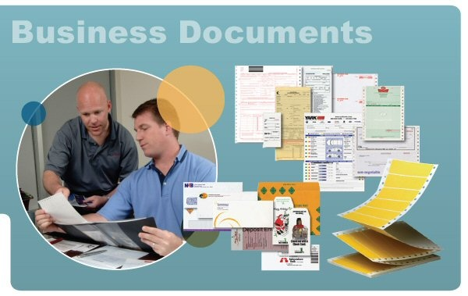

Slide 7
Trade License
License can be defined as a written permission issued by concerned authority stating necessary particulars such as name, location, purpose of license, issue date, fees and so forth.
In Bangladesh trade license is issued by local government. In city corporation areas like Dhaka, Chittagong, Rajshahi, Khulna, Sylhet, Narayangonj, Comilla, Gazipur and in other areas it will be issued by respective pourashava or union parishad.

Slide 8
Trade License
The following documents for having a trade license issued, if you are willing to establish your business in a major city:
Application with photos.
Layout plan
Enclose two ‘No Objection Certificates’ from two close neighbors.
In case of limited company, AoA, MoA, and Incorporation Certificate issued by joint stock company, TIN
no objection certificate from the Department of Environment

Slide 9
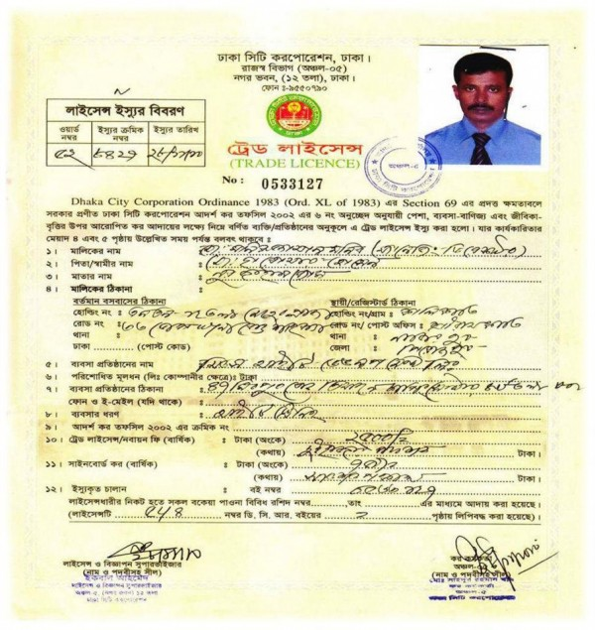

Slide 10
Factory Inspection License
This document should be taken to represent the minimum acceptable standard.
Compliance with these requirements will be checked during factory inspections.
After establishment of any factory, as per factories Act 1965 as in practice, of the present government.

Slide 11
Factory Inspection License
Documents required for factory Inspection License
Trade License.
Factory Lay out plan (Machineries).
Building Plan.
Application in prescribed Form.

Slide 12
Bonded warehouse license
A 100% export oriented industry will get the Bonded Warehouse License from custom authority.
This type of industry can reduce its cost by getting a Bonded Warehouse License.
They may import raw materials without duty free and zero Customs charge.
But condition is that you must export 100% of your products.

Slide 13
You have to submit your application along with the following documents
Application in a prescribed form.
A Bond for Tk. 3 (Three) crore in a non-judicial stamp worth Tk. 1000.00.
Trade License (updated).
Updated Import Registration Certificate (industrial sector).
Updated Export Registration Certificate.
Memorandum of Articles and Certificate of Incorporation (in case of limited company).
Tax Identification Number.
VAT Registration Certificate.
Bank Solvency Certificate.
Membership certificate of BGMEA/BKMEA.
A copy of house rent contract or ownership documents.
No Objection Certificate from Department of Environment (in case of chemical exercise).
No Objection Certificate from the Power Development Board (PDB).
Registration Certificate from Board of Investment.
Letter of recommendation from Board of Investment for issuing Bonded Warehouse License.

Slide 14
Continued….
Treasury challan for payment of Taka 1000 as license fee.
Nationality Certificate.
Two copies of passport size photographs for every director/owner.
Documents of machinery imports
Two sets of layout plan of the factory.
Certificate from the Fire Service Department.
Declaration in a Tk. 100/- non-judicial

Slide 15
BSTI License
Bangladesh Standards and Testing Institution (BSTI) is the authority in Bangladesh which gives certificate for standard of products.
To ensure such quality and standard, Government of Bangladesh has setup BSTI and wants to safeguard the interest of consumer.
BSTI issues such license after conduction test as to quality and conducts inspection time to time in the market whether the concerned manufacturer ensure quality as perceived, tested and certified by it.

Slide 16
BSTI License
Bangladesh Standards and Testing Institution (BSTI) provide two kinds of product certification:
a) Mandatory Certification (List of mandatory certification products) where you cannot launch your product without a certificate from BSTI
b) Voluntary Certification where you can launch your product but a BSTI certificate gives you extra credibility benefits.

Slide 17
Taxpayer’s Identification Number (TIN) Certificate
TIN is a unique number NBR (National Board of Revenue) provide if apply anybody.
At present about forty lac TIN Certificate holder in Bangladesh of which only eight lac pay tax.

Slide 18
How do you get a TIN?
Write an application to the Deputy Commissioner of Taxes of respective area showing why the TIN Certificate has needed.
Fill-up TIN Application Form.
Enclosed 2 copies of photographs
Enclosed photocopy of National ID/ photocopy of pass port

Slide 19
eTIN registration which means Electronic Tax Identification Number
This process will be done by online. NRB has published a circular about this matter.
The old TIN is 10 digit numbers. But in the new system, TAX Identification Number (TIN) number will be a 12 digit number.
All new taxpayer will get 12 digit number, also existing Tax payer also have to get new 12 digit TIN number.

Slide 20
Registration of Value Added Tax (VAT)
For VAT purposes, companies may be registered separately with the Customs, Excise, and VAT Commission (under the NBR).
VAT is to be paid on value added by manufacturer, Importer, Exporter, Traders at different stages of their working.
Online VAT registration has been just launched in BD

Slide 21
Trade Mark Registration
A trademark is a distinctive sign which identifies certain goods or services as those produced or provided by a specific person or enterprise.
In Bangladesh trademarks and service marks are registered under The Trademarks Act- 2009. Registration provides 7 years protection; it can be renewed every after 10 year on payment of renewal fees.

Slide 22


Slide 23
Patents and Designs Registration
A patent is an exclusive right granted for an invention, which is a product or a process that provides, in general, a new way of doing something, or offers a new technical solution to a problem.
Under the Patents and Designs Act -1911 patents are granted.
Patents provide 16 years protection from the date of filing of the application.

Slide 24
Copyrights Registration
It is a form of intellectual property (like the patent, the trademark, and the trade secret) applicable to any expressible form of an idea or information that is substantive and discrete.
Copyrights are protected for original intellectual work of literature, art, music, software, etc. under the copyrights Act – 2000 (Amended in 2005).

Slide 25
Export Registration Certificate (ERC)
Export Registration Certificate is a certificate of license that is needed to be Exporters in Bangladesh
Issuing Ministry: Ministry of Commerce
Name: Office of Chief Controller of Imports and Exports (CCI&E)
Address: 111-113, Motijheel C/A, Dhaka 1000

Slide 26
Export registration certificate
For getting IRC following documents need to submit:
Photocopy of trade license
Copy of TIN
Copy of MoA, and AoA in case of company
Partnership agreement with registration copy
Bank solvency certificate
Main copy of treasury challen
Three copies of photograph of owner
Three copies of photograph of managing director
Membership certificate from chamber of commerce
National ID

Slide 27
Import Registration Certificate (IRC)
Office of Chief Controller of Imports and Exports (CCI&E) works under Imports and Export (Control) Act, 1950.
It is responsible for: Issuing Import Registration Certificate (IRC) and Export Registration Certificate (ERC), Export and Import Permit, Monitoring and Evaluation of Import Statistics etc.

Slide 28
Import registration certificate
For getting IRC following documents need to submit:
Photocopy of trade license
Copy of TIN
Copy of MoA, and AoA in case of company
Partnership agreement with registration copy
Bank solvency certificate
Main copy of treasury challen
Three copies of photograph of owner
Three copies of photograph of managing director
Membership certificate from chamber of commerce
National ID

Slide 29
BOI registration process for foreign investors
Immigration Procedure
Modified Rules of Landing Permit / Visa on Arrival
Incorporating a Company
Memorandum of Association
Articles of Association
Registration with BOI
Obtaining Industrial Plot
Environmental Legislation
Obtaining Utility Connections
Human Resources and Employment
Exchange Control & Remittance
Living in Bangladesh

Slide 30
Permission from Department of Environment
Protection of environment has become an important issue all over the world in recent years.
Permission of the Department of Environment is essential for establishing an industrial unit in any place in Bangladesh.
It may result in air pollution through noise or otherwise, cause water pollution through factory wastage & the like.

Slide 31
Connection of Utilities: Gas, Electricity, Water and Telephone
Before installation of machinery we have to obtain the permission for connection of some utilities like gas, electricity and T&T.
These utilities are essential for business houses, especially for industrial enterprises.
Thus connection is to be taken through applying to respective authority and after payment of initial connection fees.
Thereafter monthly bill is to be paid regularly for the continuation in operations and avoid over dues payment, fines and penalties.

Slide 32
Opening Bank Account
As a part of business, we should open an account in one of our favorite banks.
There are various kinds of Bank Accounts which people are looking for.
These account’s opening go through some procedure. Required information for opening a bank account varies from bank to bank.

Slide 33
Kinds of Bank Account
Sole Proprietorship Account
Limited Company Account
Partnership Firm Account
Foreign Currency Account Opening

Slide 34
Membership of Chamber/Associations
After having a TIN from Taxation Department you would have to be a member of respective chamber or association.
Without the membership you will not be allowed to apply for Export Registration Certificate (ERC), Import Registration Certificate (IRC) etc.
If you decide to start business at Dhaka, you should apply to get a membership in the Dhaka Chamber of Commerce and Industry.
However, you may also be a member of particular Manufacture Association.

Slide 35
Thanks to join with us!
Any Question?

