Slide 1
Chapter 4
Business Combination

Slide 2
Learning Goals
After studying this chapter, students will be able to understand:
The concept of business combination and its process
Merits and demerits of Business combination
Various types of Business Combination and influencing Factors

Slide 3
Chapter Contents
Definition of BC
Emergence
Causes
Advantages of BC
Disadvantages of BC
Techniques of BC
Factors influences
Process of BC
Advantages and Disadvantages of different types of BC

Slide 4
Definition of Business Combination
Business combination is a blending of two or more existing undertaking into one undertaking, the shareholders of each blending company becoming substantially the shareholders in the company which is to carry on the blended undertaking.
Similar two or more business can form a group of business to face the uncertainty to achieve goals

Slide 5
Emergence of Various techniques of business combinations
From 1897 – 1904: During this period merger & acquisition took place between the firms like electricity, railways, etc.
Most of the mergers during this period were horizontal in nature and occurred between the steel, metal and construction industries.

Slide 6
From 1903 – 1905
Most of the mergers & acquisition which took place during the first phase were considered as unsuccessful for not being efficient enough to attain the required competence.
The crash was stimulated by the decelerating of the world's financial system in 1903, which was followed by a stock market collapse in 1904.
During this phase the authorized structure was not encouraging either.

Slide 7
From 1916 – 1940
The mergers and acquisitions process was triggered (activate) by the financial boom which was seen after the World War I.
The government strategies laid in 1920s made the corporate ambiance (atmosphere) supportive enough for firms to work in harmony.
Financial institutions like government and private banks also played a significant part in aiding the mergers and acquisitions process.

Slide 8
From 1965 – 1970
Most of the mergers from 1965-70 were horizontal mergers and were triggered by elevating stock and interest rates, and stern implementation of anti-trust rules and regulations.
During this phase the bidding companies were small in size and fiscal strength than the target companies.
These kinds of mergers were sponsored by equities, thereby eliminating the roles of banks which they actively played in investment activities earlier.

Slide 9
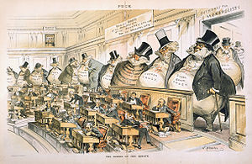

Slide 10
From 1981 – 1989
This phase saw the acquisition of the companies which were much bigger in size as compared to the firms in previous phases.
Industries like oil and gas, pharmaceuticals, banking, aviation combined their business with their national and international counterparts.

Slide 11
From 1992 till present
This period was stimulated by globalization, upsurge in stock market boom and deregulation policies.
Major mergers were seen taking place between telecom and banking giants out of which most were sponsored by equities.
Therefore, we can conclude that as long as business entities exist and the economic factors are favorable, the trend of mergers and acquisitions will continue.

Slide 12
Causes of Business combination
Wasteful competition
Economics of large-scale operation
Desire for monopoly power
Business cycles
Tariffs
Individual organizing ability and ambition
Respect for large size business
Rationalization

Slide 13
Advantages of Business Combination
Increase in Capital
Elimination of Competition
Saving in Expenses
Controls over Production
Large Scale Marketing
Experts Services
Research Work
Use of Modern Technology
Stability
Division of Labor

Slide 14
Disadvantages of Business Combination
Creation of Monopoly
Concentration of Wealth
Not Acceptable
Changes of Friction
No Personal Contact
Costly Management
Over Capitalization
Misuse of Funds
National Interest Ignored
Speculation

Slide 15
Types of combinations
Horizontal combination:
A horizontal combination comes into being when units carrying on the same trade or pursuing the same productive activity join together with common end in view.
Examples of such combinations are provided by the Sugar Syndicate and Association of cement companies in Bangladesh

Slide 16
Horizontal combination
Sugar | Sugar | Sugar | Sugar | Market Total
Mill | Mill | Mill | Mill
1 | 2 | 3 | 4

Slide 17
2. Vertical combination
Vertical combination is the combination of firms in successive stages of the same industry. It implies the integration of various processes of an industry.
1 | Cotton | Ginning
2 | Cotton | Spinning
3 | Cotton | Weaving
4 | Cotton | Market

Slide 18
Lateral or Allied Combination
Lateral integration refers to the combination of those firms which manufacture different kinds of products though they are ‘allied in some way’.
It can be of two kinds
i) convergent lateral integration and
ii) divergent lateral integration.

Slide 19
Lateral or Allied Combination
Convergent lateral combination comes into existence when different firms join together to supply goods and services to help the functioning of one major undertaking.
For instance a book publishing may join with other units producing paper, doing printing work and providing book binding services.

Slide 20
Convergent lateral combination
Printing
Press
Paper
Mill
Book Publishing
Binding Form

Slide 21
Divergent lateral integration or combination
When a major firm supplies its product to the other combining firms which use it as their raw material.
Thus, the product of one firm becomes the raw material of many other firms.
For example, ship breaking output will use in the Steel mill as r/m.

Slide 22
Divergent lateral integration or combination
Steel
Tube
Wire
Nails

Slide 23
Diagonal combination
It is also called ‘Service’ integration. Diagonal integration comes into existence when a unit providing auxiliary goods and services to an industry is combined with a unit engaged in the main line of production, within the organization.

Slide 24
Diagonal combination
Steel Plant
Transport
Company
Power
Generation
Repairs of maintenance
Maintenance

Slide 25
Circular combination
When firms belonging to different industries and producing altogether different products combine together under the banner of a central agency, it is referred to as a mixed or circular combination.
Godrej
Cosmetics
Electrical
Lock
Office
Goods
Equipments

Slide 26
Techniques of Business combination
Merger
Merger is a combination that mainly refers to asset liquidation of the acquired.
After a merger, the original companies may lose their separate identities and form a new company, or one company may absorb the other.

Slide 27
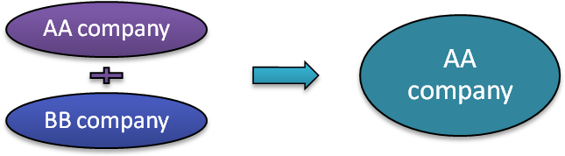
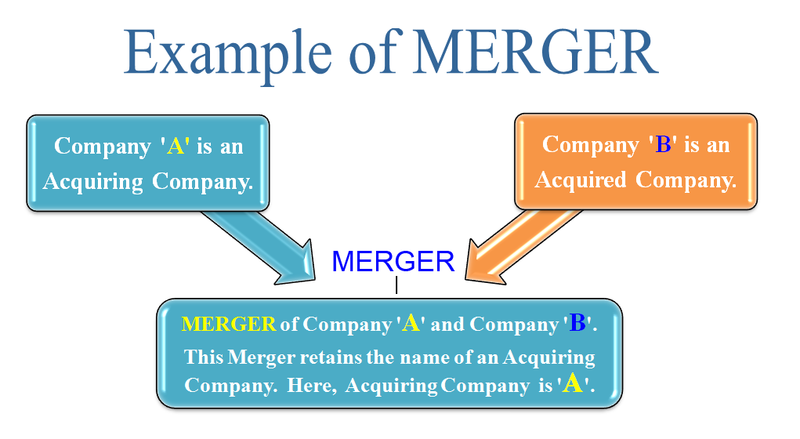

Slide 28
Conglomerate
A merger between firms that are involved in totally unrelated business activities.
There are two types of conglomerate mergers: pure and mixed.
Pure conglomerate mergers involve firms with nothing in common, while mixed conglomerate mergers involve firms that are looking for product extensions or market extensions. Example: A leading manufacturer of athletic shoes merges with a soft drink firm.

Slide 29
Example of a Conglomerate in Bangladesh
BEXIMCO Group
Industries it operates in:
Textiles and garments
Pharmaceuticals
Real estate
Energy (oil, gas, and power)
Information technology
Consumer products
Other examples:
Akij Group – tobacco, textiles, cement, food & beverage, ceramics
PRAN-RFL Group – food and beverages, plastics, electronics, agriculture

Slide 30
Horizontal Merger
A merger occurring between companies in the same industry.
Horizontal merger is a business consolidation that occurs between firms who operate in the same space, often as competitors offering the same good or service.
Horizontal mergers are common in industries with fewer firms, as competition tends to be higher and the synergies and potential gains in market share are much greater for merging firms in such an industry.
Example: A merger between Coca-Cola and the Pepsi beverage division.

Slide 31
Market Extension Mergers
A market extension merger takes place between two companies that deal in the same products but in separate markets.
The main purpose of the market extension merger is to make sure that the merging companies can get access to a bigger market and that ensures a bigger client base.

Slide 32
Product Extension Mergers
A product extension merger takes place between two business organizations that deal in products that are related to each other and operate in the same market.
The product extension merger allows the merging companies to group together their products and get access to a bigger set of consumers. This ensures that they earn higher profits.

Slide 33
Vertical Merger
A merger between two companies producing different goods or services for one specific finished product.
A vertical merger occurs when two or more firms, operating at different levels within an industry's supply chain, merge operations.
Most often the logic behind the merger is to increase synergies created by merging firms that would be more efficient operating as one.

Slide 34
Vertical merger
A notable example of a vertical merger in Bangladesh is the 2016 merger between Robi Axiata and Airtel Bangladesh. This strategic move combined Robi Axiata, a telecommunications service provider, with Airtel Bangladesh, creating a single entity that enhanced their control over various stages of the telecommunications supply chain. By integrating operations, the merger allowed for improved network infrastructure, streamlined services, and a more robust market presence in the country's competitive telecom sector.

Slide 35
Reverse merge
Occurs when a privately held company acquires a publicly traded, but usually dormant, company.
By doing so, the private company becomes public.

Slide 36
Acquisition
An acquisition is a kind of business combination that refers to purchase of a company's asset.
In this type one company that is more stable and financially strong in the market buys the assets of the weaker company and integrates all the operations in its own firm.
The stronger company buys the assets of the target company and then takes over the company with all its assets and liabilities.
This type is much similar to a merger but is known to be a forceful combination.

Slide 37
Consolidation
Consolidation is a kind of association in which two or more companies of same size come together to form a new identity in the market.
All the combined companies share equal shares, assets, and liabilities along with their resources, talent, technology, and other essentials.
The combined companies loose their name and identity and are finally known by the new structure and name.

Slide 38
AA company
BB company
CC company

Slide 39
Takeover
Takeover is a form of acquisition usually followed by a merger. Takeover can be hostile or friendly.
The public tender offer is a means of acquiring a target firm against the wishes of management.
In a friendly takeover the acquiring firm negotiates with the targeted company.

Slide 40
Types of Takeover
Legal Context
Friendly Takeover
Hostile Takeover
Business Context
Horizontal Takeover
Vertical Takeover
Conglomerate Takeover

Slide 41
Thanks to Join with us!
Question so far?

