Slide 1
Trade practices and facilitating agencies in Bangladesh

Slide 2
Trade policy:
The regulations and policies that determine how a country conducts trade with other countries is called trade policy.
It includes use of tariffs and other trade barriers. Trade policy can involve various complex types of actions , such as the elimination of quantitative restrictions or the reduction of tariffs.

Slide 3
Objectives of trade policy
1. To appreciate trade with other nations
2. To protect domestic market prevailing in the country.
3. To increase the export of particular product
4. To prevent the imports of particular goods to safe the domestic industries
5. To encourage the imports of capital goods for speeding up the economic development
6. To restrict the imports of goods which create unfavorable balance of payment.
7. To enter into trade agreements with foreign nations for stabilizing the foreign trade.

Slide 4
Trade policy management in Bangladesh
Trade policy regime in Bangladesh has five aspects.
1. General institutional and legal framework
2. Formulation and administration of trade policy
3. Trade policy implications
4. Trade agreements and arrangements
5. Foreign investment regime.

Slide 5
General institutional and legal framework:
All laws related to trade passed through parliament. Different governmental , semi-governmental and non governmental organizations ( EPB, Ministry of commerce, Chamber houses) assist government to determine new laws, modify present laws.

Slide 6
Formulation and administration of trade policy
1. Ministry of commerce and ministry of finance are the key players for formulating and implementing trade and trade related policies. Bangladesh tariff commission, the export promotion bureau, the office of the chief of imports and exports assist the ministry for formulating trade policies.
2. Ministry of finance makes the final decisions regarding tariffs through the national board of revenue ( NRB).

Slide 7
3. A number of other ministries and agencies are involved in the process of formulating and implementing trade and trade related policies. Under the ministry of industries, BSTI work for determining Bangladesh standard, Department of patent designs and trademarks deals with patents.
As well as, privatization commission, the board of investment, BEPZA , PPP office also assists for policy formulation.

Slide 8
4. In the area of services, Bangladesh Bank play a key role in typical monetary and financial sector regulation. The securities and exchange commission exercises regulatory and supervisory functions over stock exchanges and merchant banks.
Other ministries , like ministry of post and telecommunications, the ministry of civil aviation and tourism, the ministry of shipping and the ministry of communication for road and rail transport also play the vital roles.

Slide 9
5. Some policy consultative bodies like import advisory committee and the export promotion council, the national committee on export and the national council for industrial development effectively participate in policy formulation.
6. The private sector also participate in policy formulation through advisory bodies. BGMEA, BKMEA, the federation of Bangladesh chambers of commerce and industry are key role players.

Slide 10
Main legislation relating to trade and trade related activities
1. Customs Act, 1969
2. Import and export (Control) Act 1950
3. Exporters and indenters (registration) order 1981
4. BSTI act 1986
5. Food safety ordinance 1994
6. Fish feed and animal feed act 2010 and fish hatchery act 2010
7. Animal slaughter and meat quality control act 2011
8. Public procurement act 2006 and public procurement regulations 2008
9. Competition law 2012
10. Bangladesh economic zones act 2010
11. National ICT act 2009
12. Foreign investment (promotion and protection) act 1980
13. Bangladesh export processing zones authority act 1980
14. Banking companies act 1991
15. Money laundering prevention act 2012
16. Securities and exchange commission rules 2006
17. Insurance act 1887
18. Telecommunication regulation act no 18, 2001
19. Merchant shipping ordinance, 1993.
20. Bangladesh tourism board act 2010.

Slide 11
Trade agreement and arrangement:
Bangladesh successfully negotiated regional trade and economic agreements. Such as:
1. The south Asian free trade area ( SAFTA)
2. The Asia pacific trade agreement (APTA)
3. The bay of Bengal initiative for multi-sectoral , technical and economical cooperation (BIMSTEC).
4. Bangladesh is member of WTO.
5. Bangladesh has bilateral trade agreements with 43 countries, namely: Albania, Algeria, Hungary, India, Indonesia, Iran, Iraq, Kenya, South Korea, Kuwait, Libya, Malaysia, Mali, Morocco, Myanmar, Nepal, Pakistan, Poland, Romania, Senegal, Sri Lanka, Sudan, etc.

Slide 12
Industrial policy (2022):
To achieve the balance development through economical , social and environmental protection government developed the industrial policy 2022. In this policy the government emphasize small and medium sized industry development. Beside this, large scale industry and selected service sectors also given importance.

Slide 13
The goal of industrial policy 2022:
1. Improve the socio-economical condition of the people by achieving industrial growth through sustainable and environmental industrialization. .
2. Increase the national contribution of industrial sector 40% within 2027 by skill manpower, productivity and employment to achieve the vision of 2041 of the government.
3. Increase the capability of both government and private sector to achieve the long term growth of industrialization by adapting technological changes in 4th industrial revolution.
4. Collect sustainable and develop technology and develop the existing technology for building strong base for light engineering industry.

Slide 14
Objectives of industrial policy:
1. Create more entrepreneurs by protecting , developing and enhancing local industries, give more motivation for developing new innovative technology by research and give them patent.
2. Create the favorable industrial environment for developing small, medium and cottage industries as main stream industrial development.

Slide 15
3. Establishment of export oriented and diversified industries by inspiring development of backward linkage industries.
4. Create the environment for high technological heavy industries by developing forward and backward industries for light and heavy industries.
5. Accelerate local and foreign investment by the more development of investment environment.
6. Assist and encourage for sustainable (environmental protective) industrialization.

Slide 16
7. Specialized industrialization through proper utilization of area based agricultural, forestry, animal, natural and sea resources.
8. Increasing the opportunities for women entrepreneurs.
9. Provide legal and infrastructural facilities for encouraging foreign investment side by side local investment.

Slide 17
10. Protect human health and interest developing and controlling the quality of industrial products.
11. Increase the productivity of industrial product and increase the ability for local and international commercialization.
12. To ensure the supply of skill manpower that incorporate with market demand and changing technology under 4th industrial revaluation, provide assistance and coordinate education and training programs of public and private sector.

Slide 18
Competition Act:
In Bangladesh, the Competition Act was enacted in 2012 with the subsequent establishment of the Bangladesh Competition Commission (BCC).
Competition law, also known as anti-trust law, is the set of legislations which promote and maintain market competition by regulating anti-competitive behavior and arrangements among the companies in a particular economy.
Evaly case

Slide 19
Competition law aims to control mainly three types of situations in an economy:
1. Anticompetitive agreements and natural monopoly: Where two or more firms agree among themselves to fix prices, limit production, divide markets geographically, or rig bids when tendering for government contracts.
2. Abuses of dominance or exclusionary behavior: Where one firm is so powerful that it can act without thinking about its competitors. Abuses of dominance or exclusionary behavior can include predatory pricing, i.e. pricing below cost to drive competitors out of a market and then raising prices once they are gone.
3. Merger-control regulation: Where firms that want to merge are reviewed to ensure that their deal is not likely to reduce competition significantly, which may lead to abusive behavior.

Slide 20
Facilitating Agencies of Business
Business in Bangladesh is facilitated by some facilitating agencies.
After the Independence of Bangladesh, these facilitating agencies has played a major role in assisting business in Bangladesh by providing various incentives and facilities that ultimately helped the business firms in achieving their business goals.
Some of them are Chittagong Chamber of Commerce, Dhaka Chamber of Commerce, BGMEA, BKMEA, BEPZA, BOI, Customs, FBCCI, EPB etc.

Slide 21


Slide 22
Required services to establish a Business
A. Stimulative support
B. Endorsive support
C. Protective support

Slide 23
Stimulative support:
1. Entrepreneurial education
2. Motivation training
3. Investment opportunities
4. Providing consultancy

Slide 24
Endorsive support:
1. Registering the industrial organization
2. Obtaining capital
3. Infrastructural facilities
4. Selecting and procuring machinery
5. Obtaining management consultancy
6. Marketing the products

Slide 25
Protective support:
1. Modernization of the business
2. Expansion of the business
3. Marketing the commodity
4. Arranging additional funding for utilizing the potential production capacity
5. Extension of the time period for repayment of debt and interest thereof
6. Establishment of common services center.

Slide 26
Support services of government institutions:
Government provide services to businessman through some policies, such as:
1. Industrial and investment policy
2. Fiscal policy
3. Import – export policy
4. Policy for providing different infrastructural facilities.

Slide 27
Government provides institutional and non institutional facilities for business development, such as:
A. Industrial and investment policy – Now national industrial policy 2022 is working.
B. Government encouragement to establish industries.
Government emphasize balance industrial development. Giving facilities on the basis of area: a. Developed area b. Least develop area c. Under-develop area

Slide 28
C. Revenue privileges to encourage business: i. Tax holiday ii. Opportunity for determining higher rate for depreciation – 80% in first year and 20% in the next year iii. Investment allowance – 20% of actual cost of machinery and plant will be given. 25% for least developed area. iv. Loss transfer v. Tax free area vi. Exemption from dual tax

Slide 29
D. Financing of business
Government ensure the local and foreign currency loan through different institutions.
E. Institutions assisting industrialization: i. Investment corporation of Bangladesh ii. Commercial Banks iii. Controller of import and export iv. Bangladesh handloom products export corporation v. Bangladesh industrial technical assistance corporation vi. Bangladesh standard and testing institute vii. Bangladesh council for scientific and industrial research (BCSIR).

Slide 30
Clearing and Forwarding (C&F) Agency
To take delivery of goods, a number of documents are to be submitted, import duty is to be paid.
To help performing these services & assist both importer & custom authority a group of expert who perform these function are called clearing agent.

Slide 31
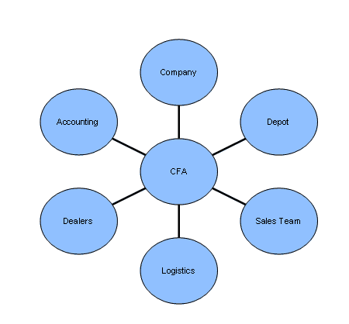

Slide 32
Facilities Provided by C&F Agents
Unloading & proper stacking of materials.
Maintaining adequate 'A' class godown in good condition with required infrastructure.
Loading and Arranging transport for dispatches.
Delivery / Despatch of goods to Dealers / customers as per SO or STO. [sales order/stock transfer order]
Invoicing as per company price list, Permitting discounts on invoice as per policy.
Maintaining stock records in the computer system and existing checking physical stock tallies with the same.
Proper storage & handling of stock in godown.

Slide 33
Customs and Excise
Custom is concerned with smooth operation of foreign trade & excise is concerned with production of home goods & duties charged thereon.
In one hand the custom authority & excise authority excise control, supervision and monitoring, on the other hand it impose & levy duty which is one of the important source of revenue of a country.

Slide 34
Custom Authority
Government appoints custom officials as per general order of appointment set for the purpose. Some officials come through B.C.S. or Public Service commission & some are directly appointed by the Government.
The functions, powers & authorities of the persons under the hierarchy of the authority are guided by custom Act.

Slide 35
Objectives
In order to respond to the challenge of the constantly changing requirements in the implementation of control in the protection of the Community's financial, social and economic interests, without posing unnecessary hindrance to legitimate business, and to fulfill the main priorities,

Slide 36
Customs
Customs has a major role in the trade facilitation of Bangladesh.
It plays one of the major role in collecting the revenues for the Government and also facilitates in the accomplishment of trade and commerce.
Customs are usually a major budget contributor, and sometimes the most important source of revenue for a country.
Customs also have a unique observation position.

Slide 37
Chamber of commerce and Industries
A chamber of commerce (also referred to in some circles as a board of trade) is a form of business network, e.g. a local organization of businesses whose goal is to add the interest of businesses.
Business owners in towns and cities form these local societies to advocate on behalf of the business community.
Local businesses are members, and they elect a board of directors or executive council to set policy for the chamber.

Slide 38
Chamber models
Local and regional chambers
State chambers
Compulsory/public law chambers
Continental/private law chambers
Multilateral chambers

Slide 39
Importance of Chamber of Commerce in the development of industry and commerce of the Country
Development of industry
Transportation of goods
Promoting sound infrastructure
Human resource development
Harmonization of sales tax structure
Providing updated information
Creating market

Slide 40
Export Promotion Bureau (EPB)
Export Promotion Bureau (EPB) of Bangladesh promotes exports for the South Asian nation.
Every year EPB arranges fairs locally and internationally. Generally EPB is a National Export Promotion Agency under the ministry of commerce.
The main function of EPB is to promote export trade and improve plan & policies helpful to the private sector.
The EPB administered by a Board of Management (BOM) comprising members from both public & private sectors where Honorable Minister for Commerce is the ex-officio Chairman and the Vice-Chairman is the chief executive of the Export Promotion Bureau.

Slide 41
Division of EPB
It consists of several divisions.
These are; policy and planning division, commodities department division, information division, fairs and display division, administration and finance division, textile division, statistics and research division, and Information and Communication Technology division.
EPB is a semi-autonomous organization under the Ministry of Commerce of the Government of Bangladesh.
Its main objective is to promote the export sector of the country.

Slide 42
EPB’s duties and responsibilities
Coordinating export development efforts at different sectors and production levels;
Formulating and adopting of policy and program for active promotion of exports;
Coordinating, monitoring and evaluating national export performance and analyzing export trends;
Carrying out promotional activities in product development & expansion of supply side capacity ;
Collecting and disseminating trade information to the stakeholders; Organizing participation in international trade fairs abroad;
Imparting training for HRD ;

Slide 43
Port Authority
The aim is to help incoming & outgoing ships to unload goods brought, in load goods export, at ease & within minimum time.
To this end port authority needs to be alert all the time-day & night & arrange all possible facilities in one hand, prevent unlawful activities on other hand.

Slide 44
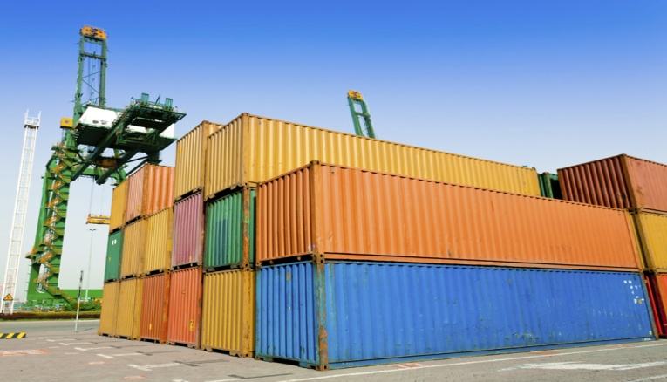

Slide 45
Function of sea port authority
Sea port authority needs to undertake following activities to facilitate foreign trade of a country.
Ensure efficient jetty management.
Provide for easy incoming & outgoing of ships.
Attempt to minimize time for loading & unloading of goods in a ship.
Minimize breathing time

Slide 46
Function of sea port authority
Help to custom authority to conduct inspection & when necessary.
Frame rules & regulations to ensure efficient management & ensure operation of relevant government acts in their proper implementation.
Arranging go down & other space for goods imported & exported.

Slide 47
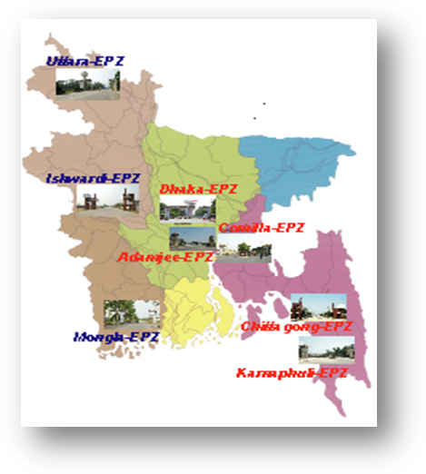
BEPZA

Slide 48
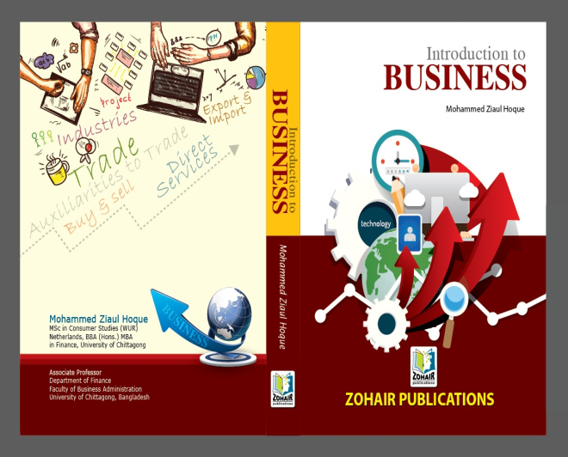
Thanks!
Question?

