Slide 1
Contemporary issues of Business

Slide 2
Contents
Communicating in contemporary business environment
Social business
Green business
E-business
Virtual business/organization
Boundary less organization
Corporate governance
Business ethics and CSR
Ethical decision making
Public private partnership (PPP)
Economic analyses of contemporary issues in Bangladesh
Labor issues in Bangladesh’s RMG sector
Contemporary business ideas

Slide 3
Communicating in contemporary business environment
Communication theory
Social networking
Web-based information
Business ICT environment
Talking to non-accountant
Knowledge sharing
Teleworking

Slide 4
Social business
A social business is a company created for social benefit rather than private profit. It is known as “Yunus Social business (YSB)”.

Slide 5
Social business
Seven principles of social business
Business objective will be to overcome poverty or one or more problems (such as education, health, technology access, and environment) which threaten people and society; not profit maximization
Financial and economic sustainability
Investors get back their invested amount only; no dividend is given beyond investment money
When investment amount is paid back, company profit stays the company for expansion and improvement
Environmentally conscious
Workforce gets market wage with better working condition
Do it with joy.

Slide 6
Green or sustainable business
Sustainable business or green business is an enterprise to be that has minimal negative impact on the global or local environment , community, society or economy. Four criteria for green business:
It incorporates principles of sustainability into each of its business decisions.
It supplies environmentally friendly products or services that replace demand for no green products and/or services
It is greener than traditional competition
It has made an enduring commitment to environmental principles in its business operations.

Slide 7
Corporate sustainability strategies
Innovation and technology
Collaboration
Process improvement
Sustainability reporting

Slide 8
Green business in Bangladesh
Grameen Shakti (GS) – is the market leader in installing solar based technologies for various uses.
Green Technology centre (GTC) – It trains daily hundreds of women about the use of green technology and production of organic food. .
Fertilizer: A small scale biogas plant based on cow dung can produce more than 8000 kilograms of slurry which is important source of fertilizer.
Brick field: Under the project of united nations development program (UNDP), the brick filed in Dhamri use the environment friendly Hybrid Hoffman Kiln (HHK) technology to avoid green house has emissions.
Bangladesh renewable energy society:

Slide 9
Standards of green business
ISO 14001 is the cornerstone standard of the ISO 14000 series. It specifies a framework of control for an environmental management system. Other ISO 14000 series standards are actually guidelines.
ISO 14004 provides guidance on the development and implementation of environment management system
ISO 14010 provides general principles of environmental auditing
ISO 14011 provides specific guidance on audit an environment management system

Slide 10
Six essential characteristics of green business
Triple top line value production: Financial benefits for the company, natural world betterment, and social advantages for employees and members for the local community.
Nature based knowledge and technology
Product of service to product of consumption
Solar, wind, geothermal and ocean energy
Local based organizations and economies
Continuous improvement process.

Slide 11
E-business
Electronic business or e-business can be defined as the application of information and communication technologies is support of all the activities of business.

Slide 12
E-business and e-commerce
E- business refers to more strategic focus with an emphasis on the functions that occur using electronic capabilities.
E – commerce is a subset of an overall e-business strategy.

Slide 13
E – business model
E – business model | Classification by provider and consumer
E – shop | Business to business (B2B)
E – commerce | Business to Consumer (B2C)
E-procurement | Business to employee (B2E)
E- mails | Business to Government (B2G)
E- auctions | Government to Business (G2B)
Virtual communities | Government to government (G2G)
 | Government to citizen (G2C)
 | Consumer to consumer (C2C)
 | Consumer to business (C2B)

Slide 14
Virtual business
Virtual Business: A virtual business employs electronic means to transact business.
Virtual corporations: Groups of people can assemble online and enter into an agreement to work together toward a for profit goal, with or without having to formally incorporate or form a traditional company.
Virtual enterprise: A virtual enterprise is a network of independent companies suppliers, customers, competitors, linked by information technology to share skills, costs, and access to one another’s markets.

Slide 15

A virtual organization
A virtual organization is a temporary or permanent collection of geographically dispersed individuals, groups, organizational units, or entire organizations that depend on electronic linking in order to complete the production process (working definition).

Slide 16
Boundary less organization
An association where management has largely succeeded in breaking down barriers between internal levels, job functions and departments, as well as reducing external barriers between the association and those with whom it does business.
Modular business
Virtual business
Strategic alliance
Network organization.

Slide 17
Modular Business
The concept behind Modular Business is that each business is unique, but all businesses share some basic processes and functions. Those functions can be considered Business Modules that fit together to build a complete, profitable business.
Google, Amazon, 3M.

Slide 18
Strategic alliance
A strategic alliance is an arrangement between two companies to undertake a mutually beneficial project while each retains its independence. The agreement is less complex and less binding than a joint venture, in which two businesses pool resources to create a separate business entity.
RIMAS is pleased to announce a strategic alliance with GRAM. This is the start of a cooperation that must lead to a strong driving force and franchise formula for the production of solar panels in the Bangladesh region.

Slide 19
Network organization
A network organization is a collection of autonomous firms or units that behave as a single larger entity, using social mechanisms for coordination and control. The entities that make up a network organization are usually legally independent entities (separate firms) but not always.
An organization that has been using network structure is H&M (Hennes & Mauritz), a very popular brand that has followers world over. H&M has outsourced the production and processing of their goods to different countries majorly Asian and South East Asian countries.

Slide 20
Characteristics of boundary less organization
1. Eliminate the chain of command, have limited spans of control, and replace departments with empowered team
2. Technology based organization
3. By removing vertical boundaries , management flattens the hierarchy and
Minimize status and rank
Uses cross hierarchical teams
Uses participative decision making practices
Uses 360 degree performance appraisal

Slide 21
Characteristics of boundary less organization
4. Reduce horizontal boundaries of functional department by
Replace functional departments with cross functional teams
Use lateral transfers and rotate people into and out of different functional areas.
5. Break down barriers to external constituencies ( suppliers, customers, regulators, etc.) and barriers created by geography.
6. Common tread of boundary less organization in networked computers.

Slide 22
Corporate governance
Corporate governance is the system of rules, regulations, practices, and processes, by which a company is directed, operated, monitored, controlled and reviewed with the lens of welfare being of stakeholders.
Corporate governance essentially involves balancing the interests of a company's many stakeholders such as financiers, shareholders, debenture holders, sponsors, management, suppliers, consumers, lender, borrowers, creditors, debtor's, political activists, pressure groups, free rider, CSR, government and the local community.

Slide 23
Corporate governance
Deregulation, disintegration, and institutionalization are the main feature of corporate governance of Bangladesh. But due to the non-constitution of different committees, rapidly changes in different laws and actions.
Unethical pressure from the majority of shareholders while decision making, lack of political will and commitment to ensure sound corporate governance. Moreover, the corporate structure is dominated by family members over the board which practice hinders the level of fairness. accountability, and transparency.

Slide 24
Public private partnership
The concept of PPP though not relatively new but has not yet developed and defined straight forward (World Bank, 2007a). According to Asian Development Bank, PPP is a range of possible relationships among public and private entities in the context of infrastructure and other services that present a framework for engaging private sector and also structure the role for government in ensuring that social obligations are met (ADB, 2008).
PPP have gained utmost attention from the public sector and donor groups particularly in terms of service quality, procurement efficiency, risk minimization and the ability to combine adequate managerial and technical capabilities.

Slide 25
Ethics and CSR
Ethics – A set of moral principles or values that governs the conduct of an individual or a group.
What is lawful conduct is not always ethical conduct.
The law may permit something that would be ethically wrong.
Corporate social responsibility (CSR), is the idea that business has a duty to serve society in general as well as the financial interests of stockholders.

Slide 26
Ethical decision making
Ethical decision making is a cognitive process that consider various ethical principles, rules and virtues and maintenance of relationships to guide or judge individual or group decisions or intended actions.

Slide 27
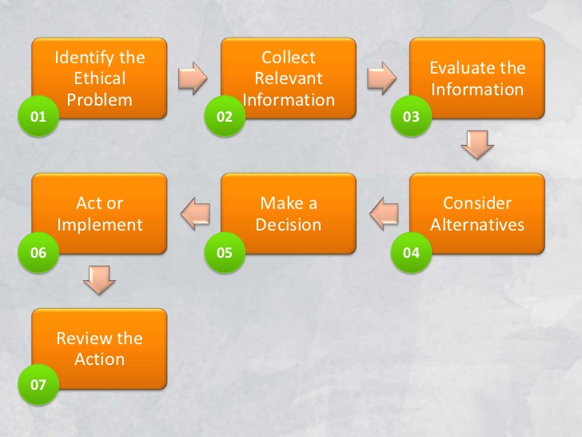
Ethical decision making

Slide 28
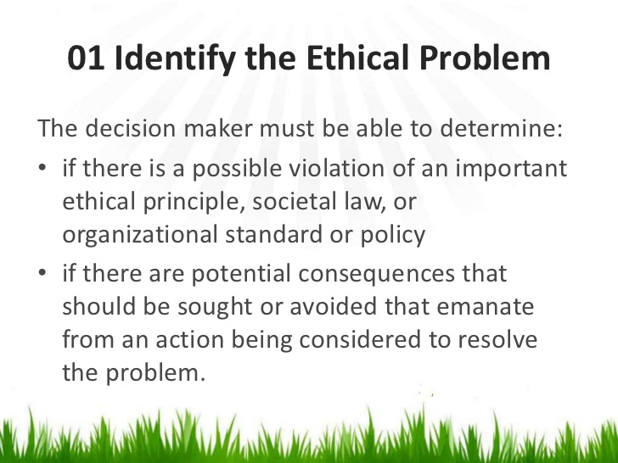
Ethical decision making

Slide 29
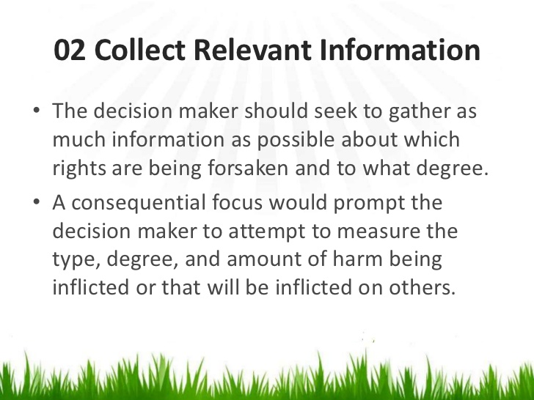
Ethical decision making

Slide 30
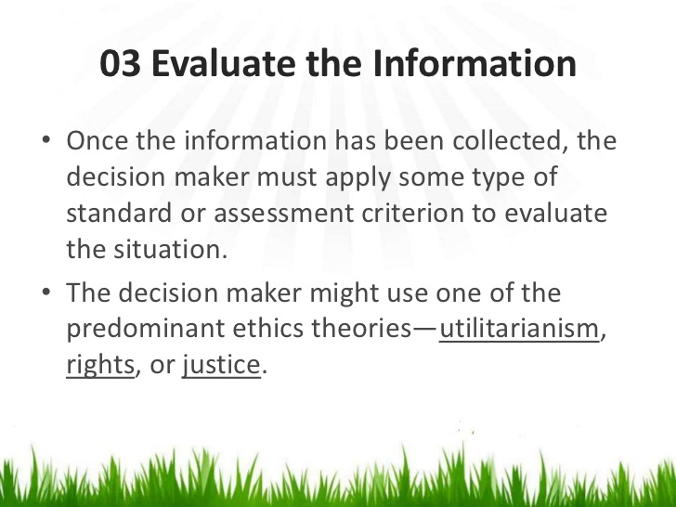
Ethical decision making

Slide 31
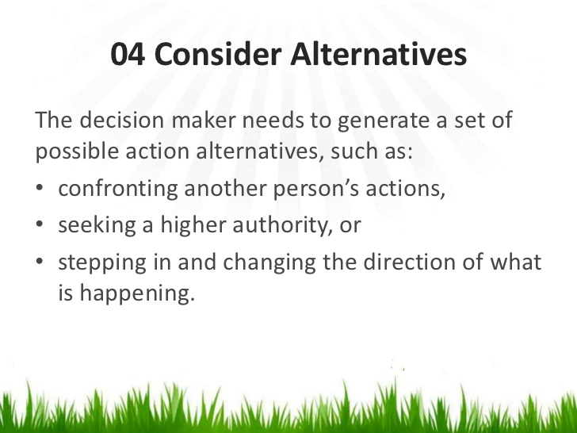
Ethical decision making

Slide 32
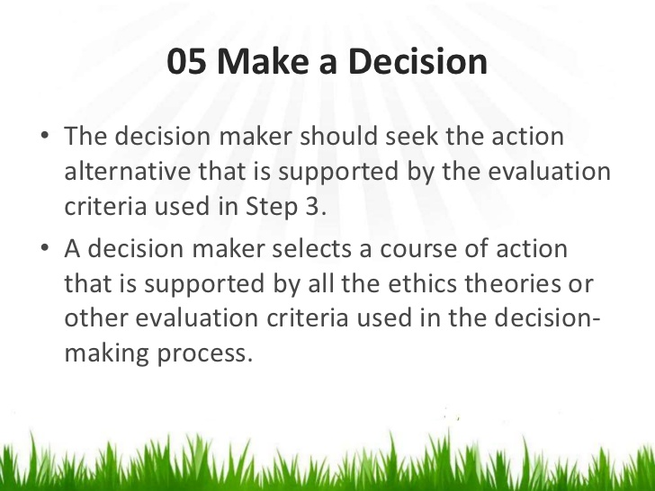
Ethical decision making

Slide 33
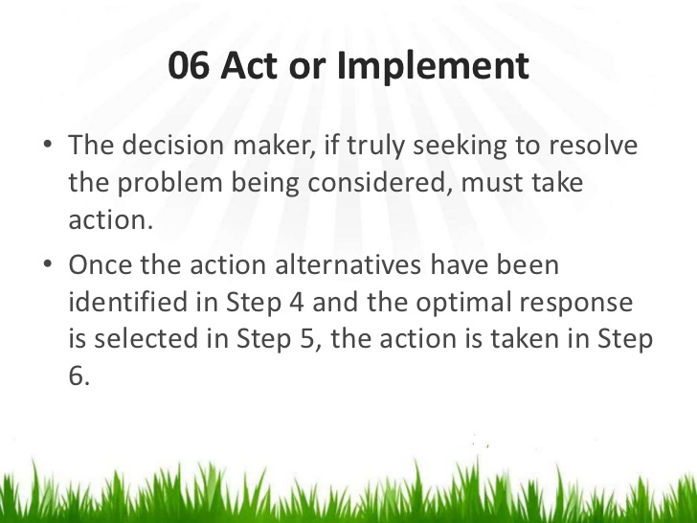
Ethical decision making

Slide 34
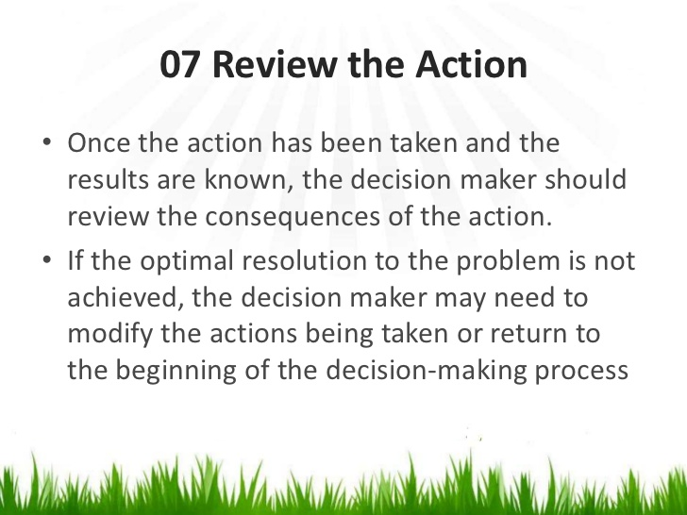
Ethical decision making

Slide 35
Labor issues in Bangladesh RMG sector
Existence of poor compliance standards
Lack of safety measures
Frequent labor unrest
Poor wage
Low productivity
Lack of trade unionism and collective bargaining rights
Existence of forced labor
Unhealthy working conditions

Slide 36
Contemporary business ideas
Green cleaning
College advisor
Social media consultant
Blogging
Farmer’s market grocery delivery
Kids spas
Handmade cards
Female handyman

Slide 37
Contemporary business ideas
Etsy list agent: Etsy is an American e-commerce website focused on handmade or vintage items and craft supplies. Etsy list agent works for designer.
Tutoring
Empty nester catering
Personal concierge
Property manager
Community personal trainers
Nutrition consultant

Slide 38
Contemporary business ideas
Pie bakery
Corporate physical trainer
Image consultant
Phone app developer
Personalized product designer

