Slide 1
PROJECT PRESENTATION
Team No. 17
Syed Abrar Ullah Hussaini, Smit Ramteke
CSE 3330/5330
The University of Texas at Arlington, Arlington
FALL 2015

Slide 2
For each phase of the project
- Phase 1 and Phase 2 were quite difficult.
- Phase 3 was the easiest.
- Phase 4 was relatively easy.
- 1st EER for phase 2 was disastrous.
- Fall back to lecture and notes and got it right for phase 3.
- Pacing between lectures, course materials and project was just right.

Slide 3
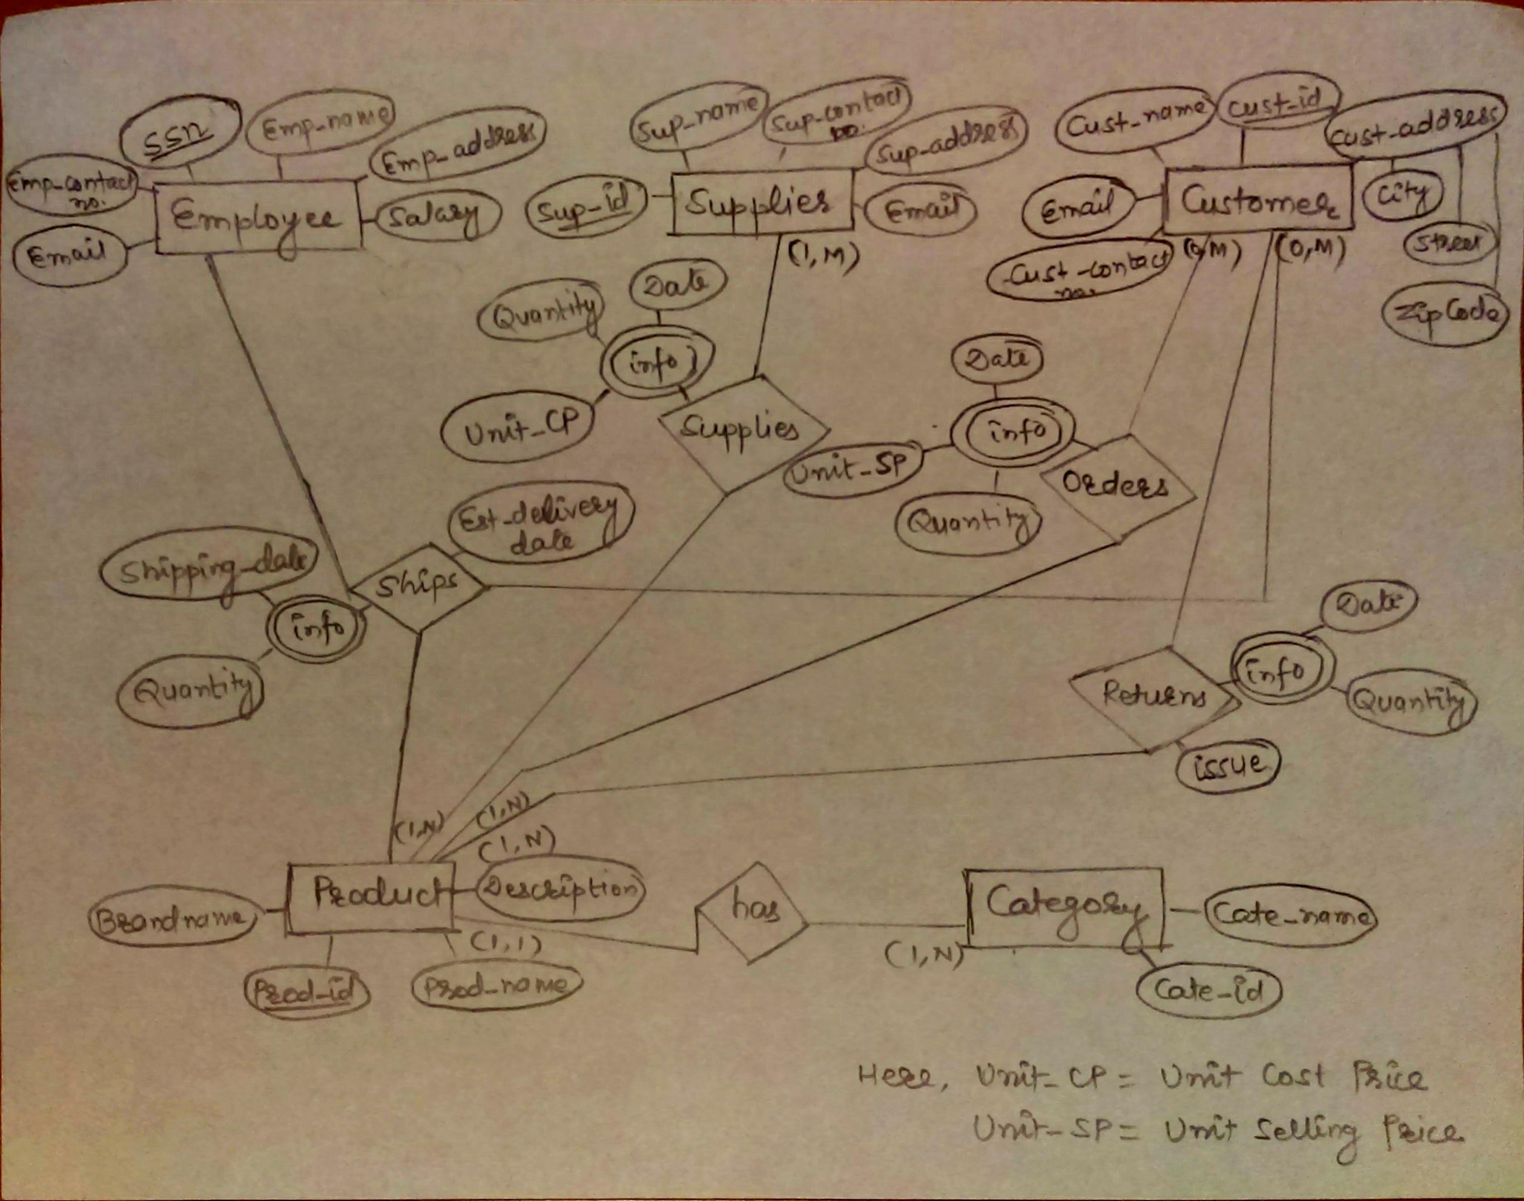
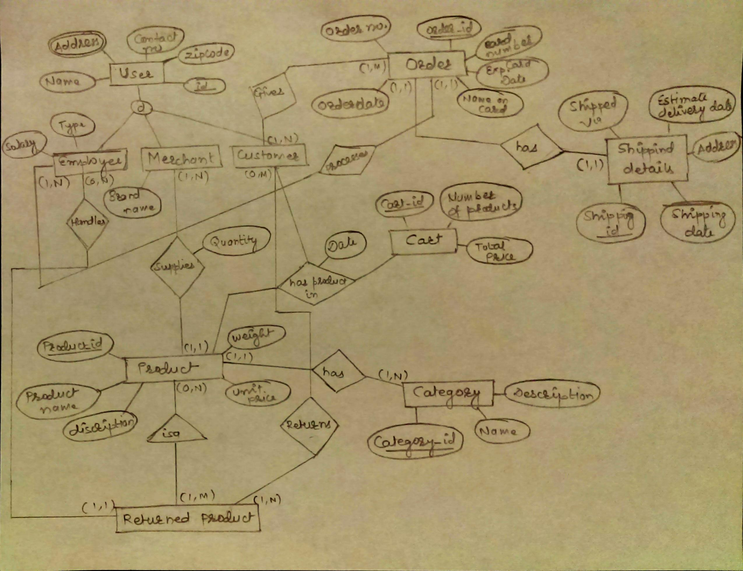
PHASE 2 EER
PHASE 3 EER

Slide 4
What is your takeaway from phases 1 to 3?
- Learning curve for Phase 1 was quite tough.
- Phase 2 seemed easy but it was difficult as well.
- Both Phase 1 and Phase 2 needed proper understanding of the problem
statements and real world business practices.
- Phase 3 was as easy as it gets.

Slide 5
What was your takeaway from Phase 4?
- Needs quite a bit understanding about SQL queries.
- Having functionalities and business goals from Phase 1 narrow down
query formation.
- Inserting values is cumbersome.
- Having a few but important relations in Phase 3 helps.
What is your takeaway from Phase 5?
- Still working on it so hard to tell about it, but it’s a bit easy.

Slide 6
Did the course and project provide a good understanding of DMBS usage?
- Yes it did.
- Provided understanding about what goes into Database. What goes into
Database designing, how to plan about it.
- Understanding about business goal provide a good foundation of
Database design as well as Logical planner.

Slide 7
How the project experience can be improved? - It can be improved by providing better and clear view about Phase 1. - Better understanding about functionalities should be provided.
How can course experience can be improved?
- Course has right pacing and covered many topics.
- Module III felts like very short and rushed out at the end.
- If course material on Blackboard would have been more convenient.

Slide 8
How can the test experience be improved?
- Format of test was good.
- Questions were of mixed difficulty.
- Exam format should be the same.
Did the lecture modules with project provide a good understanding about end user view of DBMS?
- Provided a good view about Logical Planner, Physical Planner, cost and
maintenance of DBMS, cost of Database design etc.
- Also provided understanding about risk involvement with DBMS.

Slide 9
Constructive comments/suggestion on Project for future offerings.
- As said earlier, Phase 1 might be the toughest part, so it should be clear
as to what is expected and what are certain terms like “functionalities” and
“business goals.”
Other thoughts
- TA was knowledgeable and very helpful.
- During the course of Project is it advisable to meet TA or Professor as much
as possible for clearing doubts about certain phase and for an early
evaluation.

Slide 10
Should this be an individual project?
- No. Having a team helps tremendously to reduce work load.
- Also having a project partner means, you split your work according to
topics you are good at.
e.g. If someone isn’t as good as SQL queries, Phase 4 would be rather
tough for him/her.
Will you recommend this course to others?
- Yes.

Slide 11
THANK YOU!!

