Slide 1
Numerical Analysis for Coupled Hydro Mechanical Slope Stability of an Open-Pit Mine (using PINN)
Presented By
Abrar Mahir
Regestration No. 2020223031
Supervised By
Dr. Md. Shofiqul Islam
Professor
Department of Petroleum and Mining Engineering
Shahjalal University of Science and Technology, Sylhet

Slide 2
Presentation Outline
Introduction & Problem Statement
Literature Review
Research Gap
Objectives of the Study
Methodology & Governing Equations
PINN Architecture & Training
Study Area & Data Source
Software Tools
Possible Outcomes
2 / 14

Slide 3
1. Introduction & Problem Statement
The Challenge
Limitations of Current Methods
Open-pit mine slope failures are among the most destructive geological hazards globally, triggered by rainfall infiltration, pore-pressure buildup, and inadequate pit design.
Rainfall infiltration increases pore-water pressure, diminishes matric suction, and reduces effective stress and shear strength of the geomaterial.
Modeling this requires solving coupled nonlinear PDEs: Richards equation (seepage) + Navier-Cauchy (mechanics) simultaneously.
LEM: Requires assumed failure surface geometry; ignores stress-strain behavior
FEM-SSR: Mesh-dependent; computationally prohibitive for coupled transient HM problems
PINNs: Mesh-free, embeds physics in loss function, uses automatic differentiation — but no existing study applies coupled HM-PINN with dual failure criteria to real mine data
3 / 14

Slide 4
2. Literature Review
Table 1 : Literature Review Table
Author (Year) | Focus Area | Method | Gap for This Study
Ulusay et al. (2014) | Open-pit slope stability, hydrogeology | LEM + field investigation (423 Packer tests) | No PINN; no coupled HM numerical analysis
Bandai & Ghezzehei (2021) | PINN for Richards equation | PINN inverse estimation of SWCC params | 1D seepage only; no mechanics or FOS
Amini et al. (2023) | PINN for coupled THM | Fixed-Stress Split; Adam+L-BFGS training | No slope stability; no SSR; no mining context
He et al. (2024) | Surrogate FOS prediction | Data-driven NN trained on FEM-SSR | Not physics-informed; no PDE constraints
Bekele et al. (2021) | PINN for geomechanics | Elastoplastic PINN with MC yield | No seepage coupling; MC only; no field data
Depina et al. (2022) | DD-PINN for heterogeneous soils | Domain decomposition for Richards eq. | Seepage only; no FOS; no mining scale
All six studies contribute individual components but none integrates coupled HM-PINN + dual failure criteria + real mine data.
4 / 14

Slide 5
3. Research Gap
GAP 1
No coupled two-way HM-PINN framework exists for open-pit mine slope stability. Current PINNs address seepage OR mechanics in isolation.
GAP 2
No study compares Mohr-Coulomb vs. Generalized Hoek-Brown FOS within a unified PINN-SSR framework on the same slope geometry.
GAP 3
Existing PINN geomechanics studies use synthetic/benchmark data. No application with real primary-source mine data (lab tests, piezometers, Packer tests).
GAP 4
The quantitative impact of coupling strategy (one-way vs. two-way monolithic) on PINN-predicted FOS has not been investigated.
5 / 14

Slide 6
4. Objectives of the Study
1. Formulate and implement coupled Richards + Navier-Cauchy equations within a monolithic two-way PINN framework with Kozeny-Carman porosity-strain feedback.
2. Integrate the Shear Strength Reduction (SSR) method with the trained PINN for automatic FOS determination using both Mohr-Coulomb and Generalized Hoek-Brown criteria.
3. Validate the PINN model against analytical solutions and published LEM results from the Işıkdere lignite mine using primary-source geotechnical data.
4. Compare FOS predictions and critical failure surface geometries from MC and GHB criteria within the unified PINN-SSR framework.
6 / 14

Slide 7
5. Methodology - Governing Equations
Seepage Domain — Richards Equation
Mechanical Domain — Equilibrium
∂θ/∂t = ∇·[K(ψ)∇(ψ + z)] + S
∇·σ + ρ₆·g = 0
Constitutive: Mualem–van Genuchten SWCC
Θ = [1 + (α|ψ|)ⁿ]⁻ᵐ
K(ψ) = Kₛ·Θ½·[1−(1−Θ^(1/m))^m]²
Bishop effective stress (unsaturated):
σ′ = σ − uₐ·I + χ(uₐ − uₗ)·I
Constitutive: σ = D(E,ν)·ε (Hooke’s law)
Two-Way Monolithic Coupling
Porosity–strain: n = n₀ + εᵥ Kozeny–Carman: Kₛ=Kₛ₀·[n/n₀]³·[(1−n₀)/(1−n)]²
Bulk density: ρ₆ = ρₑ + θ(ψ)·ρₘ → Simultaneous in single loss function
MC-SSR: c′ᵣ = c′/SRF; φ′ᵣ = arctan(tanφ′/SRF)
GHB-SSR: σ′₁ = σ′₃ + σci·(m₆·σ′₃/σci + s)^a → reduce m₆, s, σci
7 / 14

Slide 8
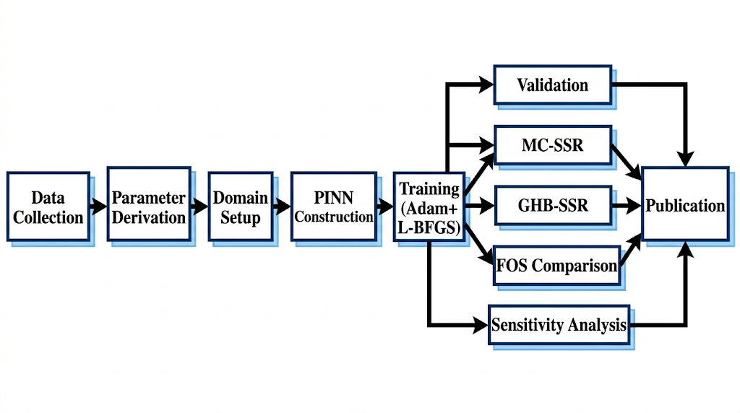
5. Methodology — Research Flowchart
Figure 1 : Flowchart of Methodology
Phase 1: Extract Ulusay et al. (2014) data → Convert to SI → Derive SWCC via Rosetta → Derive E, ν via Hoek-Diederichs → Non-dimensionalize
Phase 2: Build 8×64 FNN (tanh) → Construct monolithic loss function → GradNorm adaptive weighting → Adam 100K epochs → L-BFGS 10K iterations → Validate against analytical + LEM benchmarks
Phase 3: Run MC-SSR (c′/SRF, arctan(tanφ′/SRF)) → Run GHB-SSR (reduce m₆, s, σci) → Compare FOS → Identify failure surfaces → Sensitivity analysis
8 / 14

Slide 9
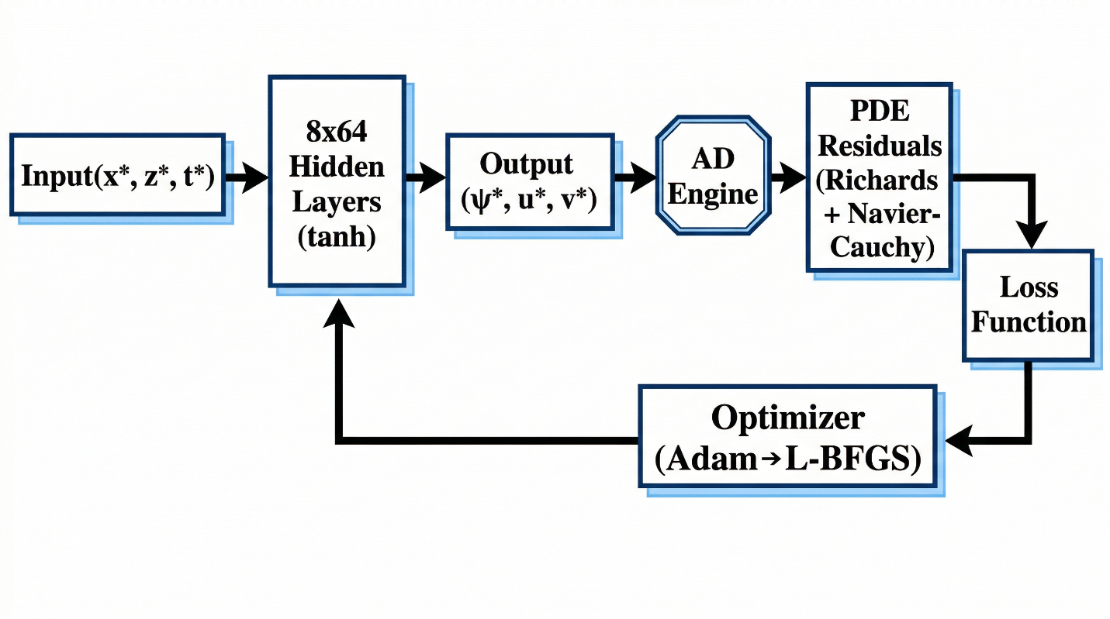
6. PINN Architecture
Automatic
Differentiation
∂ψ/∂t, ∇·σ, ∇²u
Loss Function
L = w₁L_PDE
+ w₂L_BC
+ w₃L_IC
+ w₄L_data
8 Hidden Layers × 64 neurons
tanh activation
Figure 2 : Flowchart of PINN architecture
~29,500 trainable parameters | 10,000–50,000 collocation points | GradNorm adaptive weighting | Adam → L-BFGS hybrid training
9 / 14

Slide 10
7. Study Area & Primary Data Source
Table 2 : Data Set Table
Işıkdere Lignite Open-Pit Mine, Milas Basin, Muğla, Turkey
Data Category | Details
Mine dimensions | 2.5 km × 750 m × 170 m depth
Operator / Since | Turkish Coal Enterprises (TKI) / 2009
Boreholes drilled | 30 (depths 51–170 m)
Packer (Lugeon) tests | 423 tests across all hydrostratigraphic units
Structural measurements | 452 (bedding + joints, 19 scan-line locations)
Unit weight tests | 64 specimens across 7 materials
Shear test sets | 15 sets (bedding, underclay, fault gouge, debris)
Monitoring wells | 23 wells, weekly for 1 year (Aug 2010–Jul 2011)
Source publication | Ulusay et al. (2014), Engineering Geology, 181, 261–280
10 / 14

Slide 11
7. Key Material Parameters (Extracted)
Table 3 : Key Material Table
Material | γ (kN/m³) | c′ (kPa) | φ′ (°) | GSI | UCS (MPa) | Kₛ (m/s)
Marl (Sekköy Fm.) | 14.9 | 4.4* | 15.4* | 50 | 17.9 | ≈10⁻⁹
Weak zone marl | 16.9 | 0.9 | 14.0 | 45 | 4.29 | ≈10⁻⁹
Tuffite | 14.4 | 0.0 | 34.2 | 26 | 3.59 | ≈10⁻⁹
Coal seam | 8.6 | — | — | 40 | 7.80 | 3.5×10⁻⁶
Underclay | 18.4 | 10.1 | 19.2 | — | — | ≈0
Slope debris | 17.6 | 8.9 | 21.7 | — | — | —
* Residual strength (back-analysis validated: c = 4.4 kPa, φ = 15.4° for smooth bedding)
Hoek-Brown Parameters (D = 1 for all units, production blasting)
Coal seam K from 80 Packer tests: 0.1–0.5 m/day | Storage coeff.: 0.00003 | Bedrock K: 0.27 m/day (below pit bottom)
11 / 14

Slide 12
8. Software Tools
Table 4 : Software tools Table
Tool | Purpose
Python 3.10+ | Primary programming language
PyTorch 2.x | NN construction, automatic differentiation, GPU training
NumPy / SciPy | Numerical computations, L-BFGS optimizer, analytical benchmarks
Rosetta3 | Van Genuchten SWCC parameter derivation from grain size data
Matplotlib | Publication-quality figures (stress fields, convergence, failure surfaces)
RocScience Slide/RS2 | Independent LEM/FEM-SSR validation (same tool used by Ulusay et al.)
LaTeX / MS Word | Manuscript preparation for Q1 journal submission
12 / 14

Slide 13
9. Possible Outcomes
Validated Framework
Mesh-free PINN for fully coupled transient HM analysis in heterogeneous, multi-layered open-pit mine slopes
Dual-Criteria FOS
Quantitative comparison of Mohr-Coulomb vs. Hoek-Brown FOS expected 2-8% difference; sensitivity to failure criterion choice quantified
Coupling Impact
Two-way monolithic coupling expected to produce FOS 10–20% lower than one-way sequential during rainfall — quantifies safety overestimation
Failure Surfaces
Automatic identification from shear strain fields without geometric assumptions; compound/multi-planar mechanisms expected
13 / 14

Slide 14
Thank You

