Slide 1
Web Based Multi Vendor E-commerce System
Team Members:
Project Proposal – CSE299
Abdullah Ibne Ali - 1711200042
Abrar Faisal - 1712677642
Faculty – SAA3
Sadman Chowdhury Siam - 1711172042
Group - 03
Section - 14

Slide 2


What Is E-Commerce?
A system that refers to buying and selling of goods from different places
Order products with this system
Use Digital payment method
Use digital platform such as web, Android, IOS to establish their system for their user

Slide 3

Literature Review
Daraz, Ajker deal – Top Multi Vendor Ecommerce in BD
Pickaboo - Specialized For Electronics
Amazon - For Importing Quality Products
Chaldal - For Grocery Items
Agora, Shwapno - Basically Popular Super Shops now
Providing Ecommerce services

Slide 4

Problem
Problem of Movement
Traffic Jam and discomfort in public transportation
Wasting of Time
Not sufficient parking places
Problem in Malls and Local Market
Crowded shopping malls
Uneven payment methods
Unnecessary & excessive price tag

Slide 5
Feature Of our E-commerce solution
Basic Features:
Login, Registration and User responsibility
Flexible and Responsive Homepage
User Profile
Product Uploading
Checkout
Payment Gateway

Slide 6

User Functionalities
User can register as
Customer and Vendor
User can pay using
Bkash, Credit or Debit cards
User can see
Real time update of the system with estimated delivery time
User will get
Order receipt in their phone

Slide 7




Technology Requirement
Front End
HTML, CSS, Bootstrap
JavaScript
Framework: React
Back End
Python
Database: PostgreSQL
Framework: Django
Server
AWS or Heroku

Slide 8
Functional & Non-Functional Requirements
Functional
Non-Functional
Registration & Authentication
Need Phone(OTP) and Id verification
Pre order option
Restrict if order exceeds certain number
Vendor Registration
Authentication with NID and Photo

Slide 9
Work Prioritization
1
System and Interface Design
2
User Authentication & Authorization
3
Cart Management & Receipt Generation
4
Payment Getaway Development
5
Real Time Update and Other Async Processes

Slide 10

Work Plan
Milestone | Tasks | Hrs | Date
1 | Analysis & Distribution Of Task | 42 | 5/02/20
2 | Development & Testing | 129+ | 20/02/20
3 | Finalize & Deployment | 12+ | 20/04/20

Slide 11
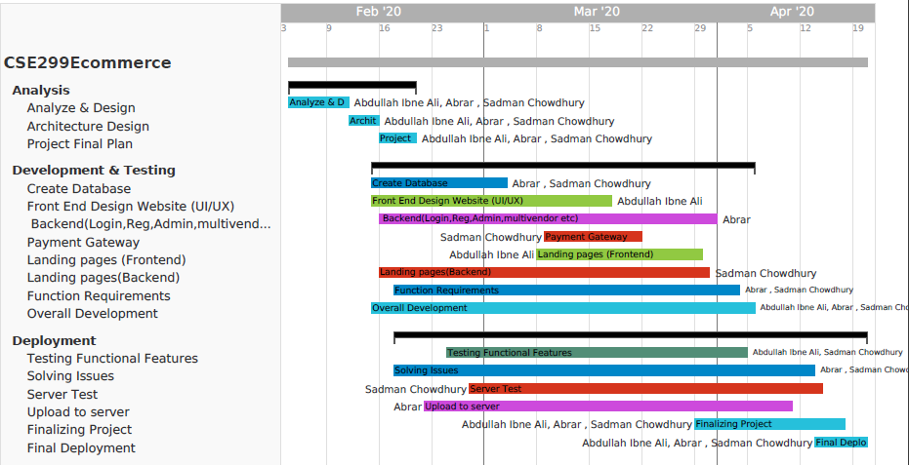
Gantt Chart

Slide 12

Business Strategy
We will take 15% from each product sold by our business users.
Revenue generation by advertising of the vendor and products.
We will sell subscription and coupon to our normal user.

Slide 13
Procurement Plan
Estimated Cost for Proffesional Deployment:
Reason | Cost
Hosting Server | 10,000/-
Domain | 2,000/-
Graphic Tools & Icons | 20,000/-
Total | 32,000/-

Slide 14
THANK YOU

