Slide 1
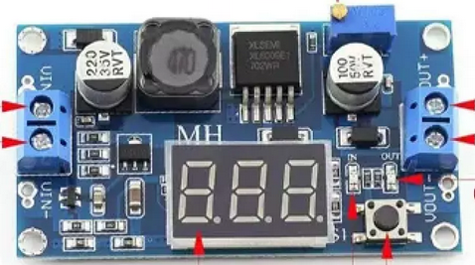
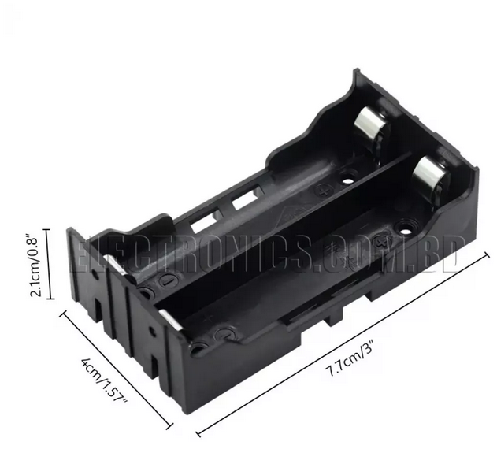
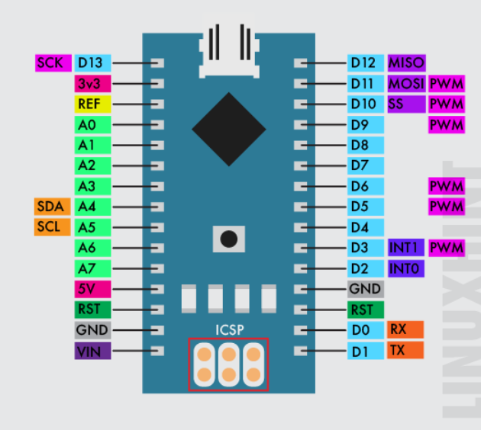
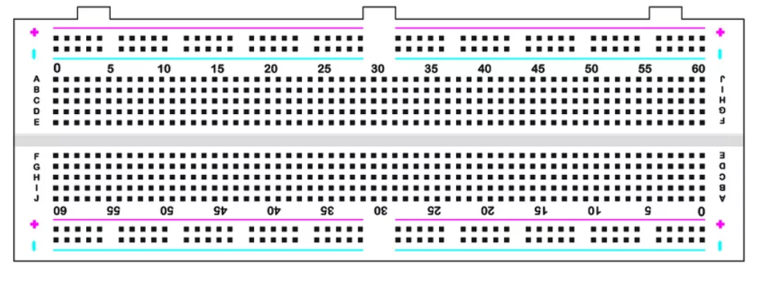







Preliminary Setup
Servo

Slide 2
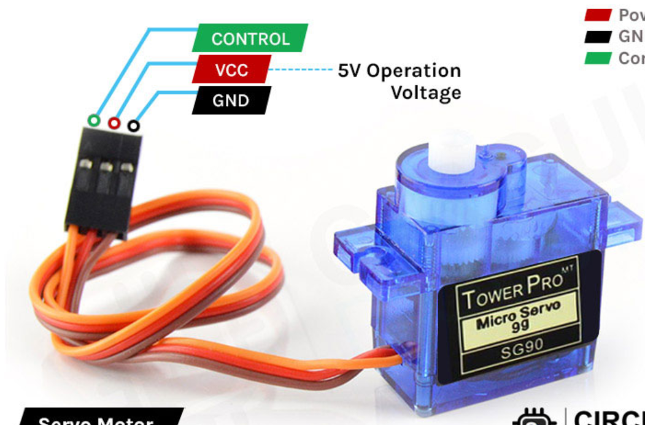
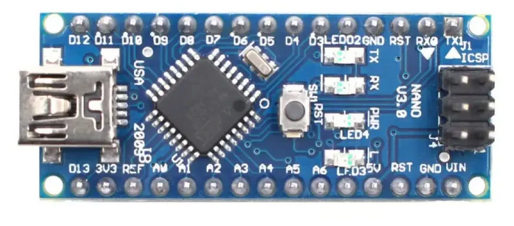











Preliminary Setup
Servo

Slide 3
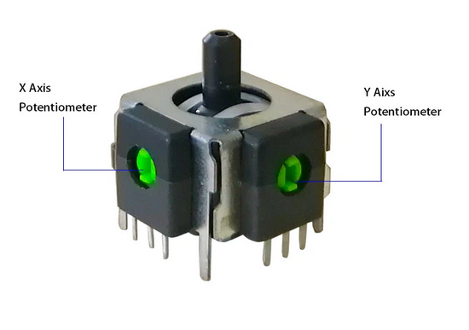
Preliminary Setup
Hardware Summary
JOYSTICK
X
Y
VCC
GND

Slide 4
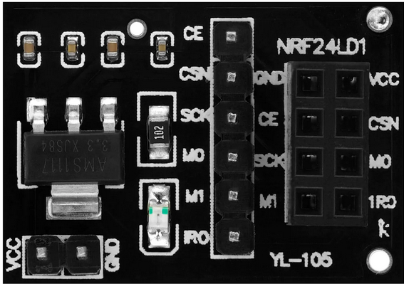
Preliminary Setup
SETUP 1
Radio Link
Receiver
&
Transmitter

Slide 5
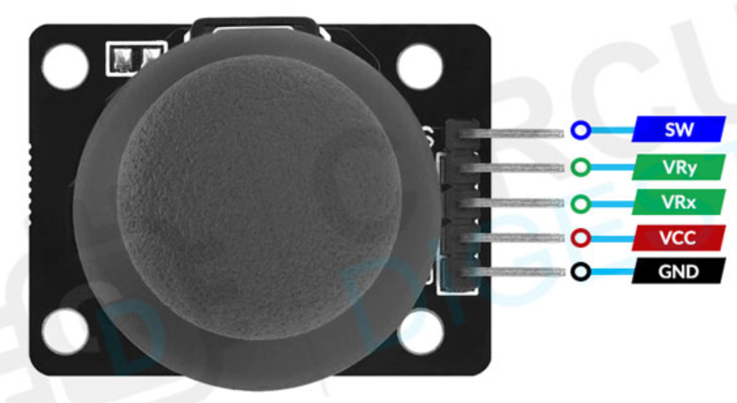



Preliminary Setup
SETUP 2
Radio Link
Transmitter

Slide 6



Preliminary Setup
SETUP 2
Radio Link
Receiver

Slide 7
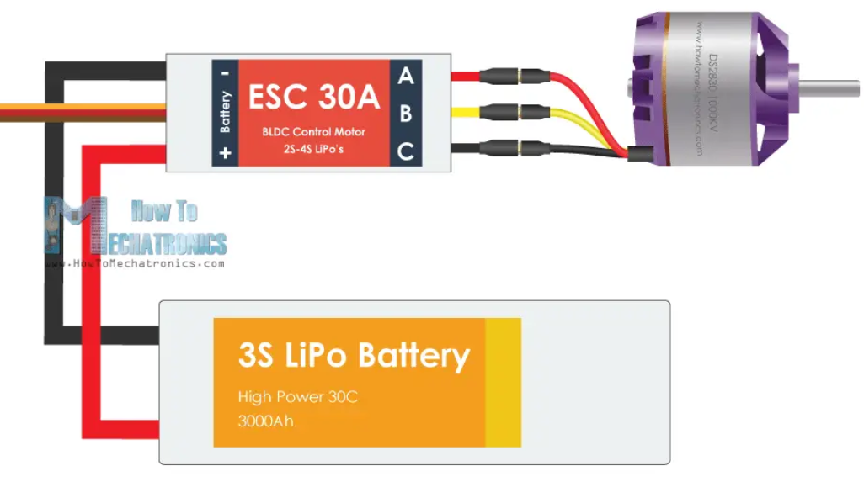
Preliminary Setup
SETUP 1
Engine

