Slide 1
Restaurant Revenue Prediction Using Decision Tree Modelling
By Ankit B Raut
Ivy Professional School, Kolkata

Slide 2
Agenda
04
1
Objectives
2
Introduction
3
Dataset Dictionary
4
Technology Used
5
System Design
6
Methodology
7
Experiment And Results
8
Continuous & Categorical Data
9
Decision Tree Model
10
Conclusion

Slide 3
Objectives
This dataset contains information about various restaurants and aims to predict the revenue based on several features.
Build a Supervised machine Learning Model for forecasting value of restaurants Revenue based on multiple attributes.
Provide graphical comparisons to provide better view.

Slide 4
Introduction
This is dataset which is including data about Restaurants different features. Dataset shows Which Cuisines, Locations, Average Meal Price etc. Influence factors are affecting in Restaurant’s Revenue Prediction.
Each row represents a unique restaurant with various attributes that may influence its revenue.

Slide 5
Dataset Dictionary
Name: The name of the restaurant.
Location: The location of the restaurant (e.g., Rural, Downtown).
Cuisine: The type of cuisine offered (e.g., Japanese, Mexican, Italian).
Rating: The average rating of the restaurant.
Seating Capacity: The number of seats available in the restaurant.
Average Meal Price: The average price of a meal at the restaurant.
Marketing Budget: The marketing budget allocated for the restaurant.
Social Media Followers: The number of social media followers.
Chef Experience Years: The number of years of experience of the head chef.
Number of Reviews: The total number of reviews the restaurant has received.
Avg Review Length: The average length of reviews.
Ambience Score: A score representing the ambience of the restaurant.
Service Quality Score: A score representing the quality of service.
Parking Availability: Indicates if parking is available (Yes/No).
Weekend Reservations: The number of reservations made on weekends.
Weekday Reservations: The number of reservations made on weekdays.
Revenue: The total revenue generated by the restaurant.

Slide 6
Technology Used
Decision Tree:A decision tree prediction model is a type of supervised learning algorithm used for both classification and regression tasks. It models decisions and their possible consequences in a tree-like graph structure.
Linear Regression: Regression is a method for predicting a dependent component with the help of independent variables. The method is commonly used to predict and calculate correlations between independent and dependent variables. The regression model establishes a linear or exponential connection between independent and dependent variables.

Slide 7
System Design
A data flow diagram shows the way information flows through a process or system. It includes data inputs and outputs; data stores and the various sub processes the data moves through. DFDs are built using standardized symbols and notation to describe various entities and their relationships. In this project there is one DFD
Restaurants Revenue Prediction
User

Slide 8







System Design
Different processes are carried out to obtain the actual information such as one hot encoding. Then feature extraction is performed to extract necessary features. User can give an input to the detection model and it will provide an output.
Train Set
Data
Evaluation
Model
Data
Processing
Output
Test Set
Machine Algorithm
Inputs

Slide 9
Methodology
Literature Review
Dataset Collection
Data Pre-Processing
Feature Extraction
Training Set
Testing Set
Decision Tree
Error Calculation
Prediction

Slide 10
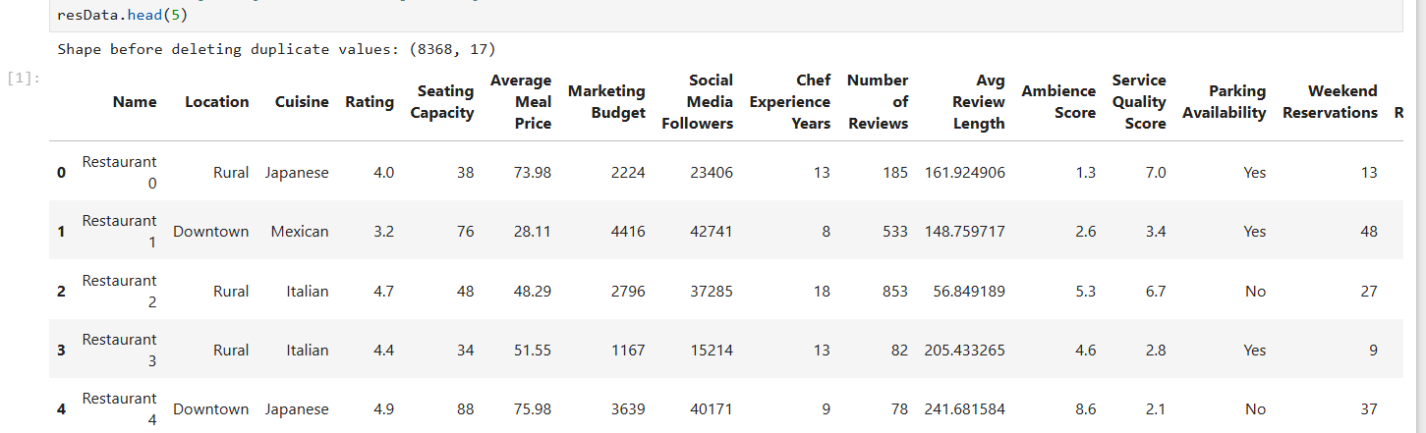
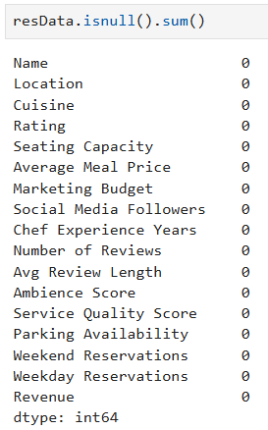
Experiment and Results
The dataset is imported and read for understanding. This dataset is taken from Kaggle.

Slide 11

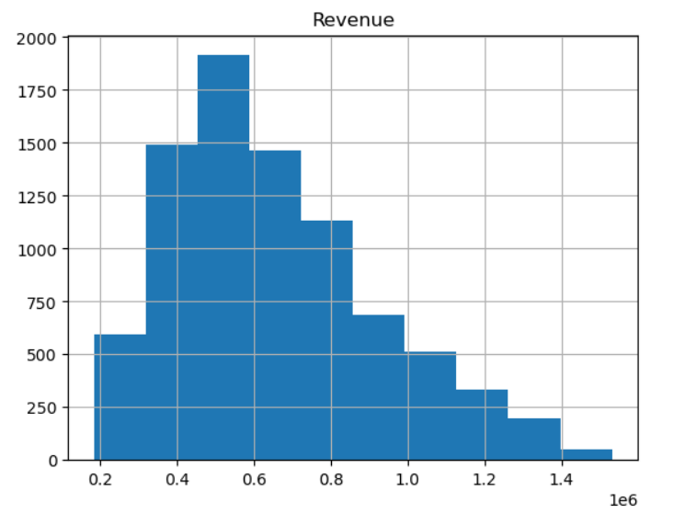

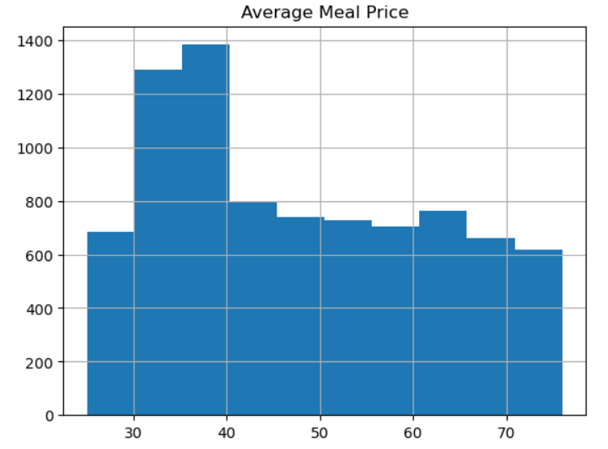
Visualizing Continuous Data

Slide 12
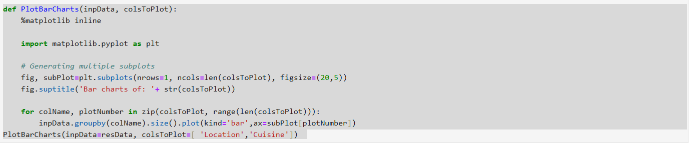
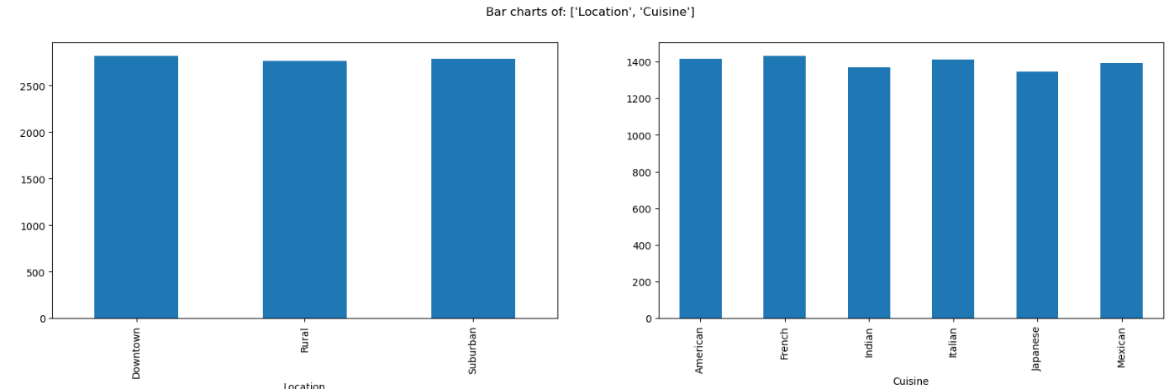
Visualizing Categorical Data

Slide 13
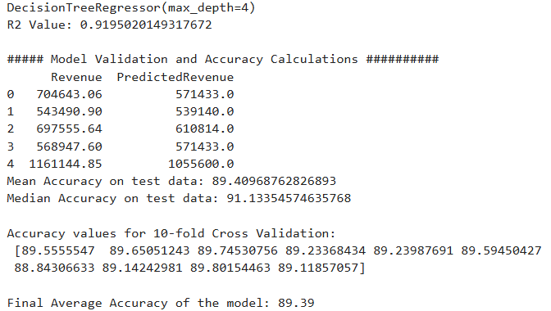
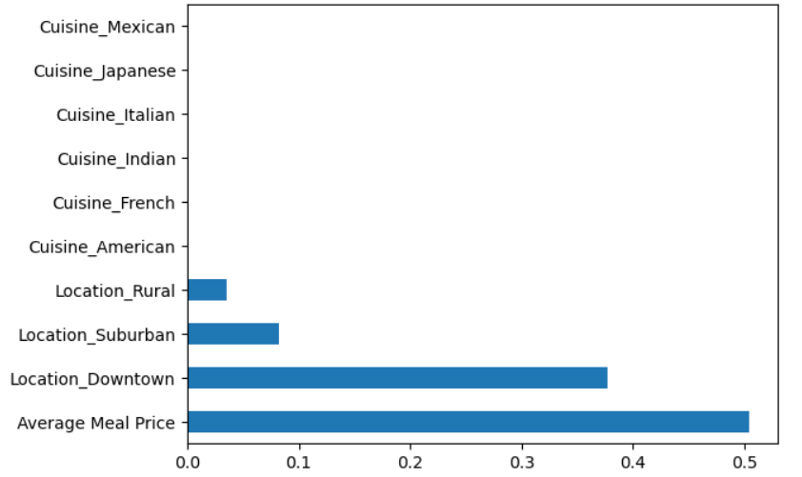
Decision Tree Model
Decision Tree Model which is showing better R2 value than Linear Regression Model.

Slide 14
Conclusion
In this project, A Decision Tree Model was successfully implemented employing various prominent algorithms from the Python libraries and modules.
The R2 value of Decision Tree Model is 0.92 and Final Average Accuracy of the Model is 89.39%. So, we are getting more precise and accurate Machine Algorithm Model.

Slide 15
Thanks!
Do you have any questions?
abraut455@gmail.com
+91 9552183297
Ivy Professional School, Kolkata

