Slide 1
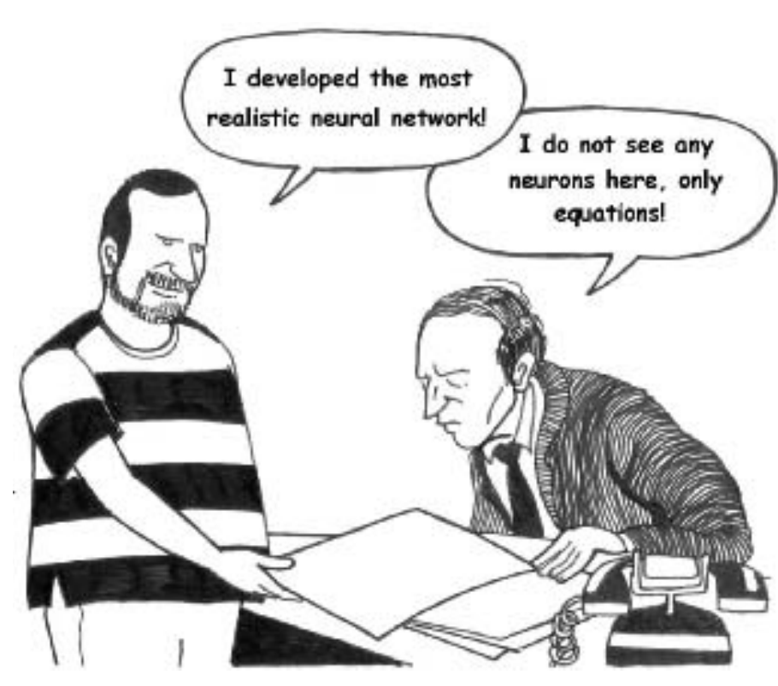

Neurobiophysics
lec 1
2017
Izhikevich, 2007

Slide 2
What the course is about
Goal: to learn about theoretical and computational neuroscience. Build a model of thousands of neurons with synaptic connections
Focus/scope:
  Theoretical (bio): physiology of neurons, astrocytes, and synaptic connections
  Theoretical (math): bifurcations and excitability
  Numerical: Conductance-based and simplified models of neurons, models of synapses

Slide 3
Is there a difference between neuro-biophysics and theoretical neurocience / comp.neurosci?
Biophysics — is a science about mechanisms, about processes and their interactions, their role in biological phenomena
Thus, the course:
  Rooted in biophysical understanding of physiology and electrical properties
  Not exclusively computational neuroscience (but based on)
  Not dynamical systems course (but we’ll need that)
... not much :)

Slide 4
Scales
Single molecules (channels, receptors) — their kinetics and molecular structure → dynamics of molecular ensembles→
Subcellular structures: synapses, dendritic spines, etc →
Ion currents/flows from subcellular compartments to whole cells →
Electrical activity of individual cells and cell-to-cell connections→
Network activity
At each level some assumptions and simplificatons are required

Slide 5
Outline
7 theoretical lectures and 7-8 modeling modules
The Hodgkin-Huxley formalism and conductance-based models, simplified models and phase-plane analysis
Physiology and biophysics of synaptic transmission
Models of synaptic transmission: vesicle release, receptor kinetics and plasticity
Information flow & Energy supply OR analysis of experimental (imaging) data

Slide 6
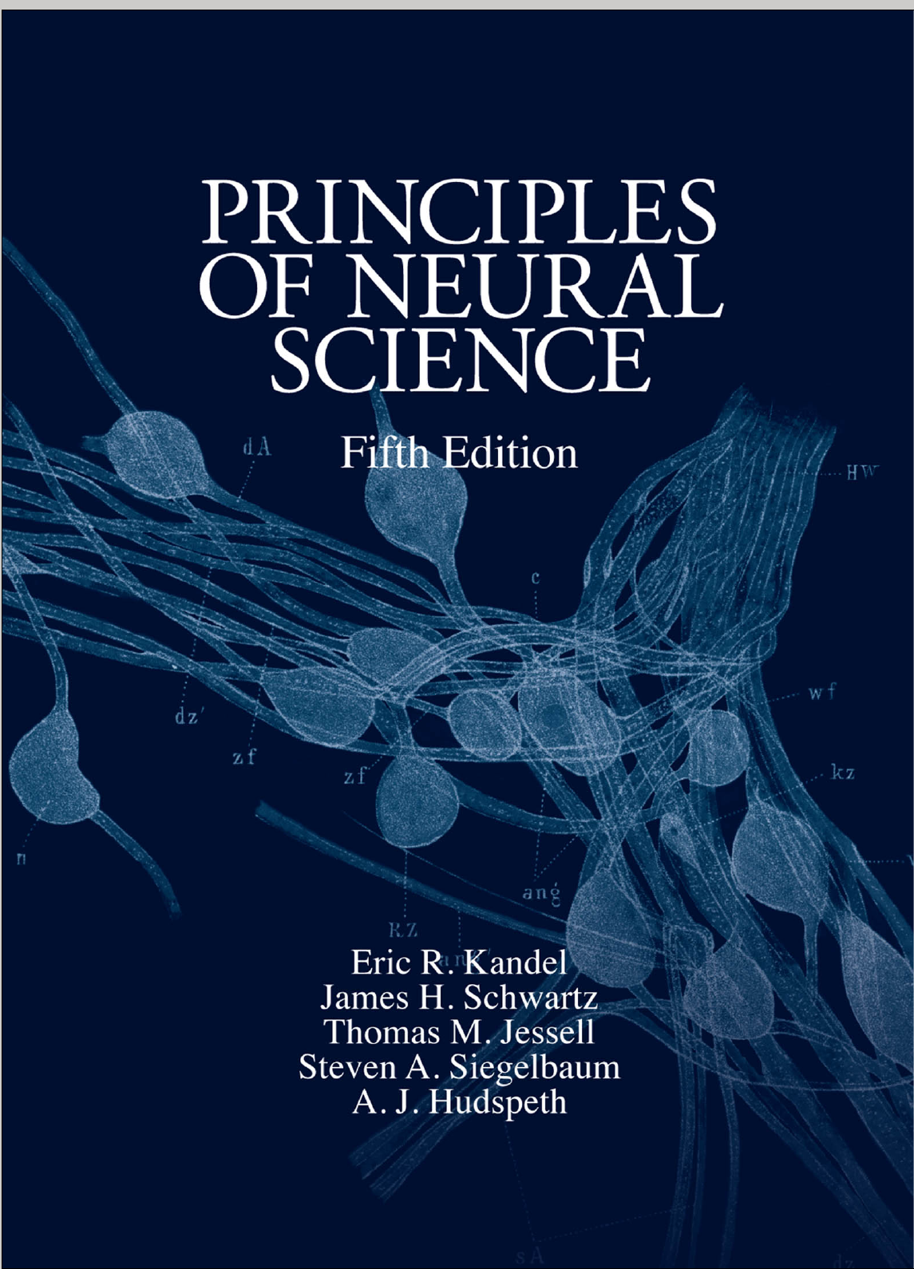
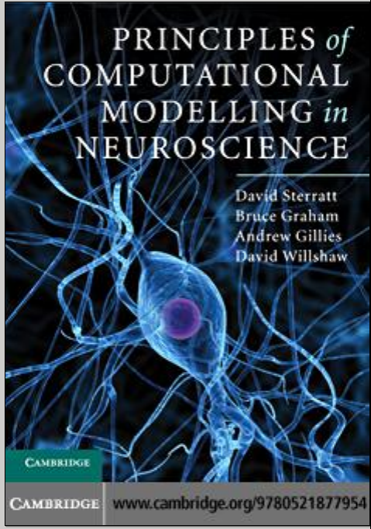
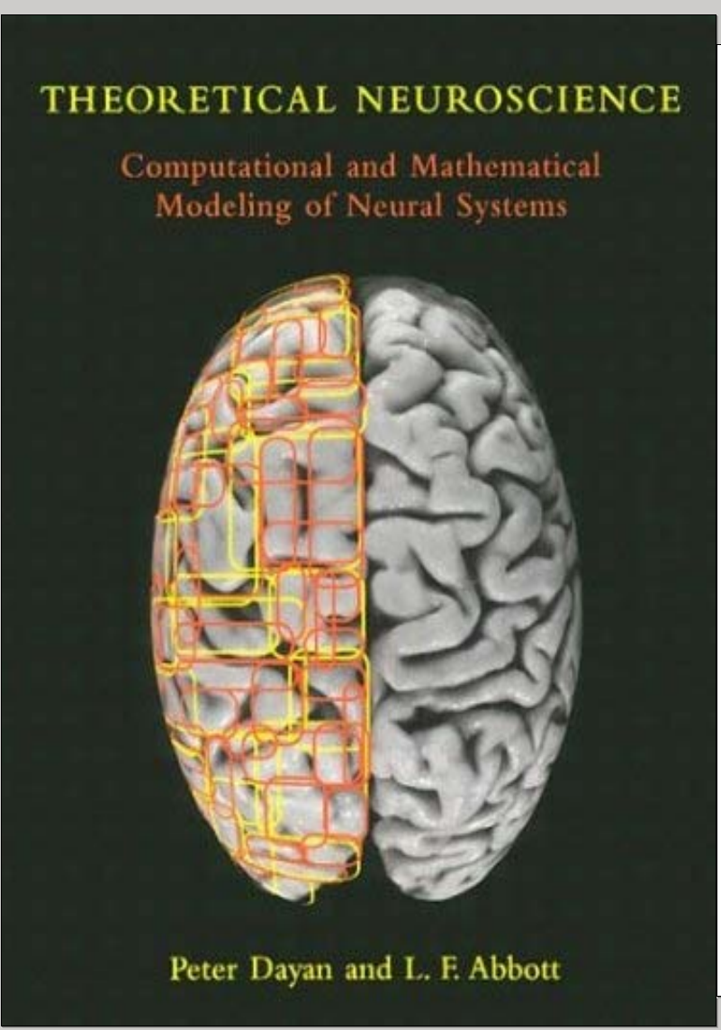
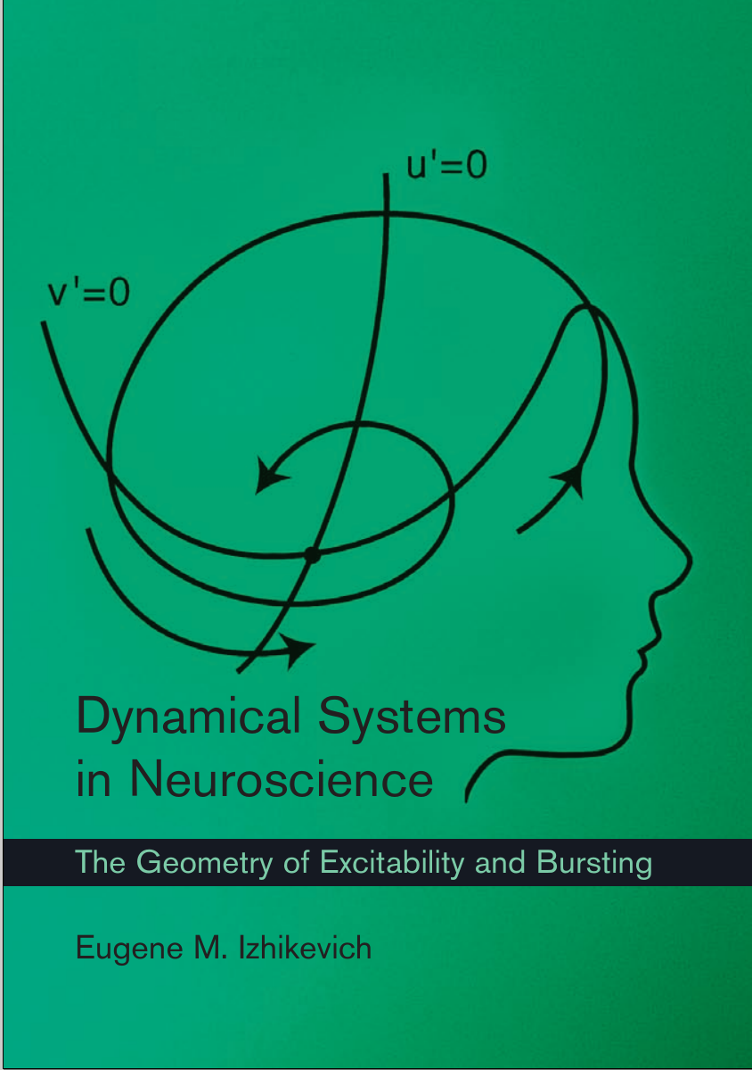
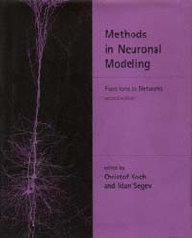
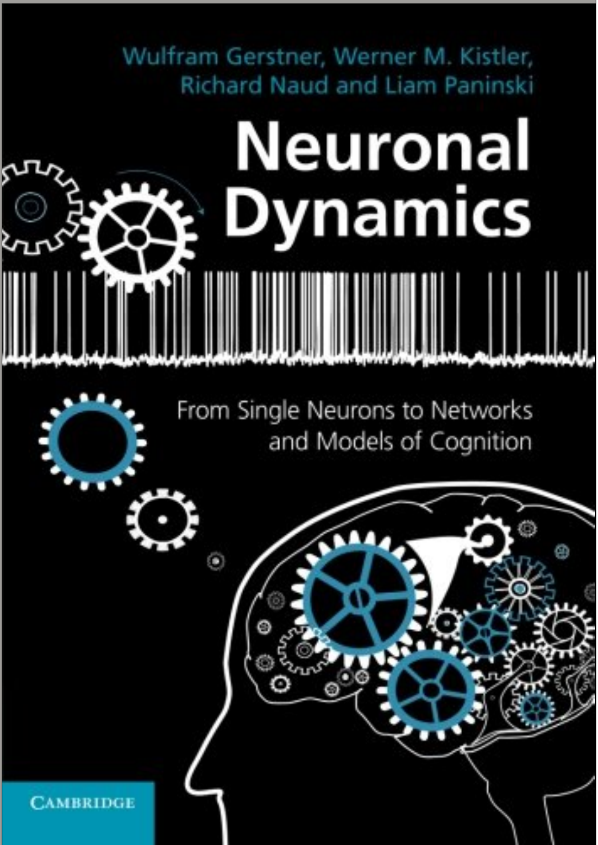
Some recommended literature
Notes:
Sterrat is a nice book , written simply and clearly.
Abbott is a bible for theoretical neuroscientists
Izhikevich is great for in-depth phaseplane analysis
Kandel is a comprehensive overview of neuroscience

Slide 7
Overview and trailers
(spoilers!!!)
________________

Slide 8
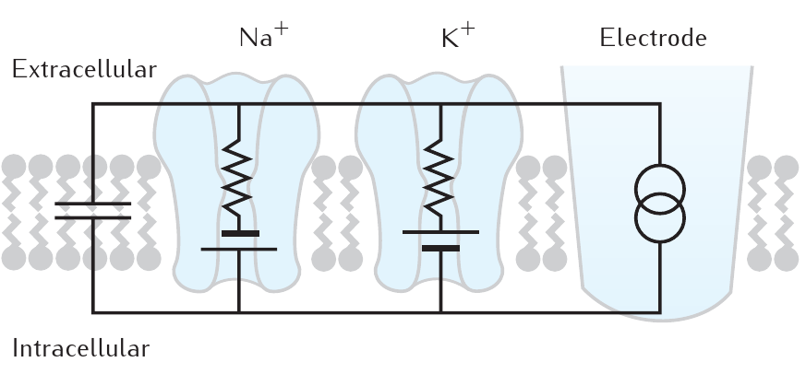
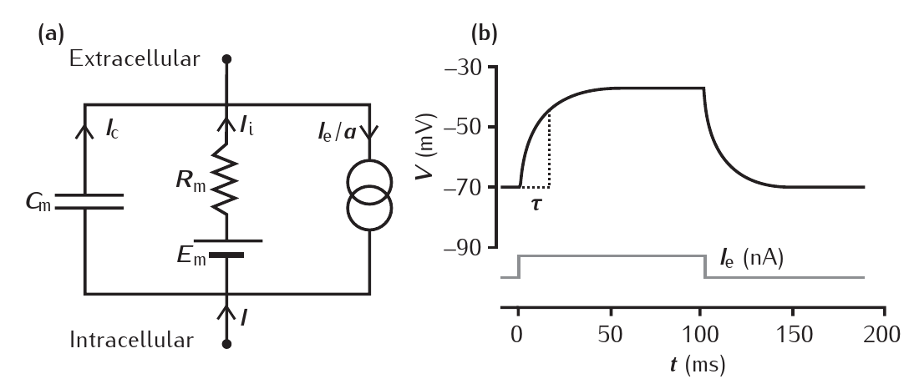
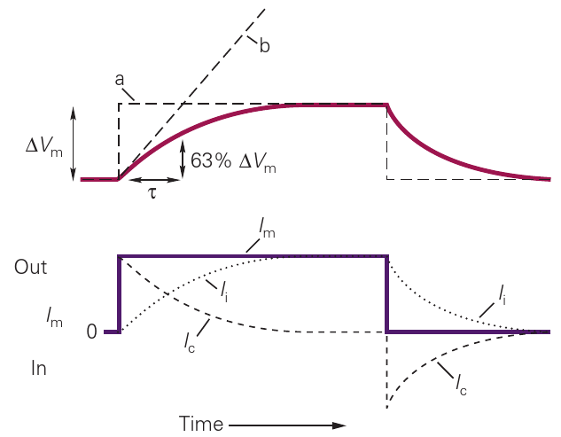
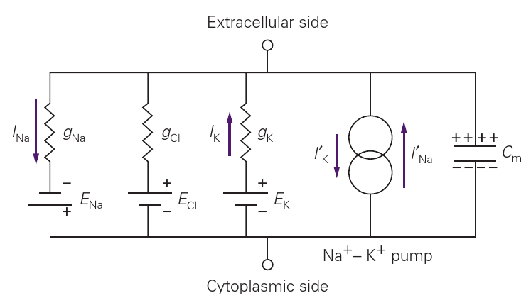
Passive electrical properties of membranes
Notes:
Normally, Cm ~ 1uF/cm² (i.e. about 300 pF/cell), Rin ~= 30-50 MOhm
Note, that assuming constant density of ion channels and lipid membrane properties, a large cell will have the same time constant as a small cell

Slide 9
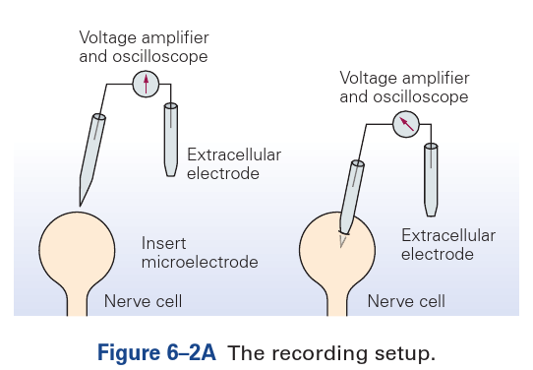
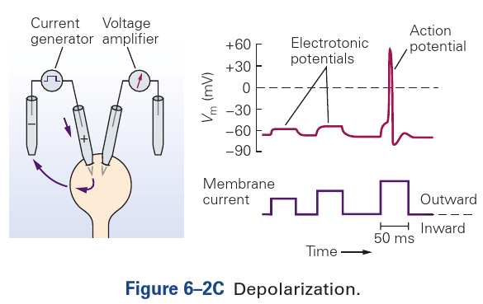
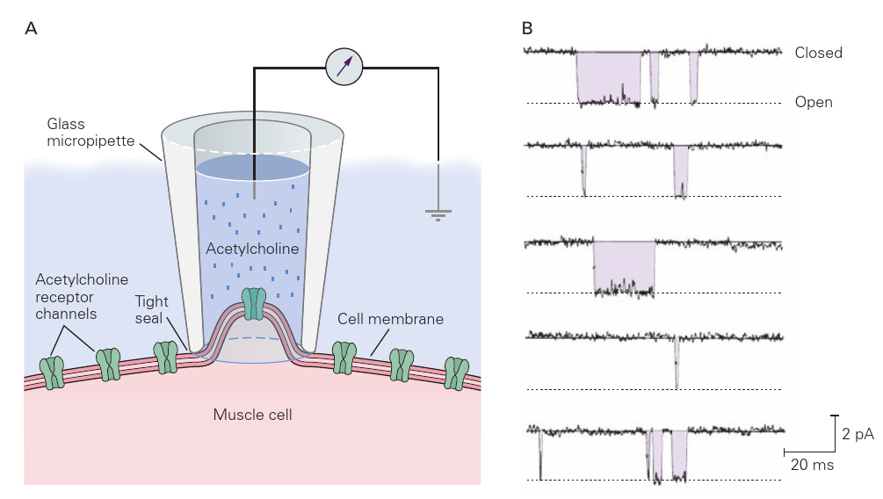
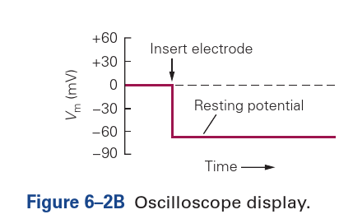
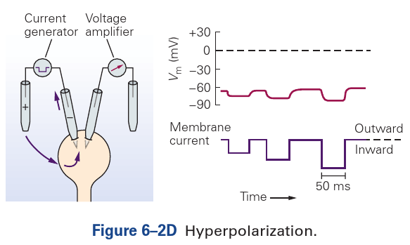
Measuring electrical properties of a membrane
Notes:
Measuring currents through the pipette at a given holded transmembrane potential is voltage clamp
Measuring transmembrane potential for a given current input is current clamp
Measuring currents through a pipette sealed to membrane (with or without perforation) is patch-clamp; it allows to measure currents through individual channels directly
Each individual channel protein stochastically switches between open (conductive) and closed (non-conducting) conformations/states.

Slide 10
Electrochemical potential and electrodiffusion
Electrochemical potential
C : concentration
z : ion charge
F : Faraday’s constant
R : universal gas constant
φ : electrical potential
concentration
motivating
force
motility
Flow
Nernst-Planck equation
Ficks’s law
Notes:
Flux is proportional to the abundance of meausured subtance (concentration), motility and the driving force
The driving force is the negative gradient of electrochemical potential (refresh physical chemistry)
Nernst-Planck equation describes the flux of ions from one phase to another

Slide 11
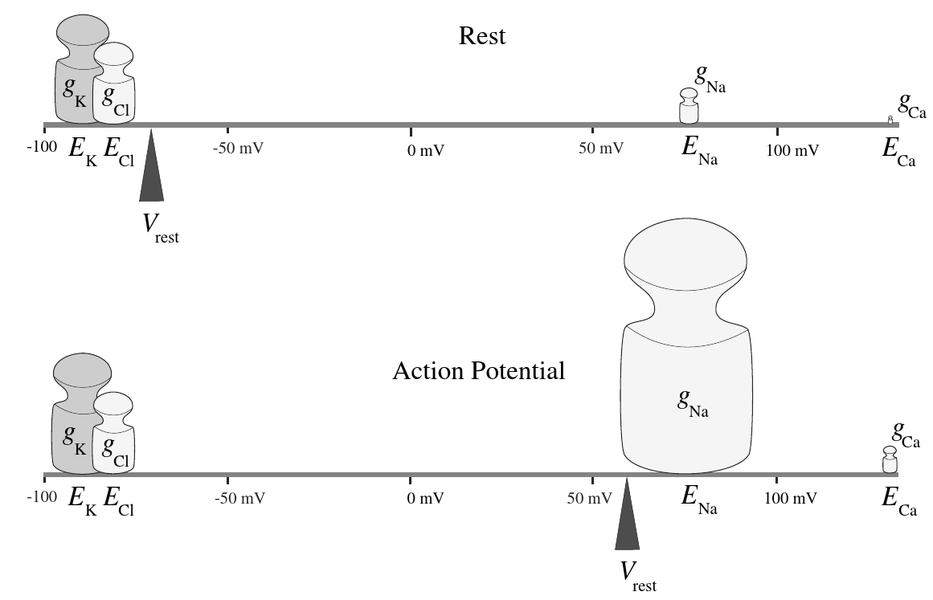
Electrochemical potential and electrodiffusion
Electrochemical potential
a : activity
z : ion charge
F : Faraday’s constant
R : universal gas constant
φ : electrical potential
activity
Force
motility
Flow
Nernst-Planck equation
Notes:
During resting conditions: large conductances for potassium and chloride equilibrate with small Na⁺ conductance, but with a “longer lever arm”
During action potential/spike: dramatically increased Na⁺ conductance overweights the Cl⁻ and K⁺ conductances

Slide 12
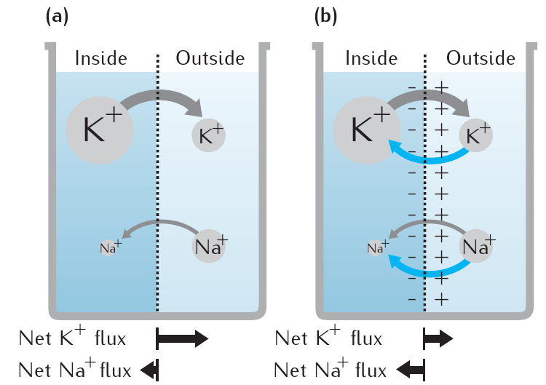
Constant-field approximation (GHK)
constant field
approximation
Equilibrium for net current, not individual currents
— ion concentrations on the membrane interfaces
separation coefficient
Goldman equation for resting potential
permeability
Goldman-Hodgkin-Katz equation for ion flow
Notes:
In the approximation that the potential drops linearly within membrane (thin membranes) one can use the Goldman-Hodgkin-Katz approximation to the Nernst-Planck equation
During “equilibrium” the net current is equal to zero, but individual currents may be non-zero → Goldman equation for potential
Permeability of an ion is related to its diffusion coefficient, affinity to the intra-membrane part and thickness of membrane

Slide 13
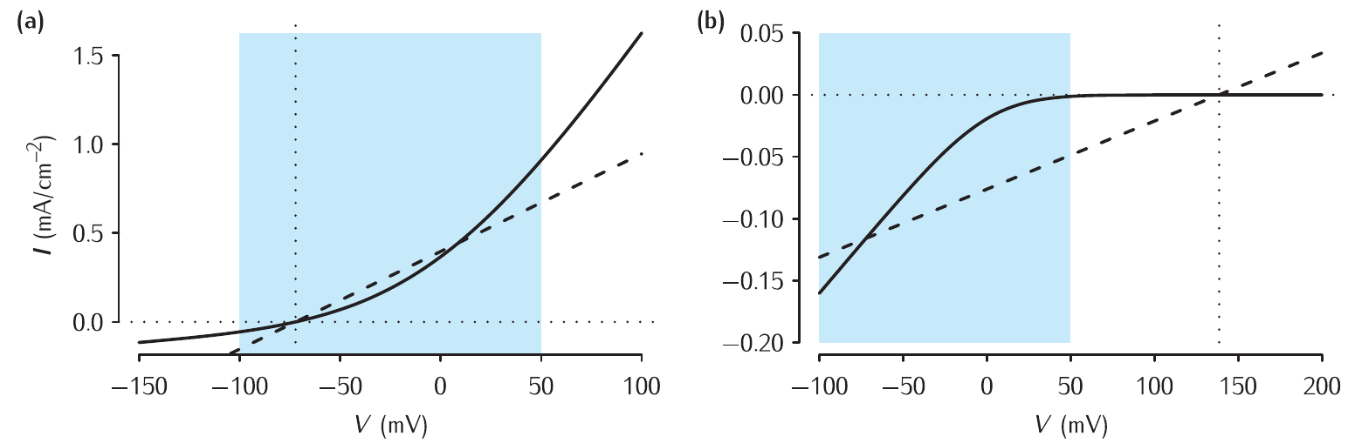
I-V relations in the GHK and linear approximations
K⁺ flow
Ca^{2+ flow}
physiology range
used in Hodgkin-Huxley
used in Frankenhauser-Haxley
Nernst potential
(reversal potential)
Nernst potential
(reversal potential)
- current “rectification” — conductance in one direction is higher than in the other
- the higher difference in concentrations, the more nonlinear the curve
Notes:
While the famous Hodgkin-Huxley model uses linear instantaneous I-V relationships, the GHK approach is potentially more accurate
Within the physiological range the two approximations don’t deviate much for potassium, but significantly deviate for Ca²⁺
There is more nonlinearity in I-V relationship for ions with larger charge and higher difference between concentrations in and out of the cell

Slide 14
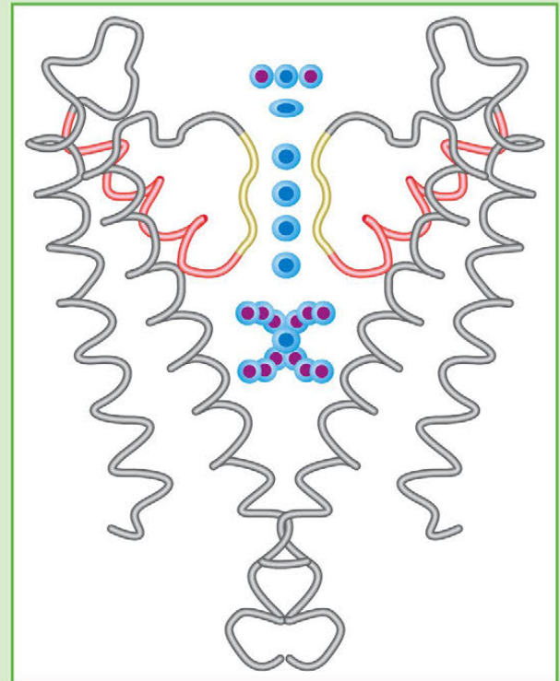
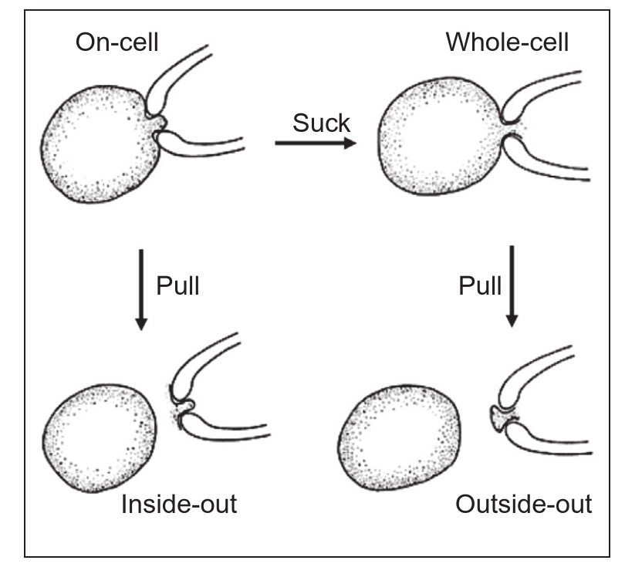
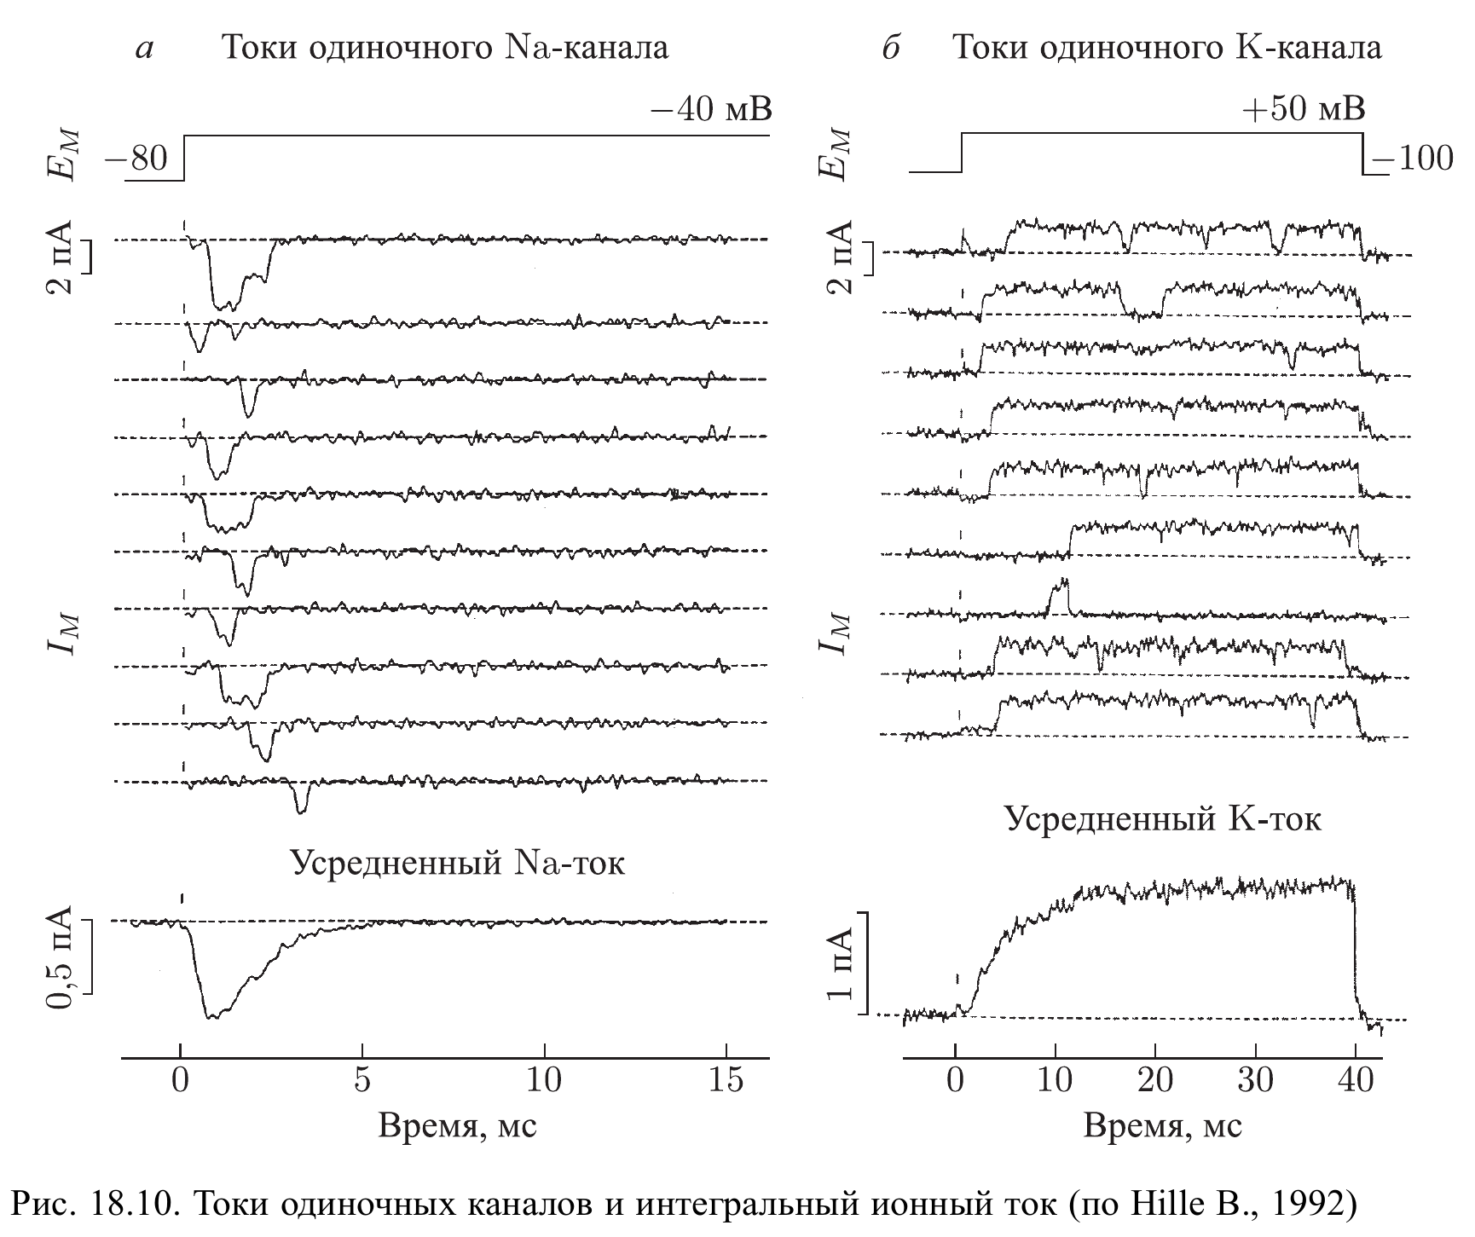
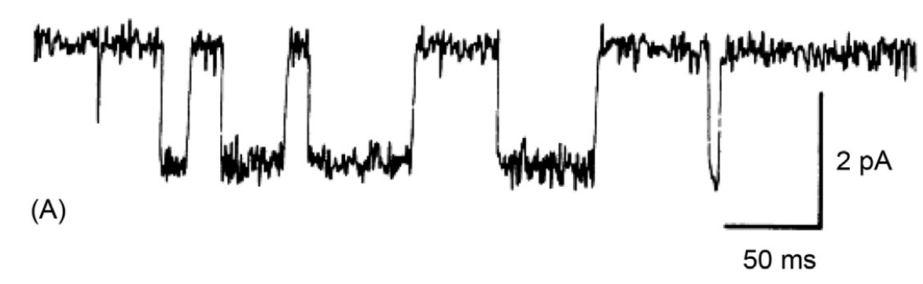
Ion channels
sodium currents through
Single K⁺ channel
sodium currents through
single Na⁺ channel
trial-averaged currents
Notes:
Currents through a single ion channel can be measured with a patch-clamp technique. Here, inside-out configuration is shown
Individual channels behave like stochastic units (open and close at random), but ensemble or trial averages ares smooth
Many channels have closed state and one dinstinct open state with a conductance about 10-20pS. Some may have several sublevels of conductance

Slide 15
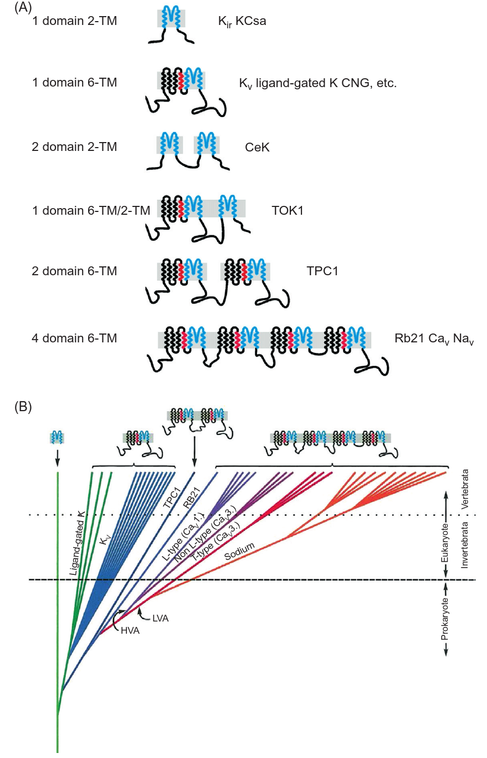
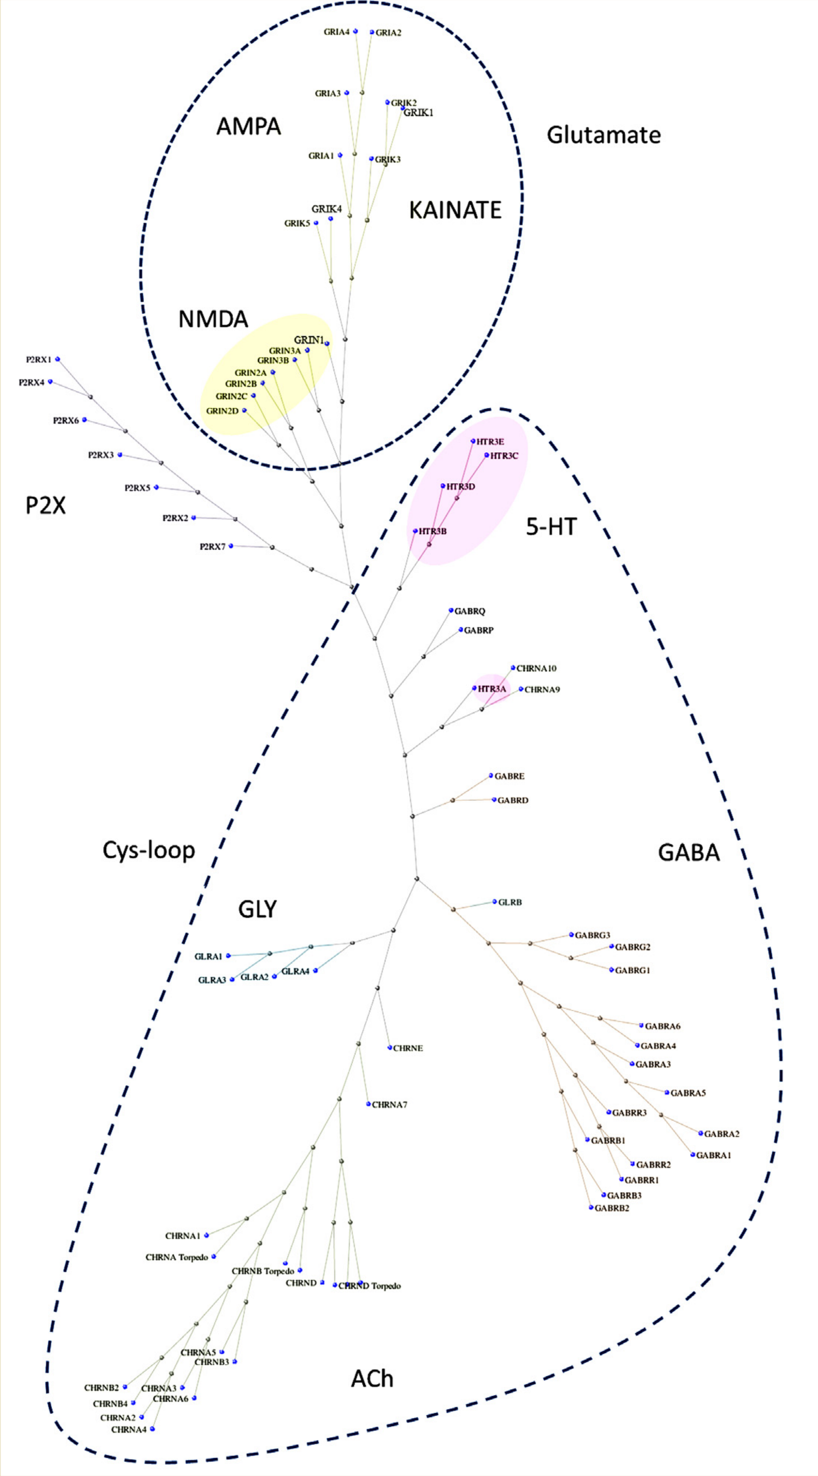
Channel families
W. Stein, T. Litman. Channels, Carriers, and Pumps. 2nd edition. Elseiver 2015
Notes:
Many channels of the plasma membrane belong to the Kv superfamily (voltage-gated potassium channels)
Voltage-gated potassium channels form pores via tetramerization of four subunits
Na and Ca channels encode the four subunits in a single peptide chain
The pore-forming part is highly conservative and differs mainly in the selective filter region

Slide 16
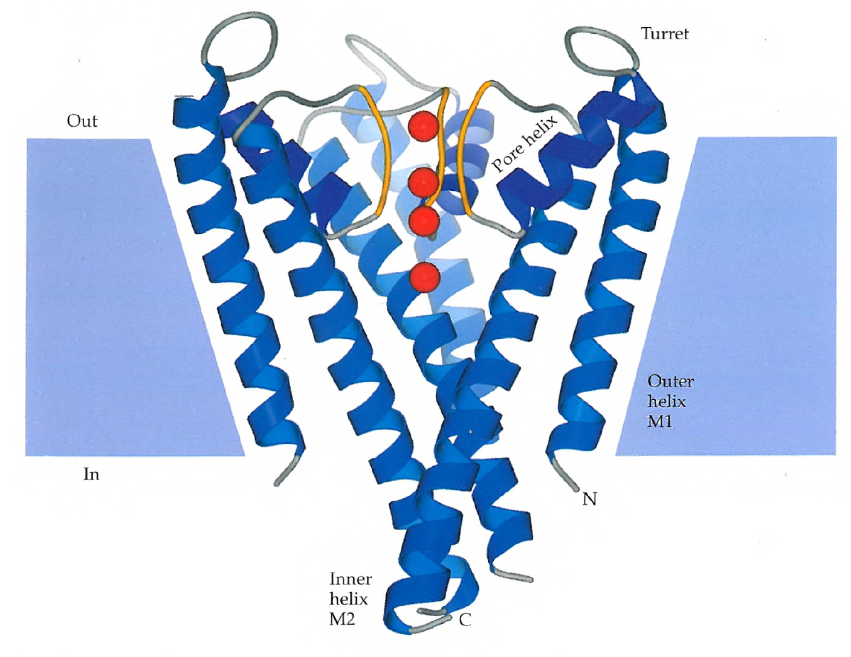
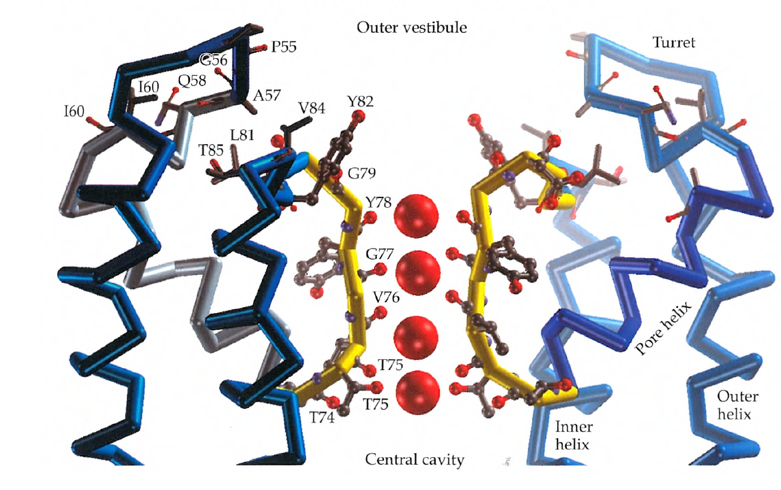
Voltage-gated K⁺-channels (Kv)
Notes:
Pore is formed on the interface of S6 domains of the four subunits
P-domains form the selective filter
Negative charges in the aminoacid residues stabilize cations in it.
The diameter of the selective filter and overall match to the hydration shell sets the selectivity

Slide 17
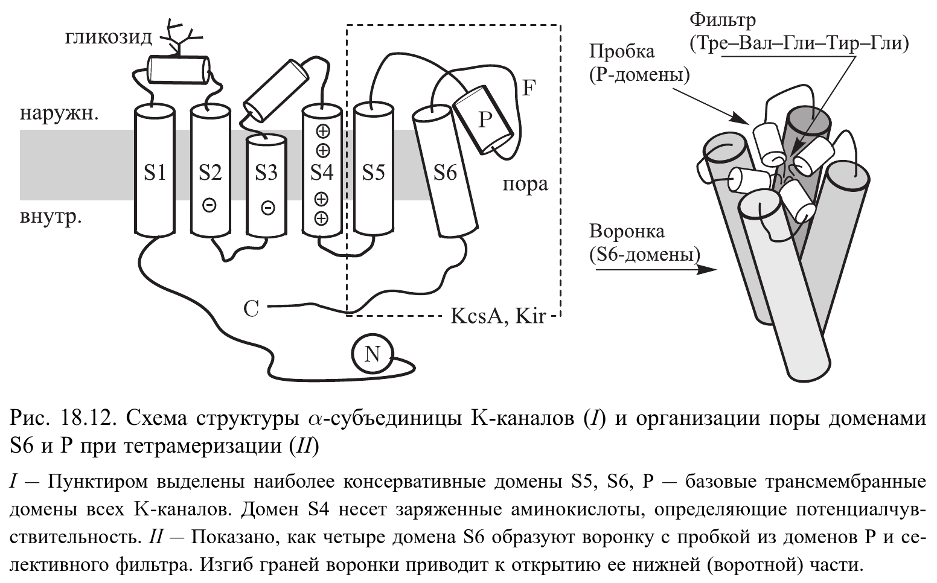
Voltage-gated potassium channels
Notes:
Voltage-gated channels have a conserved structure with an S5 domain carrying charged aminoacids (Arg), witch allows for transmembrane-related conformational changes.
Other parts may account for inactivation, Ca²⁺-sensitivity, etc

Slide 18
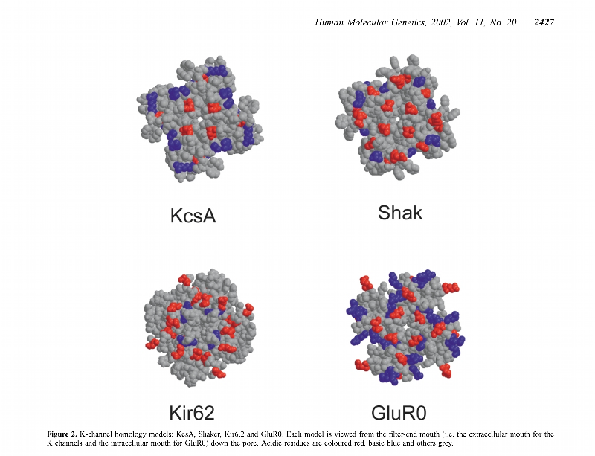
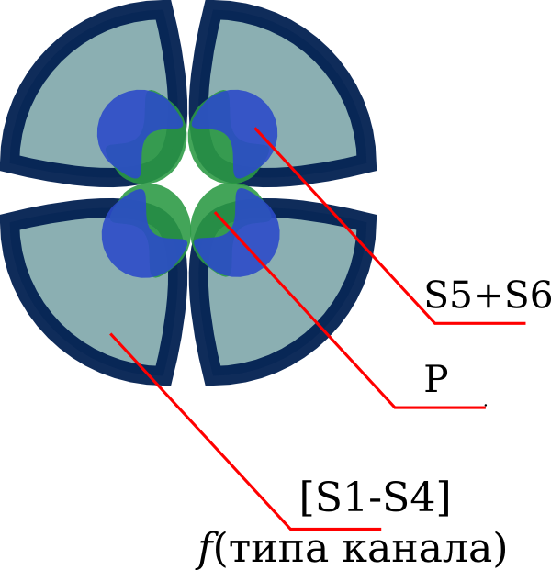
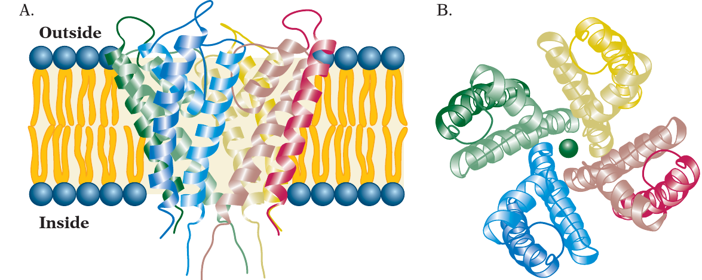
Kv-channels
acidic residues
basic residues
Notes:
Most potassium channels share the same fold of the pore-forming complex

Slide 19
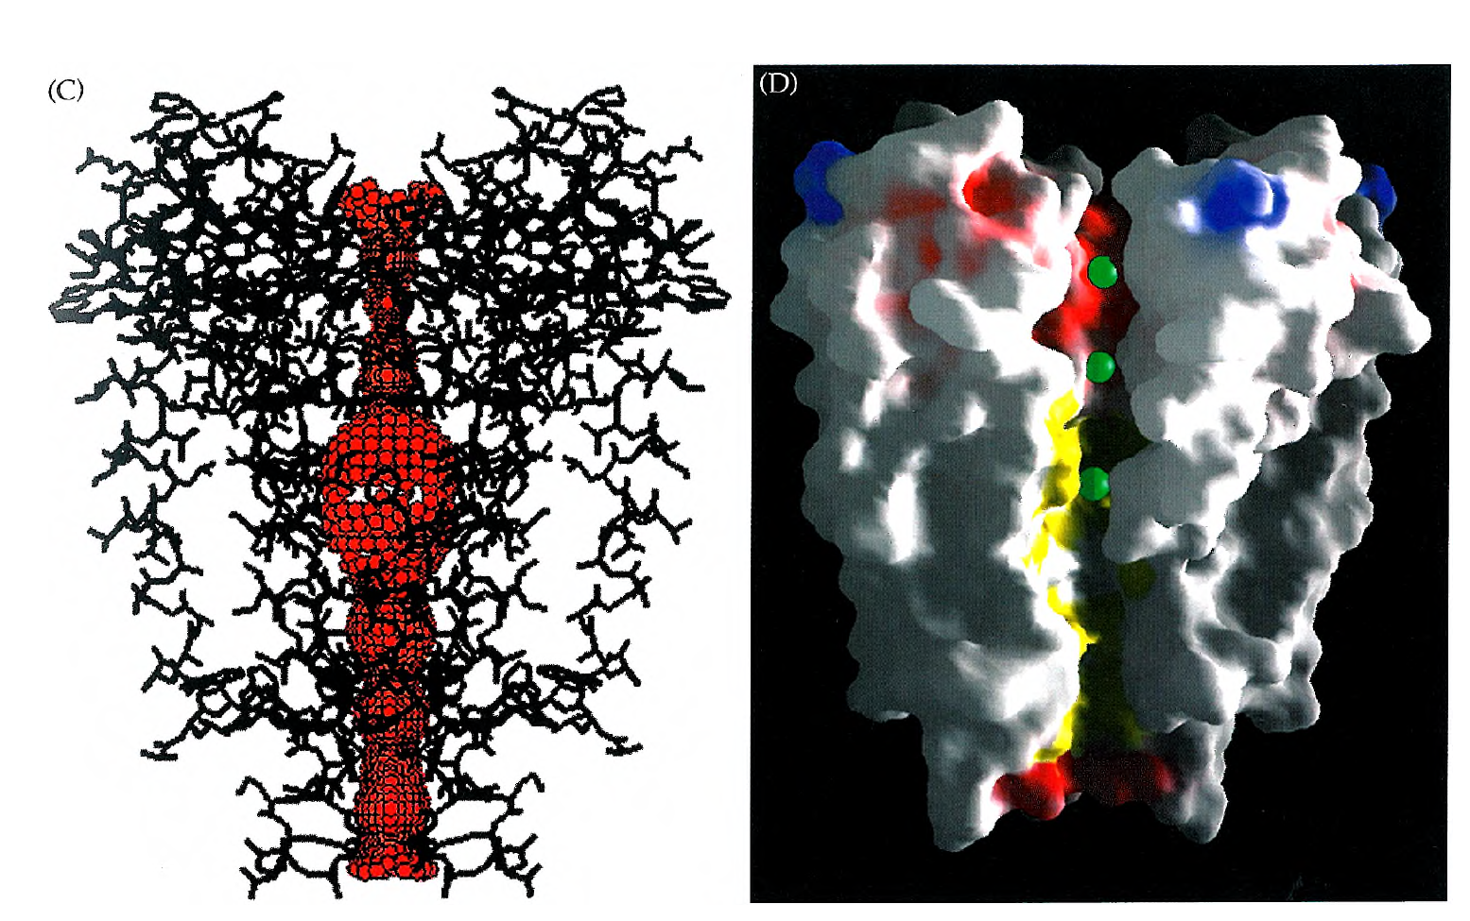
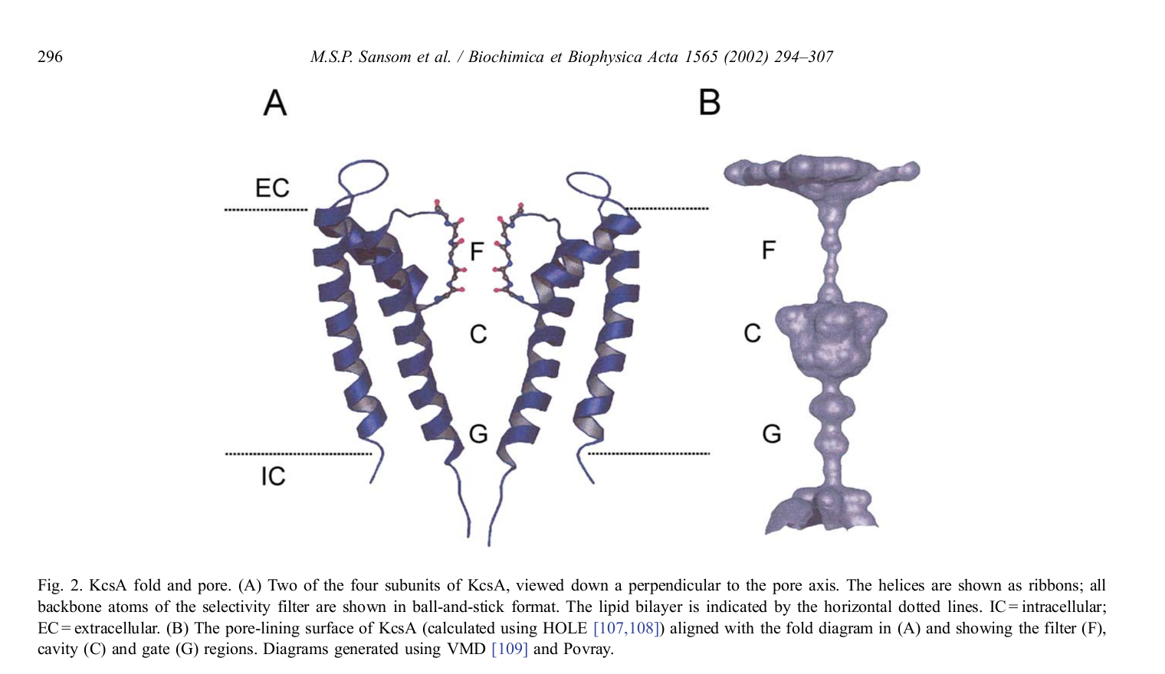
The central cavity
Notes:
Below the selectivity filter there is a water-filled cavity, usually occupied by a few K⁺ ions
Presence of K⁺ in the pore allows for fast transport
Structures, crystallized without K⁺ didn’t form a pore

Slide 20
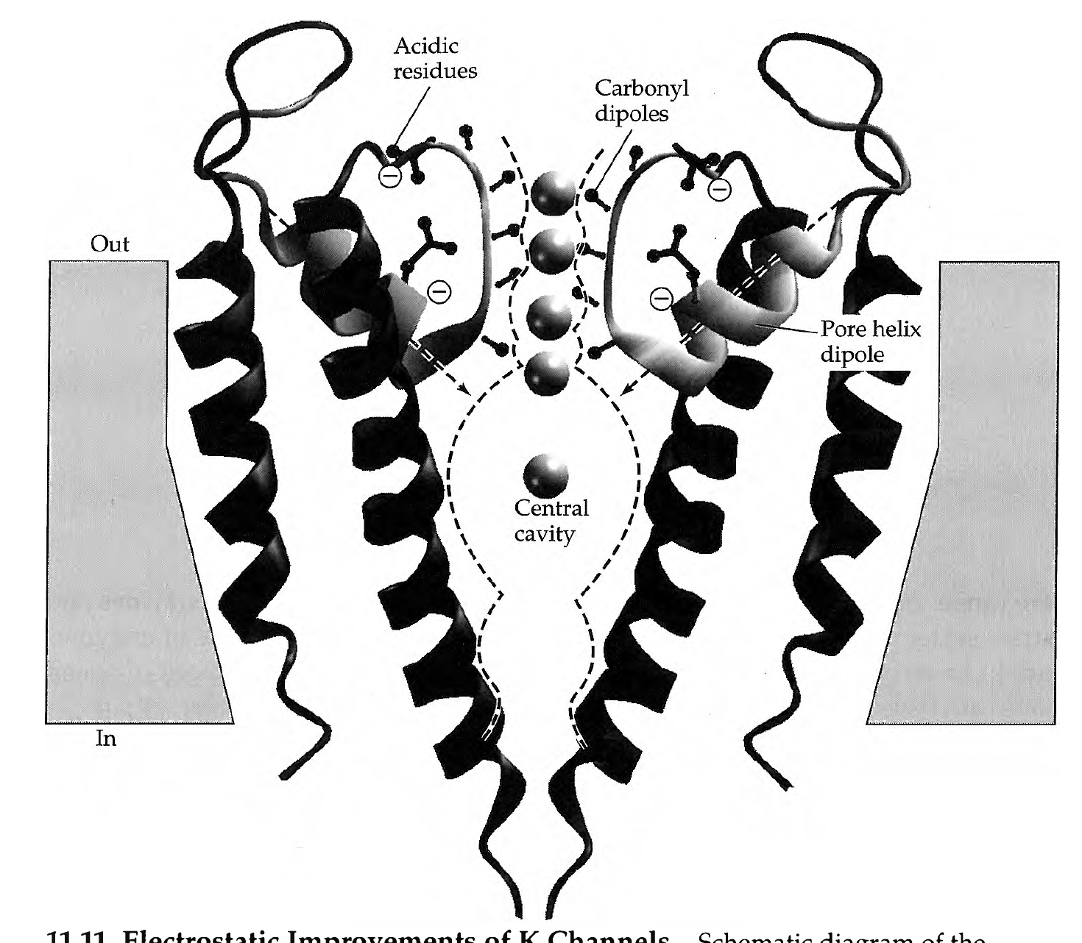
Ion stabilization in the pore
B.Hille, Ion channels of excitable membranes
3rd ed.

Slide 21
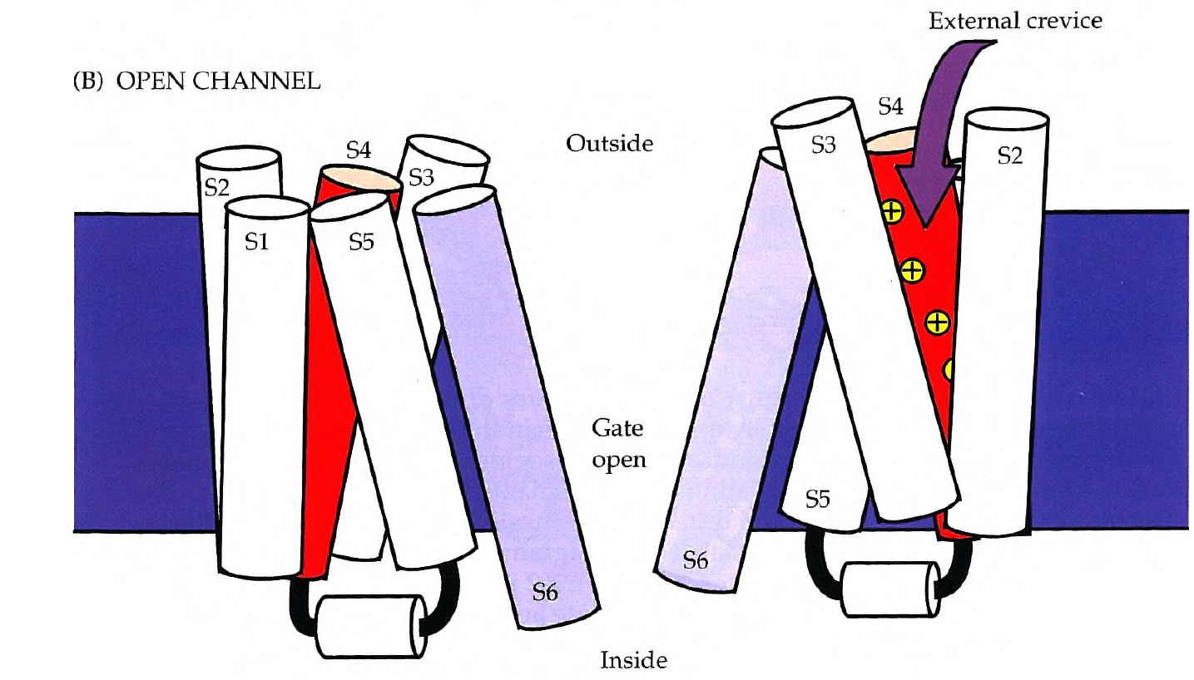
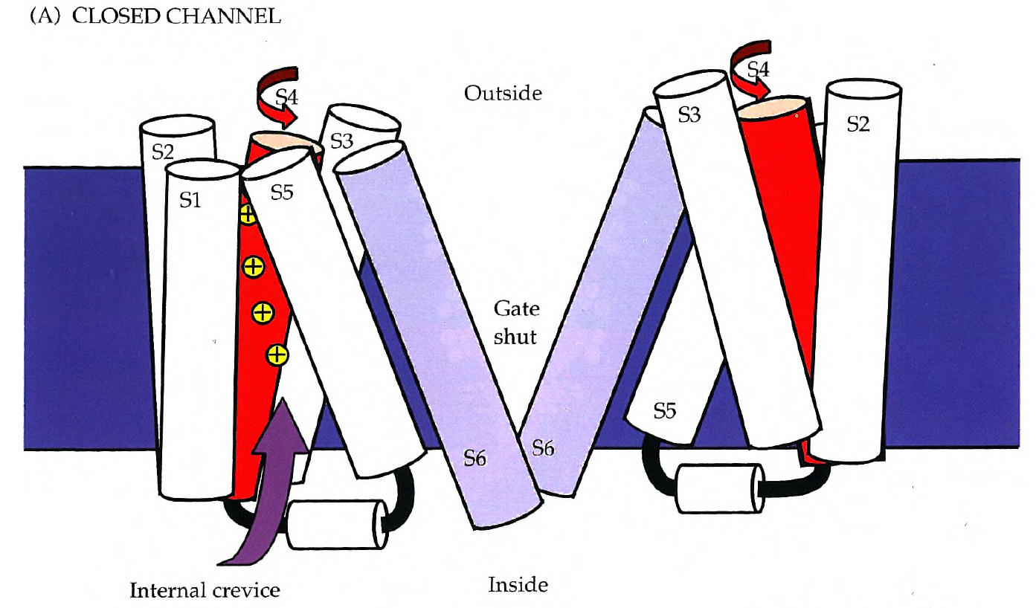
Channel gating

Slide 22
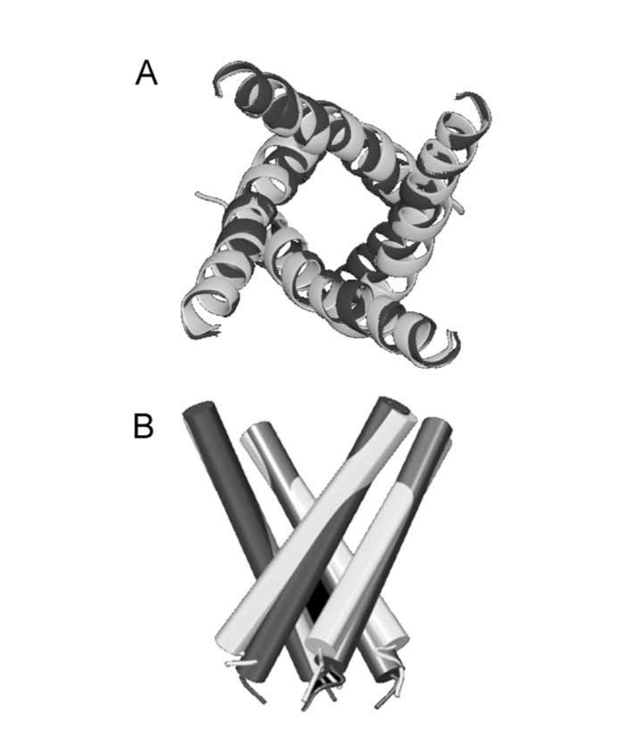
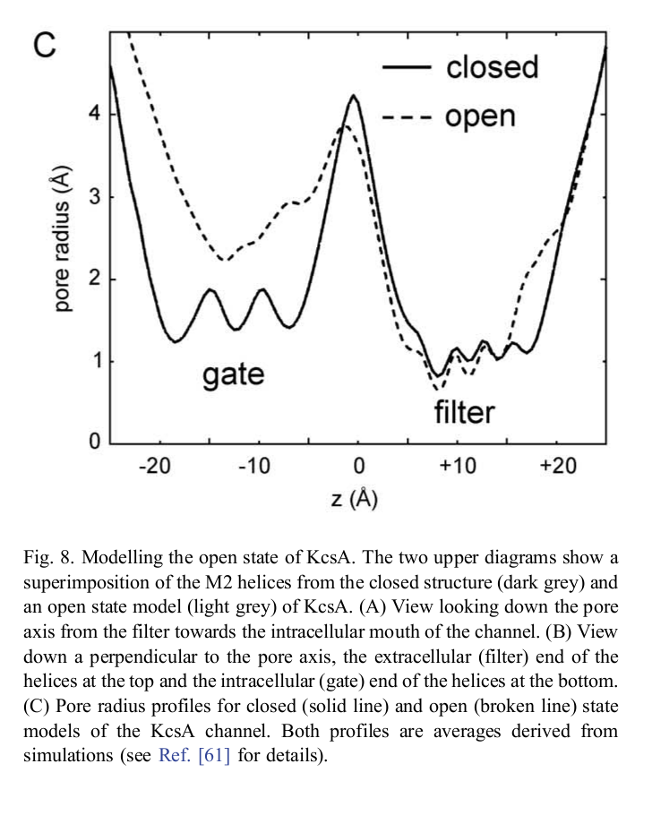
Channel gating

Slide 23
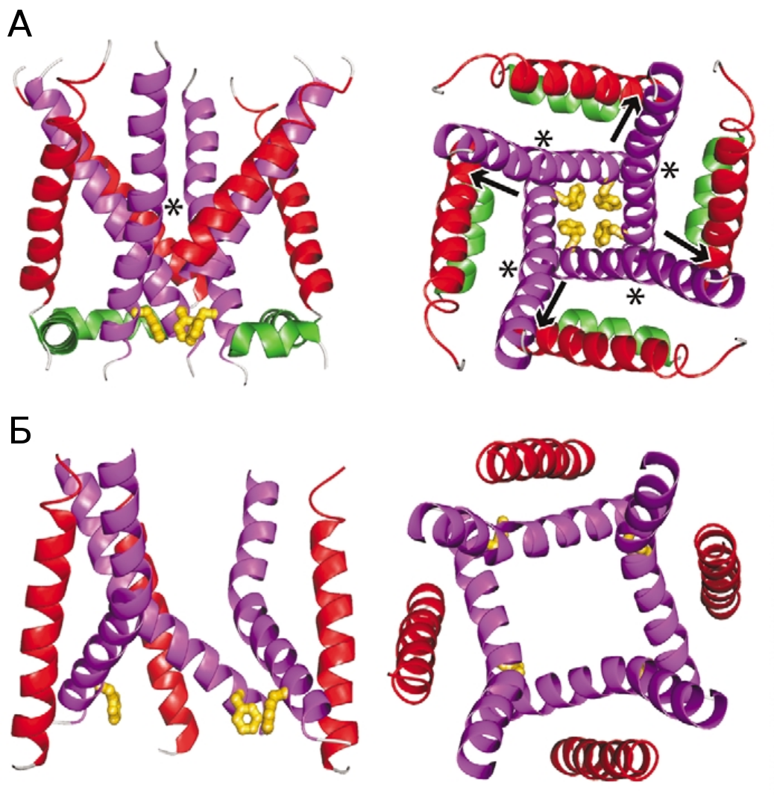
Channel gating
Doyle, Trends Neurosci,2004 Jun;27(6):298-302.

Slide 24
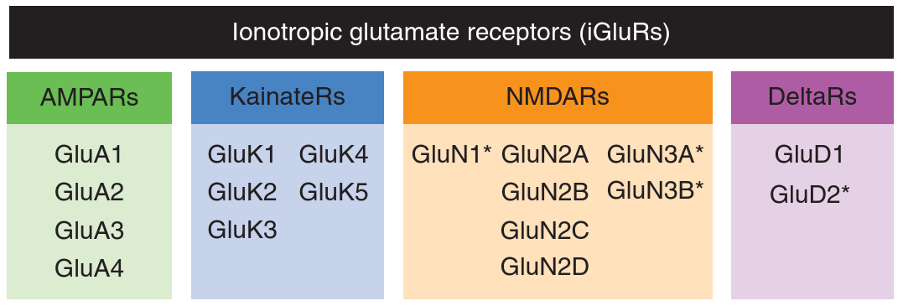
Glutamate receptors that make channels
- heterotetrameres
- pre- and post-translational modifications

Slide 25
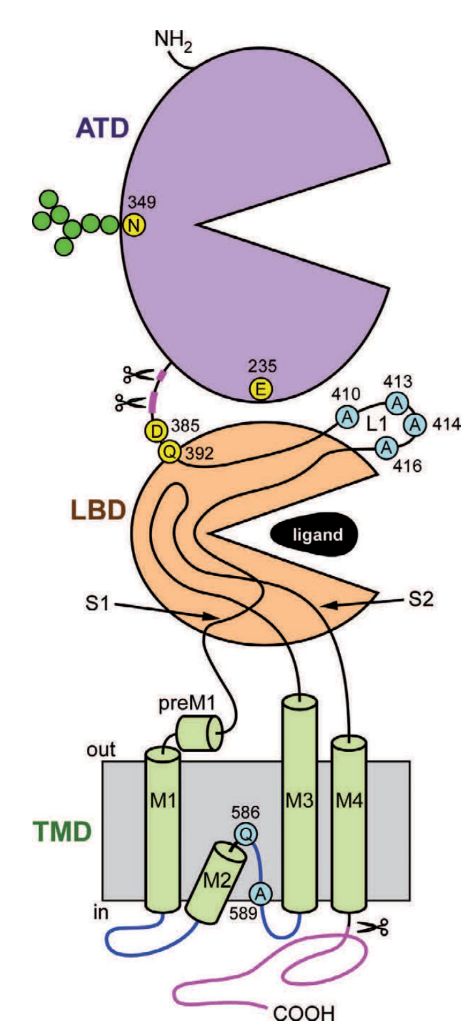
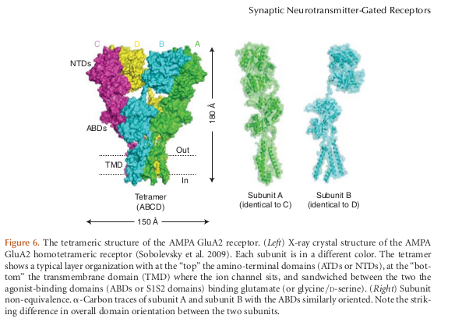
Molecular structure of Glu-receptors

Slide 26
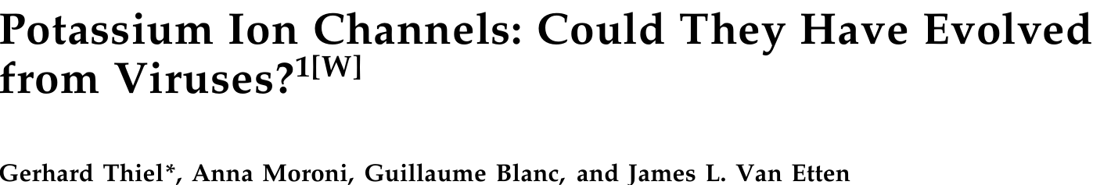
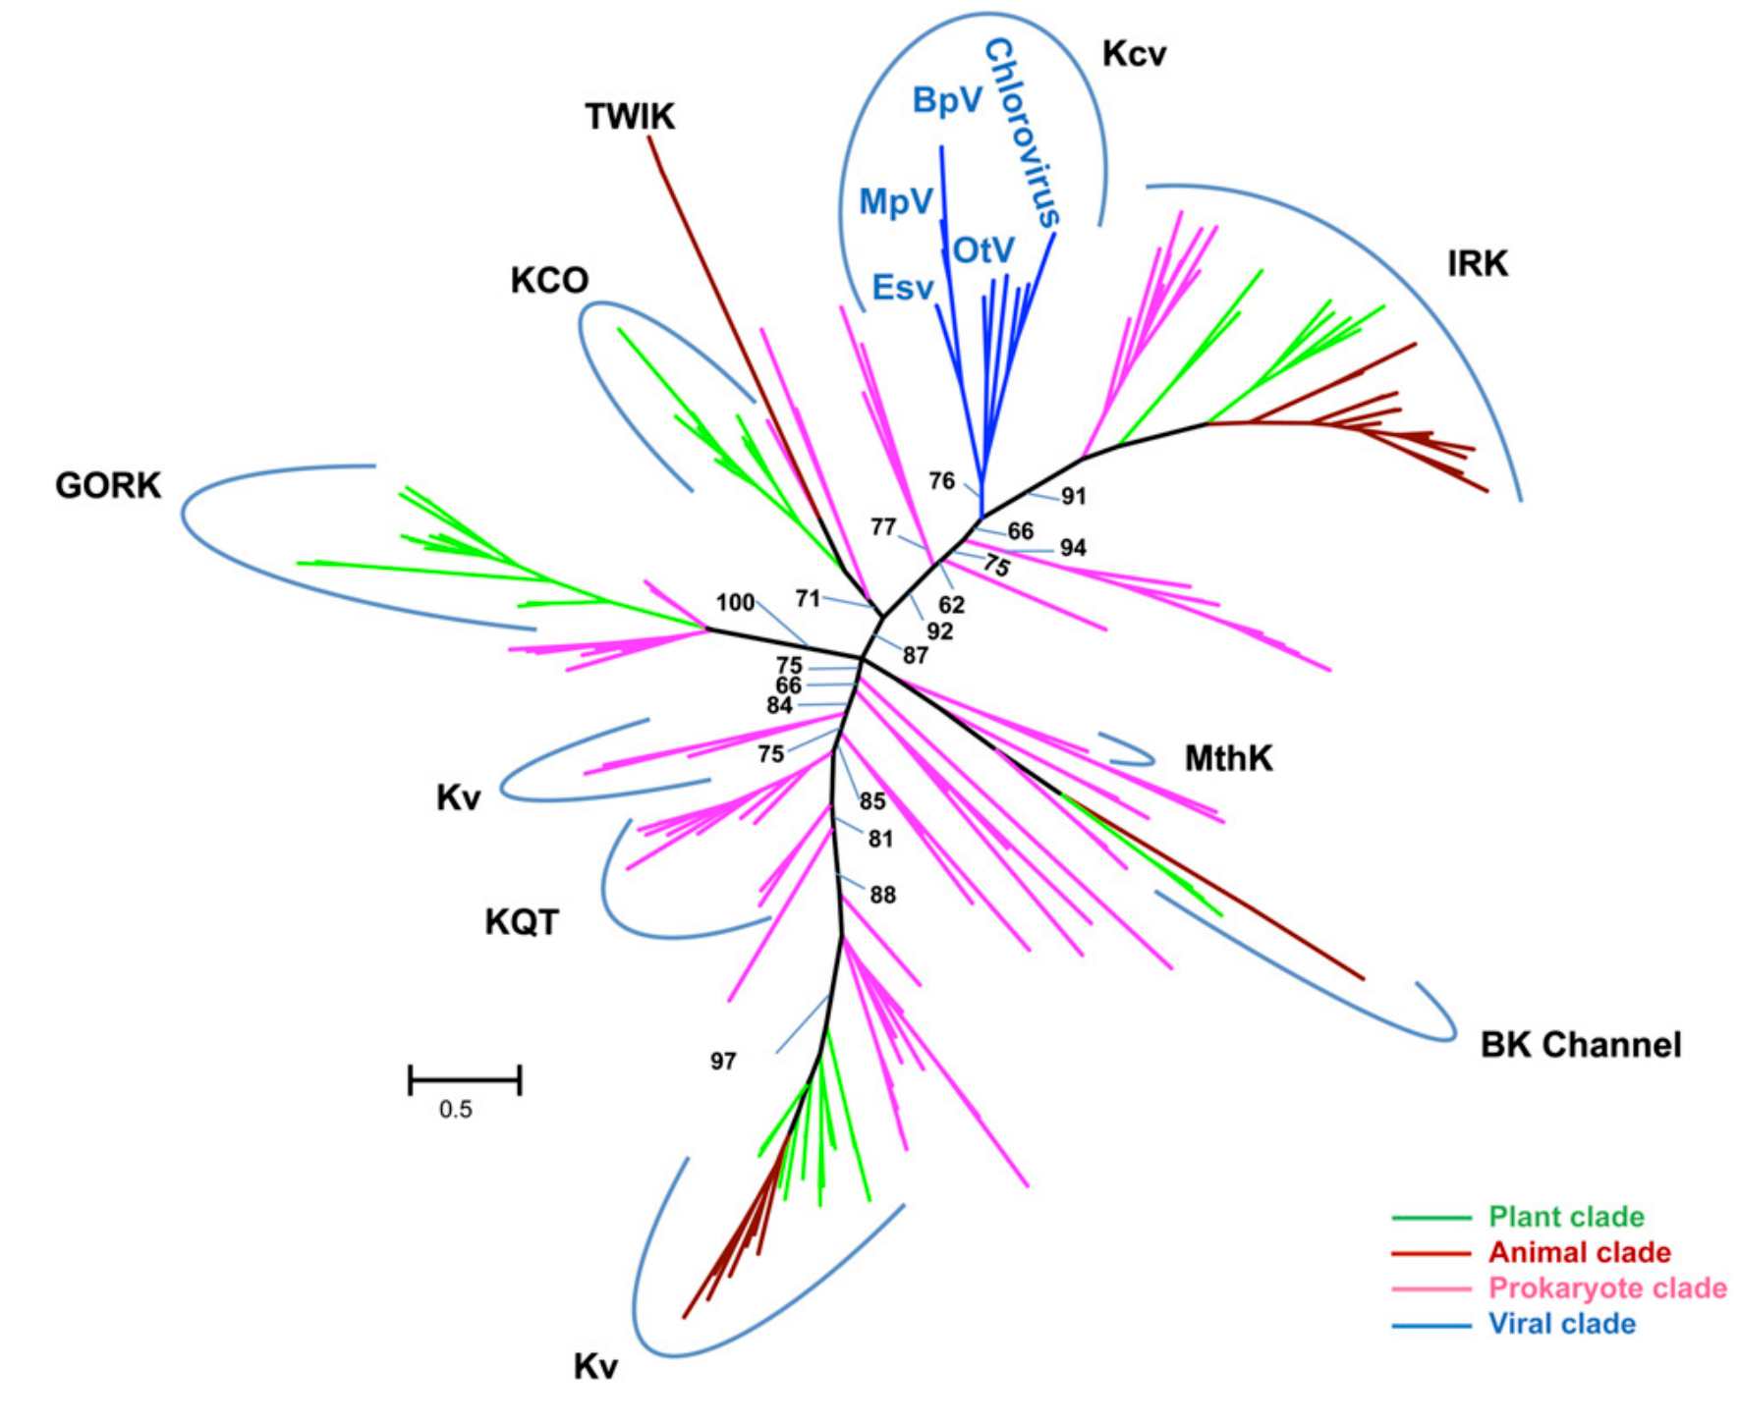
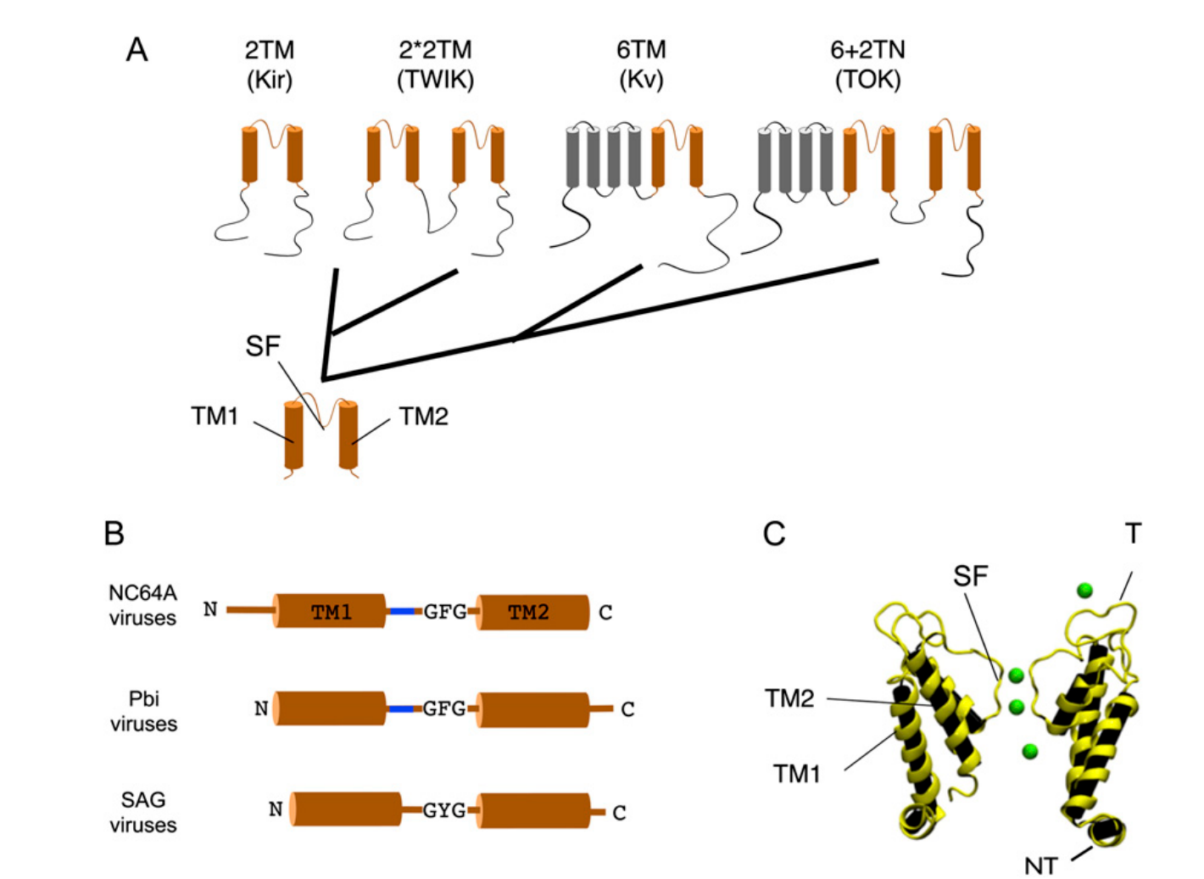
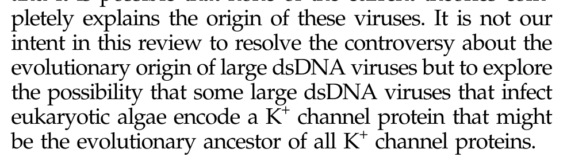

Slide 27
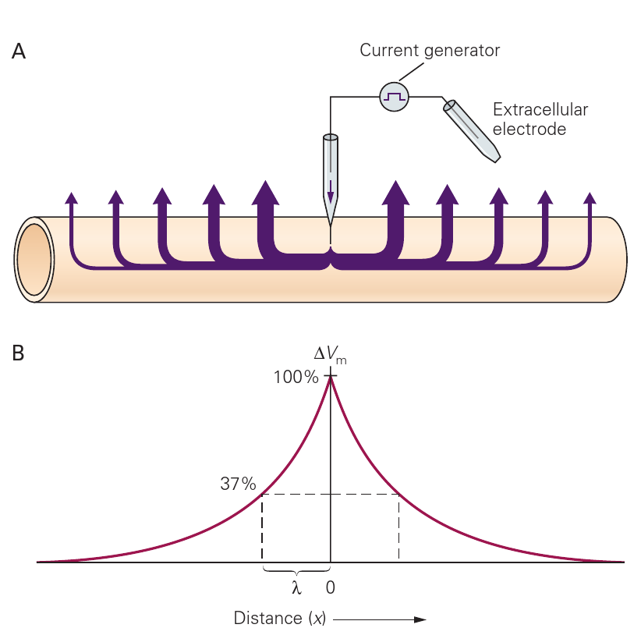
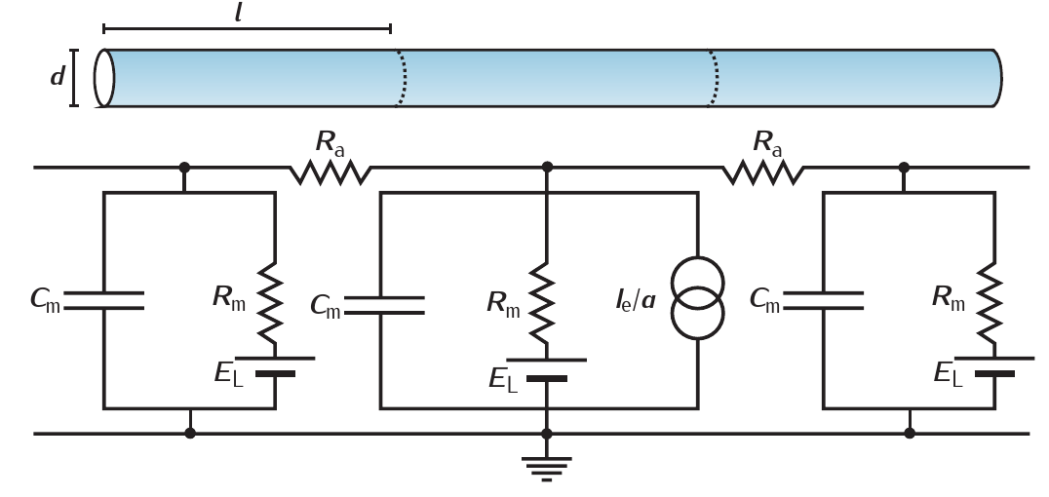
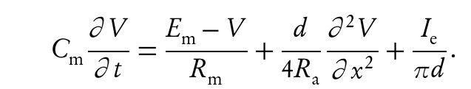

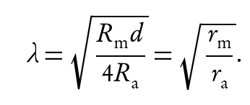
Cable properties of the nerve fibre

Slide 28



Conductance in myelinated fibres
Kandel et al. Principles of Neural Science, 5th ed. McGraw Hill 2013

Slide 29




Structure of the myelinated fibre
Rasband J Neurosci Res 2004
Scherer, Arroyo, J Periph Nerv Sys 2002

Slide 30


Excitability, spiking and bursting
Prescott SA, De Koninck Y, Sejnowski TJ (2008)
PLoS Comput Biol 4(10): e1000198. doi:10.1371/journal.pcbi.1000198
E. Izhikevich International Journal of Bifurcation and Chaos, 10: 6 (2000) 1171–266 (c) World Scientific Publishing Company

Slide 31


Different neurons have different responses to depolarizing current
Kandel et al. Principles of Neural Science, 5th ed. McGraw Hill 2013

Slide 32



What is a good model?

Slide 33



What is a good model of a neuron?
Brette R (2015) PloS Comput Biol 11(4): e1004114. doi:10.1371/journal.pcbi.1004114

Slide 34




Synaptic transmission
Astrocytes and the synapse
Kandel et al. Principles of Neural Science, 5th ed. McGraw Hill 2013
Notes:
Электрических синапсов в мозгу немного, но могут играть важную роль в генерации гамма-ритма, например (между определенными классами интернейронов)

Slide 35


The Glu-ergic synapse
Harris, Jolivet,Attwell ,2012: doi:dx.doi.org/10.1016/j.neuron.2012.08.019

Slide 36


NMDA-receptors (Glu-ergic synapses)

Slide 37


Information processing on dendrites

Slide 38


Spike back-propagation

Slide 39



Large-scale biophysical models
Markram et al. Cell 2015

Slide 40


Large-scale biophysical models

Slide 41




How neuronal activity is measured in vivo
Freeman et al Nat Neurosci 2014
- 2pm
- gCamp
Lind, Brazhe, Jessen, Tan, Lauritzen PNAS 2013
Freeman et al Nat Neurosci 2014

Slide 42



What is measured in fMRI?
Logothetis 2008
Kim, Ogawa, JCBFM 2012

Slide 43


Astrocytes: the bushy cardinals of the CNS
Khakh, MacCarthy.
Cold Spring Harb Perspect Biol 2015;7:a020404
Nimmerjahn, Bergles Curr. Op in Neurobiology 2015, 32:95–106

Slide 44


Astrocytes have Ca²⁺ excitability
A. Nimmerjahn, J. Physiol. (2009), 587(8):1639-1647
Hoogland et al, PNAS (2009), 106(9) 3496-3501

Slide 45



Hoogland et al, PNAS (2009), 106(9) 3496-3501
Mathiesen, Brazhe, Thomsen, Lauritzen, JCBFM 2012

Slide 46



Optogenetics
Fenno et al 2011

