Slide 1

Enhancing Phishing Interventions with AI & Assessing the Cybersecurity Landscape
Intervention Ideas v2

Slide 2
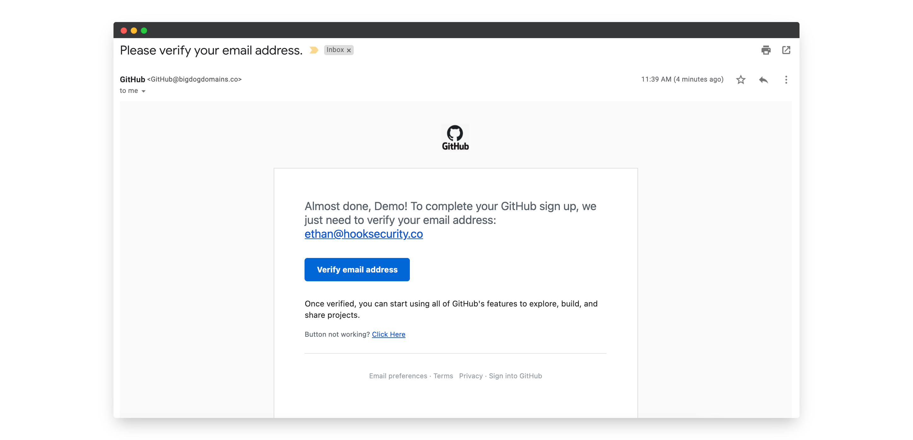


Scenario 1
Suspicion Level:
Suspiciousness:

Slide 3

Scenario 2

Slide 4

Scenario 3
This link seems suspiscious. Are you sure you want to click on this?

Slide 5
Scenario 4
This link looks dangerous… really open it?.
Ok
Go back

Slide 6
Scenario 5
You seem tired….

Slide 7
Scenario 6

Slide 8

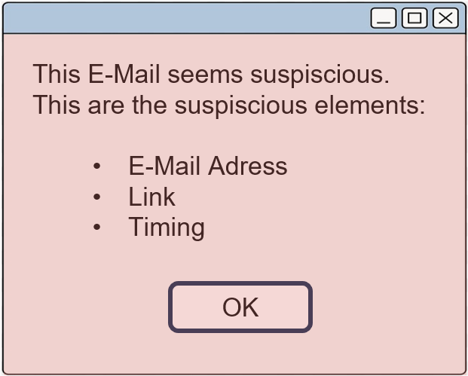


Scenario 7
Suspiciousness:
Why this E-Mail looks suspiscious:
Sent from an unfamiliar e-mail adress
Contains suspiscious link
Urgent tone

Slide 9




Scenario 8
Suspiciousness:
Sender:
Link:
Attachement:
Grammar:
Tone:

Slide 10

Scenario 9

Slide 11



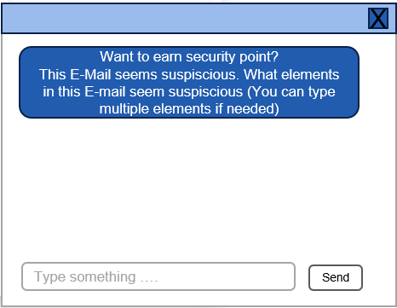
Scenario 10
Security Points: 3

Slide 12
Scenario 11

Slide 13
Scenario 12
Security Points: 3
Option A
Option B
Option C
Second question
Link elements blocked (complete test first)

Slide 14
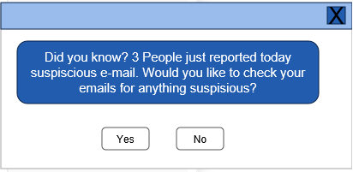
Scenario 13

Slide 15
Scenario 14
You need to wait 10 seconds before you can click any links!

Slide 16
Scenario 15
In this fictional situation, you just came back from vacation and you’re very stressed!

