Slide 1
Abremod
Notes:
We are showing two approaches, so even if you are only using Concert, you might get something from the OPL example.

Slide 2
Agenda
Cover two disparate examples
OPL
ILOG Concert
Have a C#, and Java Adapters
Working on C++
Showing Two approaches
Translating OPL
Using an Adapter for Concert
General advice on the migrating

Slide 3
Switching To Gurobi
Hurdles
Large code base
Business Logic embedded in API calls
Mitigating Factors
The time to migrate is not proportional to the size of the codebase
With mps files, you can see how the Gurobi will perform on your specific models.

Slide 4
Before you Migrate
Current State
Actively adding features?
Maintenance only?
Do you have regression tests?
MPS is your friend
Evaluate relative performance
LP is also your friend
Name your variables and constraints
Testing your code

Slide 5
Migrating From OPL
OPL includes a domain specific language
Locked to a Solver (CPLEX)
Two most likely strategies
Move to a solver-agnostic Language
AMPL
AIMMS, GAMS, MPL
Migrate to Python

Slide 6
Migrating from OPL to Python
Why Python
Best of Both worlds
Powerful as a General Purpose Language
As effective as a Domain Specific Language
Concise
Readable
Learnable
See Stackoverflow
(http://bit.ly/1QEF0fq)
Huge user base

Slide 7
OPL to Python
Feature Comparison
OPL | Python
Tuples, Sets | Tuples, Sets
Read from Excel | openpyxl, xlrd
Read from SQL | Sqlalchemy
Slicing, Grouping | Pandas
UI | Jupyter Notebook
.dat format | JSON
OPLScript | Python
Notes:
For those
comfortable with the features of OPL, you will actually find Python
has most of them covered with things that are either standards
compliant, or have a much larger user base. Some examples, pulling
from a spreadsheet, Python has openpyxl, pulling from a database,
sqlalchemy is our preferred tool. It's a great Object Relational
mapper that eliminates boilerplate code for connected to a sql
database, probably eliminates most of the need to write routine sql
statements, but still allows you do drop down and write sql if that's
what you really need. There's an O'Reilly book on it, there's
numerous tutorials. There are more than 7000 questions tagged
sqlalchemy on stackoverflow compared to 140 total for AMPL. The data
structures like arrays, and sets of strings and numbers, tuples, are
all part of the base Python, and Gurobi has an implementation of
slicing. We also really like the Pandas library for slicing, grouping
and doing joins. Again, this library has its own O'Reilly book and a
question count in the 5 digits. Pandas also has a tools for pulling
data from a lot of standard datatypes, including excel and csv files,
json formats. If you are using the OPL .dat format, we find the
standard JSON to be the best equivalent to the .dat file. We actually
have a short python script that can convert most .dat files into a
JSON format. And we'll show you how to use it here. The final line
in this chart, What's the equivalent of OPLScript in Python is Python.
And that's the key advantage of using Python. You don't need two
languages to accomplish a task. And for most production applications,
you do need the functionality of a general programming language.

Slide 8
OPL To Python
Installing Python
Use the Anaconda Distribution
Especially great on Windows
Easy installation for Gurobi Libraries
http://www.gurobi.com/downloads/get-anaconda

Slide 9
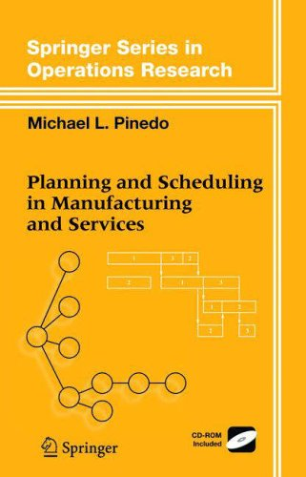
OPL To Python
Migrate a complete example
From a book
Planning and Scheduling in Manufacturing and Sevices
OPL Code is freely available
http://bit.ly/20VpATz
Reads from OPL dat file
Python Code Available on github

Slide 10
Approach
Translate the “.dat” file to JSON
JSON is a standard
Almost all programming languages have readers
OPL reads it
Native format for MongoDB
Many application have JSON exporters
Simple Python script to translate
Most dat files
without embedded logic
Using PyParsing
Another library included with Anaconda

Slide 11
OPL Data
Can Translate with Python Script
Demand = #[
2: #[
1: [ 20000 30000 15000 40000 ]
2: [ 0 50000 30000 50000 ]
]#
3: #[
1: [ 10000 5000 15000 40000 ]
2: [ 0 10000 0 5000 ]
]#
]#;
"Demand": {
"2": {
"Product 1": [ 20000, 30000, 15000, 40000 ],
"Product 2": [ 0, 50000, 30000, 50000 ]
},
"3": {
"Product 1": [ 10000, 5000, 15000, 40000 ],
"Product 2": [ 0, 10000, 0, 5000 ]
}

Slide 12
OPL Model
Data Declarations
Lang. | Statement
OPL | int RequiredLotSize = ...;
Python | RequiredLotSize = d['RequiredLotSize']
OPL | float Demand[Stages, Products, Periods] = ...;
Python | Demand = series_from_json(d['Demand'], [Stages, Products, Periods])
OPL | range Products = 1..2;
Python | Products = ['Product 1', 'Product 2']

Slide 13
OPL Model
Variable Declarations
dvar float+ x[Factories, Products, Periods];
dvar int+ y[Factories, Stages, Products, Periods] in 0..maxint;
dvar float+ z[Products, Periods];
dvar float+ q2[Products, ZPeriods];
dvar float+ v2[Products, Periods];
dvar float+ v3[Products, ZPeriods];
dvar boolean yb[bnds, Periods];

Slide 14
Variables
OPL | dvar float+ x[Factories, Products, Periods];
Python | x = get_vars('x', Factories, Products, Periods)
OPL | dvar boolean yb[bnds, Periods];
Python | yb = get_vars('yb', bnds.index, Periods, vtype=GRB.BINARY)

Slide 15
Objective function
OPL
minimize
sum (t in Periods, j in Products,
i in Factories)
ProdCost[i,j]*x[i,j,t]
Python
model.setObjective(
grb.quicksum([ProdCost[i, j] * x[i, j, t]
for i in Factories
for j in Products
for t in Periods])

Slide 16
Constraints
OPL | if (RequiredLotSize > 0) forall (i in Factories, j in Products, t in Periods) x[i,j,t] == RequiredLotSize*xlots[i,j,t]; else forall (i in Factories, j in Products, t in Periods) xlots[i,j,t] == 0;
Python | if RequiredLotSize > 0: [addConstr(x[i, j, t] == RequiredLotSize * xlots[i, j, t]) for i in Factories for j in Products for t in Periods] else: [addConstr(xlots[i, j, t] == 0) for i in Factories for j in Products for t in Periods]

Slide 17
Results From Solver
OPL | float TotProdCost = sum (t in Periods, j in Products, i in Factories) ProdCost[i,j]*x[i,j,t];
Python | TotProdCost = sum([ProdCost[i, j] * x[i, j, t].x for t in Periods for j in Products for i in Factories])

Slide 18
OPL to Python
Consider moving to Python
If you still like modeling languages, try AMPL

Slide 19
Migration Library for CPLEX Concert API

Slide 20
Migrating From Concert
Concert
C++ API developed in late 90s
Java and C# versions followed
Good option for using mainstream languages

Slide 21
Migrating from Concert
Two Strategies
Translate code
Use an Adapter

Slide 22
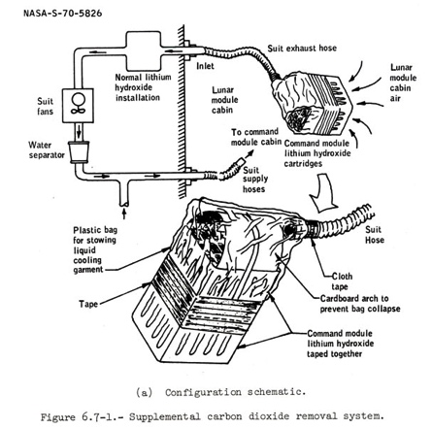
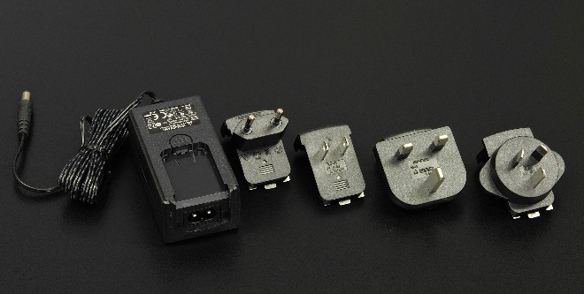
Adapter
Pattern
Object Adapter Pattern
Physical Examples
Electric plugs
CO2 Filter on Apollo 13

Slide 23
Adapter Approach
Give applications written against the Concert API, access to the Gurobi solver
Our Adapter
Not a complete implementation of Concert
Most applications use a small subset
Enough to make a model run
Free to use
Starting point for your application

Slide 24
Adapter Approach
Working Concert Application
Unlink CPLEX / Concert libraries
Add Gurobi Library
Add adapter library
Modify adapter for your code

Slide 25
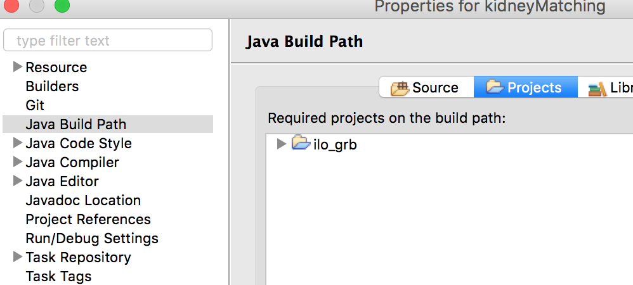
Example
Makefile
CPPLIB = … -lilo_grb … -lgurobi_c++ -lgurobi65
Eclipse

Slide 26
Adapter Library
Available for Java and C#
Working on C++
Available on Github
https://github.com/abremod/concert2gurobi4cs

Slide 27
Adapter Library
“Object Adapter”, not a “Class Adapter”
Favor Composition over Inheritance
public class IloCplex extends ilog.concert.Algorithm implements IloMPModeler {
GRBEnv env;
GRBModel model;
private boolean vars_synced = true;
private boolean constrs_synced = true;

Slide 28
Adapter Library
C++ specific
IloXXXX objects are handles
“Pimpl”
Boost shared_ptr<> covers handle functionality
class IloRange : public IloExtractable {
private:
class Impl;
boost::shared_ptr<Impl> _impl;
public:
IloRange(IloEnv env, double lb, double ub, const char *name=0);
IloColumn operator()(IloNum);
};

Slide 29
Limitations
Adapter probably won’t work out of the box
Variables tied to models, not environments
No “not extracted exceptions”
Limited Support for Callbacks
No support for Goals

Slide 30
Questions
Please use the Question box to ask questions to the speaker

Slide 31
So what happens next?
Request a free evaluation license, if you have not already done so
sales@gurobi.com
sales@gurobi.de
Set up a free consultation with a consultant from Abremod
nehme@abremod.com
Webinar slides: Will be available in the next day or two
Abremod tools available from: https://github.com/abremod/ilogrb
Webinar recording: Will be available next week

