Slide 1
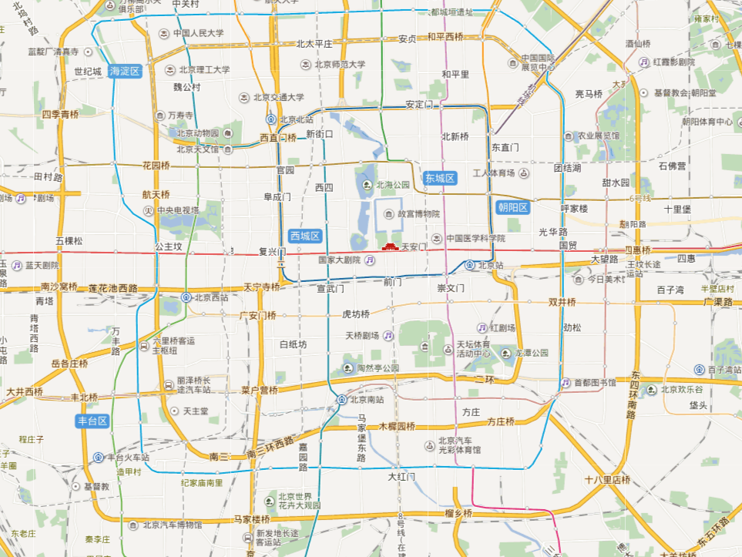


YUM_NWP_SLIDE_FLAG

