Slide 1
CS736 - Assignment-3
Team Members
Atharv Shingewar (24M0834)
Russel Abreo (24M2107)
Under the Guidance of :
Prof. Suyash Awate

Slide 2
Q1
q = 1.6

Slide 3
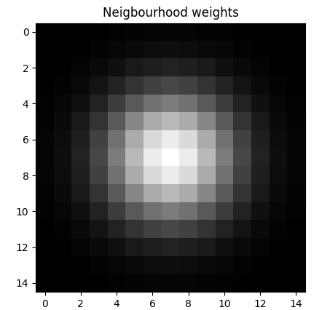
Q1 b - Neighbourhood weights

Slide 4
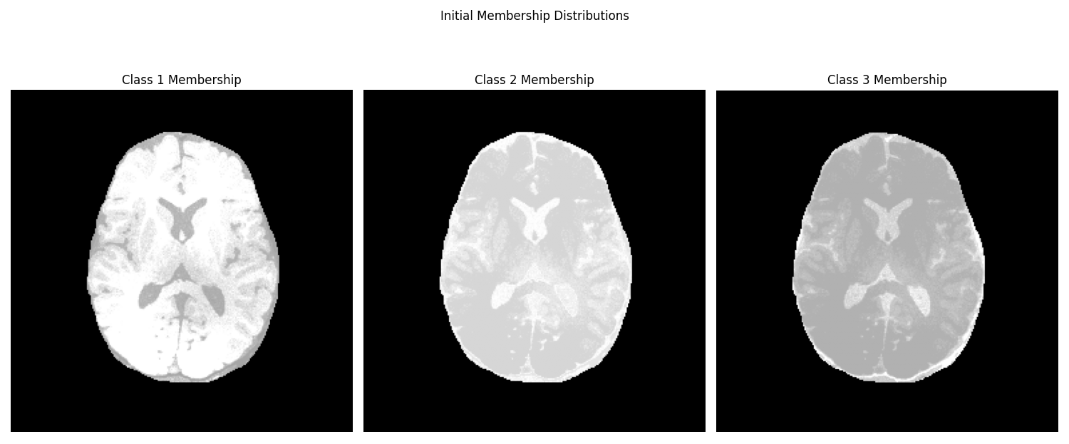
Q1 c - Initial estimates for Memberships

Slide 5
Q1 c - Initial estimates for Memberships
For each pixel intensity, compare its value with the three histogram peak intensities (chosen as initial class means) and assign the membership probability based on intensity similarity.
These similarity scores are then normalized across all class means, ensuring that the membership estimates sum to 1.

Slide 6
Q1 d
Initial class means: [set as per observations from the histogram image intensities]
0.5,
0.25,
0.1
Optimal class means:
0.59480953,
0.48876253,
0.26209626

Slide 7
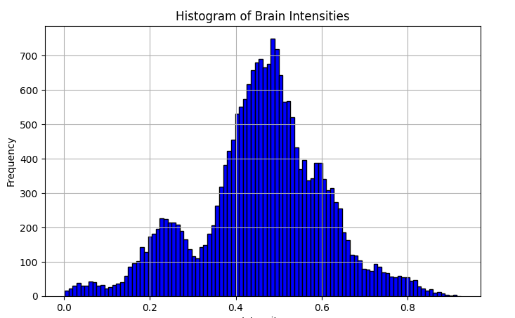
Q1 d - Histogram of Image Intensities

Slide 8
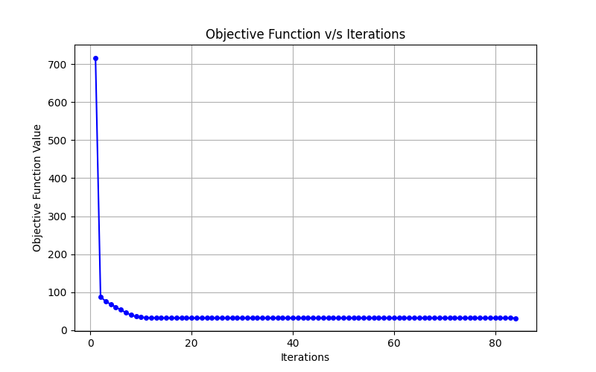
Q1 e - Objective Function Plot

Slide 9
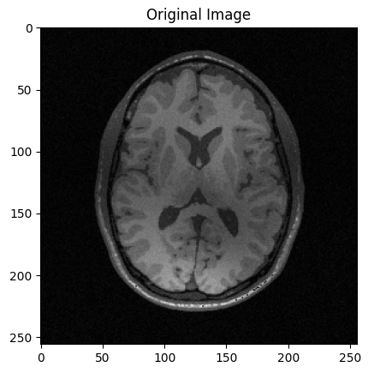
Q1 (i) - Corrupted Image

Slide 10
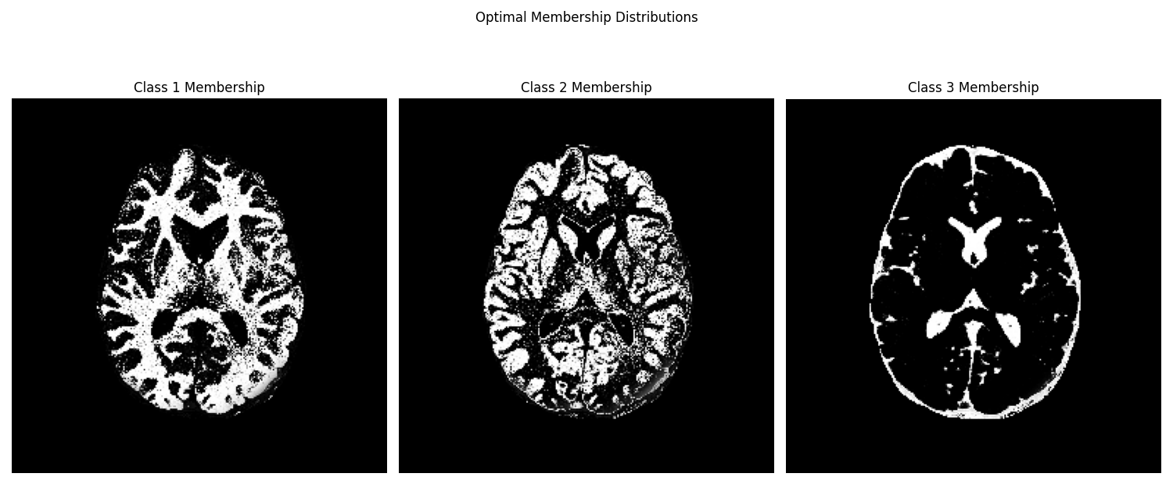
Q1 (ii)- Optimal estimates for Memberships

Slide 11
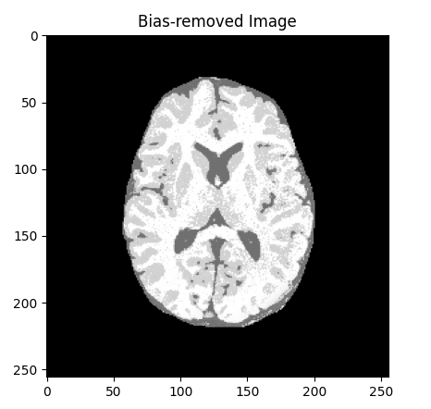
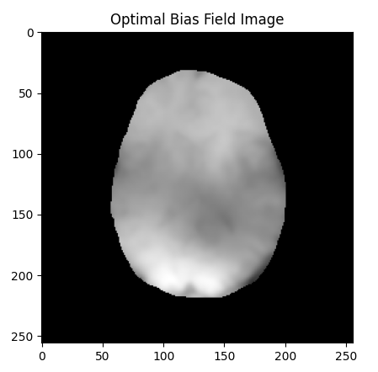
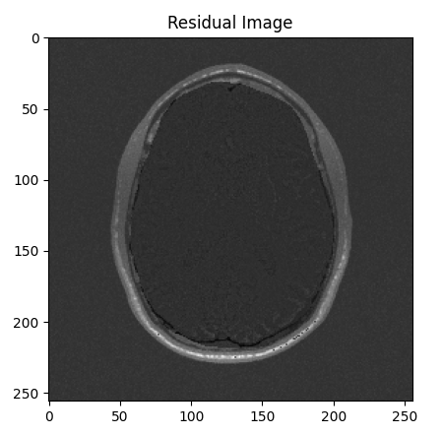
Q1(iii) - Bias Removed, Bias Field, Residual Image
Bias Removed Image
Bias Field
Residual Image

Slide 12

Q1 - Unique Solution

Slide 13

Q1 - Unique Solution

Slide 14
Q2 a
Chosen beta = 2

Slide 15
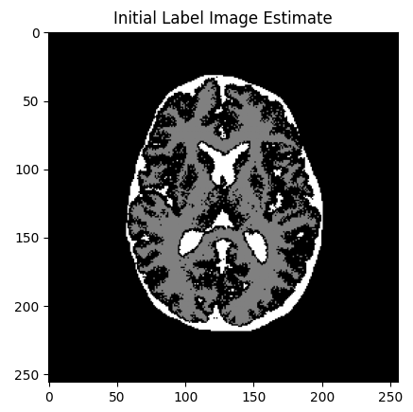
Q2 b

Slide 16
Q2 c
Mean = [0.50408191, 0.62782413 , 0.26943405]
std = [0.04414 , 0.03704 , 0.0773]

Slide 17
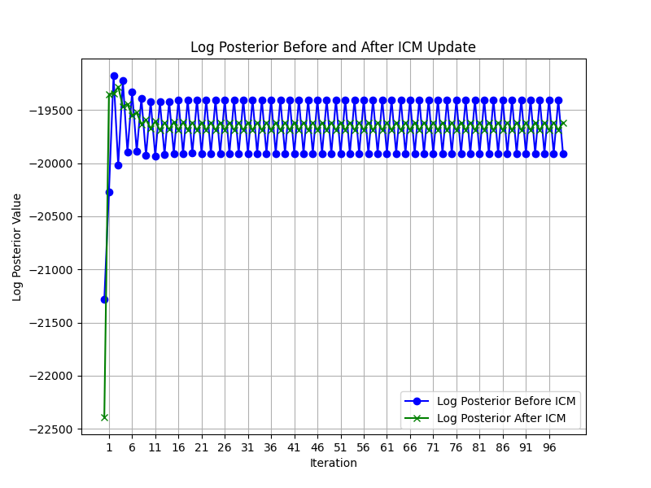
Q2 d

Slide 18
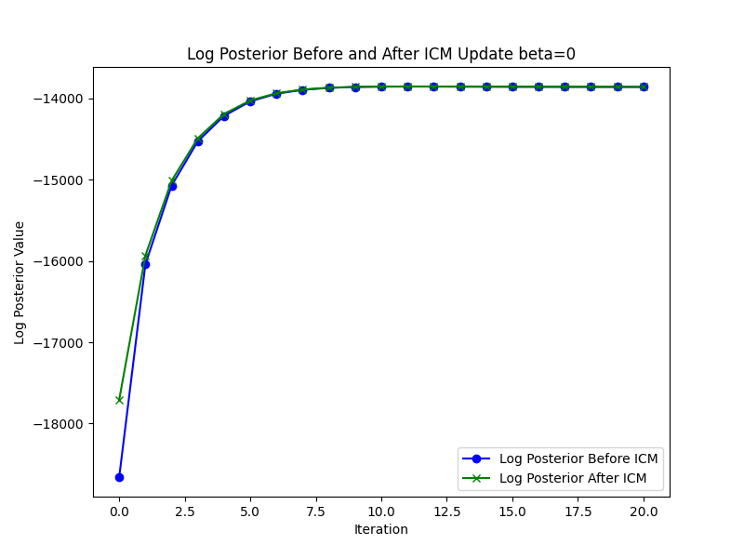
Q2 d

Slide 19
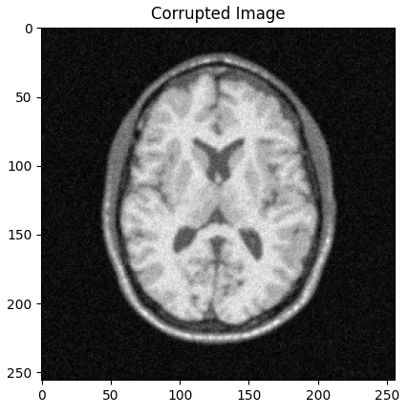
Q2e (i)

Slide 20
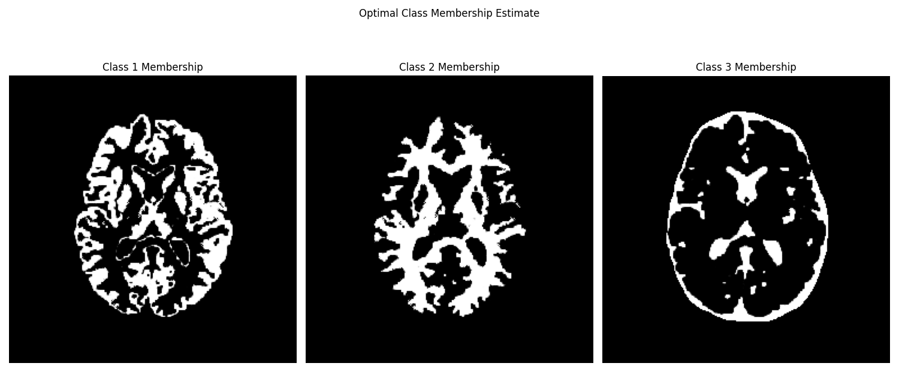
Q2e (ii)

Slide 21

Q2e (iii)

Slide 22
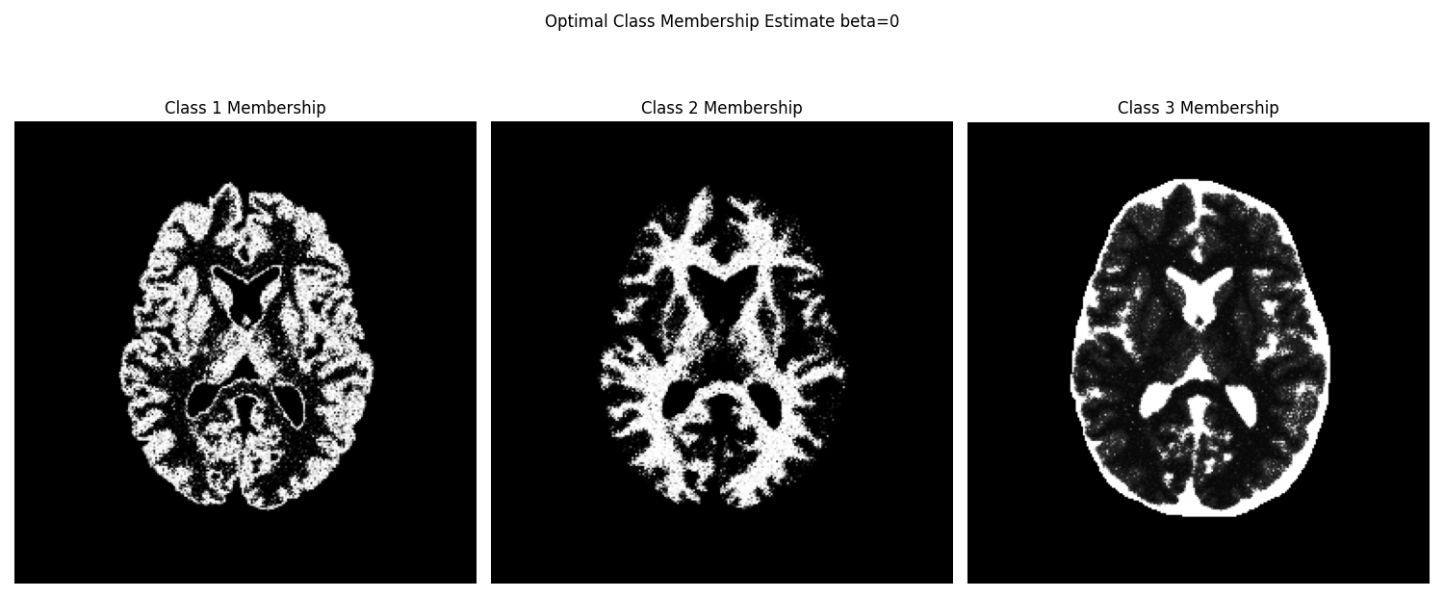
Q2e (iv)

Slide 23
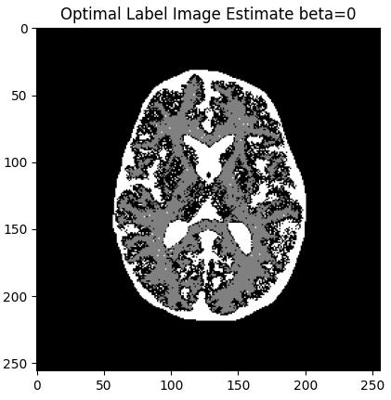
Q2 e (v)

Slide 24
Q2 f
Class 0 = 0.52287683
Class 1 = 0.63087137
Class 2 = 0.30621753

Slide 25
Thank You

