Slide 1
CS736 - Assignment-1
Team Members
Atharv Shingewar (24M0834)
Russel Abreo (24M2107)
Under the Guidance of :
Prof. Suyash Awate

Slide 2
Q1 - Optimal Parameters
Prior: Quadratic
α∗ = 0.1062
RRMSE(α∗ ) = 0.28108
RRMSE(1.2α∗ ) = 0.28141
RRMSE(0.8α∗ ) = 0.28153
Prior: Discontinuity-adaptive Huber
α∗ = 0.96612, γ∗ = 0.04165
RRMSE(α∗ , γ ∗ ) = 0.24063
RRMSE(1.2α∗ , γ ∗ ) = 0.24063
RRMSE(0.8α∗ , γ ∗ ) = 0.24281
RRMSE(α∗ , 1.2γ ∗ ) = 0.24110
6. RRMSE(α∗ , 0.8γ ∗ ) = 0.24075
Prior: Discontinuity-adaptive
α∗ = 0.93340, γ∗ = 0.04064
RRMSE(α∗ , γ ∗ ) = 0.24492
RRMSE(1.2α∗ , γ ∗ ) = 0.24492
RRMSE(0.8α∗ , γ ∗ ) = 0.24952
RRMSE(α∗ , 1.2γ ∗ ) = 0.24493
6. RRMSE(α∗ , 0.8γ ∗ ) = 0.24552

Slide 3
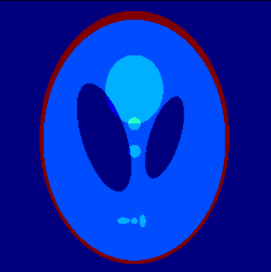
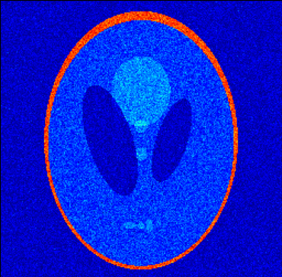
Q1 - Noiseless and Noisy Image

Slide 4

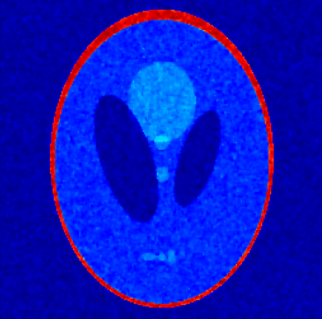

Q1 - Denoised Images
Quadratic
Discontinuity-adaptive Huber
Discontinuity-adaptive

Slide 5
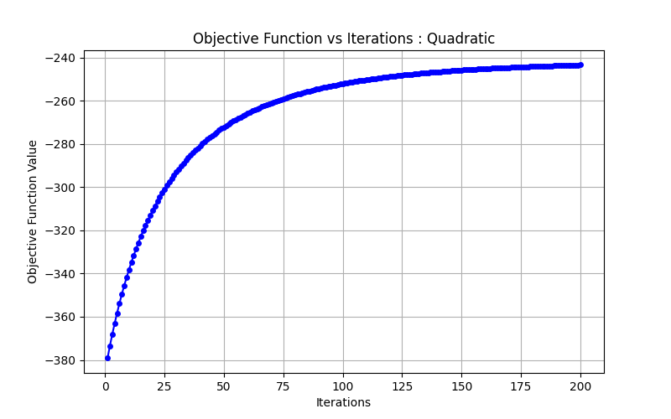
Q1 - Objective Function Plots

Slide 6
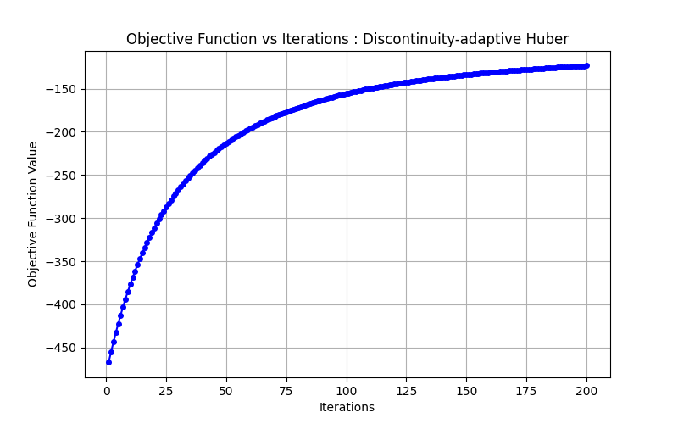
Q1 - Objective Function Plots

Slide 7
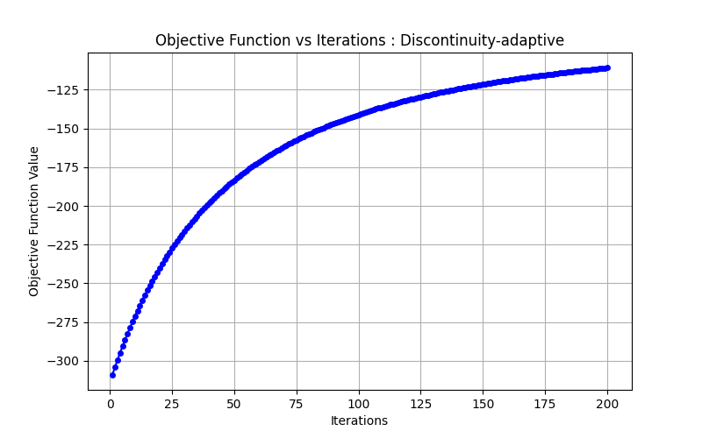
Q1 - Objective Function Plots

Slide 8
Q2 - Optimal Parameters
Prior: Quadratic
α∗ = 0.14228
RRMSE(α∗ ) = 0.12206
RRMSE(1.2α∗ ) = 0.12246
RRMSE(0.8α∗ ) = 0.12255
Prior: Discontinuity-adaptive Huber
α∗ = 0.47034, γ∗ = 0.06432
RRMSE(α∗ , γ∗ ) = 0.11421
RRMSE(1.2α∗ , γ ∗ ) = 0.11446
RRMSE(0.8α∗ , γ ∗ ) = 0.11602
RRMSE(α∗ , 1.2γ ∗ ) = 0.11459
6. RRMSE(α∗ , 0.8γ ∗ ) = 0.11458
Prior: Discontinuity-adaptive
α∗ = 0.56075, γ∗ = 0.07235
RRMSE(α∗ , γ∗ ) = 0.11517
RRMSE(1.2α∗ , γ ∗ ) = 0.11518
RRMSE(0.8α∗ , γ ∗ ) = 0.11749
RRMSE(α∗ , 1.2γ ∗ ) = 0.11528
6. RRMSE(α∗ , 0.8γ ∗ ) = 0.11548

Slide 9
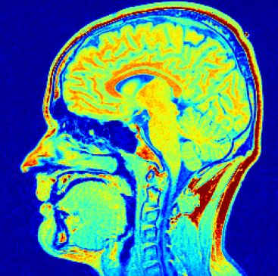
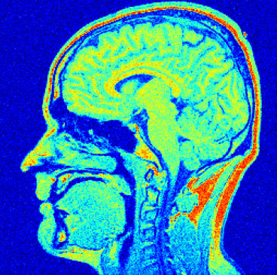
Q2 - Noiseless/Noisy Image

Slide 10



Q2 - Denoised Images
Quadratic
Discontinuity-adaptive Huber
Discontinuity-adaptive

Slide 11

Q2 - Objective Function Plots

Slide 12
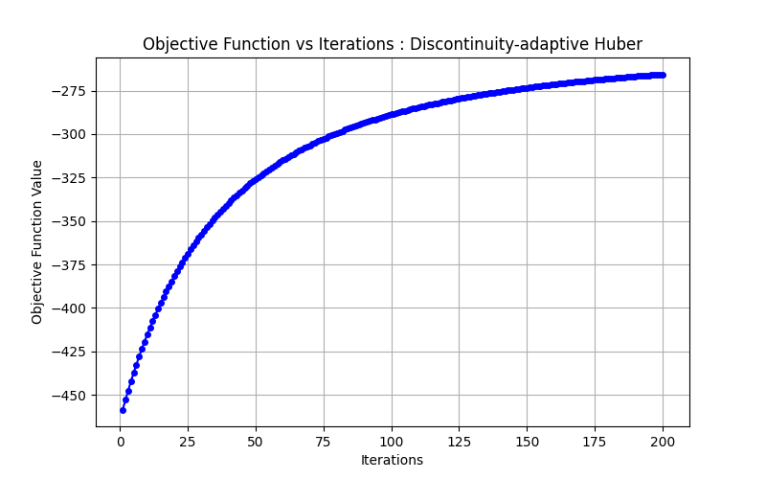
Q2 - Objective Function Plots

Slide 13
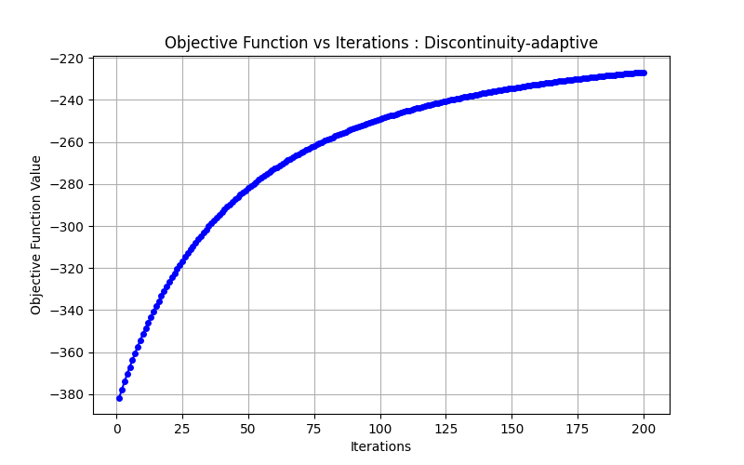
Q2 - Objective Function Plots

Slide 14
Q3 - Optimal Parameters
Prior: squared-L2
α∗ = 0.5477
RRMSE(α∗ ) = 0.17701
RRMSE(1.2α∗ ) = 0.17712
RRMSE(0.8α∗ ) = 0.17718
Prior: L2-norm
α∗ = 0.0955
RRMSE(α∗ ) = 0.17743
RRMSE(1.2α∗ ) = 0.17760
RRMSE(0.8α∗ ) = 0.17761
Prior: (Huber-regularized)
α∗ = 0.4545, γ ∗ = 0.1558
RRMSE(α∗ , γ ∗ ) = 0.17738
RRMSE(1.2α∗ , γ ∗ ) = 0.17755
RRMSE(0.8α∗ , γ ∗ ) = 0.17771
RRMSE(α∗ , 1.2γ ∗ ) = 0.17748
6. RRMSE(α∗ , 0.8γ ∗ ) = 0.17756

Slide 15
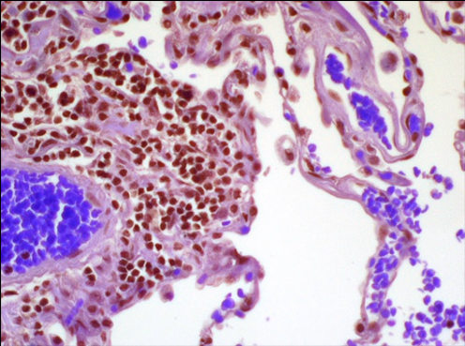
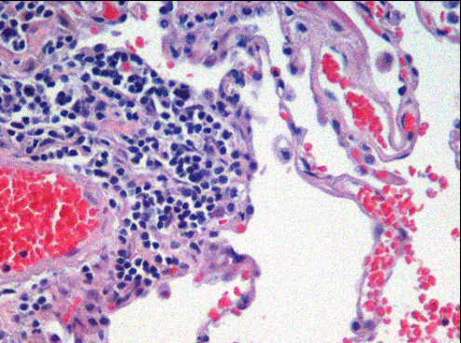
Q3 - Noiseless / Noisy Image

Slide 16



Q3 - Denoised Images
squared-L2
L2-Norm
Huber-L1

Slide 17
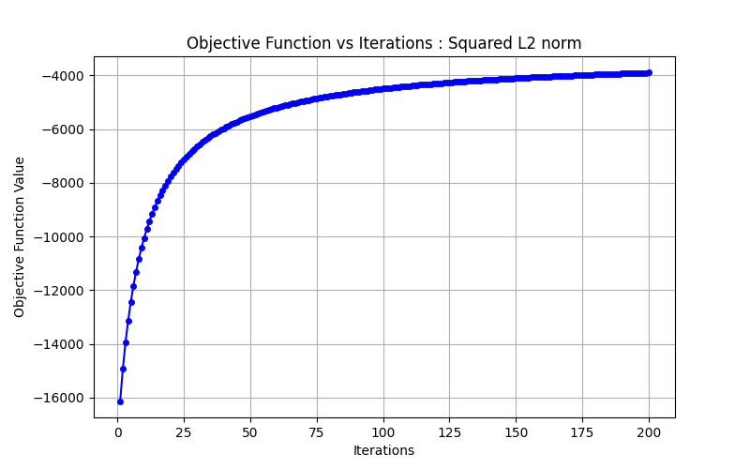
Q3 - Objective Function Plots

Slide 18
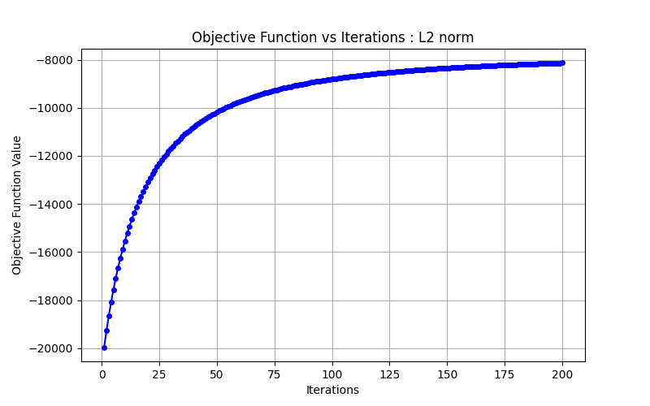
Q3 - Objective Function Plots

Slide 19
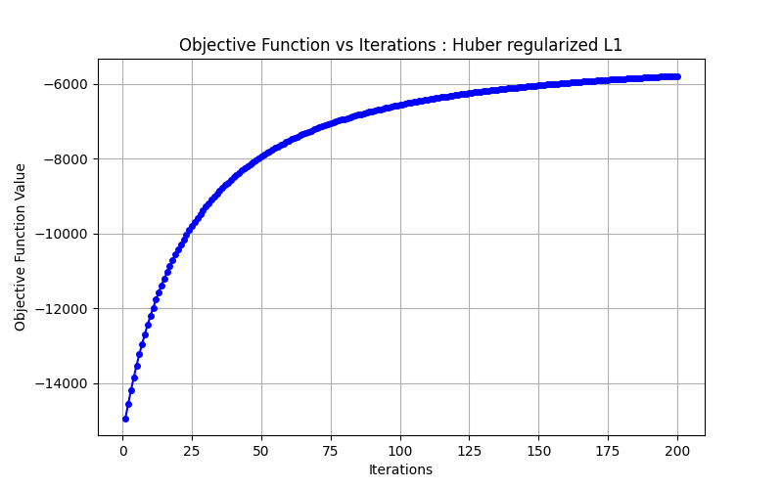
Q3 - Objective Function Plots

Slide 20
Q4 - RRMSE: Denoising using Dictionary Learning
Pre denoising RRMSE : 0.73871
Post denoising RRMSE : 0.65972

Slide 21
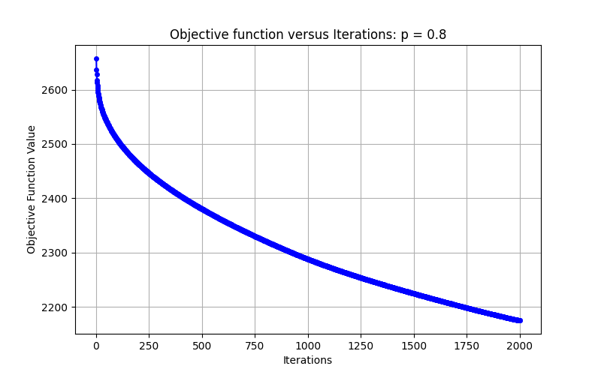
Q4 - Objective Function v/s Iterations(Dictionary Learning)

Slide 22
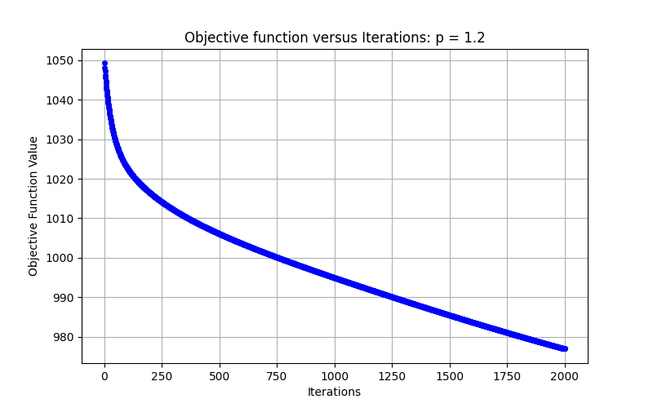
Q4 - Objective Function v/s Iterations(Dictionary Learning)

Slide 23
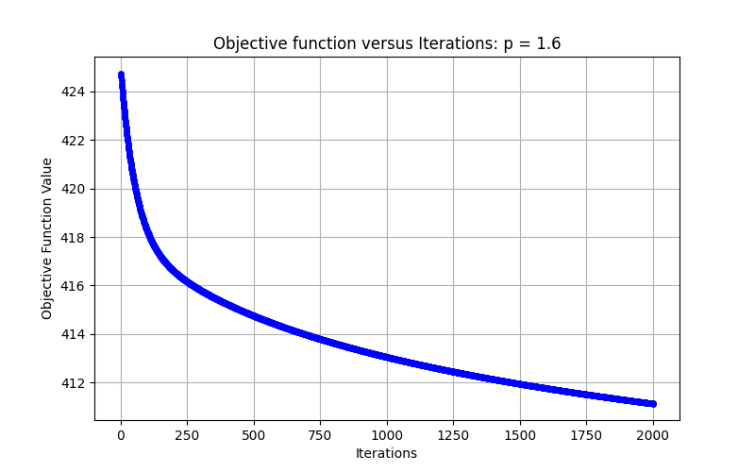
Q4 - Objective Function v/s Iterations(Dictionary Learning)

Slide 24
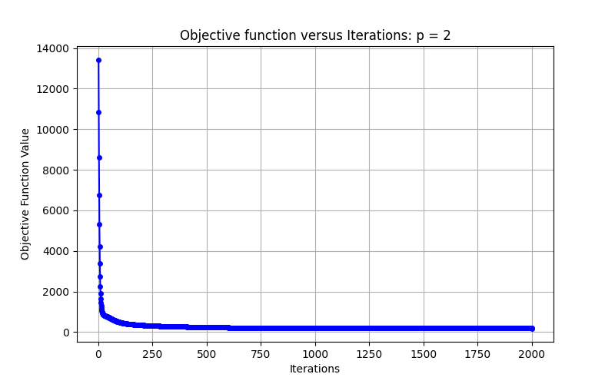
Q4 - Objective Function v/s Iterations(Dictionary Learning)

Slide 25
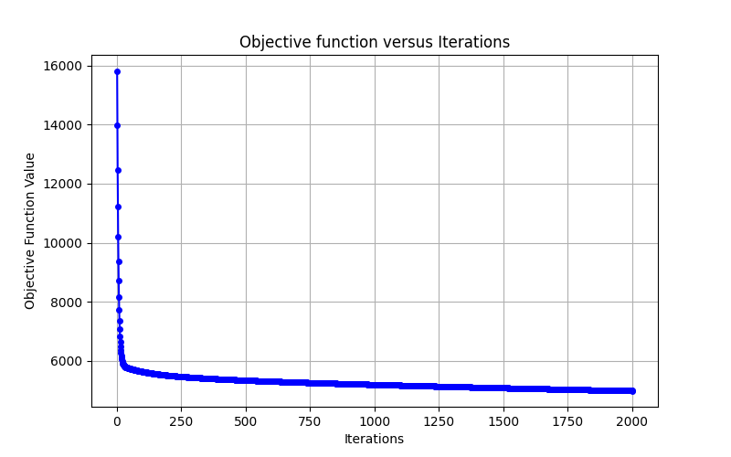
Q4 - Objective Function v/s Iterations(Image Denoising p=0.8)

Slide 26
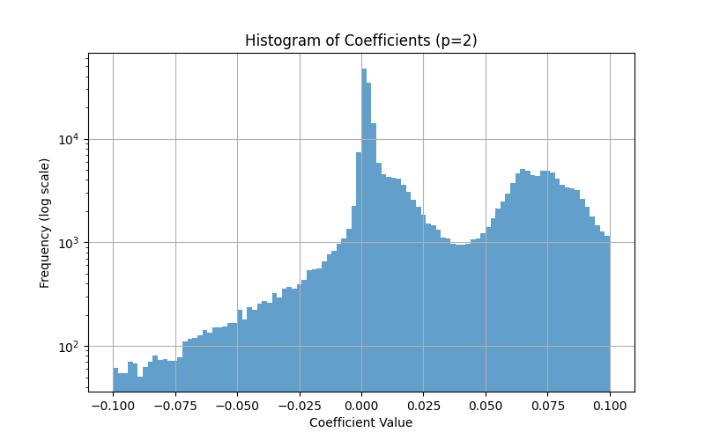
Q4 - Histograms

Slide 27
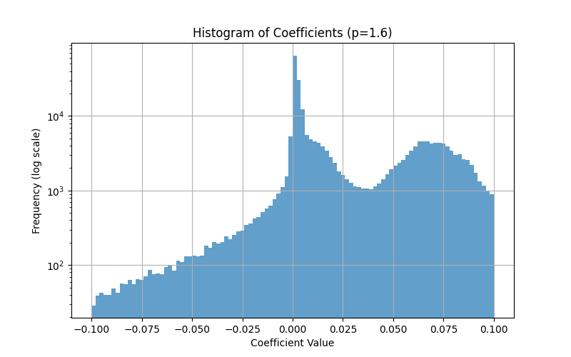
Q4 - Histograms

Slide 28
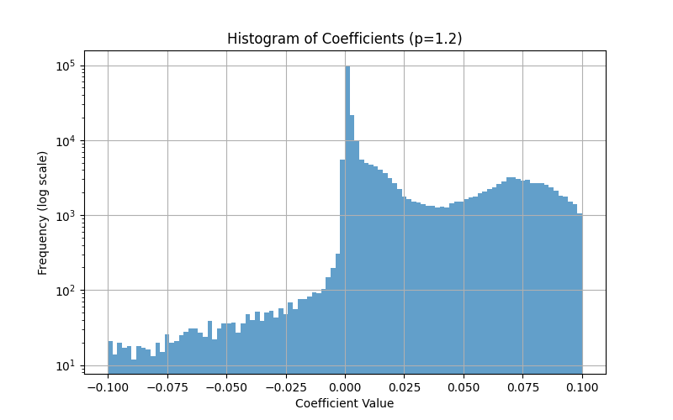
Q4 - Histograms

Slide 29
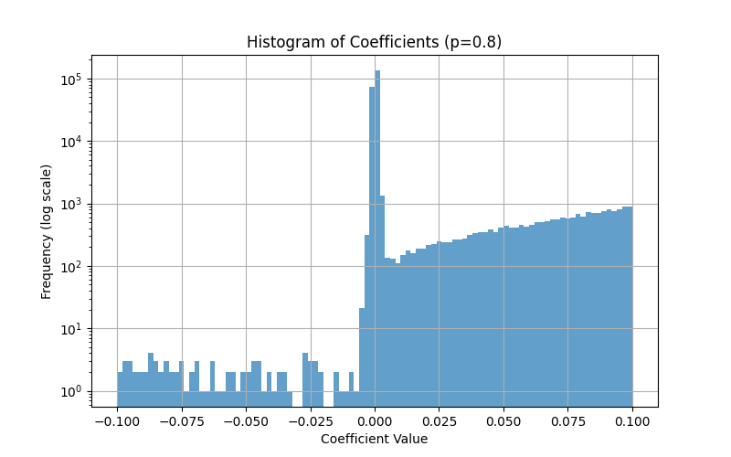
Q4 - Histograms

Slide 30
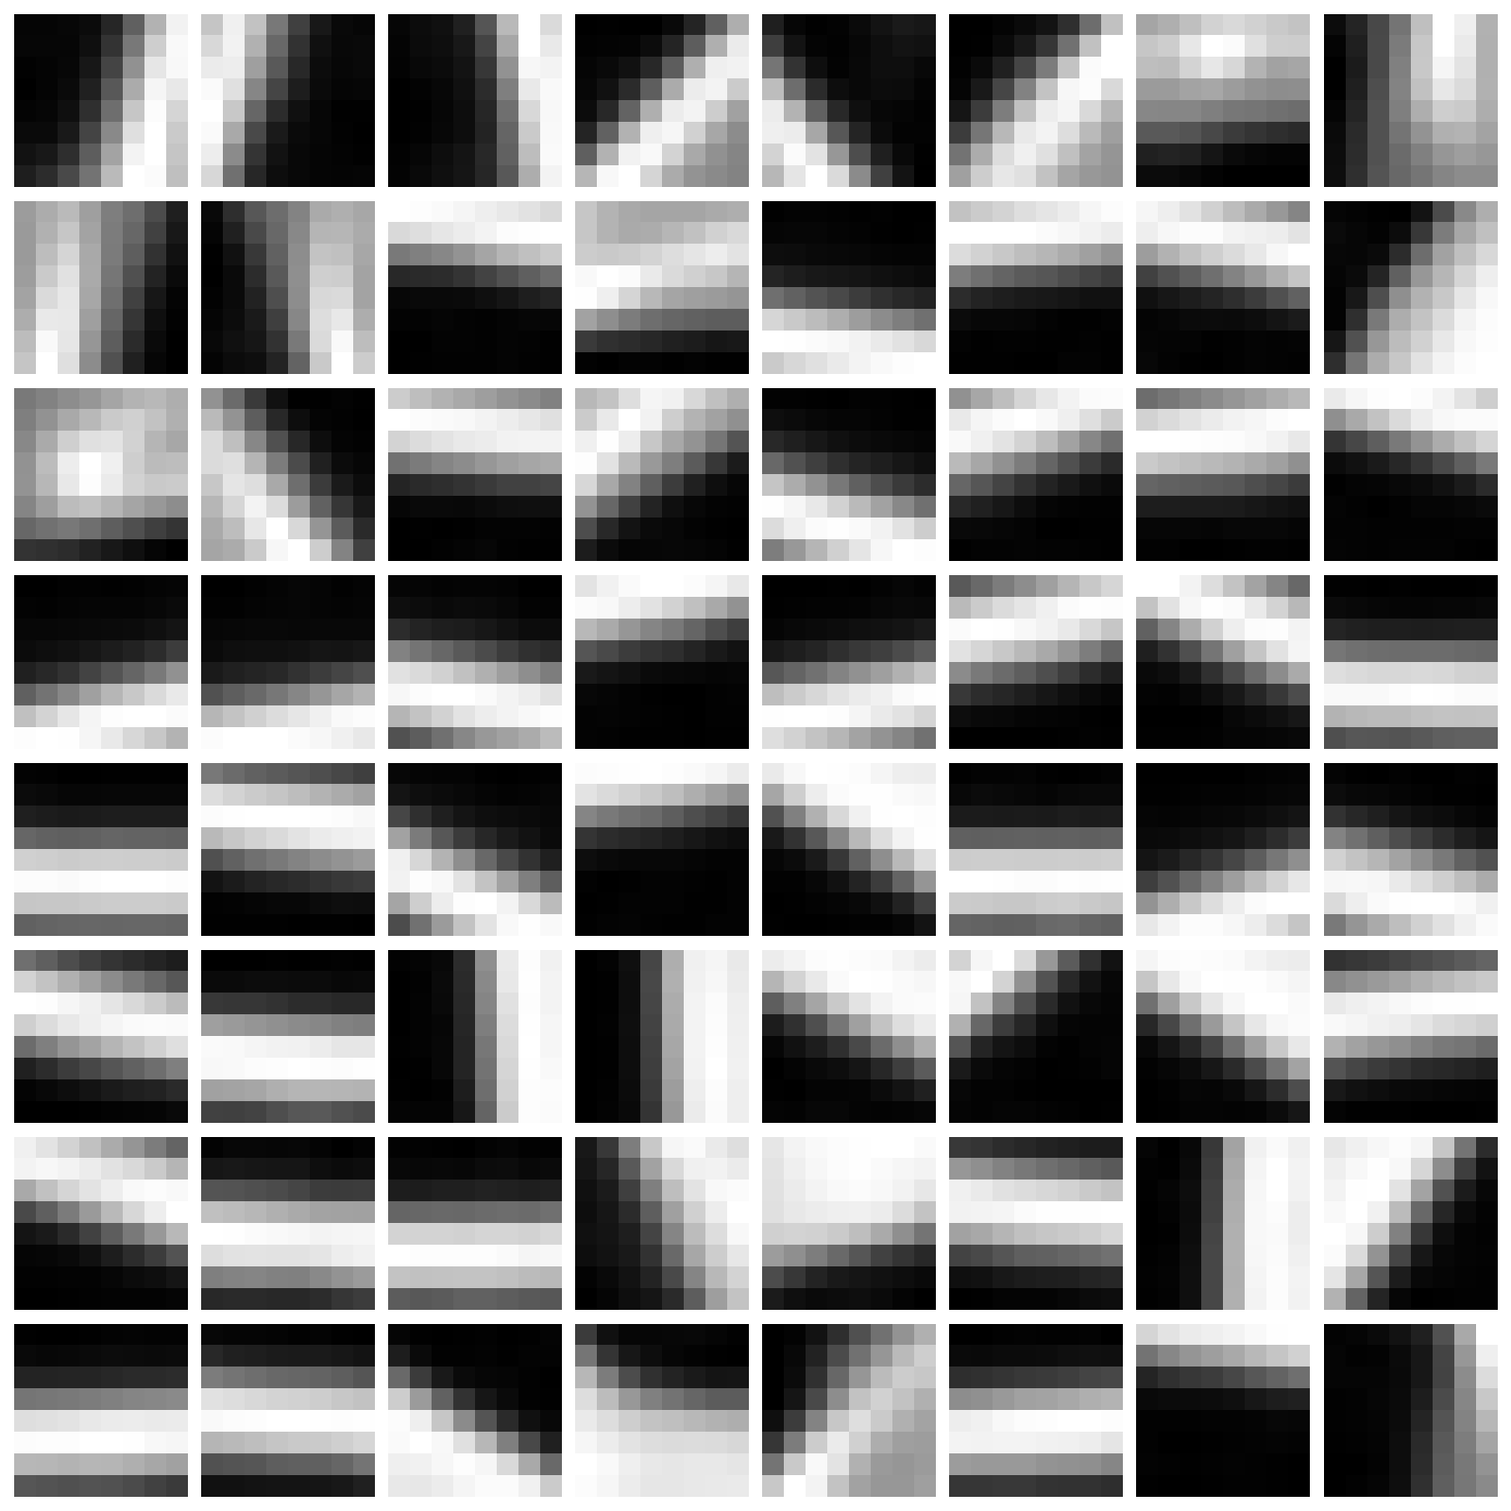
Q4 - Initial Dictionary

Slide 31
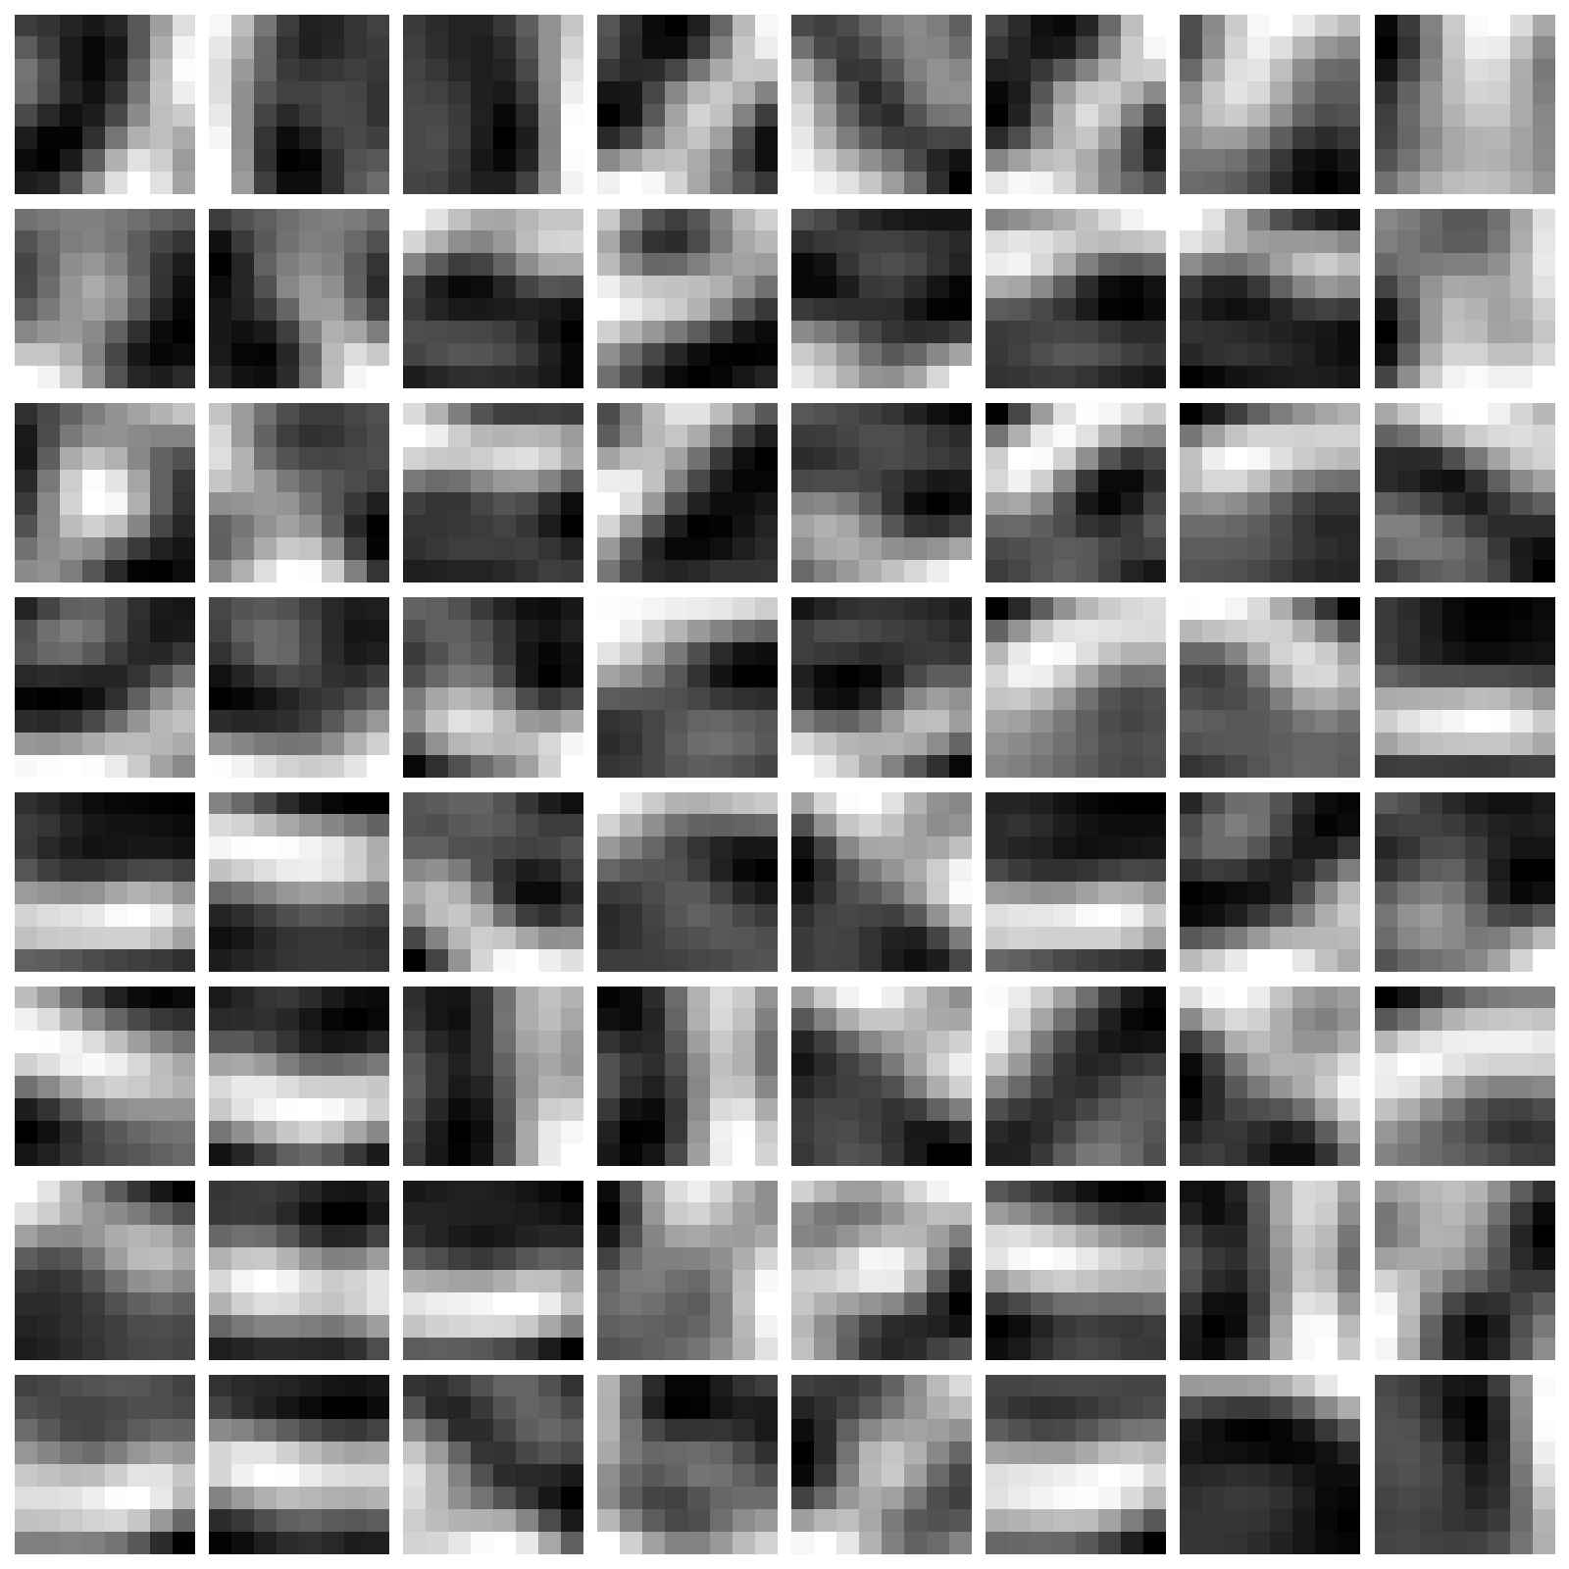
Q4 - Learned Dictionary p = 2

Slide 32
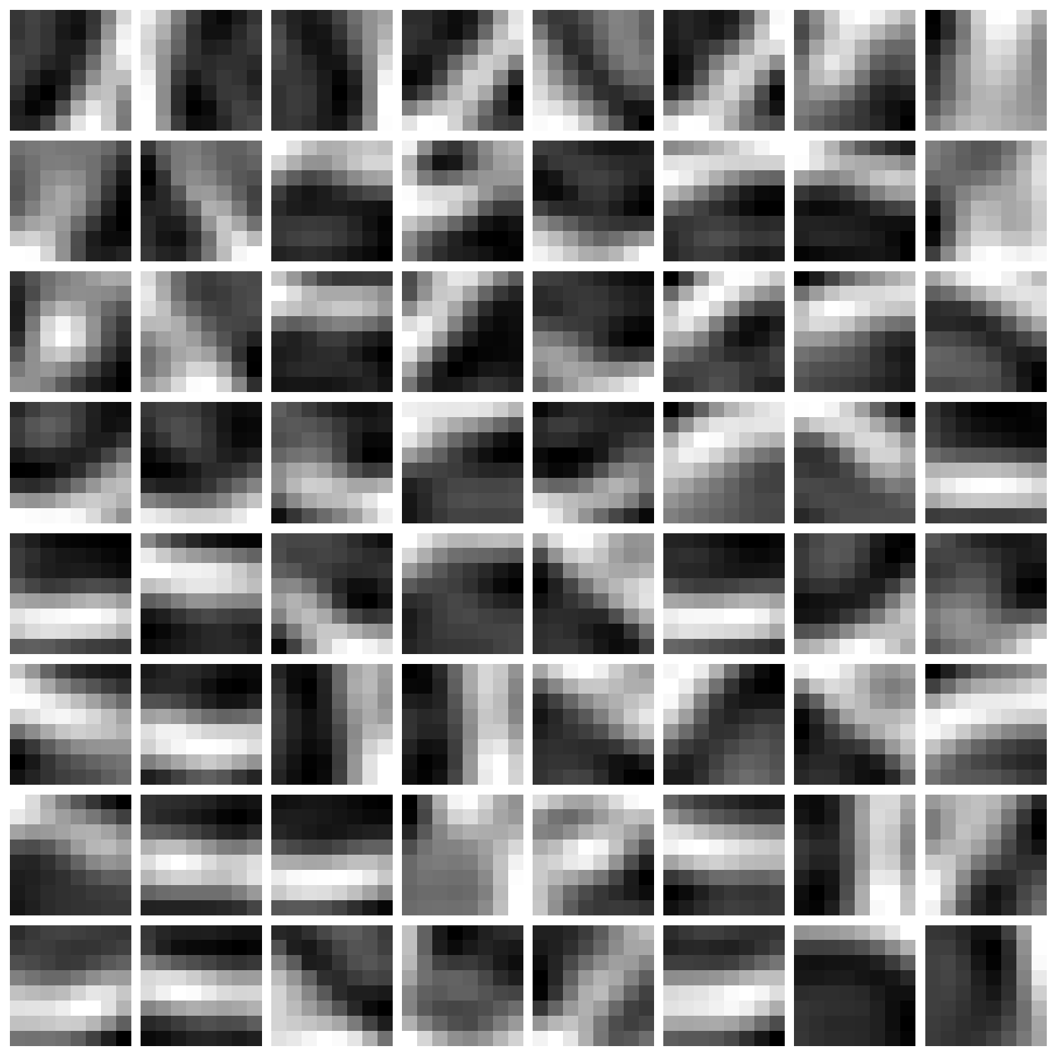
Q4 - Learned Dictionary p = 1.6

Slide 33
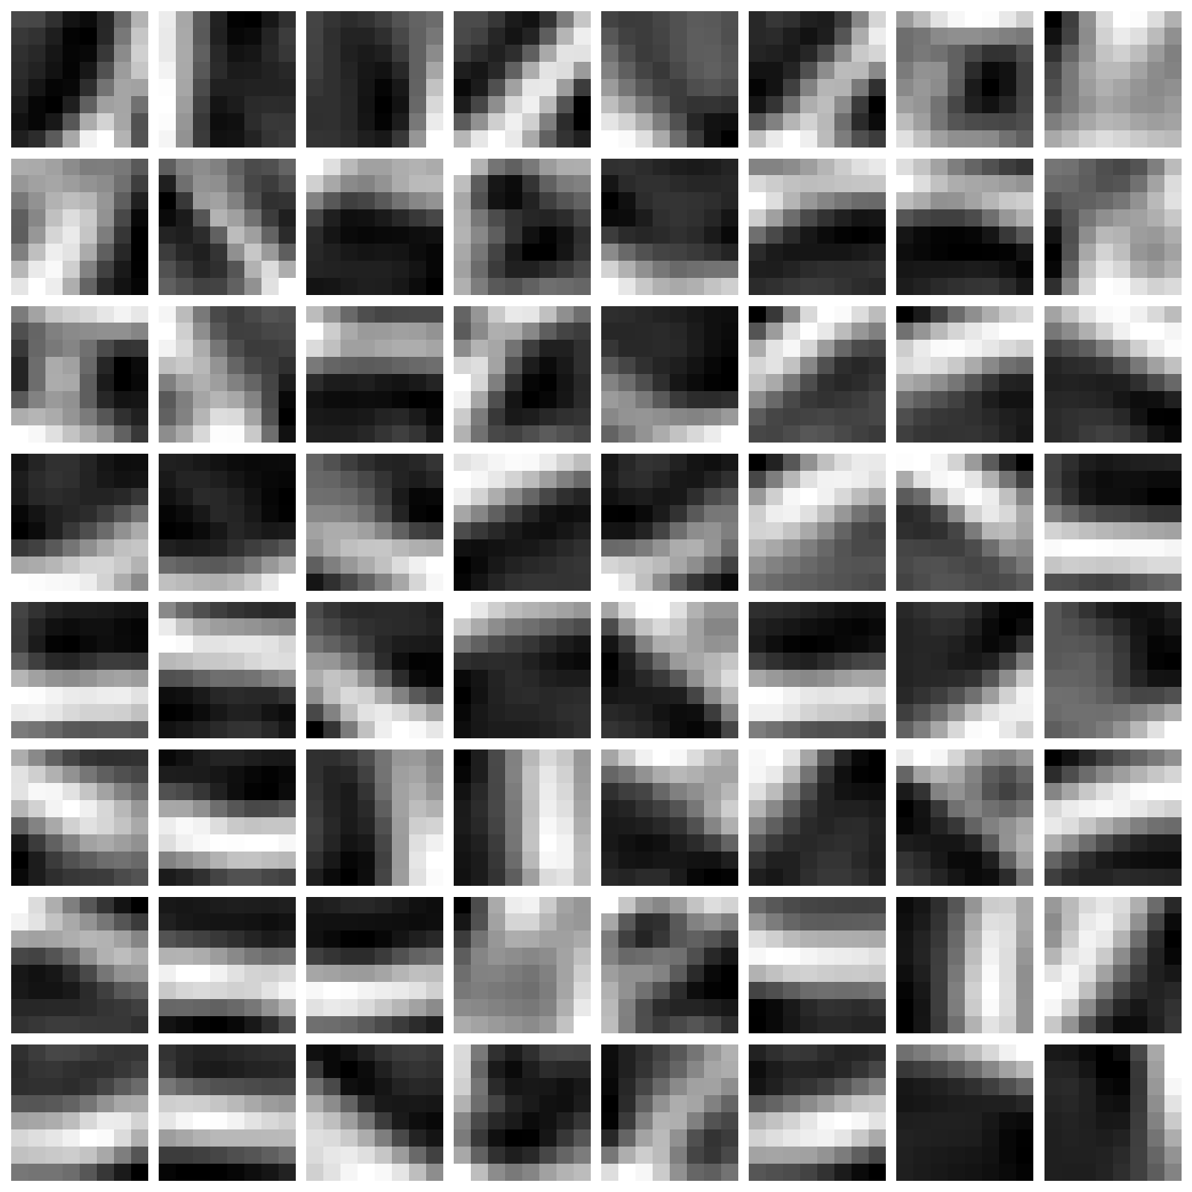
Q4 - Learned Dictionary p = 1.2

Slide 34
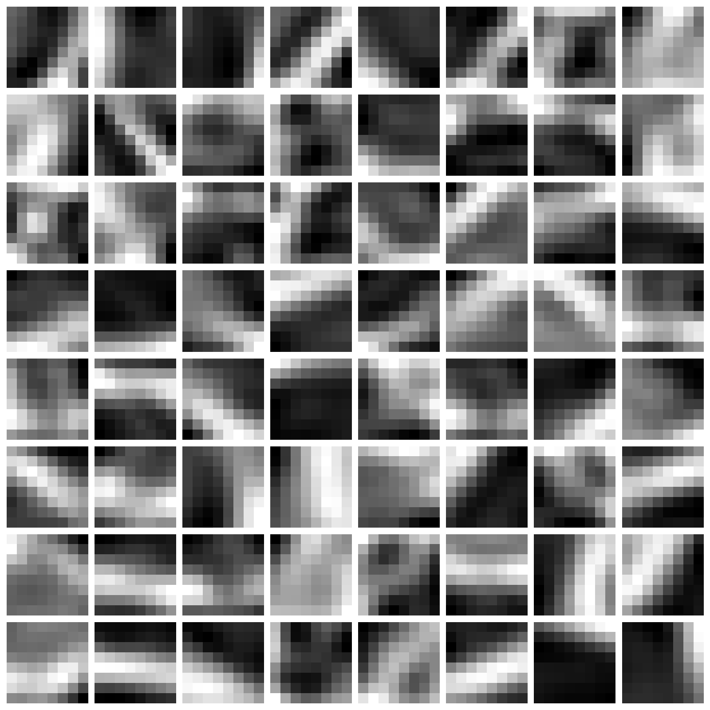
Q4 - Learned Dictionary p = 0.8

Slide 35
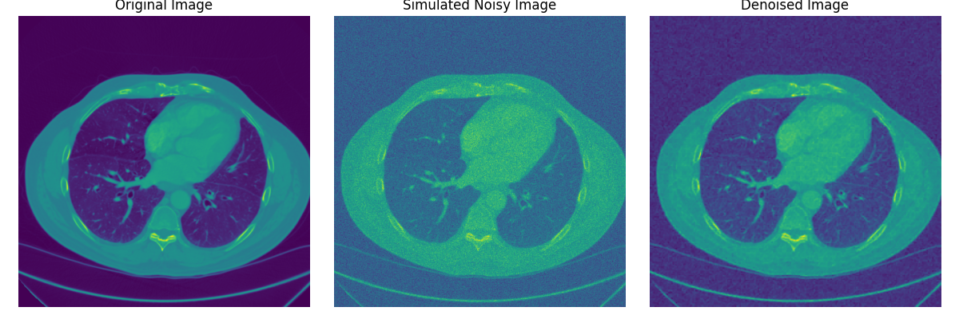
Q4 - Original / Noisy / Denoised

Slide 36
Thank You

