Slide 1
A Generator for Type Checkers
PhD thesis by Holger Gast
Tubingen, 2004
Report by Andrey Breslav

Slide 2
Problem Statement
Declaratively specify type checkers for programming languages
  Functional and Imperative
  Explicit type annotations and Type inference
Generate code implementing a declarative specification

Slide 3
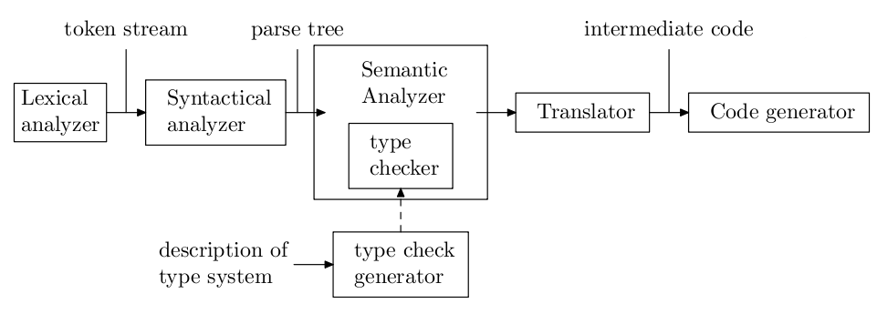
Type Checker in a Compiler

Slide 4
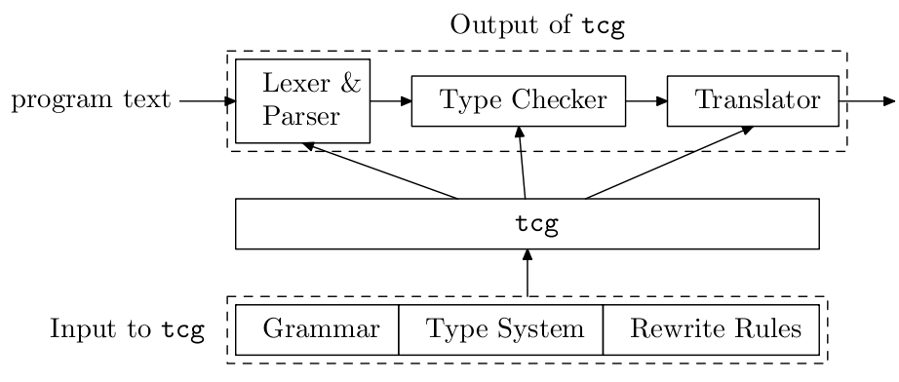
Type Check Generator (TCG)

Slide 5
Basic Principles
Abstract Syntax is annotated with typing constraints
  Constraints are collected from AST
  And solved as a system
Solution process
  TCG builds proofs of desired typing judgements
  Proof – a tree properly labeled by typing rules
    Built upon a term structure with unifiers
    Allows deferred goals
    Allows forward reasoning

Slide 6
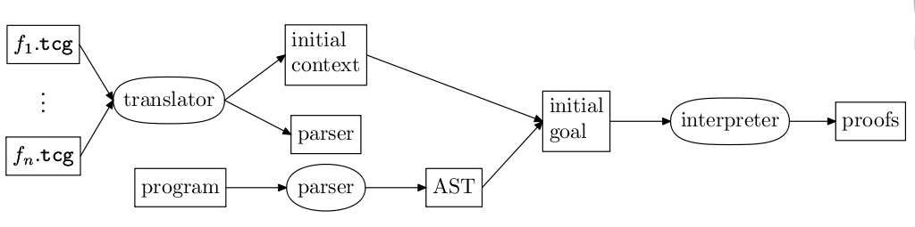
Type Checking with TCG

Slide 7
Applications
MiniML
  Polymorphic let and letrec
Pascal-like imperative language
  Subroutines, Overloading, Coercions, Records
Object-Oriented language
  Encapsulation, Inheritance, Mutually recursive types
Generic programming language
  STL-style algorithms with explicit interface constraints instead of “static polymorphism”

Slide 8
Find the Paper at
http://www-pu.informatik.uni-tuebingen.de/users/gast/tcg.html

