Slide 1
Why do we need Agile

Slide 2
Part 1
  What is Agile anyways?

Slide 3
What is Agile anyways?
Agile is a response to change
Characterized by quickness and ease of movement; Nimble

Slide 4
Change
Things change
  Requirements change
  Needs change
  Priorities change
  Technology changes
  Fashion changes
The question really becomes:
How do we deal with change?

Slide 5




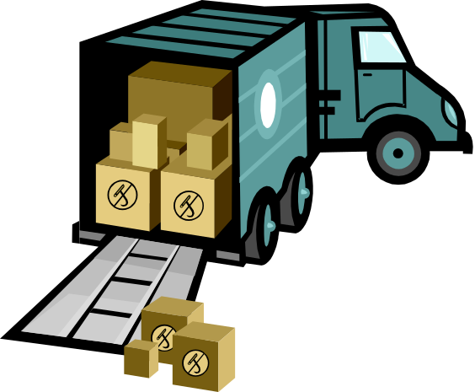


What is the Cost of Change?
Building a house
2
  In Definition ¢
  In Design $
4
  In Development $$
  In Test $$$
5
  In Release

Slide 6
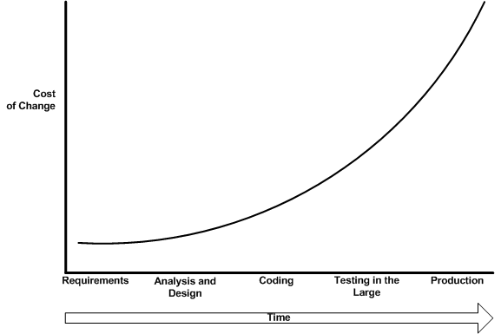
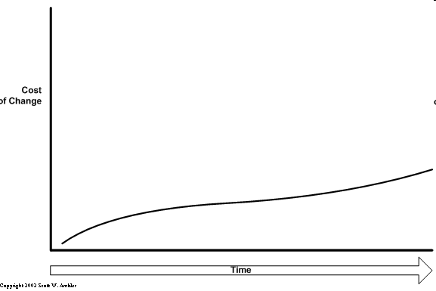
How does Cost of Change affect Software?
$$$$
Prescriptive Approach
$$$
$$
$
Agile system cost profile
¢

Slide 7
Traditional methodology doesn’t work anymore
Traditional Methods are presumptuous
  Assume all aspects can be defined prior to the start of work
  Waterfall methods assume that:
    Requirements are stable
    Technology is well known to the team and mature in its implementation
    There will be no surprises, no changes, no deviations
    Everyone on the team will have a consistent skill level
    Product Management has patience
    Senior Management has patience
    Customers have patience
Traditional methods force up-front design and therefore specification
  Up front design can not accommodate change
  Enforces specific organizational structures
    Escalation can not affect Product Development

Slide 8

Why Traditional Methods don’t work anymore
Things change
  Requirements change
  Needs change
  Priorities change
  Technology changes
  People change
  Escalation happens
The question is no longer
  How do we deal with change?
But rather
  How do we deal with change when it happens?
    How do we minimize impact and cost?
Reality!

Slide 9
Traditional methods induce failures
Provides false comfort in a plan
  Planning can not define reality
  Planning can not control reality, regardless on how detailed it is
Contingency planning is done to accommodate change
  Risk mitigation
Uncertainty begets uncertainty
  Organizations typically require more layers of plans as the degree of uncertainty increases
  Planners attempt to substitute definition for value proposition
  PMBOK recommends 28% of an effort should be dedicated to planning, prior to any design or development
Notes:
Internal forces cause business to change

Slide 10
Traditional methods induce failures
If 1/4 of a project’s lifespan happens prior to any engineering work being accomplished
  It is easier to cancel
      No real commitment from management has been made
  It is harder to determine value
      The Return on Investment is longer
  It is impossible to leapfrog the competition
      Even if the project is successful, the business suffers
Notes:
Internal forces cause business to change

Slide 11
The Realization
Waterfall no longer solves our problems
Traditional methodologies were good at managing the known
  But they are terrible at managing the unknown
To succeed we have to adapt
Reality rules. Period.
  Despite my best laid plans …

Slide 12
Enter Agilists
Industry leaders discovered similarities between their methodologies
  XP (eXtreme Programming) – Kent Beck
  Scrum – Ken Schwaber
  Lean Software Development – Mary Poppendieck
  Crystal family – Alistair Cockburn
  Feature Driven Development – Peter Coad
They met in 2001 – and decided to name the “family” of methodologies Agile
They also created the Agile Manifesto, and defining Values and Principles
www.agilemanifesto.org
Individuals and interactions over processes and tools
Working software over comprehensive documentation
Customer collaboration over contract negotiation
Responding to change over following a plan

Slide 13
Popular flavors of Agile
Extreme Programming
  Defined by its Practices
Scrum
  Defined by its management framework
Lean Software Development
  Defined by its approach to continuous improvement and quest to remove wasteful practices
Others: DSDM, FDD, Crystal
Notes:
Dynamic Systems Development Method (DSDM)
Industry standard “RAD” methodology (1994)
Feature Driven Development - Peter Coad
Crystal Family - Alistair Cockburn

Slide 14
Agile is not …
Agile is not:
  Just a collection of practices
  A silver bullet
  A check list of things to do on every project
While there are common practices and principles …
It does need to be applied and tailored to each situation
  …but start by the book, tailor each iteration
It is not right for every project
Is not a one size fits all

Slide 15
What is Agile?
Agile software development is:
  Continuous reflection and learning
  Removing inefficiencies and waste
  Building a collaborative team environment
  Working together to find better ways of delivering

Slide 16
Part 2
  How do we use Agile

Slide 17
Overview
Key imperatives determining project value:
  Increase in business profitability
  Managing business risk
  Defined requirements
Successful projects create maximum business value.
Projects succeed by meeting business need:
  Involve the business throughout
    First release shouldn’t be a surprise for users
  Regular feedback + accurate status reporting
    Closed loop, flexible, responsive: enabling change
  Defer decision-making
    Don’t try and decide everything up-front
Key imperatives determining project value:
  Increase in business profitability
  Managing business risk
  Defined requirements
Successful projects create maximum business value.
Projects succeed by meeting business need:
  Involve the business throughout
    First release shouldn’t be a surprise for users
  Regular feedback + accurate status reporting
    Closed loop, flexible, responsive: enabling change
  Defer decision-making (latest responsible moment)
    Don’t try and decide everything up-front

Slide 18
Business ownership
Executive support & user involvement - critical factors in project success
Align with business needs + stakeholder goals
  Workshops capture business requirements in “stories” written in user’s language
  Each story represents a unit of business value
  Collaborative iteration planning delivers high priority stories first
Continuous business involvement
  Short regular iterations of working code give tangible evidence of progress
  Iterations allow business to assess requirements, provide feedback, request change
  Continuous integration improves forecasting accuracy and status reporting
  Business can discard/modify requirements at any time
  Business retains GO/NO GO decision at any time
Improve relationship between IT and business
  Successful projects lead to successful relationships

Slide 19
Managing risk
Improved visibility throughout the project life-cycle
  Early validation of business case
  Accuracy in forecasting and status reporting
  Prioritization of business need
Improved quality + productivity
  Improved quality and efficiency of code
  Test Directed Development ensures requirements are met
Cost effectiveness
  Responsiveness to change at reduced cost
  Elimination of waste
  Iterations allow for frequent feedback to validate requirements

Slide 20
Reduced cost of change
Clients can change their minds:
  Collaborative iteration planning allows stories to be discarded or modified at any time
  Detailed analysis/design carried out for current iteration only
  Future stories have negligible sunk costs
  Frequent iterations/feedback leads to early identification of required change
  Reduced cost of change to completed stories
  Continuing with Agile throughout life-cycle reduces Total Cost of Operation significantly

Slide 21
Eliminating waste - Lean
Only software that is actually being used has the opportunity to deliver value
No unnecessary analysis/design:
  Detailed analysis/design for stories in current iteration only
  Understand just enough to produce high quality, working software
No unnecessary software:
  Business can change/discard stories at any time
  Stories are units of business value
No software embellishment:
  Only software required to pass test is developed
Documentation fit for purpose:
  Only produce documentation needed to produce code
  Unless for specific business need [legal, knowledge transfer etc.]

Slide 22
Planning versus Execution
Adaptive
Planning
Project
Vision
Empowered
Teams
Planning
Execution
Continuous
Integration
Automated
Testing
Continuous
Improvement
Test Driven
Development
Customer
Engagement
Refactoring
Frequent
Releases
Simple Design
Agile as a Deming Cycle
Collaborative
Focus
Minimal
Documentation
A
P
C
D
Notes:
NB. Collaborative Focus manifests as “Collective Ownership” and “Pair Programming” at the execution level
Project

Slide 23
User Story
A user story is a basic unit of work in an agile project
Describes a desired piece of business functionality
Small enough to be implemented in an iteration
  Usually completed in a couple of days (1,3 or 5 days)
A good user story is the simplest statement about the system that:
  The customer cares about
  Test cases can be written to verify
  Can be reasonably estimated
  Can be reasonably prioritized
One story

Slide 24
An Iteration
An iteration is a collection of stories the team commits to delivering in a fixed period of time
Typically 2-4 weeks
Every iteration, the team commits to delivering the stories chosen by the customer
10 – 15 Stories

Slide 25
A Release
A release is a collection of user stories describing the first release of the system
Typically 3 – 4 months in duration
50 - 100 Stories

Slide 26

Velocity – How fast are we going?
Velocity is the measure of how many stories the team typically completes during an iteration
Velocity is a unit of effort
  How many “story points” did we get done last iteration
  Measure using “Yesterdays Weather”
We don’t guess how much we will get done
  We measure

Slide 27
Backlogs, Releases and Sprints
Sprint 1
First Release
Product Back Log
Sprint 2
Second Release
Sprint 3
Sprint 4

Slide 28
Anatomy of an Iteration
Iteration Planning
Domain Experts/Analysts/QA
Prepare iteration narratives & test scripts
Developers
Review story cards/tests
Iteration Kick-Off Meeting
(fixed date)
Domain Experts/Analysts
Explain story cards
QA
Review test scripts and story cards
Developers
Define and estimate tasks
Iteration Close Meeting
(fixed date)
Everyone
Review, report and refine process
Iteration Planning
Development Support
Testing
Development
Review/
Validation Meetings
Story Cards Complete
All tasks complete for story card
Business sign-off
Regression testing begins
Bug fixing
Concurrent Activities
Iteration Planning
Iteration Planning Meeting
Development
Development Support
Iteration N-1
Iteration N
Iteration N+1

Slide 29


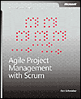





Reference Library
Planning Extreme Programming
Kent Beck, Martin Fowler
Lessons Learned in Software Testing
Cem Kaner, et al.
Agile Project Management with Scrum
Ken Schwaber
Test Driven Development
Kent Beck
Lean Software Development
Mary Poppendieck
Extreme Programming Explained v2
Kent Beck
User Stories Applied
Mike Cohn
Refactoring
Martin Fowler, et al.

