Slide 1
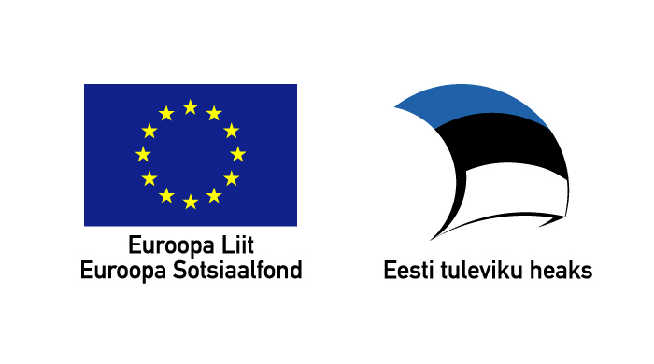

Grammatical Aspects for Language Descriptions
Andrey Breslav
abreslav@gmail.com
St. Petersburg SU ITMO / University of Tartu
This work was partly
supported by

Slide 2
Outline
Motivation
  Cross-cutting concerns in grammars
Approach
  Grammatical aspects and how they work
Examples (related to SQL)
  Defining IDE components
  Defining SQL dialects
Notes:
Goal: warn about a long introduction

Slide 3
Central statement
There are cross-cutting concerns in DSL definitions
  Many things are mixed together
Separating them is beneficial for software quality
  Better readability
  Better maintainability

Slide 4
Cross-cutting concerns in programs
Functionality scattered across many subsystems and tangled together
  Business logic
  Logging
  Security
  Component life-cycle
  ...
Notes:
Goal: bring evidence of many problems existing

Slide 5
Cross-cutting concerns in grammars
Artefacts scattered across many rules and tangled together
  Syntax descriptions
  Semantic actions
  IDE features
    Highlighting specifications
    Pretty-printing rules
    ...
  Language variations (dialects)

Slide 6
Example: Syntactic Concern
Grammar
Generator
Parser
expr : term ((PLUS | MINUS) term)* ;
term : factor ((MULT | DIV) factor)* ;
factor : NUMBER ;
Notes:
In ideal world a specification must look like this, but your parser must not only check the syntax but also build something meaningful...

Slide 7
Example: Syntax & Actions (ANTLR)
expr returns [int result] :
t=term {result = t;}
({int sign = 1;} (PLUS | MINUS {sign = -1;}) t=term {result += sign * t;})*;
term returns [int result] :
f=factor {result = f;}
({boolean div = false;} (MULT | DIV {div = true;}) f=factor {
if (div)
result /= f;
else
result *= f;
})*;
factor returns [int result] :
n=NUMBER {result = Integer.parseInt(n);};
Notes:
This is what we get when specifying what to build (ANTLR 3). Not really readable

Slide 8
Separation of concerns for semantic actions
expr : term ((PLUS | MINUS) term)* ;
term : factor ((MULT | DIV) factor)* ;
factor : NUMBER ;
returns [int result]
t={result = t;}
{int sign = 1;} {sign = -1;} t= {result += sign * t;}
returns [int result]
f= {result = f;}
{boolean div = false;} {div = true;} f= {
if (div)
result /= f;
else
result *= f;
}
returns [int result]
n= {result = Integer.parseInt(n);}
Notes:
This is what we get when specifying what to build (ANTLR 3)
Anything in a grammar may be a join point

Slide 9
Separation of concerns:
Attaching annotations (Join Points)
expr : term ((PLUS | MINUS) term)* ;
term : factor ((MULT | DIV) factor)* ;
factor : NUMBER ;
returns [int result]
t={result = t;}
{int sign = 1;} {sign = -1;} t= {result += sign * t;}
returns [int result]
f= {result = f;}
{boolean div = false;} {div = true;} f= {
if (div)
result /= f;
else
result *= f;
}
returns [int result]
n= {result = Integer.parseInt(n);}
Notes:
This is what we get when specifying what to build (ANTLR 3)
Anything in a grammar may be a join point

Slide 10
AspectJ Aspects
pointcut getter() :
call(public int Example+.get*())
Advice:
after() : getter() {
  Log.write("A get method called");
}
Example:
class Example {
public int getFoo() { .. }
public void doBar() {
    int x = getFoo(); // Matches the pointcut
    /*advice is woven here*/ }

Slide 11
Grammatical Aspects
Pointcuts
  Patterns over grammatical structure
    “productions starting with (foo)+”
Advice
  Annotations
    processed by generators
  Modifications to grammatical structure

Slide 12
Grammar is not a Text
expr
PLUS
term
term
MINUS
term

Slide 13
Grammar is not a Text
expr
PLUS
term
term
MINUS
term

Slide 14
Point-cut examples
expr : term ((PLUS | MINUS) term)* ;
  Exact match
expr : {...} ;
  Production wildcard
# : term .. ;
  Symbol wildcard and sequence wildcard
# : $t=# ((PLUS | MINUS) $t)* ;
  Symbol wildcard and a variable
Notes:
All those match what's to the left. For you not to blame me for no examples )

Slide 15
Advice examples: SQL Pretty-printer
Aspect rule for metadata:
querySpecification : SELECT .. ?sl=selectList;
  @sl.before = {{ '\n' increaseIndent }}
  @sl.after = {{ '\n' }}
Pretty-printed query:
SELECT DISTINCT
  Authors.name AS name, title, year
  FROM Books LEFT JOIN Authors ON (author = Authors.id)

Slide 16
Separation of concerns:
Attaching annotations (Join Points)
expr : term ((PLUS | MINUS) term)* ;
term : factor ((MULT | DIV) factor)* ;
factor : NUMBER ;
returns [int result]
t={result = t;}
{int sign = 1;} {sign = -1;} t= {result += sign * t;}
returns [int result]
f= {result = f;}
{boolean div = false;} {div = true;} f= {
if (div)
result /= f;
else
result *= f;
}
returns [int result]
n= {result = Integer.parseInt(n);}
Notes:
This is what we get when specifying what to build (ANTLR 3)
Anything in a grammar may be a join point

Slide 17
Useful features of metadata aspects
Annotations 1
Gen1
Program 1
Annotations 2
Gen2
Program 2
Grammar
Annotations 3
Gen3
Program 3
Annotations 4
Gen3
Program 4

Slide 18
Advice examples: SQL Dialects
Problem:
  Describe how PostgreSQL synaxt differs from SQL92
  Example: There can be ON-clause after DISTINCT
Point-cut:
  setQuantifier : ?d=DISTINCT | ...;
Advice:
  after ?d : (ON ’(’ <List expression, ’,’> ’)’)?;

Slide 19
Advice examples: SQL Dialects
Aspect rule
  tableExpression : ?f=fromClause .. ;
    instead ?f : <?f>?;
Grammar rule
  tableExpression
  : fromClause whereClause?
  groupByClause? HavingClause?;
Result
  tableExpression
  : fromClause? whereClause?
  groupByClause? havingClause?;

Slide 20
Using aspects for dialect definition
Changes 1
PostgreSQL
Changes 2
MySQL
Standard
SQL
Changes 3
Oracle SQL
Changes 4
...

Slide 21
Managing language evolution
Aspect rules may have constraints for number of matches
  E.g., [1..1] – a rule must match once and only once
Wildcards help to abstract the grammatical structure
  Aspects tolerate changes that are matched by wildcards.

Slide 22
Summary
We proposed grammatical aspects (GAs)
  separation of concerns for grammars
  tolerant to language evolution
To solve the following problems:
  Define IDE components
    Pretty-printers
    Syntax highlighters
    …
  Define DSL families
    E.g., SQL dialects

