Slide 1
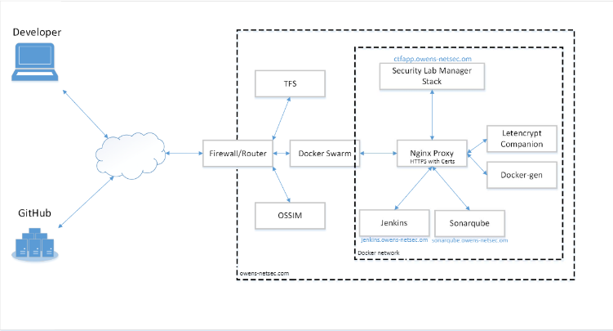




Security Lab Manager
Developed by Simon Owens Advisor/Sponsor: Mr. Mark Randall
Security Engineer University of Evansville
ABSTRACT
DEVELOPMENT
The Security Lab Manager is a web application that manages vulnerable virtualization machines for users to practice hacking on. Once hosted, users can login, choose an exercise, and start hacking in their own virtual environment. Administrators can login to view completed exercises and send grades to users. New exercises and machines can easily be added or imported.
This application was planned and developed using the Agile framework. DevOps principles of tested driven development, automated test, continuous integration, and continuous deployment were used. The CI/CD pipeline utilized sonarqube code scanners and OWASP ZAP utility to ensure code was lean and secure.
PROBLEM
Security training is desired in all parts of industry: secure coding for developers, Reverse Engineers, Q/A Testers, and Security Engineers. There are several virtual machines to practice security, but none have a student-teacher model. With this application, students can easily begin learning security, without having to setup their own environment.
VIRTUALIZATION
NA need more development/scoping/designing
REQUIREMENTS
NA need more development/scoping/designing
RESULT
NA need to complete

