Slide 1
Simon Owens University of Evansville October 22, 2018 Project sponsor/Advisor: Mark Randall
Security Lab Manager

Slide 2
Security Engineering
High demand for cyber security jobs
Secure coding for desktop and web application required for developers
Abuse case and fuzz testing required for production software
Reverse engineers require knowledge of memory management/software flaws

Slide 3
Learning Resources
Books with short answer questions
Capture the flag competitions
Setup own virtual hacking environment

Slide 4
Hands on Learning
How do we allow students to virtualize exercises?
What is the fastest way possible to do this?
Does this require the students to have powerful computing resources?

Slide 5
Manage virtual machines
Students and Professors
Training
Any class size with little setup time

Slide 6
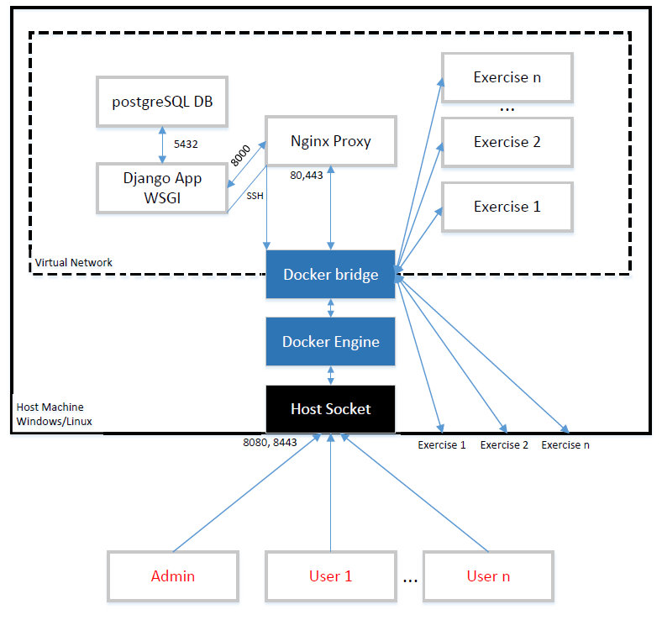
Architecture Overview
Client/Server
Web Application
Starts/Stops Docker containers

Slide 7
Requirements
Student user interface for launch, stopping, and reverting exercises
Instructor user interface for adding exercises, students, and managing application performance
Multi–threaded with the ability to cancel actions

Slide 8
Requirements
Must contain 3 web security exercises
Must contain 3 desktop security exercises
Must be developed securely
Must be easily installed and enhanced

Slide 9
Student Interface

Slide 10
Instructor Interface

Slide 11
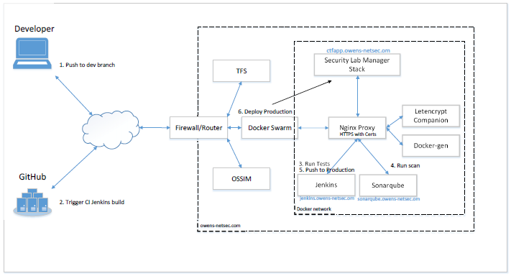
Continuous integration

Slide 12
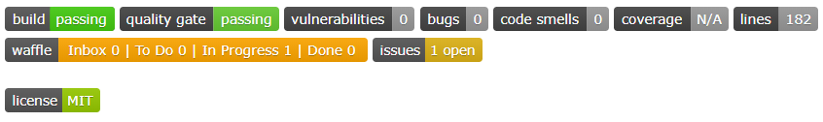
Developing Securely
Synk for dependency vulnerabilities
Sonarqube for software vulnerabilities
OWASP ZAP for continuous vulnerability scanning
Security assessment for OWASP Top 10
Reporting on Github

