Slide 1
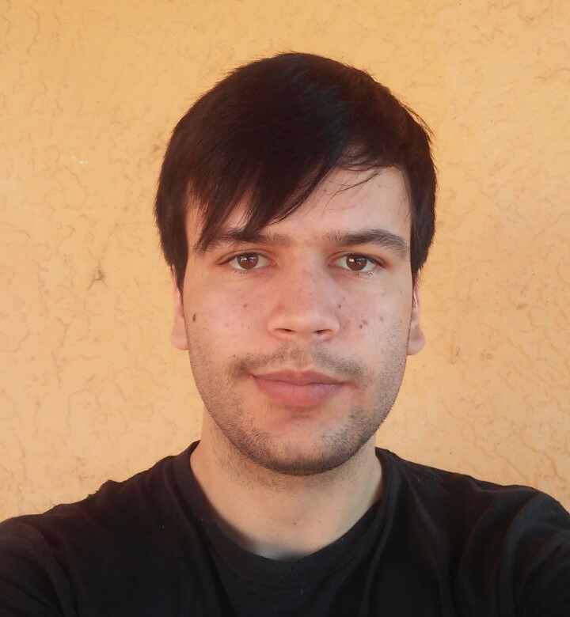

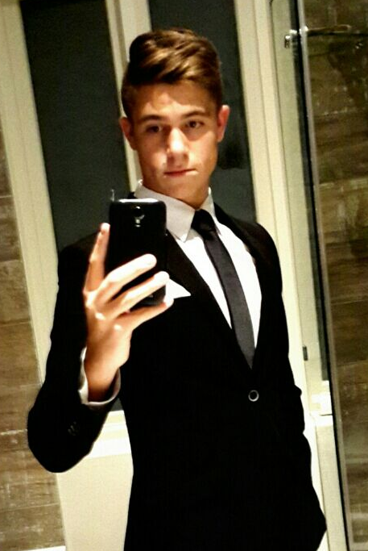
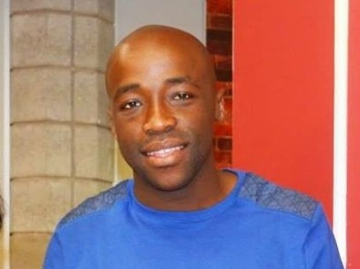
smalltalk
Michael
Daniel
CAPTAIN: Abrie
Q

Slide 2
Project objective
PRIMARY
CREATE AN APTITUDE TEST
SECONDARY
HAVE FUN
LEARN SOMETHING NEW

Slide 3
Challenges faced
SKILLS & EXPERIENCE DIFFERENCES
CONCEPT FORMULATION
DECISION MAKING
TIME MANAGEMENT

Slide 4
Lessons learnt
TECHNICAL
UML
WEB TECHNOLOGIES (JAVASCRIPT, HTML, CSS)
VERSION CONTROL
SOFT
DEVELOPMENT LIFE CYCLE
COMMUNICATION
TEAM WORK

Slide 5
Project plan
Brainstorming
Determine APTITUDE test basis
Establishing APTITUDE TEST format
Creating APTITUDE TEST questions
SOLUTION DESIGN (UML)
Platform selection
Development
Planning
Coding
TESTING
Review and finalize

Slide 6
DETERMINE APTITUDE TEST Basis
Programmer personality traits
Patience
Courage
Creativity
Logic
Types of programmers
Technologist (crazy pizza guy)
Problem solver (logical thinker)
Technical guy

Slide 7
DETERMINE APTITUDE Test Basis (CONT.)
Primary programming concepts
Variables (symbolic name)
Control structures
Selection
Iteration (loops & recursion)
sequence
Data structures
Syntax (out of scope)
Tools (out of scope)
Bbd ultimate hire criteria
Skills ← Aptitude
Attitude (soft skills)

Slide 8
Establishing APTITUDE TEST format
Types of CANDIDATES
Visual (seeing and visualizing)
Auditory (listening and verbalizing)
Read-write (reading and writing)
Kinaesthetic (hands-on, trial & error)
Question types & formats
Puzzles & visual presentation
Embedded answers
Matching
Objective & considerations
Minimize confusion
Minimize user input errors

Slide 9
ESTABLISHING APTITUDE TEST questions
Considerations
What?
How?
types of CANDIDATES
Question formats

Slide 10
design

Slide 11
Platform selection
Platform chosen
HTML, CSS, JavaScript
Reasons for selection
WEB ACCESSIBILITY
To learn something new
To impress Michael, tony and everyone

Slide 12
PRIORITIZATION
THINGS DONE
FRONT END WEB APPLICATION
GAME LOGIC
SCORING
SHOULD HAVE DONE
BACK END
SCORE CONSOLIDATION
DATABASE (USERS, SCORES)
INTEGRATION

Slide 13
Demonstration & enquiries

