Slide 1
Gym Stock Bot
The one stop solution for making gains with in-stock gym equipment!
By Andrew Brigante, Michael Markis

Slide 2
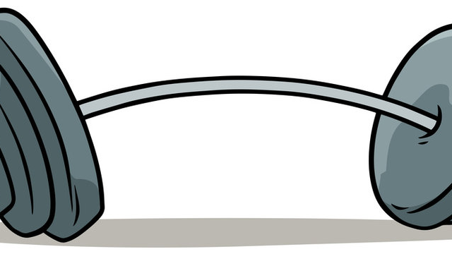

Background & Inspiration
Covid created a huge demand for gym equipment
Gym-goers are stuck refreshing multiple fitness websites
People are desperate to lift some weights and get some huge biceps

Slide 3
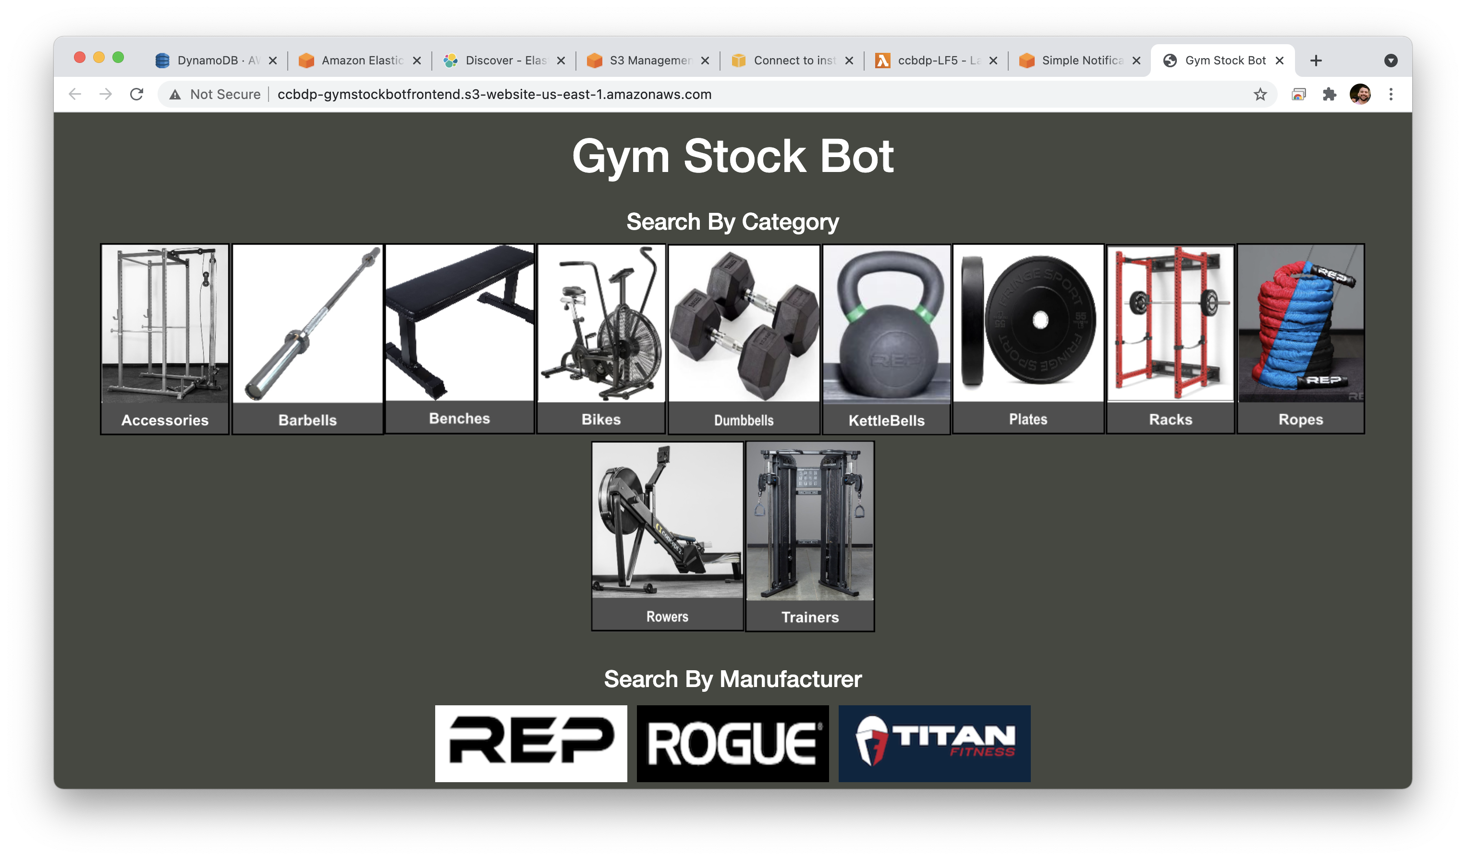
Our Solution

