Slide 1
Gym Stock Bot
The one stop solution for makin’ gainz with in-stock gym equipment!
By Andrew Brigante, Michael Markis

Slide 2


Background & Inspiration
Covid created a huge demand for gym equipment
Gym-goers are stuck refreshing multiple fitness websites
People are desperate to lift some weights and get some huge biceps

Slide 3
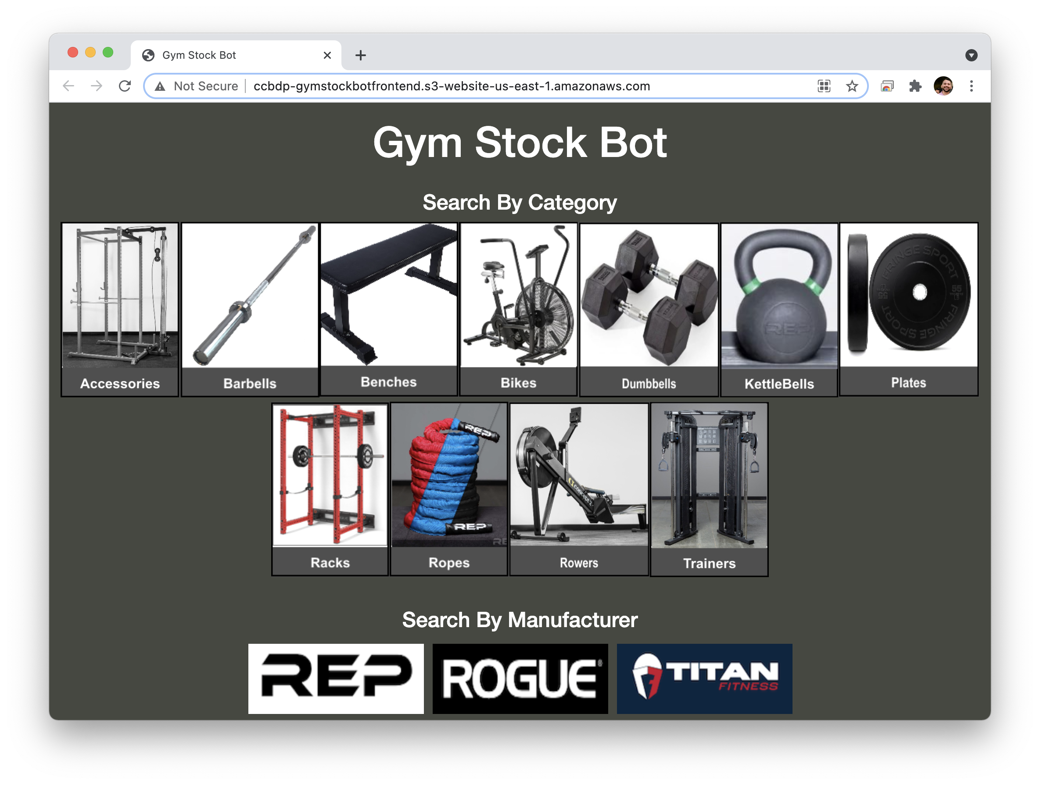
Our Solution

Slide 4














AWS Cloud
Amazon SNS
Text Subscribers
Amazon S3
Scrape Trigger
AWS Lambda LF5
Notify Subscribers
Data
Amazon SES
Email Subscribers
EC2 Instances
Scrape Manufacturer Sites To Update Stock
Amazon DynamoDB
Store Products and Subscribers
Amazon ElasticSearch Relates Products to Subscribers
AWS Lambda LF6
Rank Products
Amazon S3
Provide Front-End
AWS Lambda LF7
Subscribe to a Product
Amazon CloudWatch
Logging
Amazon API Gateway
AWS Lambda LF3
Get Page Data
Amazon Route 53

Slide 5
Workflows
Scrape
EC2 instances scrape each manufacturer’s website.
Identify in-stock items and update DynamoDB data store.
Using S3 bucket, trigger Lambda.
Lambda identifies subscribers of newly in-stock items and notifies them using email and/or text.
Present Products
User visits website. API Gateway call loads product categories and manufacturers.
User selects specific product category or manufacturer.
API Gateway call updates site with a list of in-stock products, and a list of all supported products.
Subscribe
User submits personal information.
Product lists update with a subscribe button next to each product.
User can subscribe or unsubscribe to a specific product.
Upon scrape update, user receives notification if product is in stock.

