Slide 1
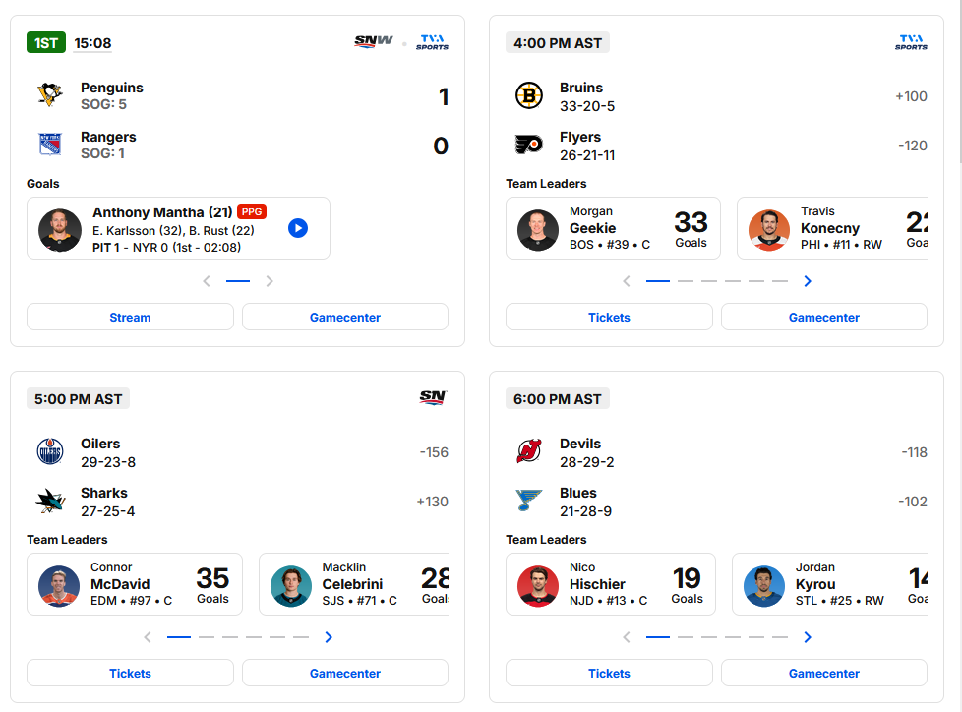
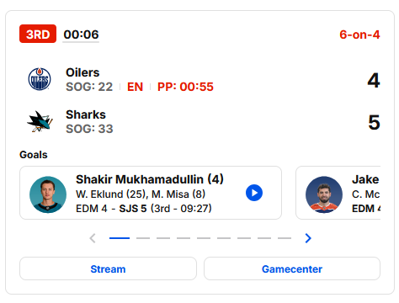
period
time
awayLogo
awayTeamName
AwayScore
awaySoG
homeLogo
homeTeamName
homeScore
homeSoG
goalScorer_1
goalScorer_2

Slide 2

headshot
fName
LName
G
str
aName1
A1
aName2
A2
aScor
hScr
time

