Slide 1
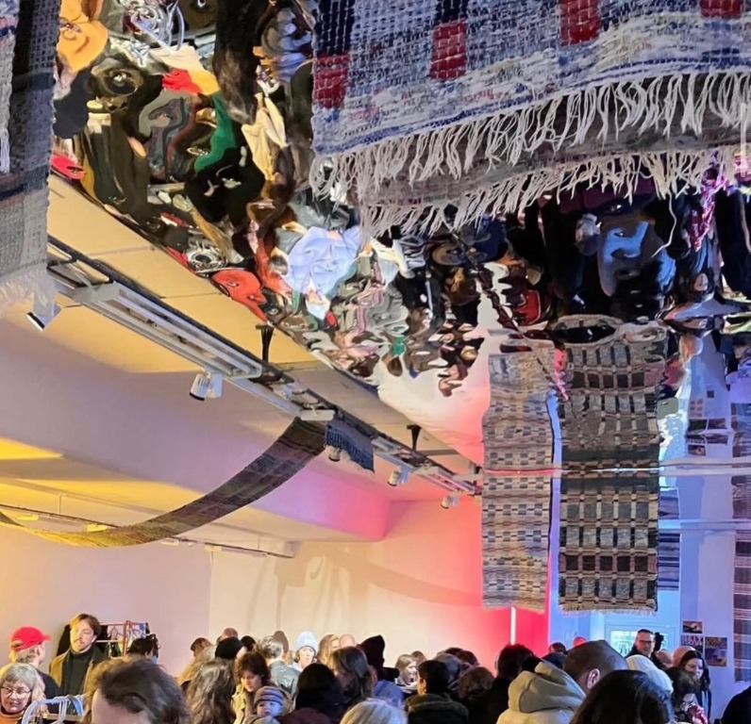
BEIT
KULTUR
A digital home
for culture
A website for a grassroots cultural association in Stockholm.
BERGHS SCHOOL PROJECT ? INDIVIDUAL BLOG
STOCKHOLM / 2026

Slide 2
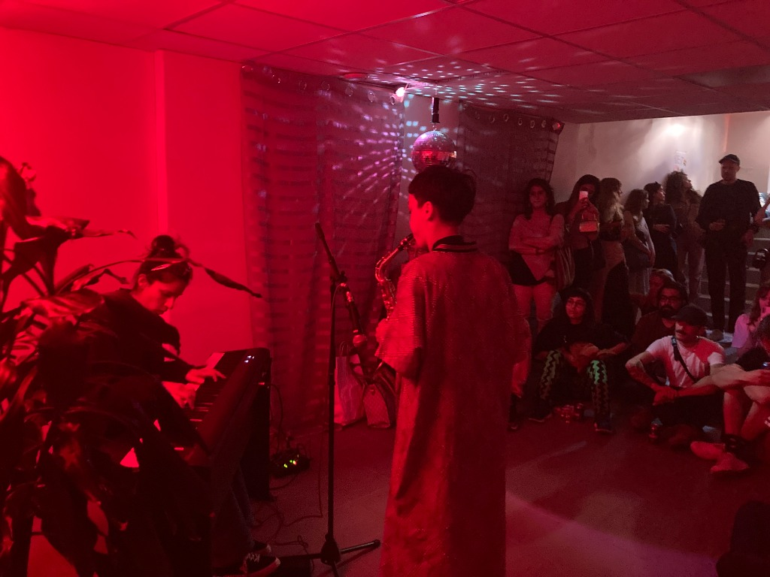
01 / THE IDEA
Culture needs room to travel
Beit Kultur creates space for artists and brings people together through culture.
?A non-profit community
that makes culture.?
The site is designed for
Artists
Audiences
Volunteers
Cultural partners
Focus: artists from the global majority and queer artists.

Slide 3
02 / VISITOR EXPERIENCE
One website, four ways in
The main pages help visitors discover what is happening and choose how to take part.
DISCOVER
READ
PARTICIPATE
SUPPORT
Events
News
Get involved
Donate
Browse cultural events, filter by art form, and check the Stockholm forecast.
Search stories, open full posts, and join the conversation with comments.
Find ways to volunteer, share creative work, or become a member.
A simple test-mode form shows one way to support the association.
Also included: About ? Projects ? Membership ? Contact

Slide 4
03 / THE BLOG
Publishing stays in volunteer hands
A familiar article flow for readers, with a protected workflow for the people who publish.
01
Find a story
Search the news list and open an article.
02
Read and respond
See the full post and its comments.
03
Sign in
Only authenticated volunteers can publish.
04
Review and publish
Draft a summary with Gemini, edit it, then publish.
AI helps with a first draft. A human checks it.

Slide 5
04 / CONNECTED FEATURES
Useful connections, not just decoration
External services add live data and assistive tools. The important actions remain visible to the user.
EXTERNAL API
AI HELPER
DATABASE
SMHI weather
Google Gemini
Neon PostgreSQL
The Events page requests a Stockholm forecast.
Volunteers can draft a short summary, then review and edit it.
Posts and comments persist when the database is configured.
TEST MODE
Donations and contact forms do not process real payments or send messages.
Private keys and database credentials stay in environment variables ? never in the code.

Slide 6
05 / DESIGN SYSTEM
Designed to feel clear and welcoming
The presentation follows the same warm surfaces, dark contrast, and bright lime accents as the website.
WARM OFF-WHITE
DARK INK
LIME
SOFT BEIGE
Responsive
Easy read
The layout adapts to phone and desktop.
A control supports larger text and more spacing.
Keyboard access
Reduced motion
Skip link and visible focus help people navigate.
Background video respects motion preferences.

Slide 7
06 / UNDER THE SURFACE
A small stack with clear responsibilities
The core idea: keep each service focused and keep credentials out of the source code.
SvelteKit
Neon PostgreSQL
Gemini
Pages, forms, and server routes
Persistent posts and comments
Volunteer-only summary drafts
SMHI
Volunteer auth
Vercel
Stockholm forecast data
Protected publishing actions
Hosting and deployment
If Neon is not configured, sample articles are shown and publishing is disabled.

Slide 8
07 / SHOW IT LIVE
A short demo walkthrough
A simple path through the site shows both the public experience and the volunteer tools.
01
Open Events: filter the list and view the weather.
NEXT
02
Open News: search for a post and read the full article.
Replace placeholder content and verify each test-mode form before a public launch.
03
Sign in as a volunteer and start a post.
04
Generate a summary, review it, and publish.
05
Show the saved post and comments.
THANK YOU ? QUESTIONS?

